Slide 1
Commutator assembly

Slide 2
Insert overall picture

Slide 3
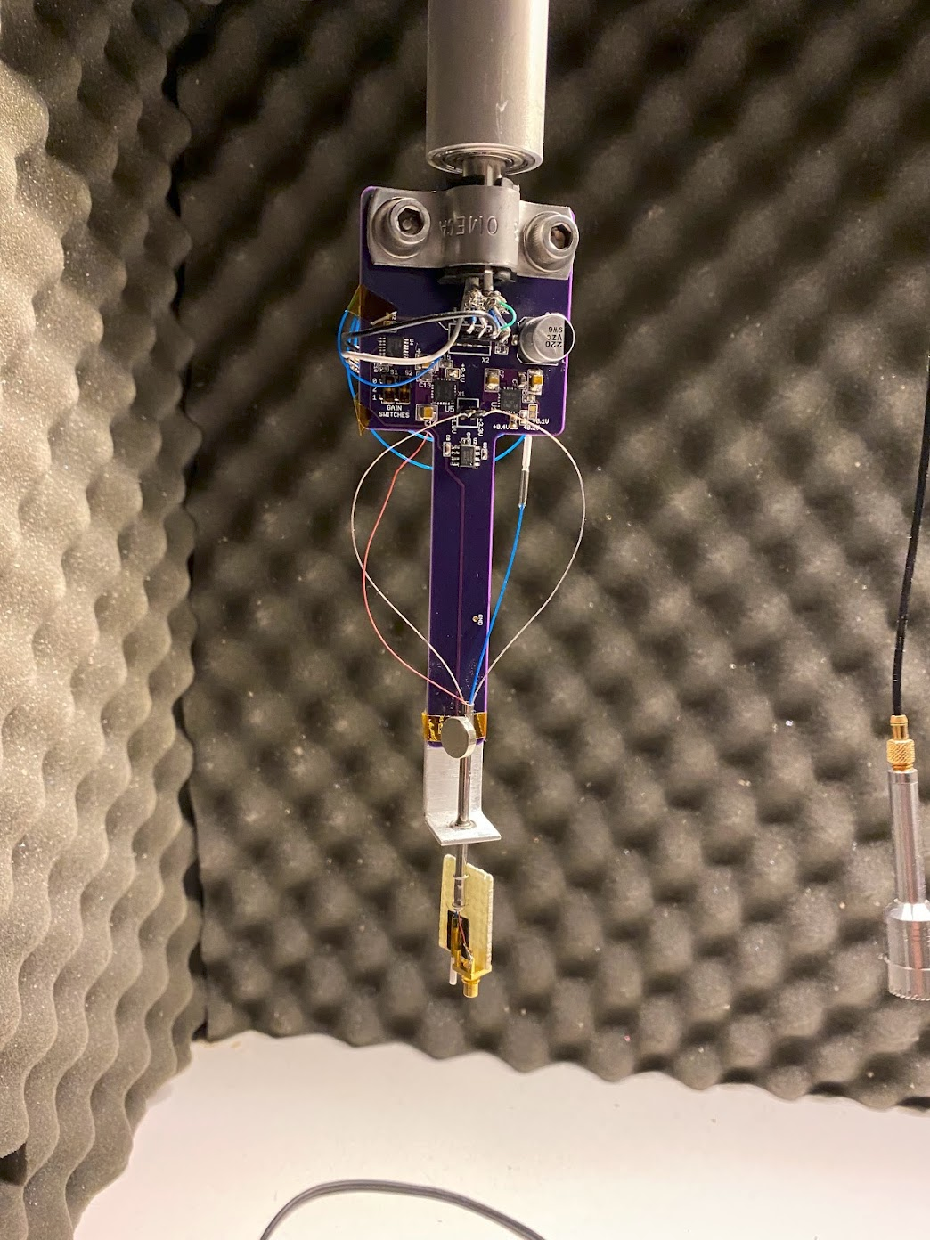
PCB is attached to rotating shaft using pipe clamp
Magnet mounted on swivel creates changing magnetic field at Hall sensor, which is sent up the shaft to the motor controller
The commutator PCB transmits power, light, and RF through a swivel joint mounted on a bearing

Slide 4
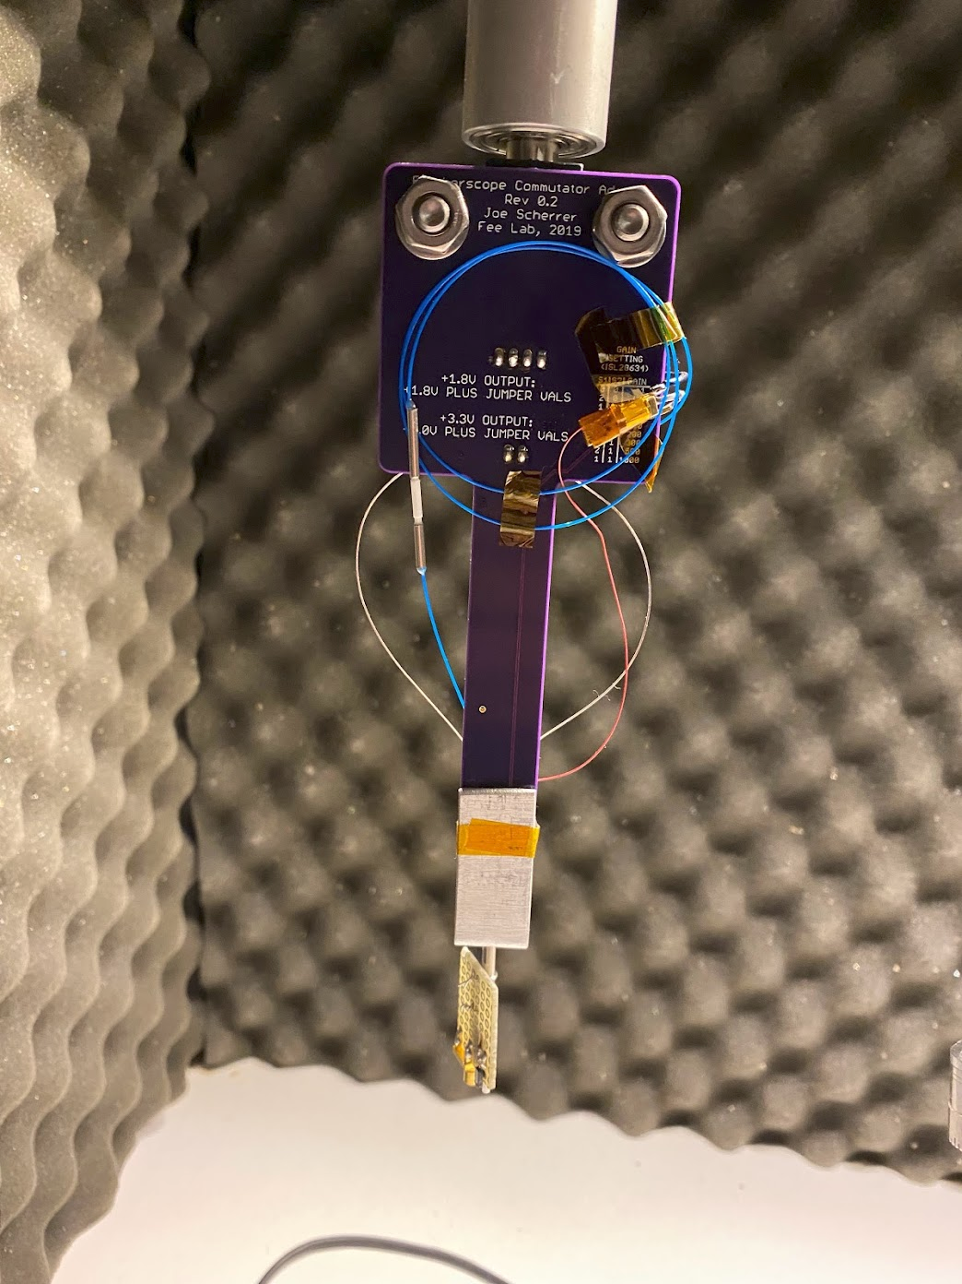
Fiber ferrule and MMCX connector junctions for easy removal of commutator board

Slide 5
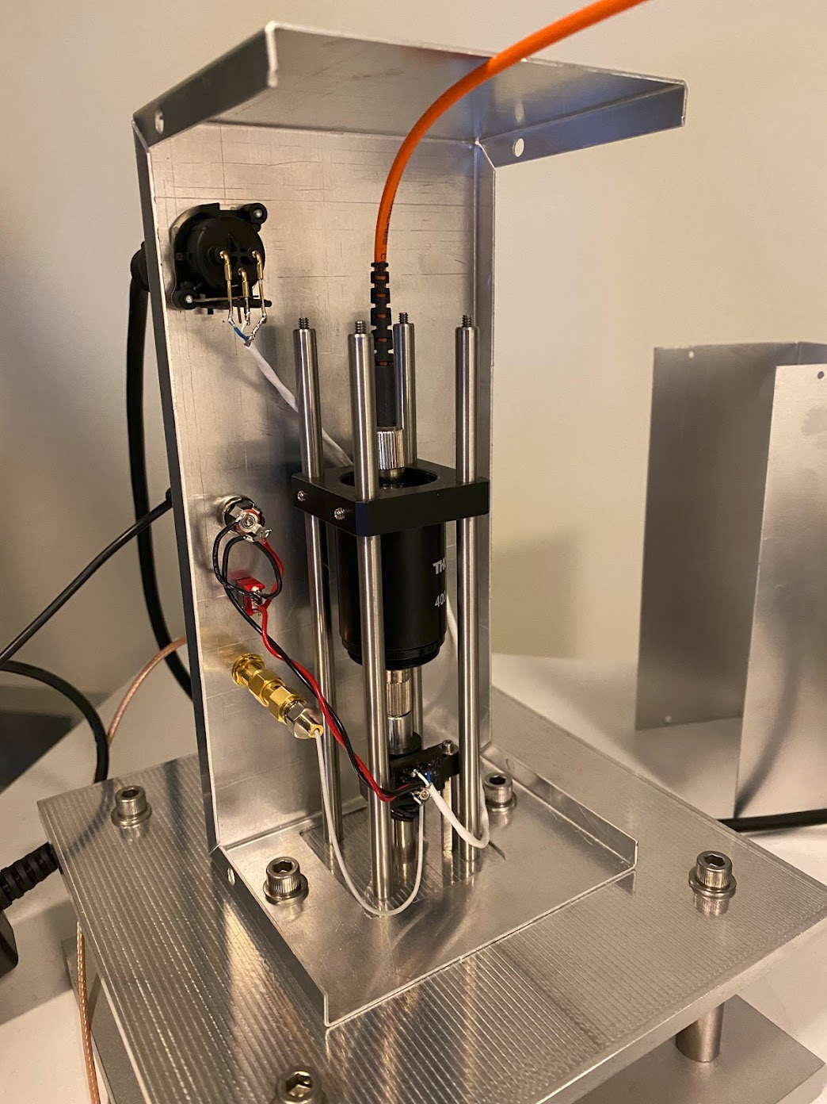
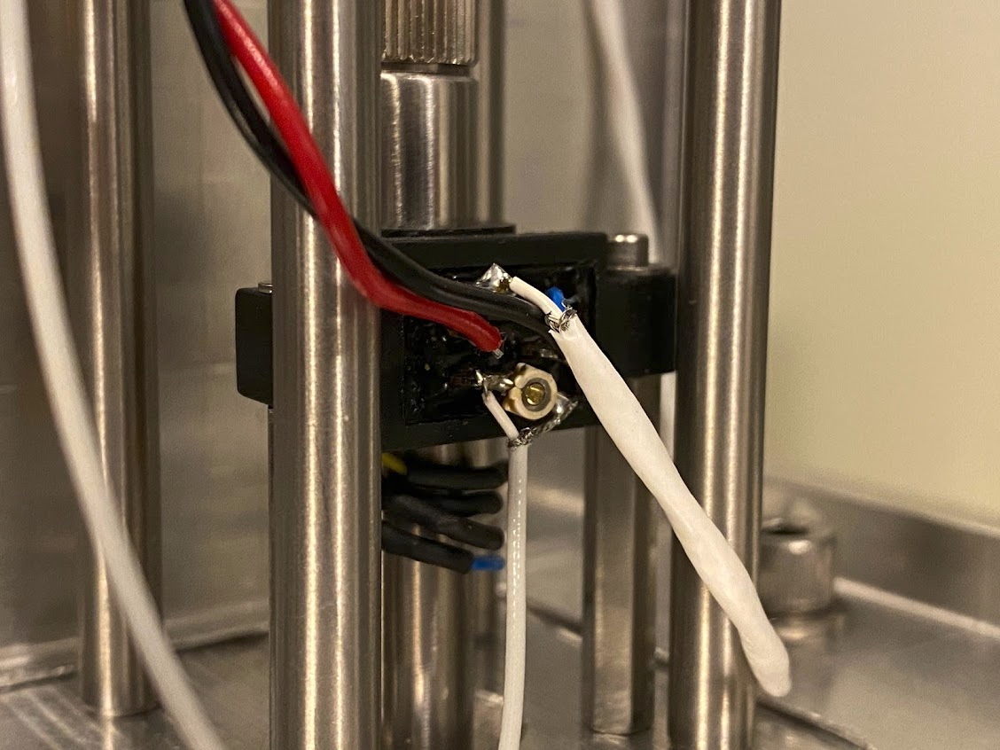
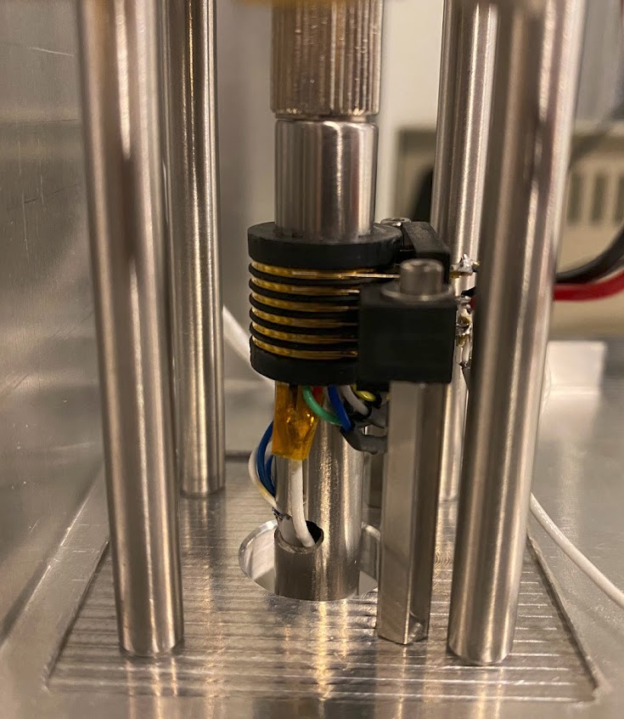
Tuning capacitor to minimize impedance mismatch
Electrical cables leave shaft through notch in side and connect to slip ring
Fiber exits at top of shaft and connects to rotating fiber coupler

Slide 6
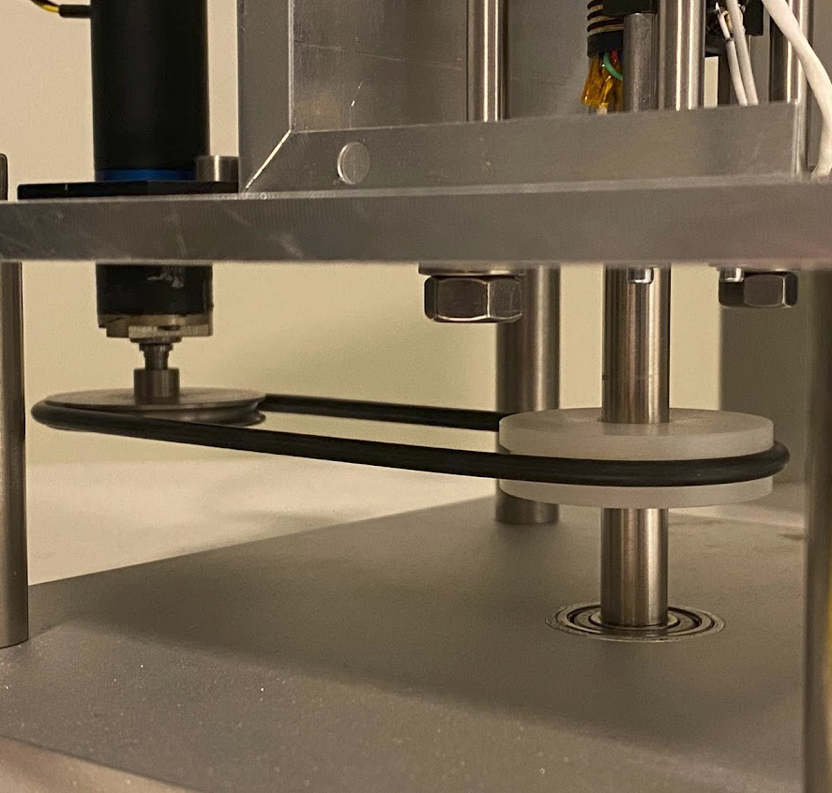
Drive belt transfers torque from motor to pulley mounted on shaft
Shaft rotates on bearings mounted in larger guide tube

