Slide 1
Samsung S9 Rear Camera Module Disassembly

Slide 2
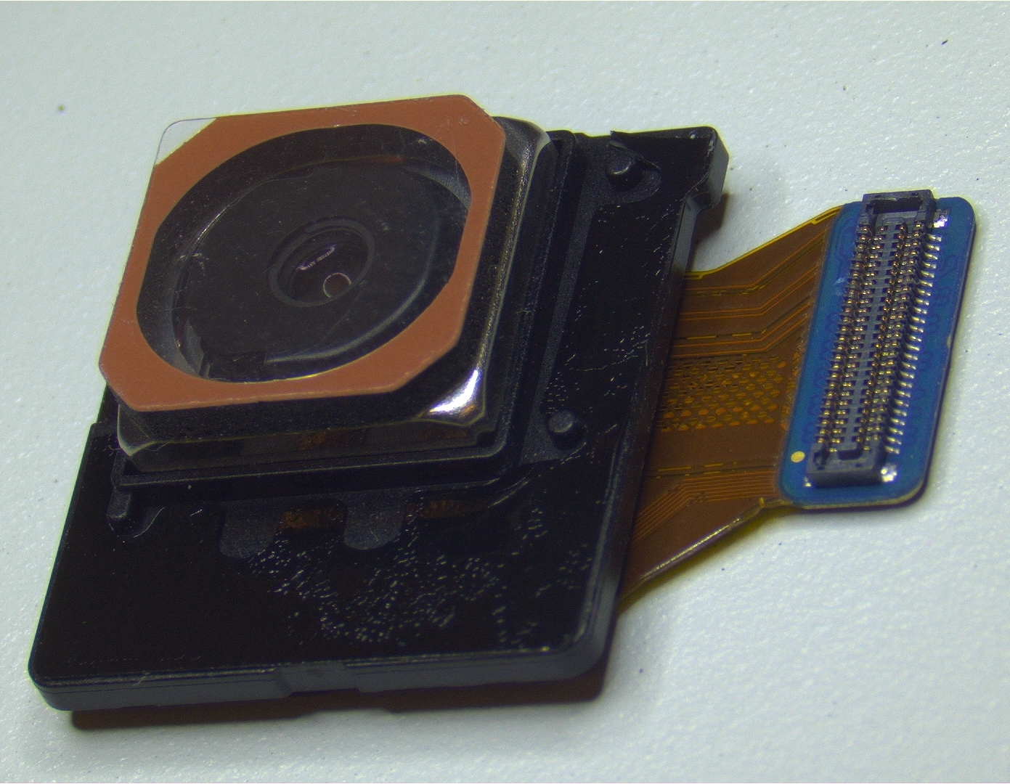
This is what the camera module looks like. The first step is to pull off the black plastic covering (indicated by the arrow) with pliers. This will take some force!

Slide 3
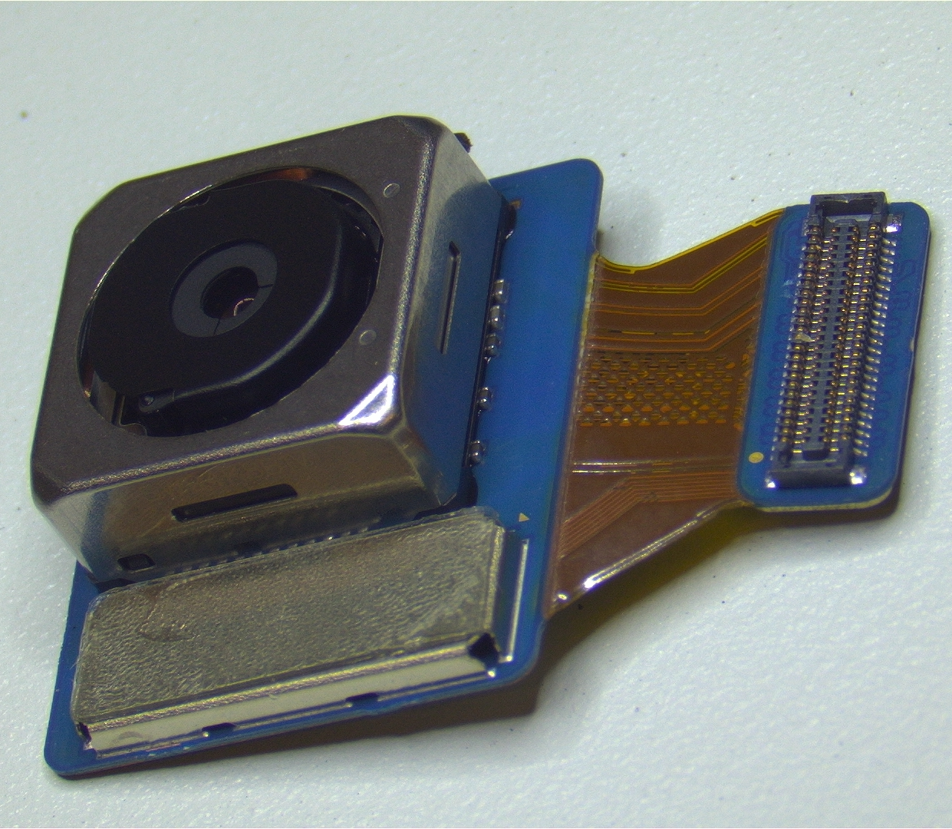
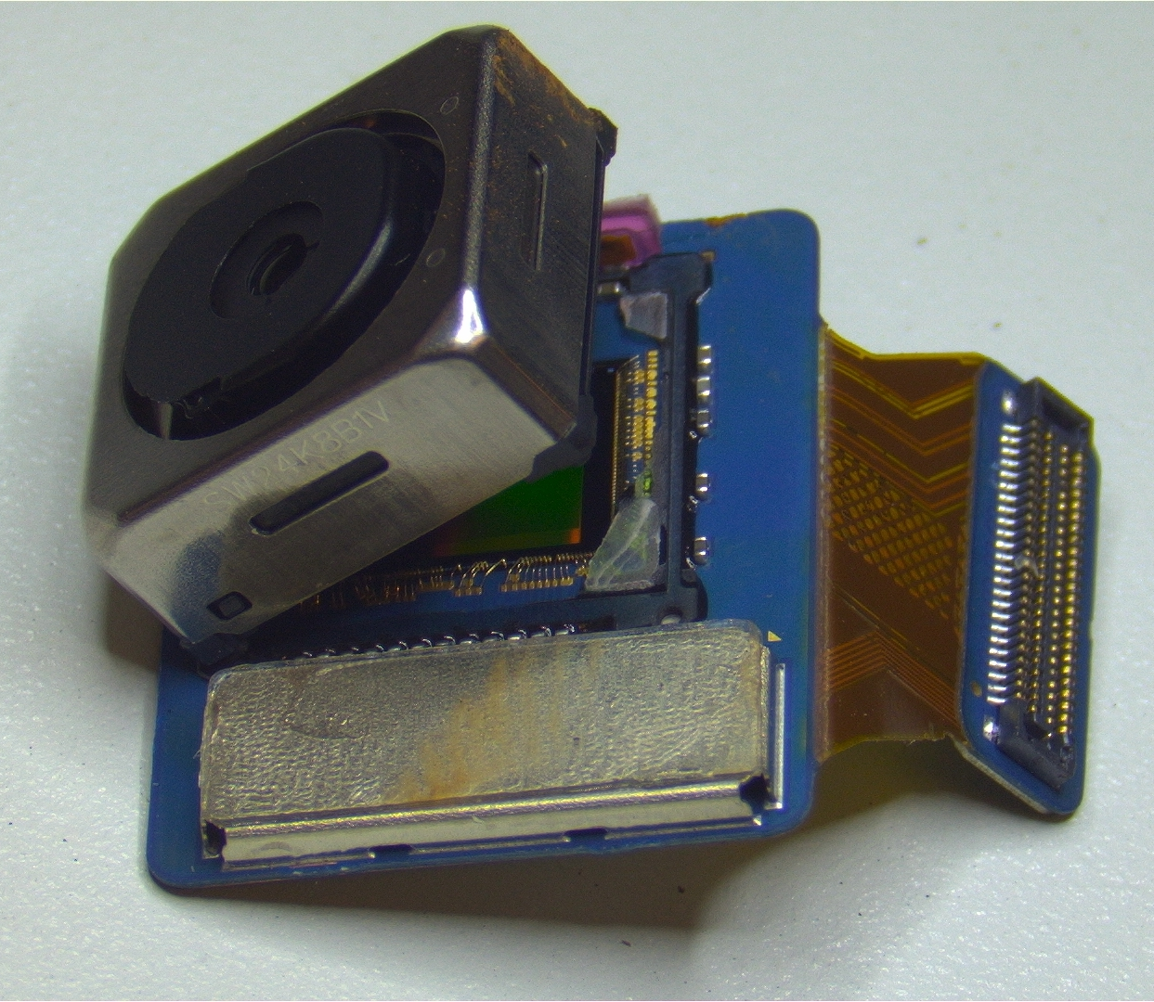
Next, grasp the metal housing of the camera assembly with pliers and detach the assembly from the PCB

Slide 4
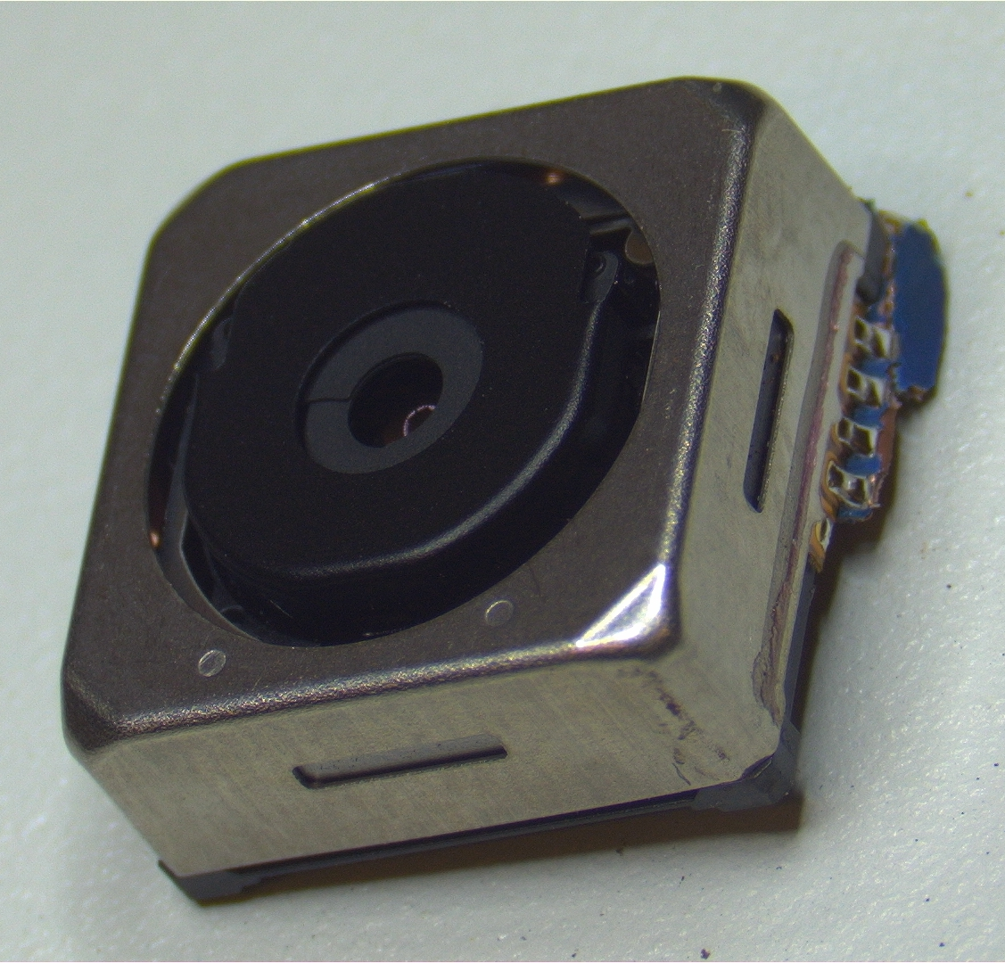
A detached camera assembly. Our next task is to remove the outer metal housing.

Slide 5
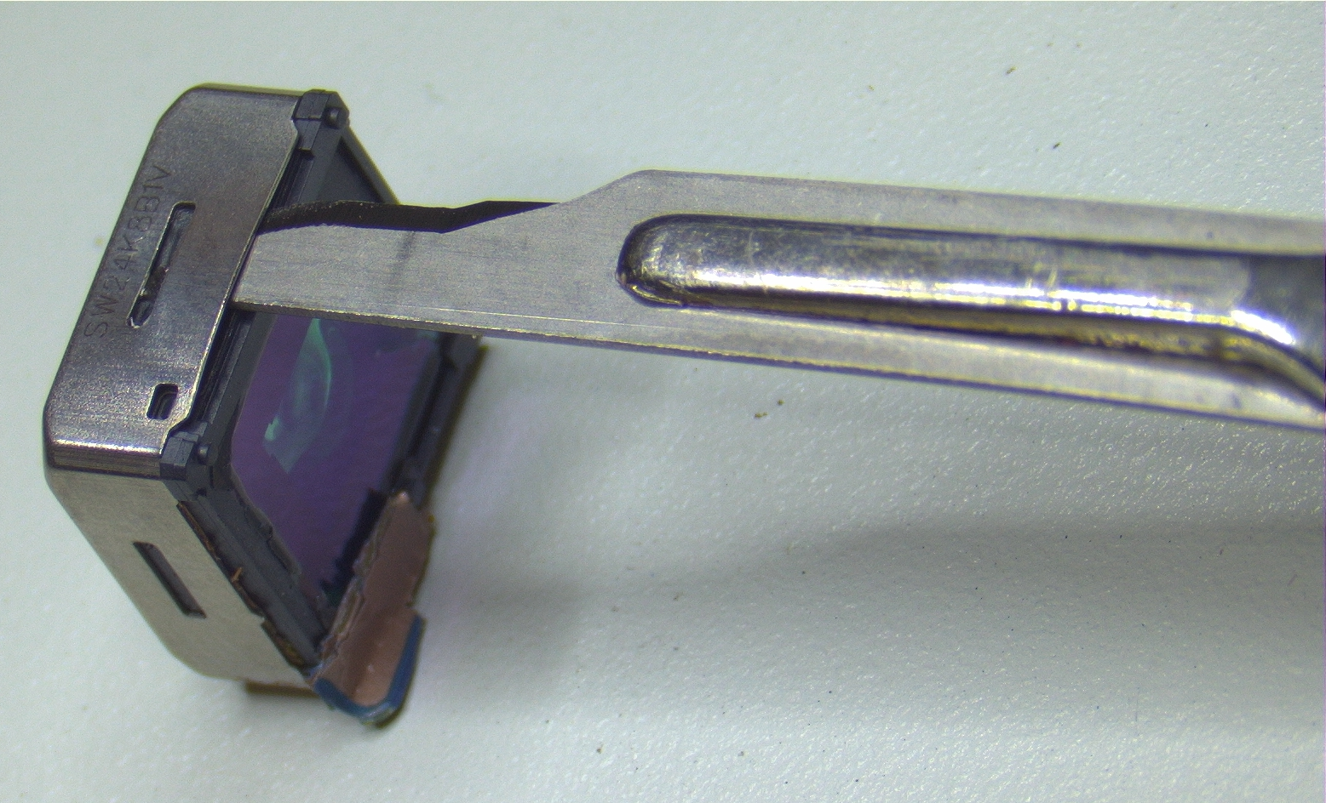
Carefully slide a scalpel blade in between the outer sheet metal and inner plastic of the lens housing. Run the blade along the entire length of all four sides, slicing through the glue adhering the two components.

Slide 6
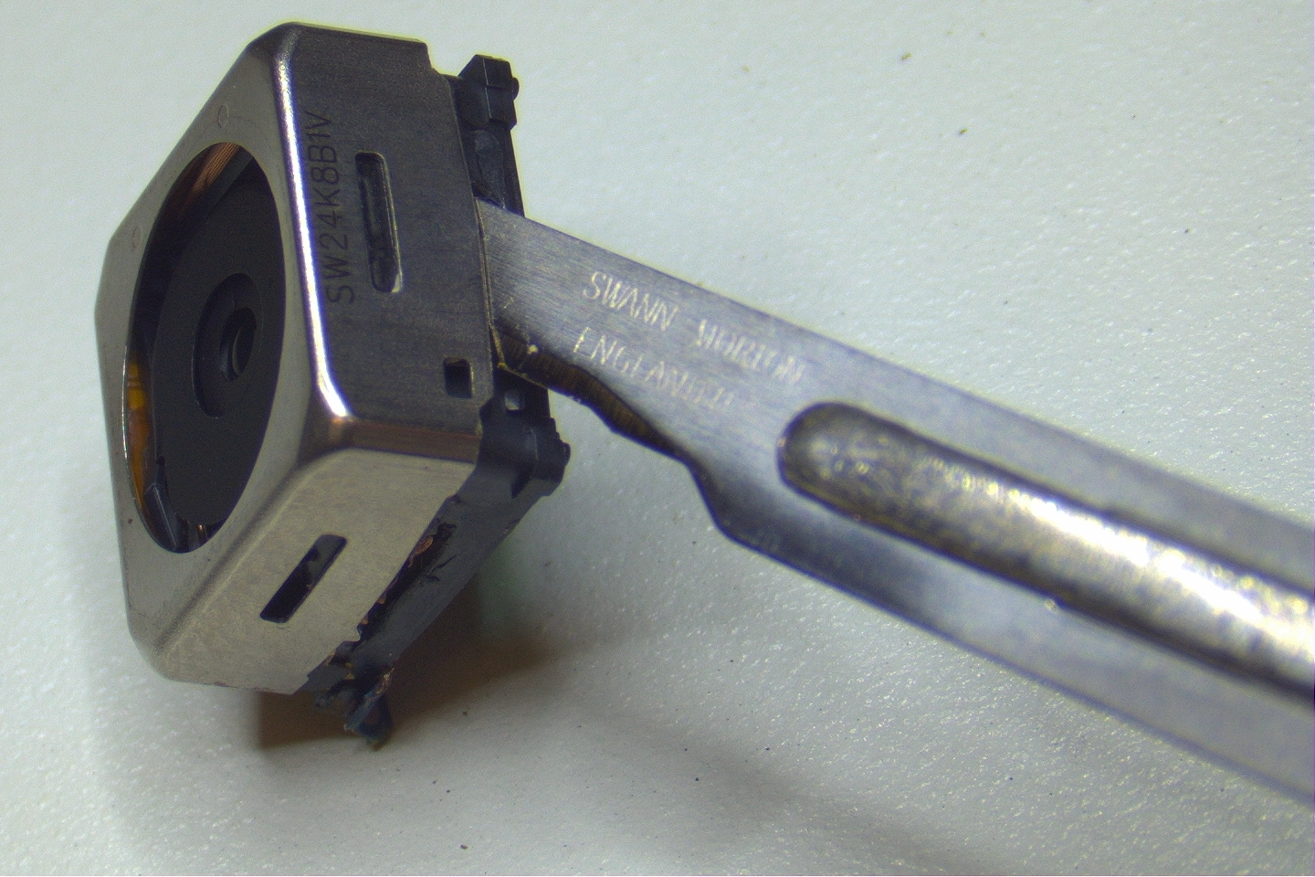
Once the metal has been detached from the inner plastic, insert the blade and rotate it to lever the metal housing up and off. Work your way around the assembly, incrementally wedging each side until the housing is completely removed.

Slide 7
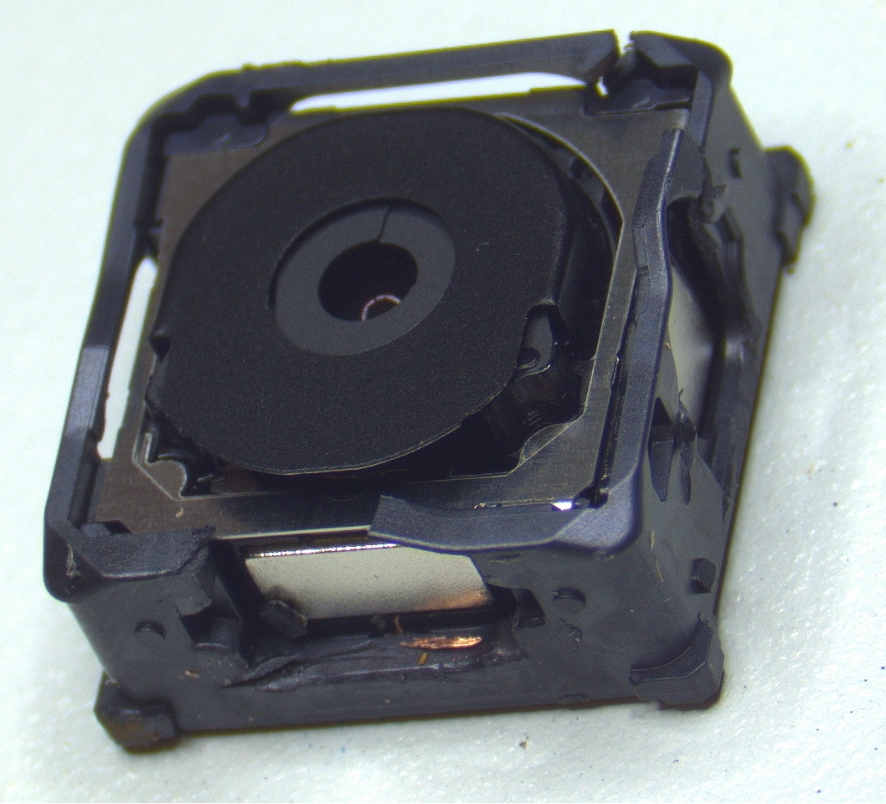
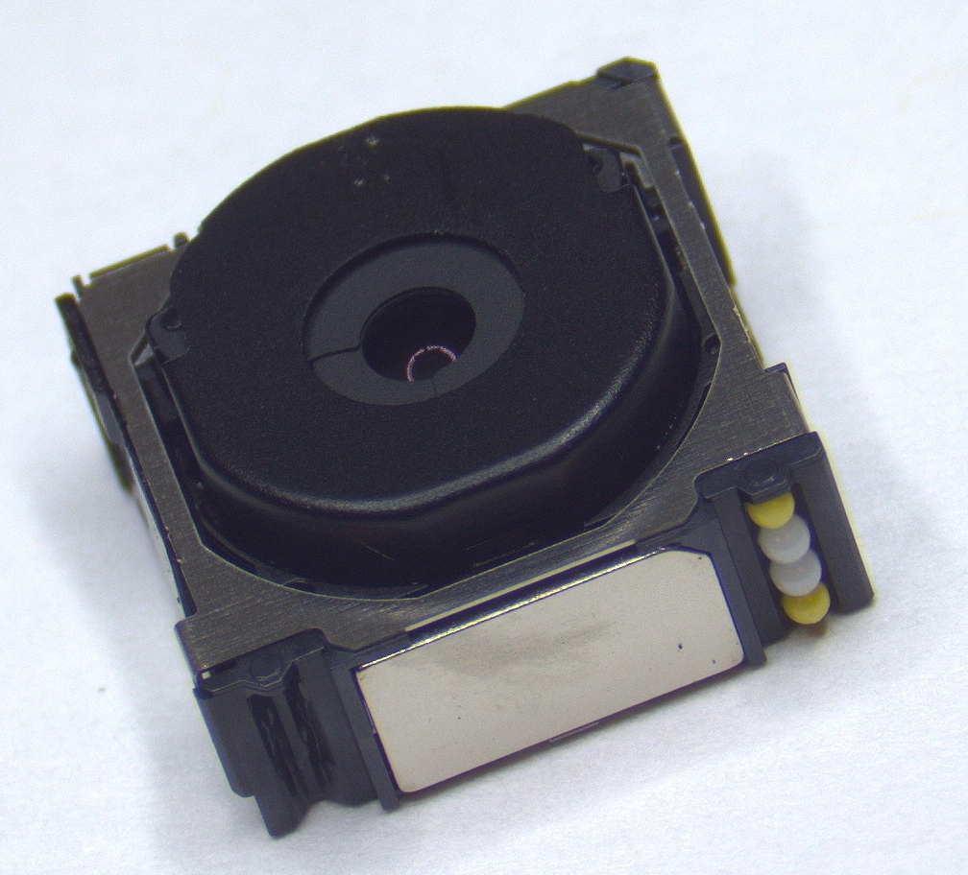
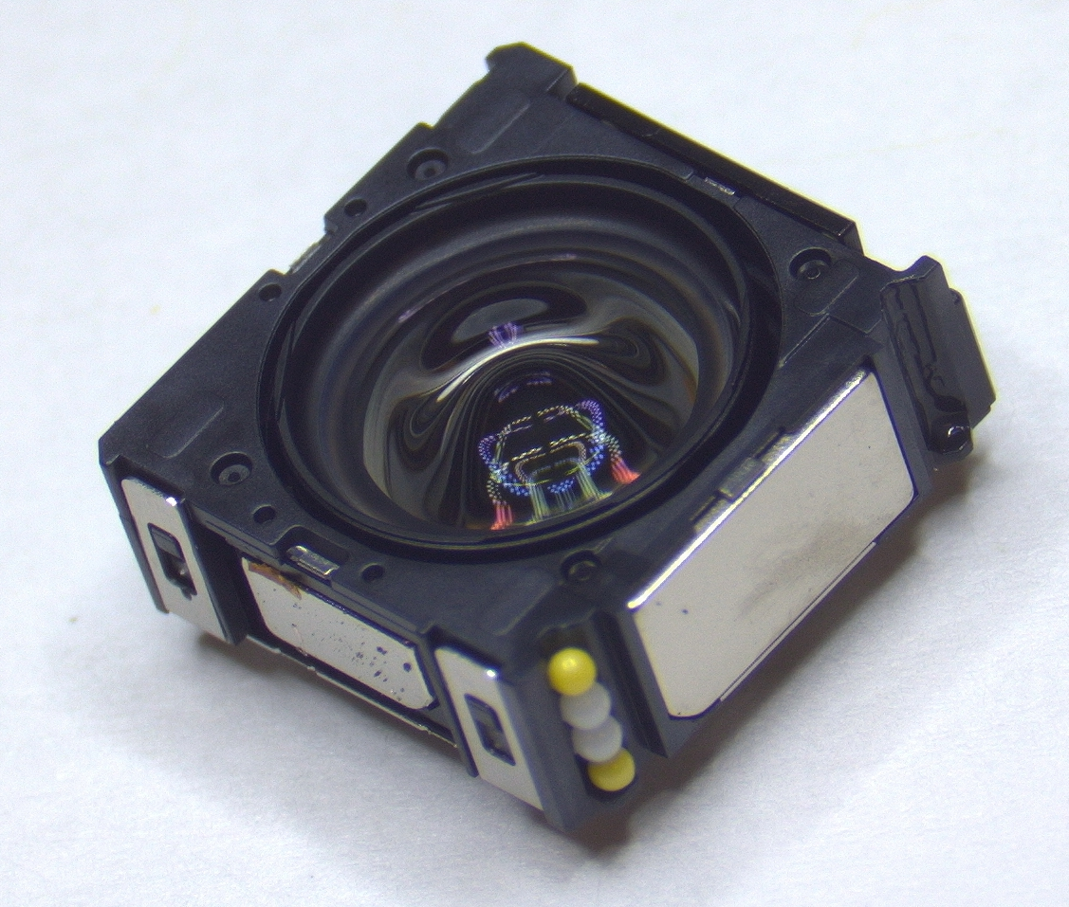
The camera assembly with metal housing removed (left). The inner lens assembly translates along the z axis on ceramic bearings in order to focus the camera. The inner assembly can be pulled out along those bearings and removed (below).

Slide 8
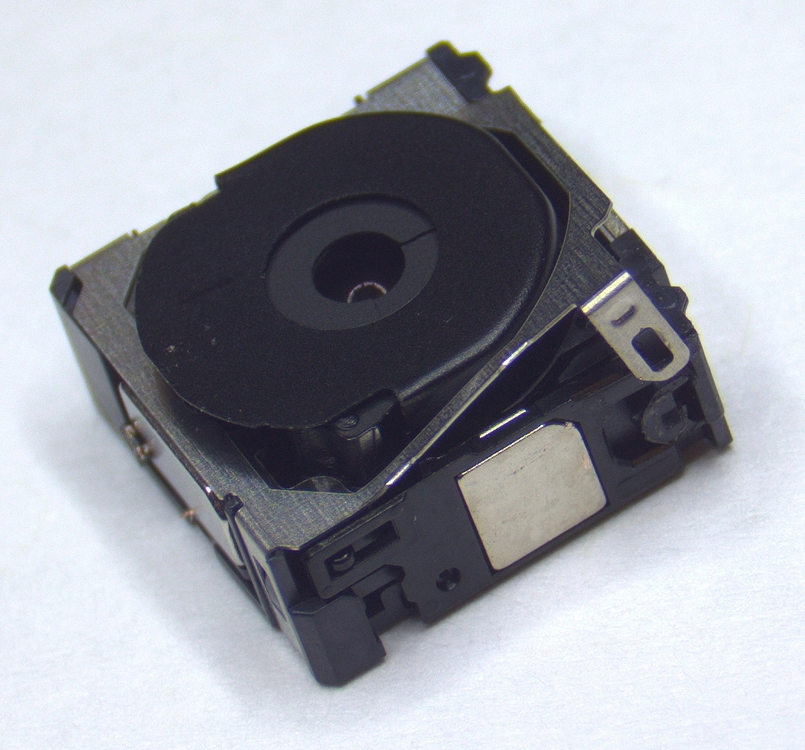
Pry up on the four metal tabs that attach the upper metal cover to the plastic base and remove

Slide 9
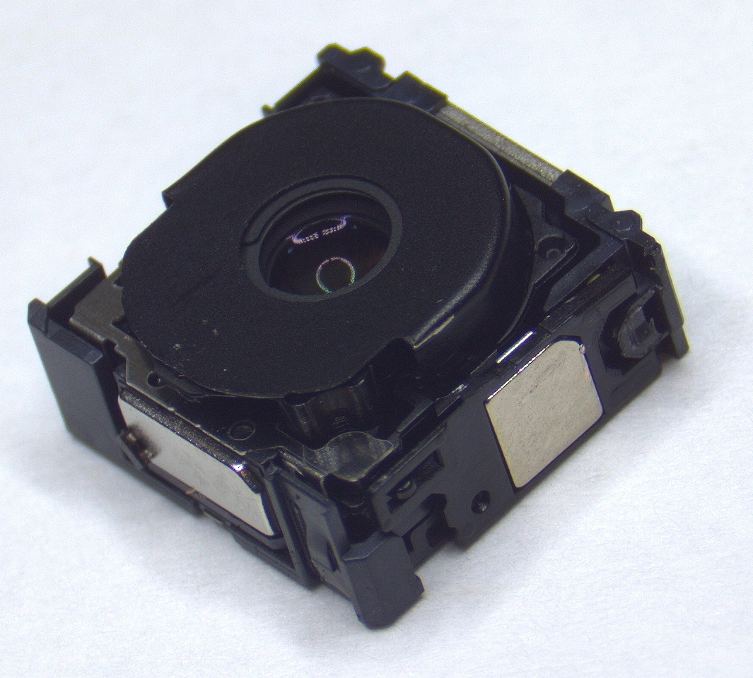
Pull up on the inner assembly and remove

Slide 10
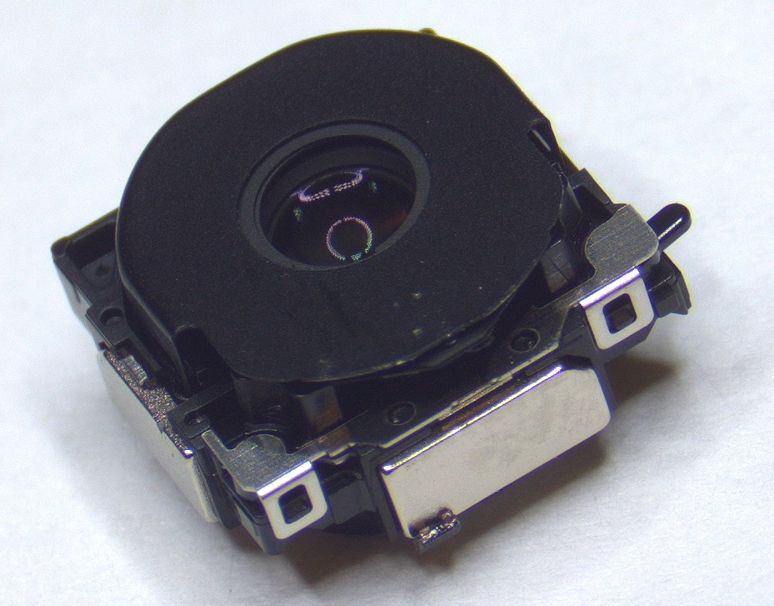
Pry up on the three black metal tabs attaching the black shroud to the assembly

Slide 11
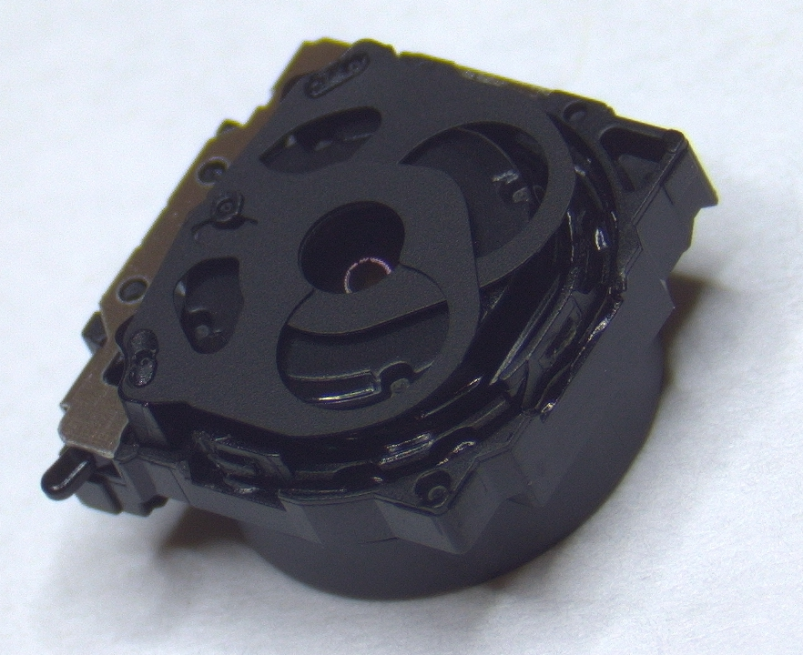
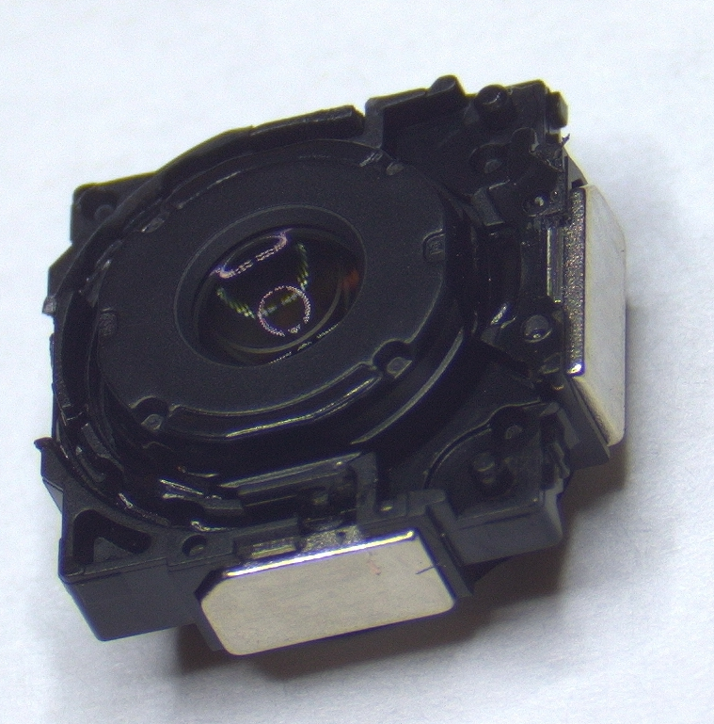
Peel off the remaining sheet metal covering and the adjustable aperture flaps (left) to expose the front face of the lens assembly (below)

Slide 12
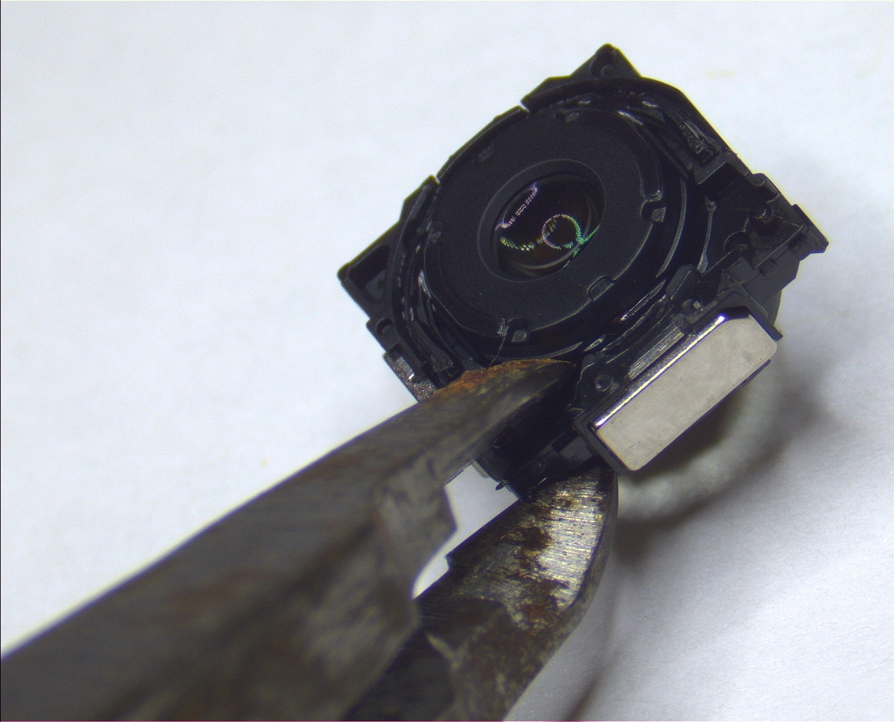
Use fine electronics wirecutters to clip each corner of the square plastic flange that is glued to the lens assembly. After clipping all four corners, the pieces can be removed with tweezers.

Slide 13
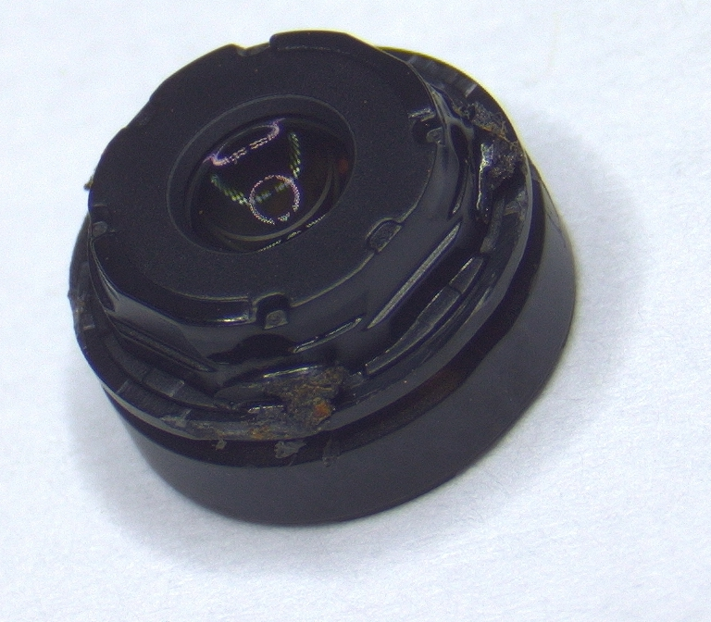
The finished product! Be very careful not to touch the lens surfaces, they are soft and near impossible to clean if you get oil from your fingers on them.

