Slide 1
Featherscope assembly

Slide 2
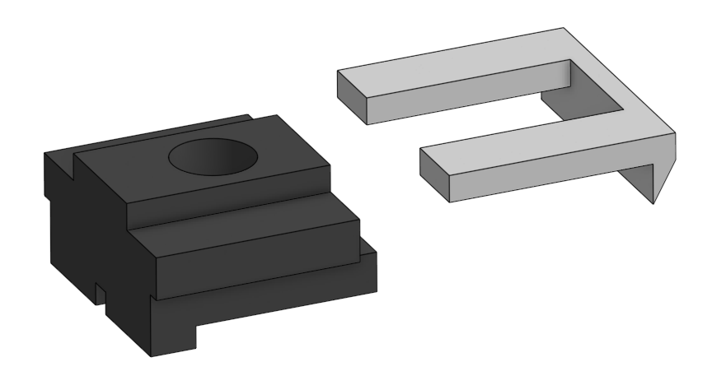
Slide magnetic bracket onto lower body

Slide 3
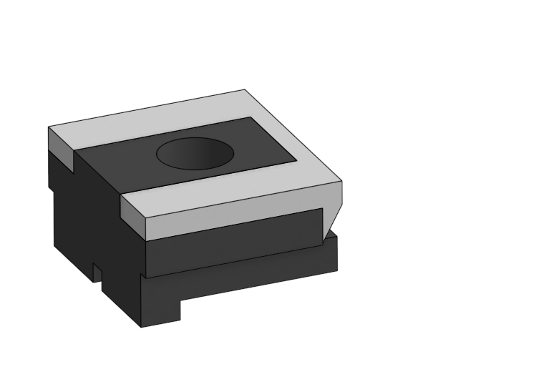
Apply cyanoacrylate glue to interface

Slide 4
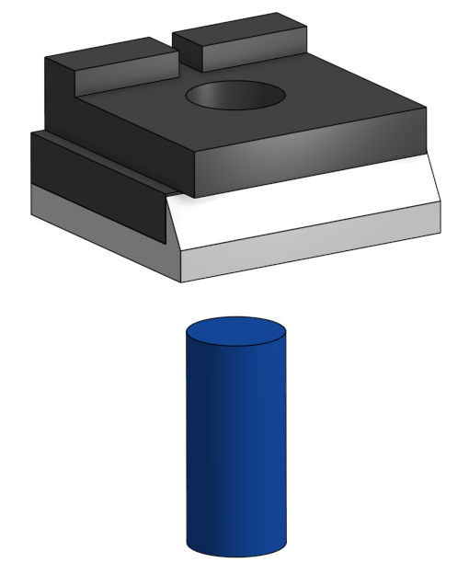
Insert objective lens into lower subassembly

Slide 5
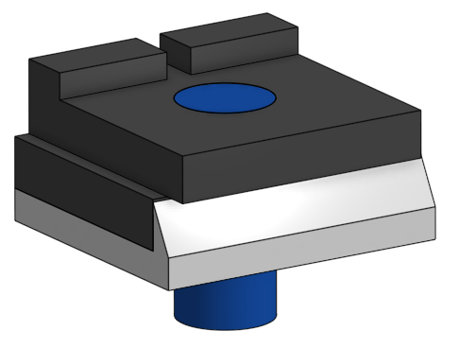
Push objective into body until top faces of lens and body are flush

Slide 6
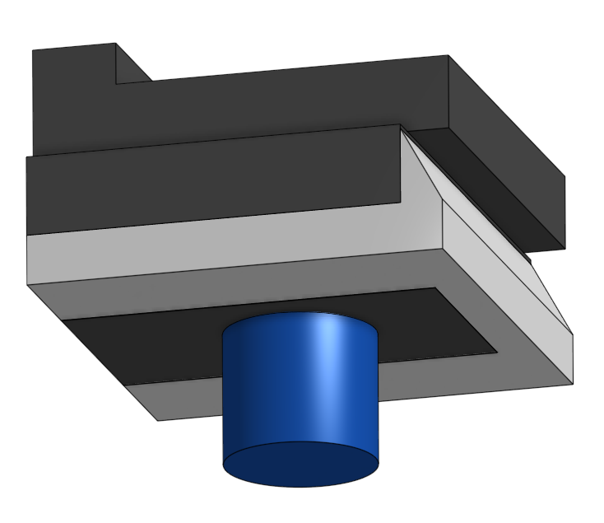
Apply 61 cement around interface

Slide 7
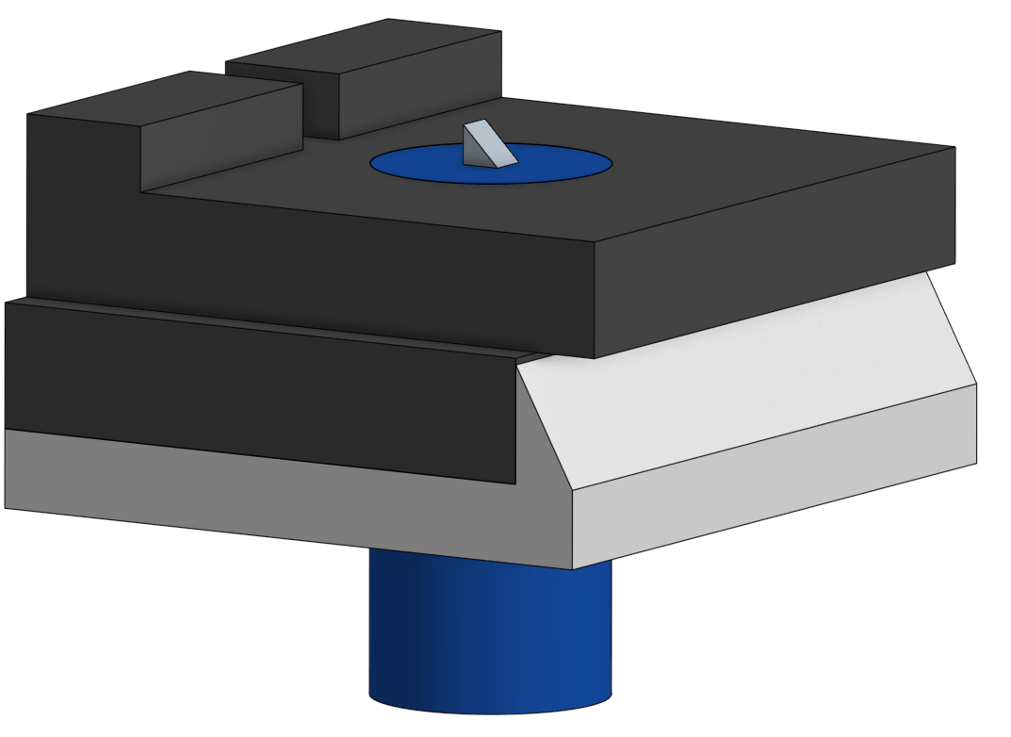
Attach prism with small amount of 61 cement

Slide 8
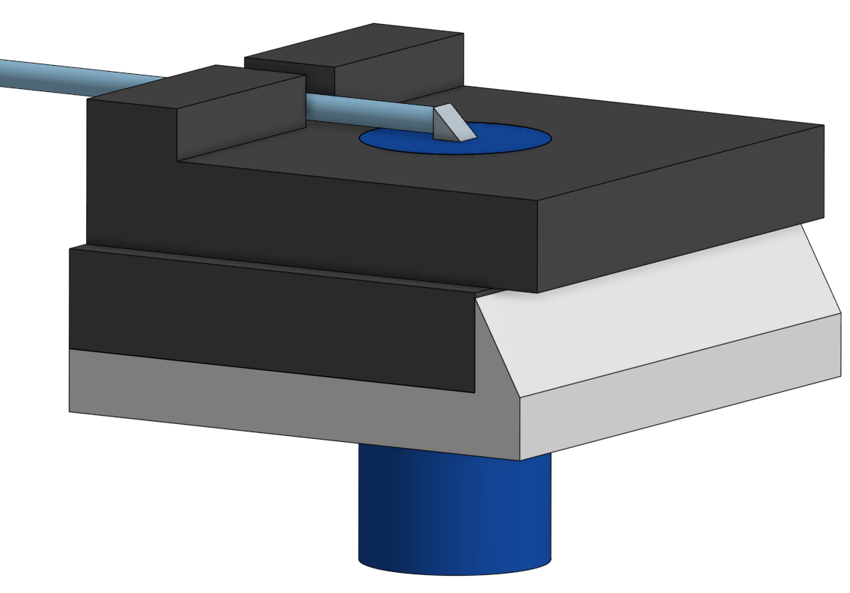
Insert fiber and attach fiber face to prism with small amount of 61 cement

Slide 9
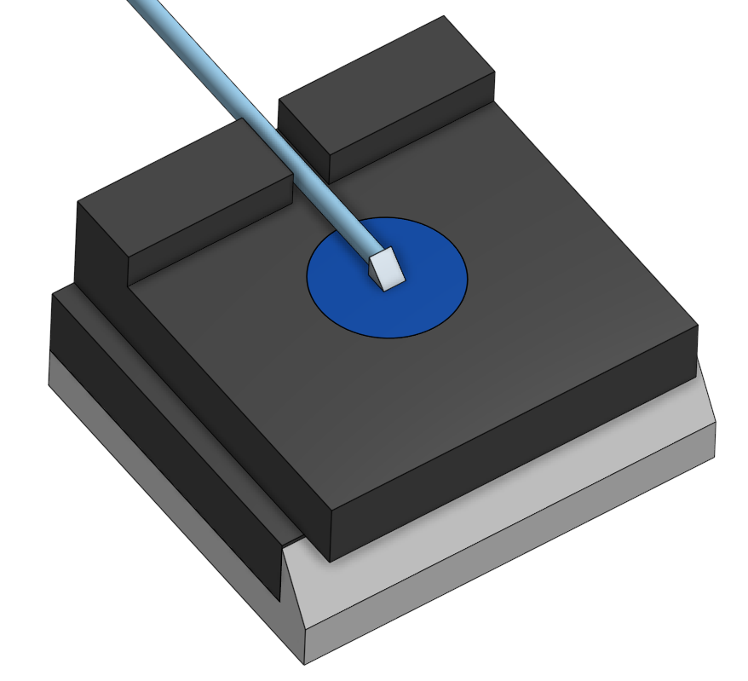
Secure fiber to body using 63 cement applied to notch

Slide 10
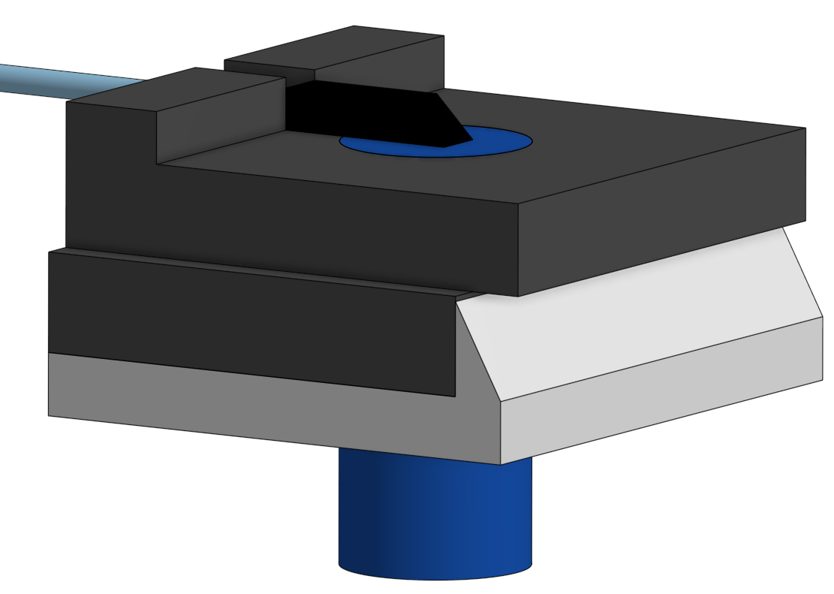
Cover prism-fiber assembly using nail polish

Slide 11
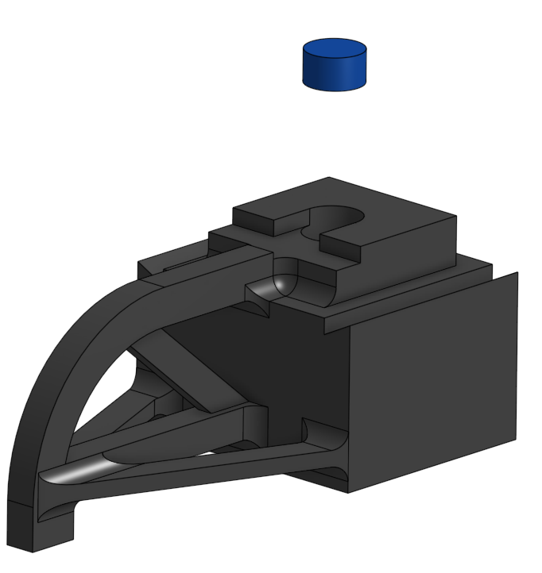
Insert tube lens into body

Slide 12
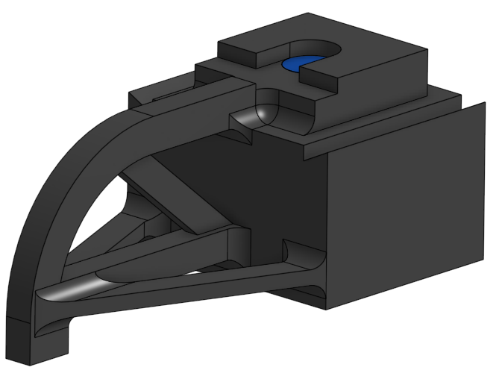
Push tube lens until faces of lens and body are flush

Slide 13
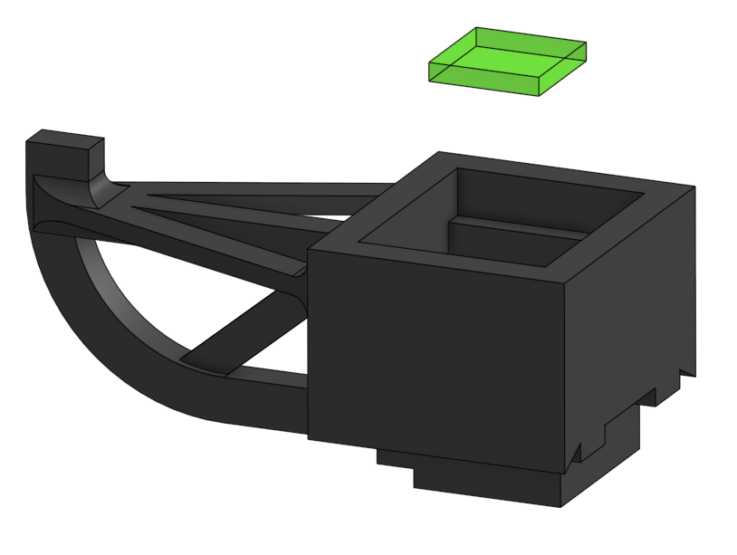
Insert dielectric filter

Slide 14
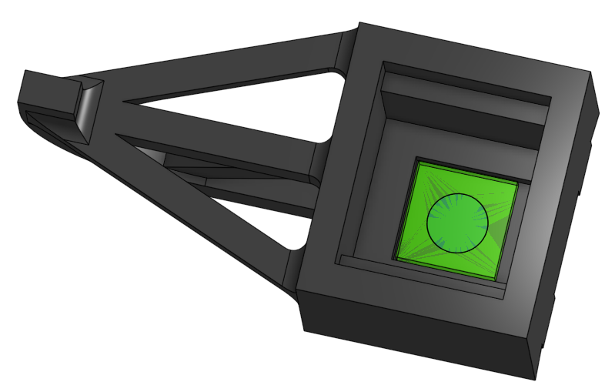
Attach filter using 61 cement applied between filter and lens

Slide 15
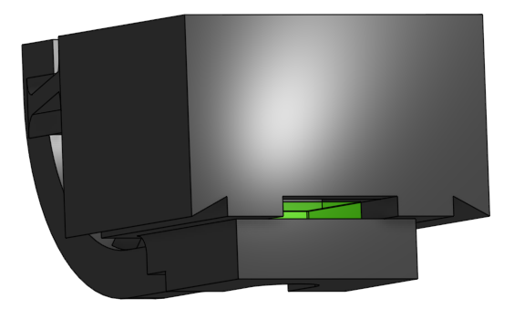
Cure cement using window on side of body

Slide 16
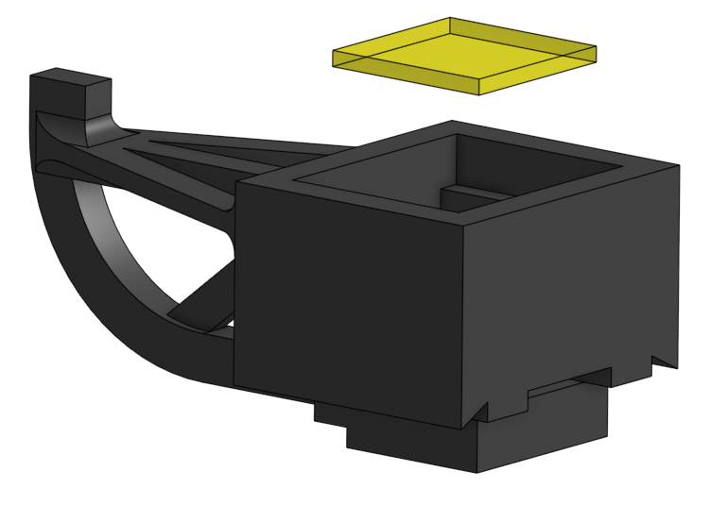
Insert wratten filter

Slide 17
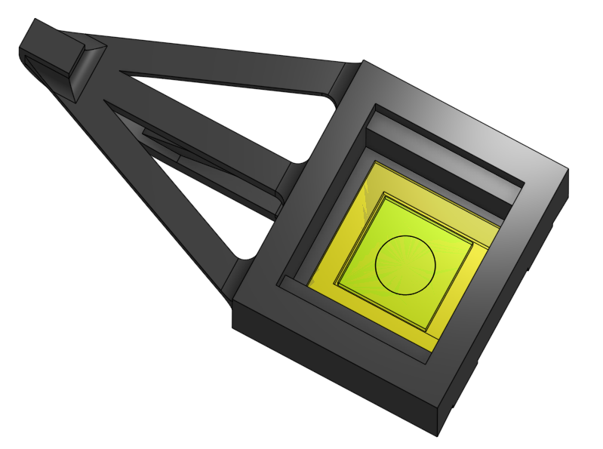
Attach using 61 cement between filters and cure using window

Slide 18
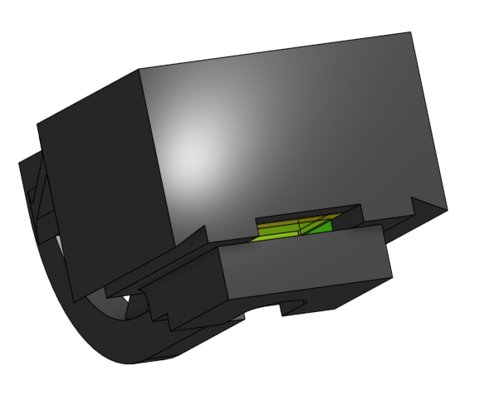
Seal window using nail polish

Slide 19
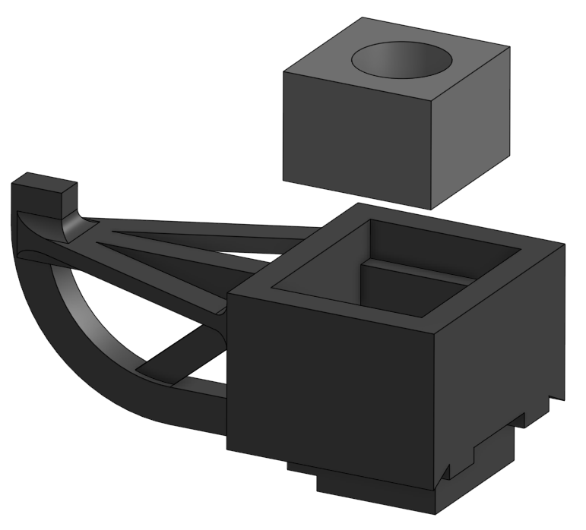
Insert focus spring into body

Slide 20
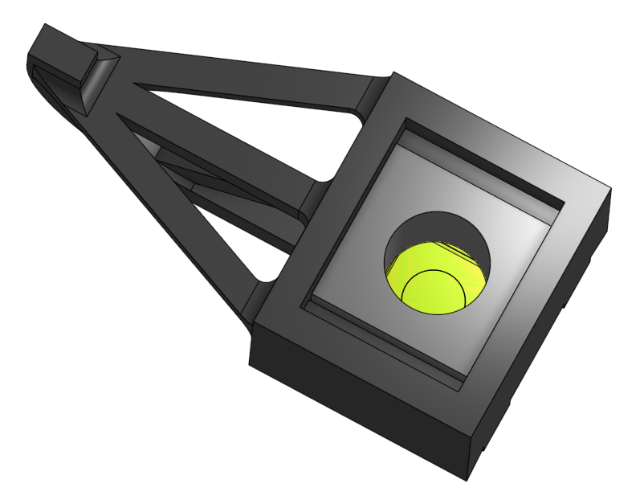
After insertion

Slide 21
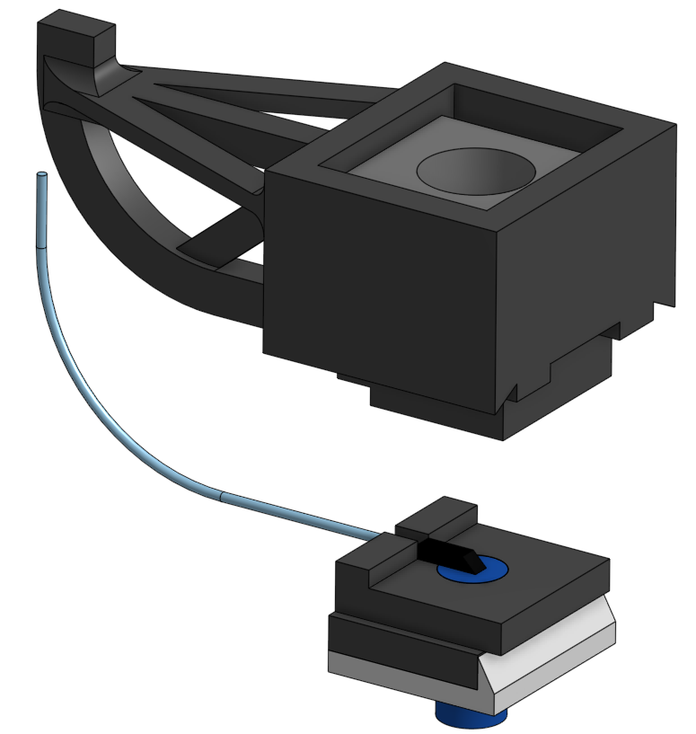
Align subassemblies

Slide 22
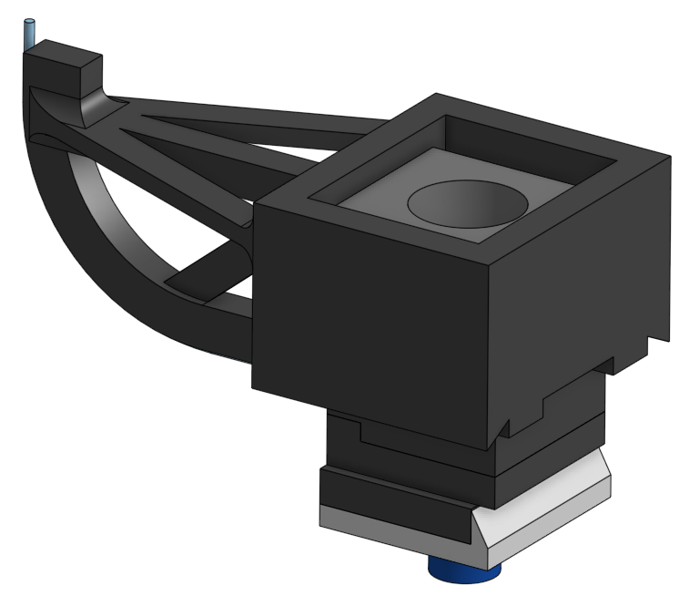
Attach subassemblies using 63 cement applied to interface
Attach fiber to relief arm using 5 minute epoxy

Slide 23
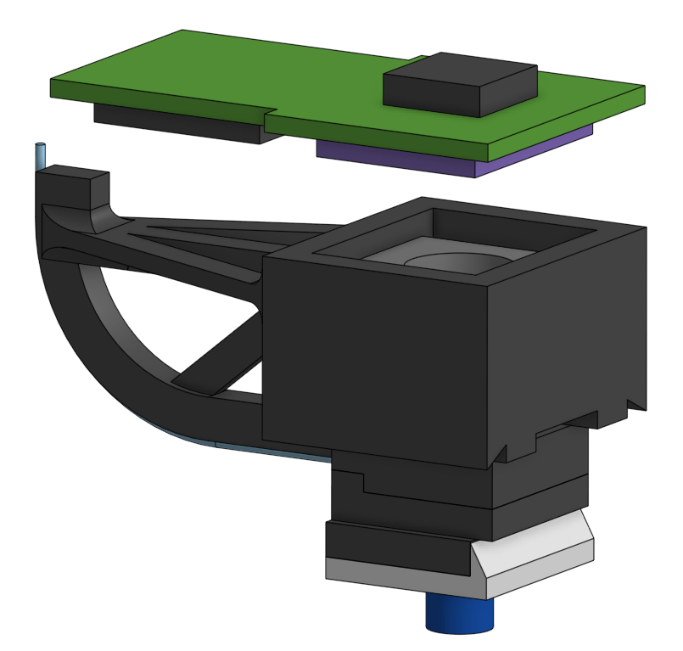
Insert PCB into body

Slide 24
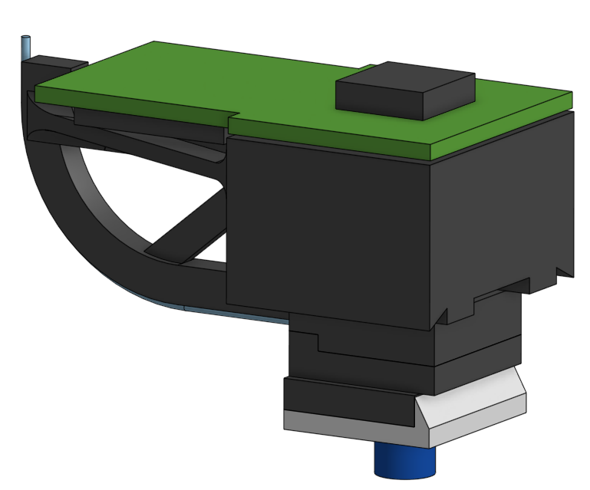
After installation

Slide 25
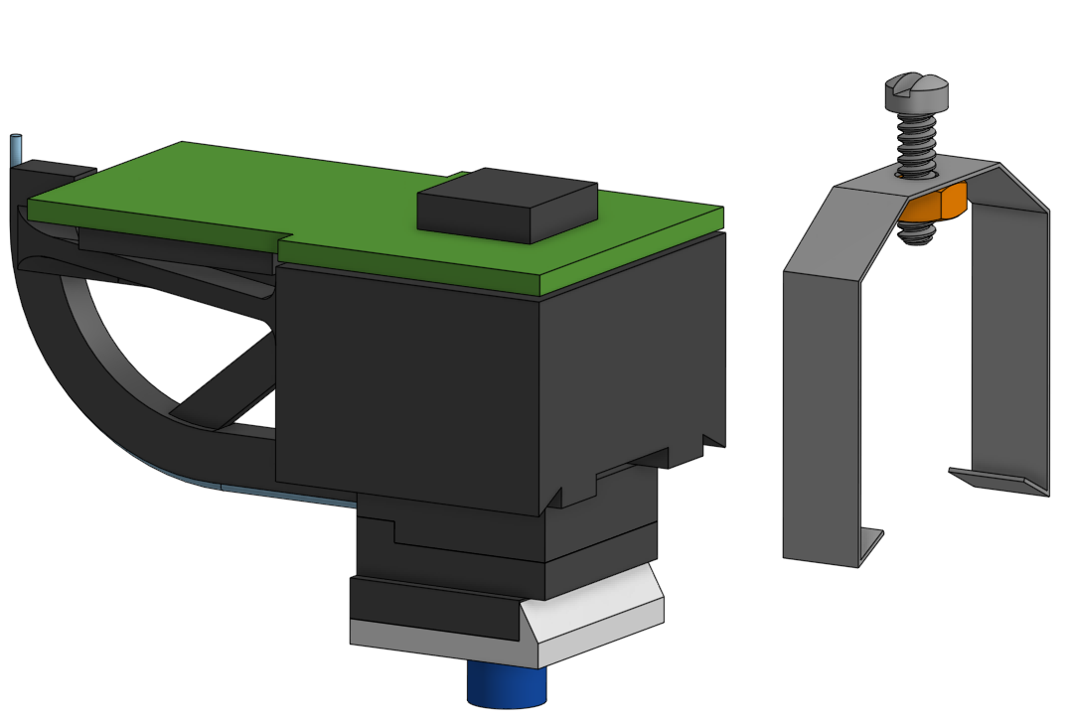
Slide focus bracket onto body

Slide 26
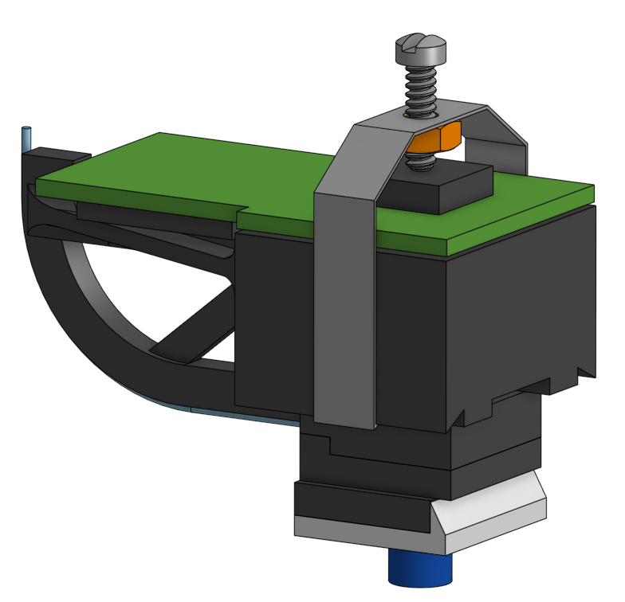
Assembly complete

