Slide 1
Kiloscope assembly

Slide 2
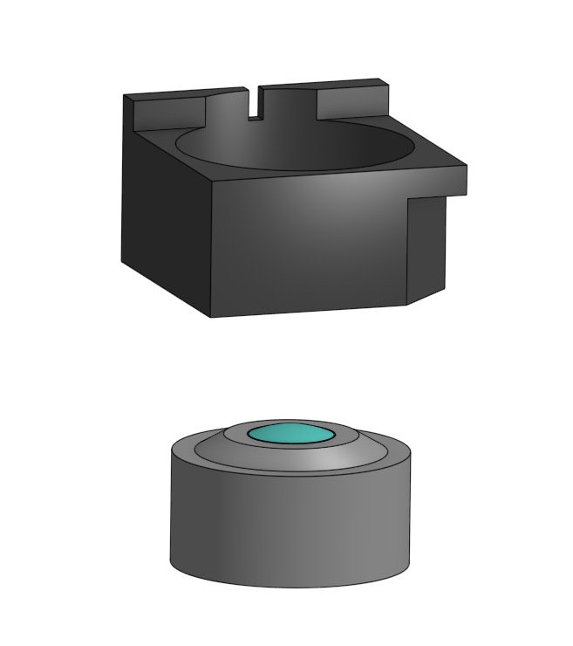
Ream the hole in the lower subassembly. Insert objective lens into lower subassembly

Slide 3
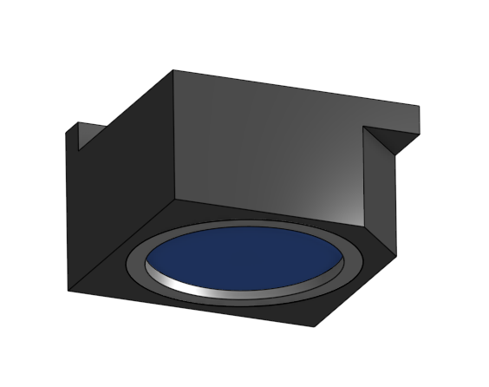
Push lens until bottom faces are flush. Apply 61 cement along the circular interface between components

Slide 4
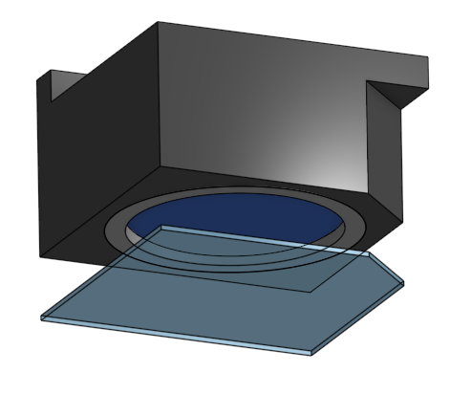
Align lower glass coverslip with lower subassembly
Ensure that coverslip does not hang over the sides of the plastic or you will not be able to seat the device in the head mount.

Slide 5
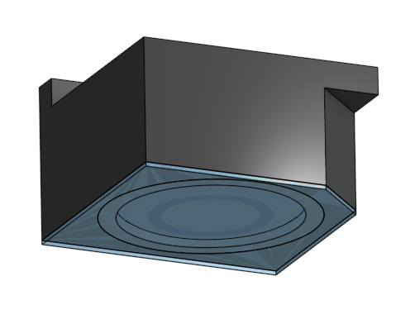
Apply 61 cement along the outside where the components meet

Slide 6
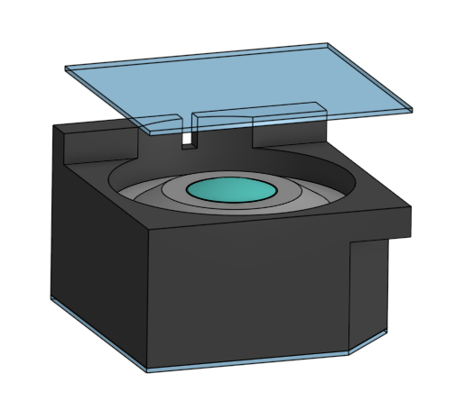
Align upper coverslip with subassembly

Slide 7
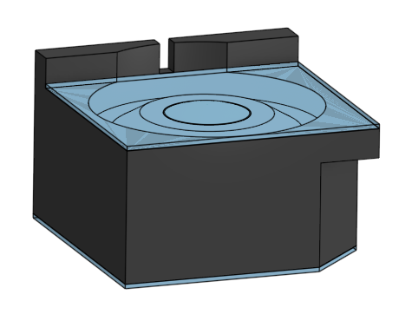
Apply 61 cement along the outside interface

Slide 8
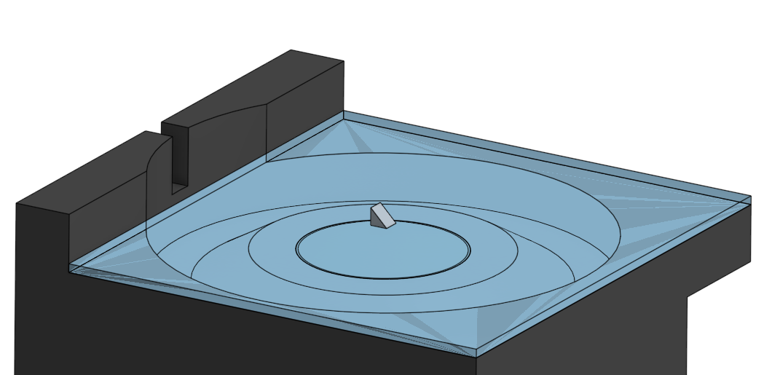
Align prism and attach with very small amount of 61 cement

Slide 9
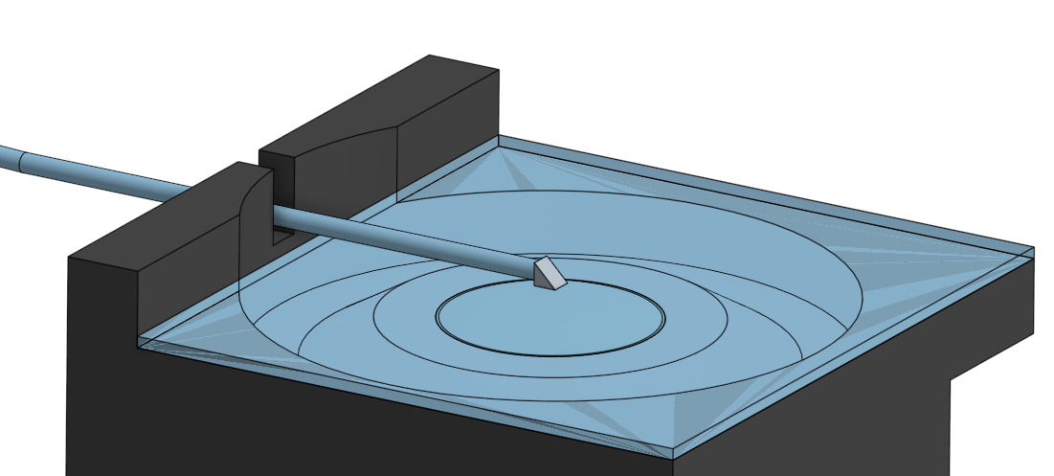
Align fiber and attach with 61 cement between fiber face and prism
Secure fiber to body using 63 cement applied to notch

Slide 10
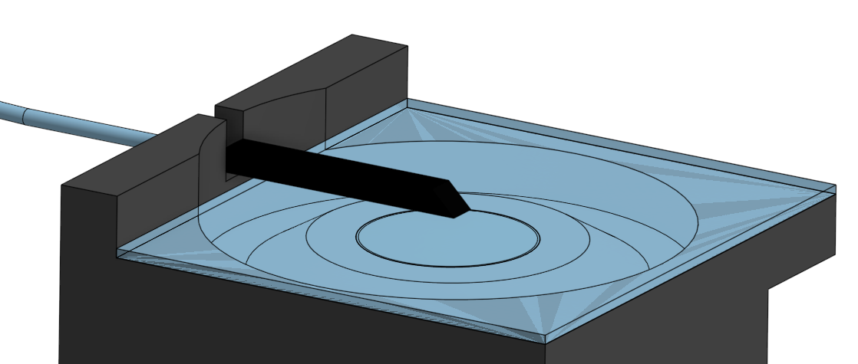
Apply nail polish to prism-fiber assembly

Slide 11
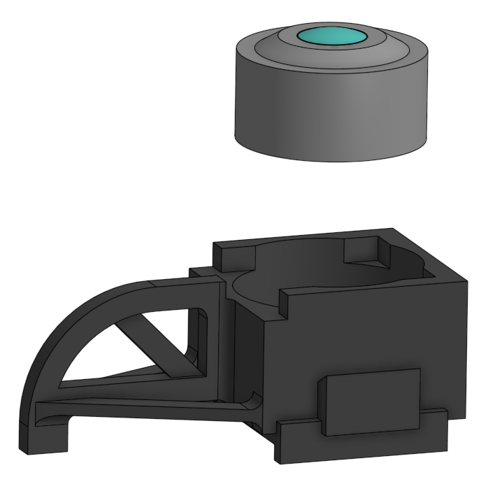
Ream the hole in the upper assembly being careful not to punch through the top lens stops.
Insert tube lens into upper subassembly

Slide 12
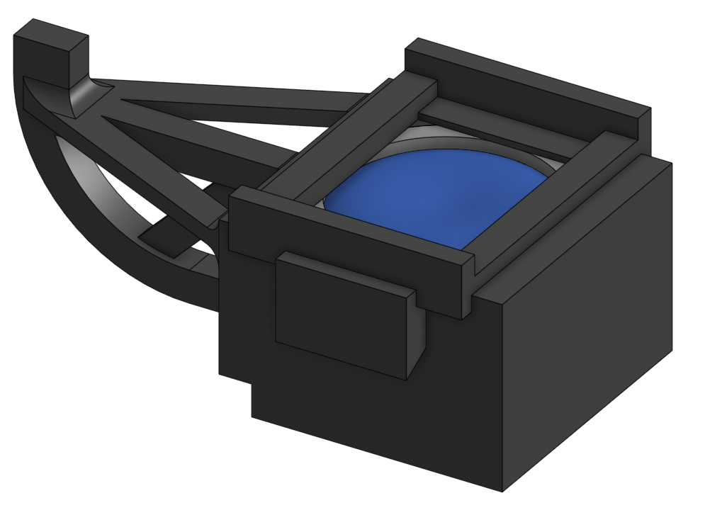
Ensure edge of lens assembly is flush with inner lip

Slide 13
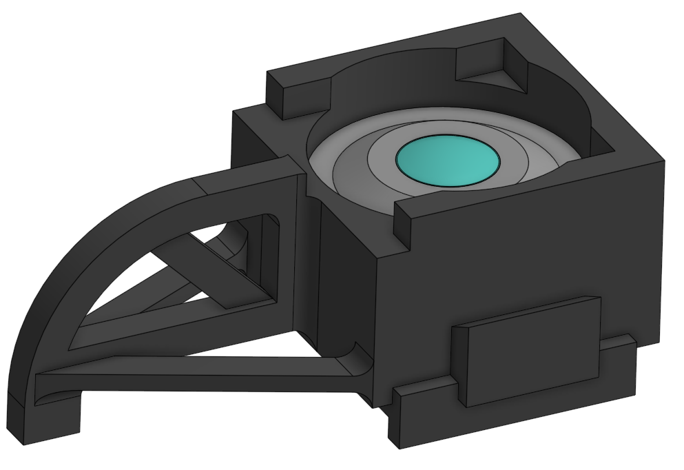
Apply 63 cement to interface

Slide 14
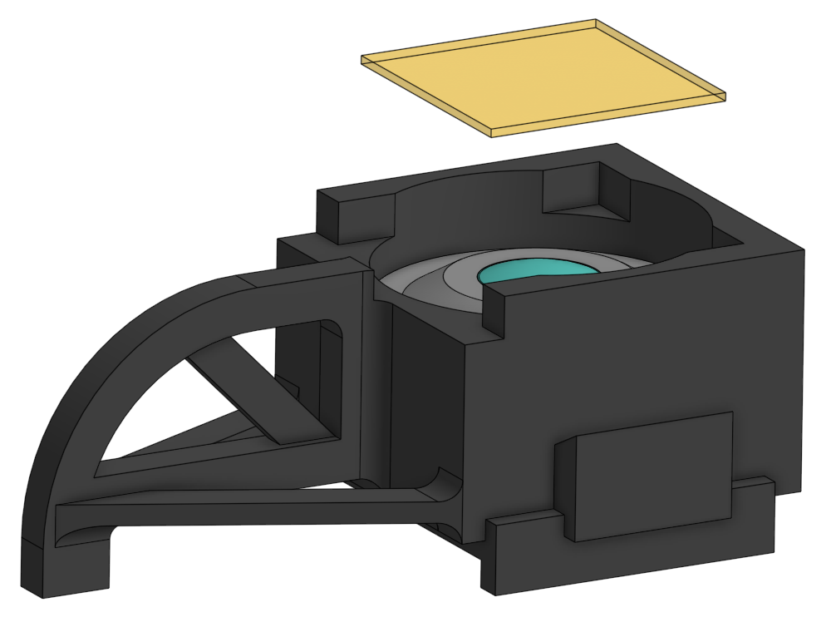
Cut wratten filter from large sheet. Align wratten filter with body

Slide 15
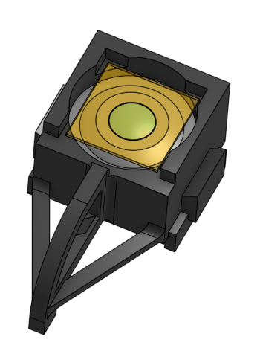
Apply 63 cement to corners

Slide 16
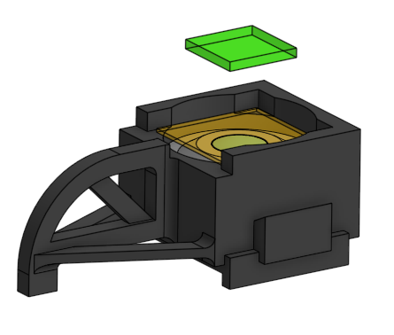
Align dielectric filter with lens aperture. The coating should face away from the wratten filter. Adhere with 61 cement

Slide 17
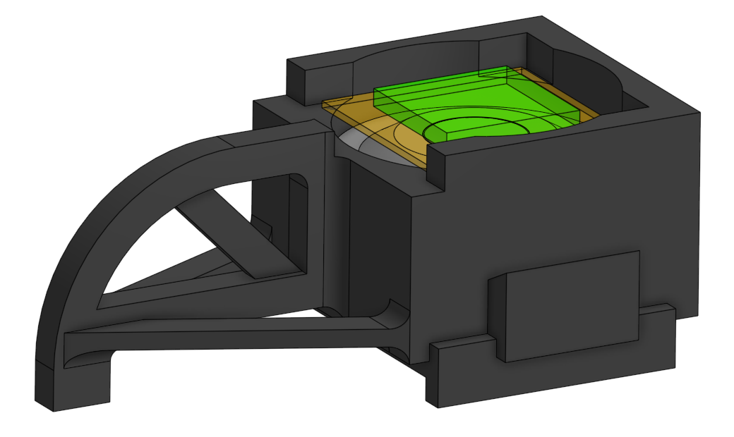
After installation

Slide 18
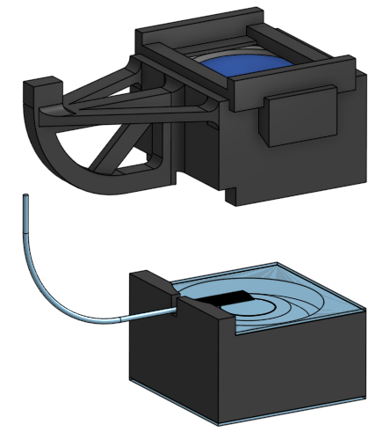
Align the upper and lower subassemblies

Slide 19
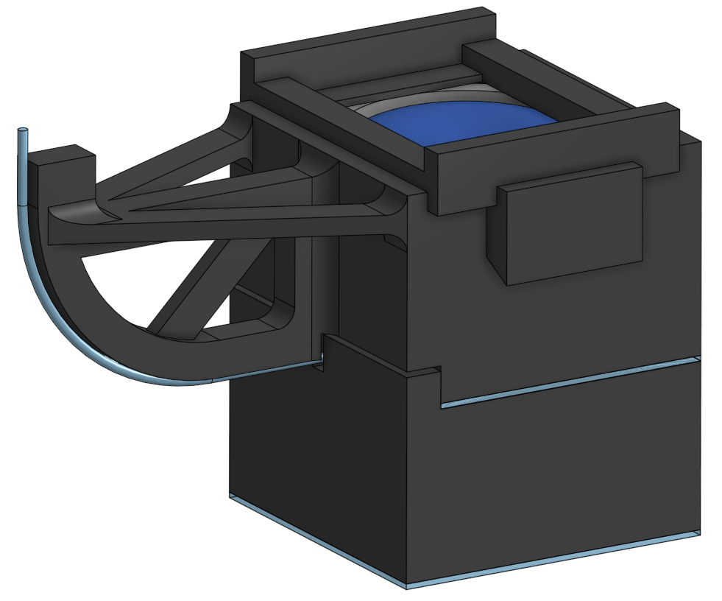
Apply 63 cement along the entire length of the interface between subassemblies
Cover fiber-support interface with 5 minute epoxy

Slide 20
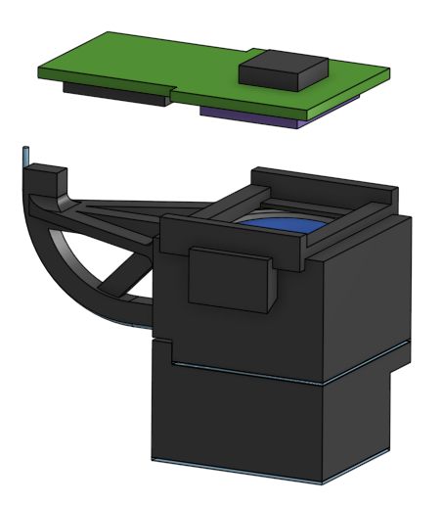
Align PCB with body

Slide 21
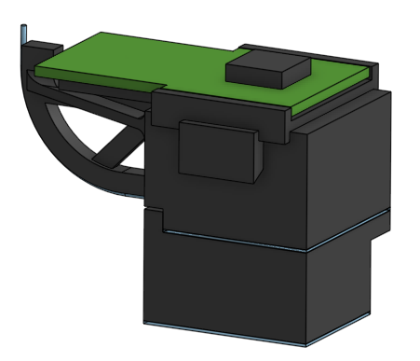
After installation

Slide 22
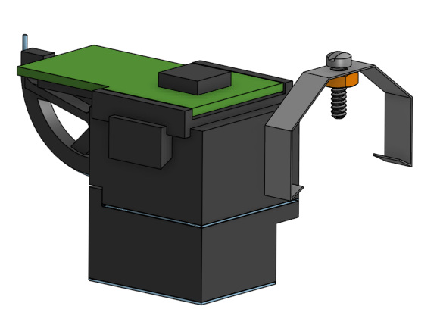
Slide focus bracket onto side ledges

Slide 23
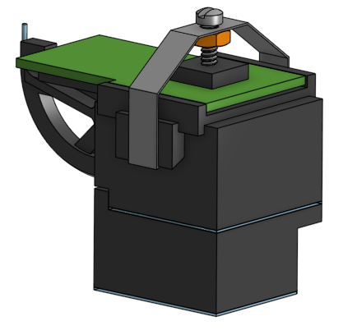
Assembly complete

