Slide 1
AP
AgentPay Firewall
One link from seller intent
to onchain settlement.
Seller-created checkout links. Buyer-owned authorization.
Official x402 settlement on Algorand Testnet.
agentpay-firewall.vercel.app
BRAINWAVE 2026 | ALGORAND x402
01
Notes:
[Sources]
- Live product: https://agentpay-firewall.vercel.app
- Source: https://github.com/FeeeeelixWong/agentpay-firewall
[/Sources]

Slide 2
AP
AgentPay Firewall
A fixed endpoint proves the protocol.
It does not create a usable payment product.
The missing product layer
01
Seller control
Amount and recipient must be set per payment, not per deployment.
02
Buyer clarity
The buyer must see exact terms before opening a wallet.
03
Verifiable proof
The 402 challenge and final receipt must match those terms.
BRAINWAVE 2026 | ALGORAND x402
02
Notes:
[Sources]
- Product implementation: https://agentpay-firewall.vercel.app
- Repository architecture and smoke tests: https://github.com/FeeeeelixWong/agentpay-firewall
[/Sources]

Slide 3
AP
AgentPay Firewall
The product has two users and one shared source of truth.
Seller intent becomes a signed checkout; the buyer approves only after the x402 challenge matches it.
SELLER
SIGNED LINK
BUYER
x402
RECEIPT
Set amount + recipient
Signed checkout terms
Review + connect Pera
402 challenge + retry
Algorand settlement
No private keys enter AgentPay. The buyer signs in Pera Wallet; GoPlausible verifies and settles.
BRAINWAVE 2026 | ALGORAND x402
03
Notes:
[Sources]
- Seller/buyer implementation: https://agentpay-firewall.vercel.app
- Official AVM x402 integration: @x402/avm, @x402/express, and GoPlausible facilitator in the repository package.json and server code
[/Sources]

Slide 4
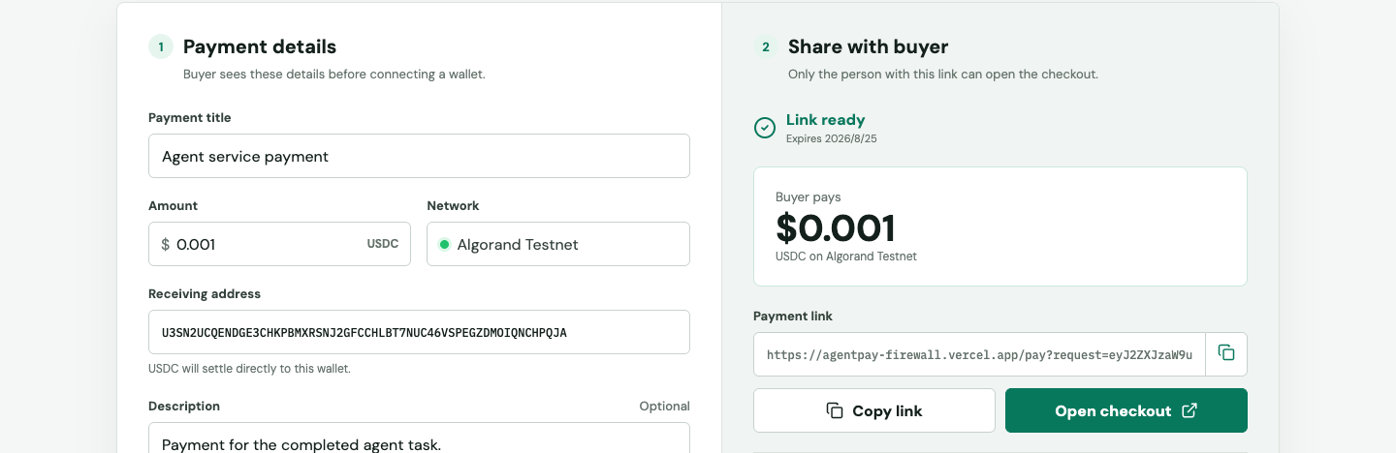
AP
AgentPay Firewall
The seller controls every payment without touching server config.
Set a title, exact USDC amount, receiving address, and context. One click creates a 7-day signed checkout link.
BRAINWAVE 2026 | ALGORAND x402
04
Notes:
[Sources]
- Product screenshot captured from https://agentpay-firewall.vercel.app
- Seller link creation implementation: https://github.com/FeeeeelixWong/agentpay-firewall
[/Sources]

Slide 5
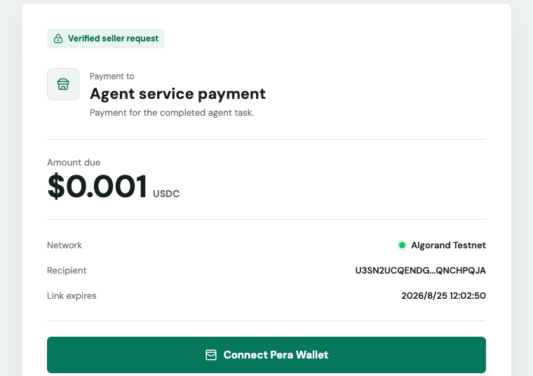
AP
AgentPay Firewall
The buyer sees the terms before the wallet opens.
Recipient, amount, network, and expiry are visible and verified against the signed link.
SIGNED TERMS
Changing amount or recipient invalidates the request.
BUYER CUSTODY
Pera Wallet keeps the key and final approval.
MATCH BEFORE SIGN
The live 402 challenge must match the checkout.
BRAINWAVE 2026 | ALGORAND x402
05
Notes:
[Sources]
- Product screenshot captured from a signed checkout at https://agentpay-firewall.vercel.app/pay
- Buyer verification and Pera Wallet integration: https://github.com/FeeeeelixWong/agentpay-firewall
[/Sources]

Slide 6
AP
AgentPay Firewall
The signed checkout maps 1:1 to a real x402 v2 challenge.
The buyer page rejects any mismatch before requesting a signature.
HTTP 402
PAYMENT-REQUIRED
PROTOCOL
AMOUNT
NETWORK
ASSET
x402 v2 exact
$0.001 USDC
Algorand Testnet
ASA 10458941
SIGNED RECIPIENT
U3SN2UCQENDGE3CHKPBMXRSNJ2GFCCHLBT7NUC46VSPEGZDMOIQNCHPQJA
BRAINWAVE 2026 | ALGORAND x402
06
Notes:
[Sources]
- Live dynamic resource: https://agentpay-firewall.vercel.app/api/x402/pay
- Hosted smoke test and payment-link mismatch assertions: https://github.com/FeeeeelixWong/agentpay-firewall
[/Sources]

Slide 7
AP
AgentPay Firewall
The official AVM payment path has already settled on Algorand Testnet.
The receipt proves live GoPlausible settlement for the same network, asset, amount, and recipient.
BUYER
SETTLED
25QHVX3LLUXIOHW7CRNRDDYMNZMVETYPGJIM66O2R2WZUMACHL2RDLRRBM
0.001
SELLER
USDC
U3SN2UCQENDGE3CHKPBMXRSNJ2GFCCHLBT7NUC46VSPEGZDMOIQNCHPQJA
ROUND 66373009
TRANSACTION
SEQAUK2K5SHHLUA35273OWDNCXXWVODYUUKPZUHQ6JZ2WPQEQWDQ
LORA
lora.algokit.io/testnet/transaction/SEQAUK2K5SHHLUA35273OWDNCXXWVODYUUKPZUHQ6JZ2WPQEQWDQ
BRAINWAVE 2026 | ALGORAND x402
07
Notes:
[Sources]
- Algorand Testnet receipt: https://lora.algokit.io/testnet/transaction/SEQAUK2K5SHHLUA35273OWDNCXXWVODYUUKPZUHQ6JZ2WPQEQWDQ
- Machine-readable evidence: docs/algorand-x402-settlement-evidence.json in https://github.com/FeeeeelixWong/agentpay-firewall
[/Sources]

Slide 8
AP
AgentPay Firewall
Ready for final review.
A complete seller-to-buyer x402 payment flow, not a protocol mock.
01
02
03
Usable product
Direct integration
Reproducible proof
Seller workspace and buyer checkout are separate, focused flows.
@x402/avm + @x402/express + GoPlausible facilitator.
402 smoke tests, mismatch rejection, and a Lora receipt.
LIVE agentpay-firewall.vercel.app
CODE github.com/FeeeeelixWong/agentpay-firewall
BRAINWAVE 2026 | ALGORAND x402
08
Notes:
[Sources]
- Live product: https://agentpay-firewall.vercel.app
- Source and reproducibility: https://github.com/FeeeeelixWong/agentpay-firewall
- Demo video: https://agentpay-firewall.vercel.app/agentpay-firewall-demo.mp4
[/Sources]

