Slide 1
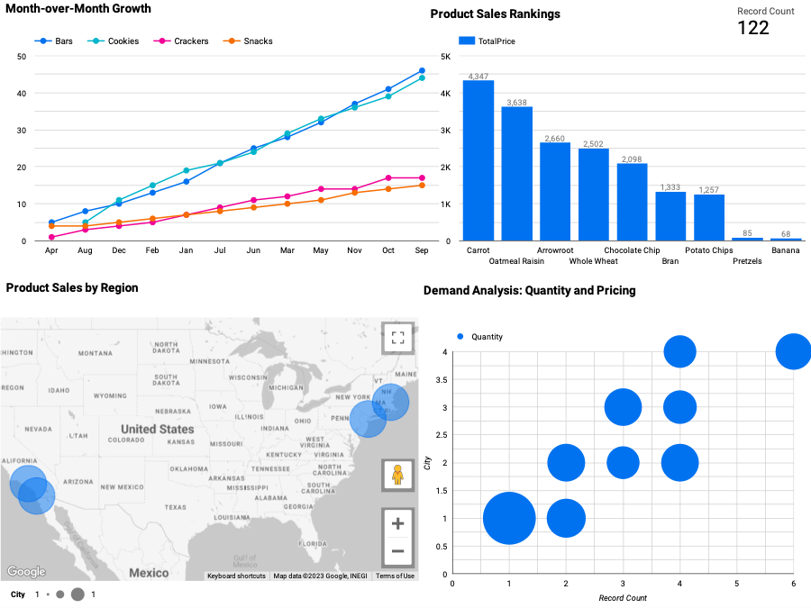
There is a bar chart to show a visual representation of the performance of various products within a specific dataset. It is designed to show which products are the top performers in terms of sales or revenue.
Sale dashboard
There is a line chart used to show a measure the percentage change in a specific metric from one calendar month to the next
Bubble Map is a data visualization tool that provides a detailed representation of product sales data across different geographic regions.
So, it provides a detailed view of sales data that can inform strategic decisions and help businesses
Bubble Chart is a data visualization that offers an analytical perspective on product demand, emphasizing the interplay between quantity and pricing. This chart provides insights into how changes in pricing affect product demand and vice versa.
https://lookerstudio.google.com/reporting/d6033353-3d4f-48ec-a0f9-91e41c2e45b4

