Slide 1
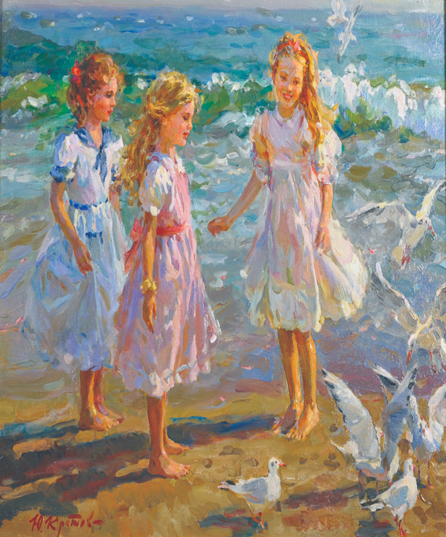
THE THREE SISTER

Slide 2
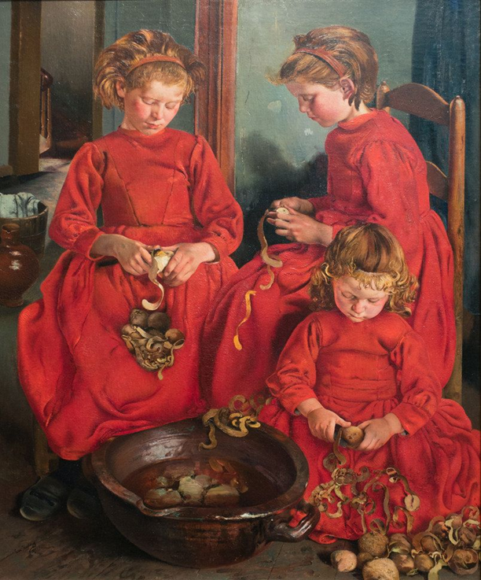
THE THREE SISTERS

