Slide 1
Research question: Has global warming contributed to rising temperatures?
A comparison of temperature rises in countries noted to be most and least susceptible to global warming.

Slide 2
Background
The Countries least susceptible to the shock of climate change are
Austria
Portugal
Canada
Switzerland
Finland
2. Countries most susceptible to the shock of climate change are:
India
Thailand
Philippines
Malaysia
Indonesia
3. These countries were retrieved from the article with link below:
https://www.swissre.com/risk-knowledge/mitigating-climate-risk/countries-economic-shock-climate-change.html

Slide 3
Temperature Analysis of Countries most and least susceptible to global warming
To begin with, we start with analysing the temperature changes between the year 1995 and 2010 for two ranges of countries.
2. The steps involved in the process are:
Analysis
Data Filtering
Data Visualization
Conclusion
Link to code: https://colab.research.google.com/drive/1EZ2wOKEiXITVTrayo2VFZOQzrS5aiaKY#scrollTo=3MCSda2uwSLH

Slide 4
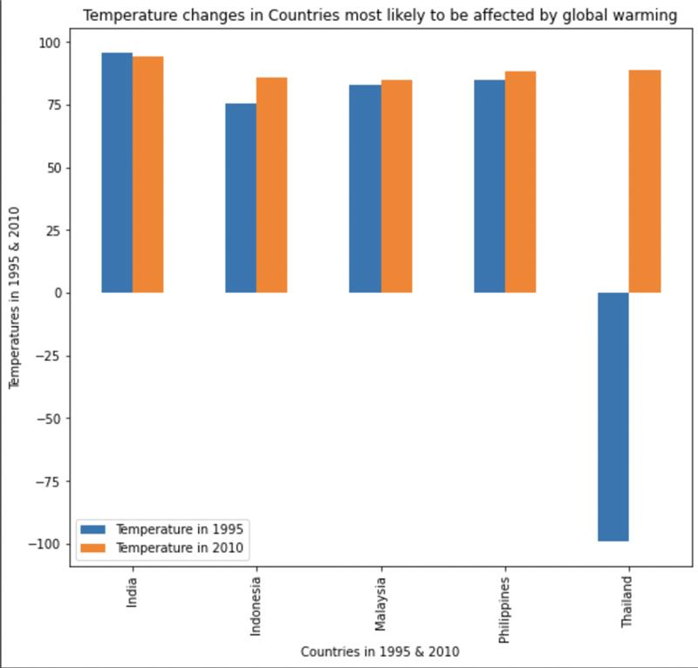
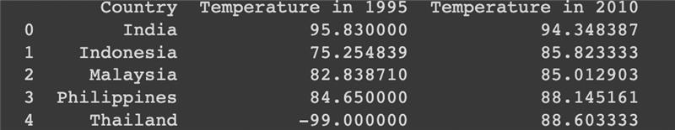
Analysis Steps for Countries most susceptible to Climate change
1.Filtered the data to focus on Countries most susceptible to climate change.
2.Derived the average temperature for each month, for the years 1995 and 2010, for each city in the Countries most susceptible to climate change.
3.Derived the maximum temperature for each country based on the city with the highest temperature for 1995 and 2010.
4. Data manipulation to achieve the table and graphs as seen. The graph plots the temperatures for 1995 and 2010 for each country.
5. The table shows temperatures for 1995 and 2010 for each country.
.
(the anomalous result of average temperature in Thailand in 1995 was due to missing data)

Slide 5
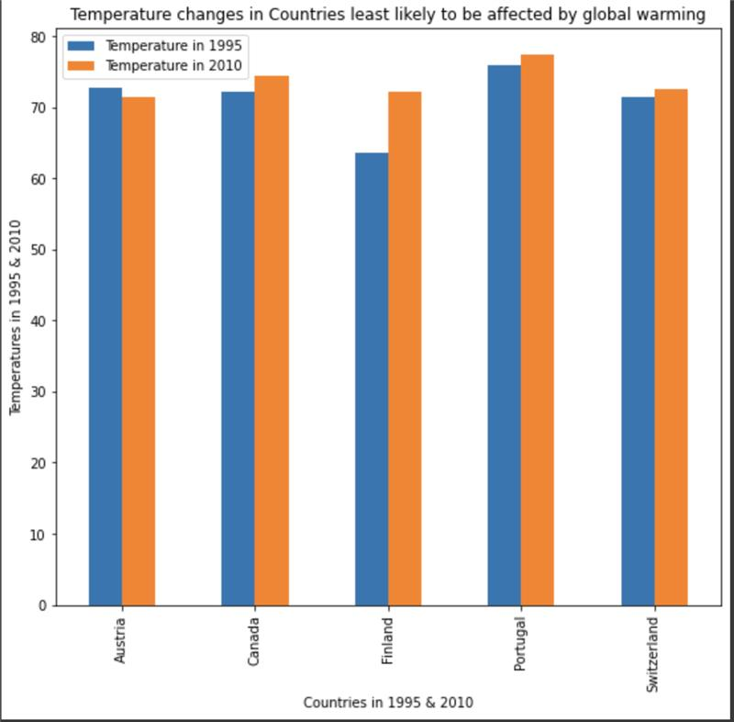

Analysis Steps for Countries least susceptible to Climate change
1.Filtered the data to focus on Countries least susceptible to climate change.
2.Derived the average temperature for each month, for the years 1995 and 2010, for each city in the Countries least susceptible to climate change.
3.Derived the maximum temperature for each country based on the city with the highest temperature for 1995 and 2010.
4. Data manipulation to achieve the table and graphs as seen. The graph plots the temperatures for 1995 and 2010 for each country.
5. The table shows temperatures for 1995 and 2010 for each country.
.

Slide 6
Conclusions and suggestions for further research
Out of the 5 countries analysed that were considered least susceptible to climate change, 4 countries showed a small increase in average temperature between 1995 and 2010.
4 of the countries that were most susceptible to climate change showed an increase in temperature between 1995 and 2010.
The increase margin for countries most susceptible to global warming isn't higher than that for countries least susceptible to global warming. Global warming hasn't caused a significant increase in temperature for the countries most susceptible, due to the similar increase margins in the two country categories.
This suggests that an increase in average temperature is not the only factor affecting the susceptibility of a country to climate change.
Ideas for further research
To explore the effects of climate change in these countries further, a next step could be to track the temperature changes in these countries for the hottest months of the year, as this could be more reflective of global temperature changes.

