Slide 1

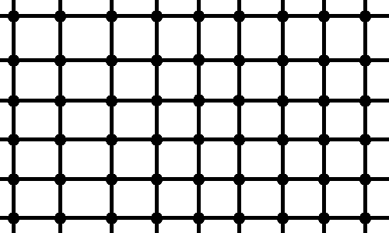
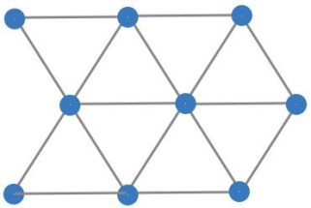

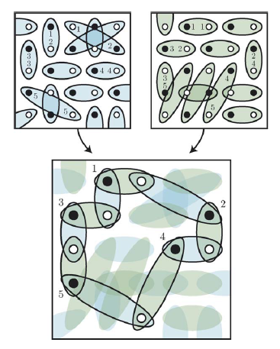
System of spins ½ with isotropic Heisenberg interaction:
density matrix parameterization and variational method
Filipp Uskov (Skoltech)
in collaboration with Oleg Lychkovsky and Elena Shpagina
Model
Challenge and main ideas
Hamiltonian:
<i, j> denotes neighboring sites
Scalar and mixed products of Pauli matrices:
Our challenge well known variational method
Divide full lattice to clusters:
N – number of spins in lattice
M – number of clusters
d - number of bonds per 1 spin
m – number of bonds in cluster
Anerson bound[3]:
Variational method:
Comparison:
Variational method in general outperform Anderson bound
for the same cluster size
Squaring parameterization of density matrix [1]
Basis is overcomplete, but we can remove unwanted vectors:
- hypothesis, checked only up to 10 spins
Symbolic relations and simplifications
Variational method example
Algorithm which based on Pauli identity ( )
implemented in Wolfram Mathematica
Scalar product of matrices implemented in Wolfram Mathematica:
Illustration from [6]
N. Il'in, E. Shpagina, F. Uskov, O. Lychkovskiy. Squaring parametrization of constrained and unconstrained sets of quantum states. J. Phys. A: Math. Theor. 51:085301, 2018
R. Tarrah, R. Valenti. Exact lower bounds to the ground-state energy of spin systems: The two-dimensional S= 1/2 antiferromagnetic Heisenberg model. Physical review B , 41(13): 9611 , 1990
P. W. Anderson. Limits on the energy of the antiferromagnetic ground state. Physical Review, 83(6):1260, 1951
Tillmann Baumgratz and Martin B Plenio. Lower bounds for ground states of condensed matter systems. New Journal of Physics , 14(2): 023027, 2012
David A. Mazziotti. Variational minimization of atomic and molecular ground-state energies via the two-particle reduced density matrix. Phys.Rev.A, 65(6):062511, 2002
K.S.D. Beach, A.W. Sandvik. Some formal results for the valence bond basis. Nuclear Physics B, 750(3):142–178, 2006
Daniel C. Mattis, C. Y. Pan. Ground-State Energy of Heisenberg antiferromagnet for Spins s=1/2 and s=1 in d=1 and 2 Dimensions. Phys.Rev.Lett., 61(4): 463, 1988
Маттис. Теория магнетизма. Москва, Мир, 1967

