Slide 1



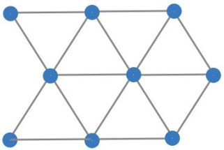
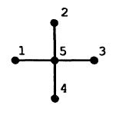
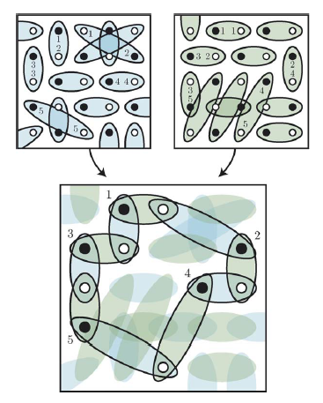
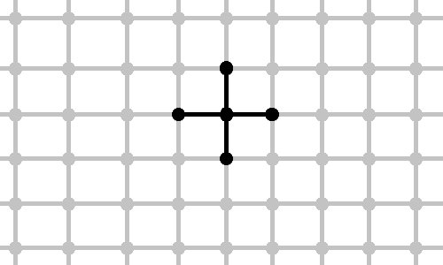

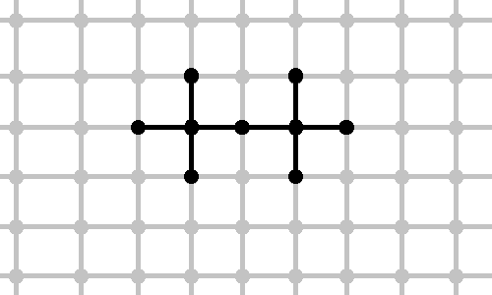




System of spins ½ with isotropic Heisenberg interaction:
parameterization density matrix, variational method, exact diagonalization
Filipp Uskov
Skoltech, Moscow State University
in collaboration with Oleg Lychkovsky and Elena Shpagina
Model
Challenge and main ideas
Typical Hamiltonian:
where <i, j> denotes neighboring sites
Scalar and mixed products of vectors of Pauli matrices:
Our challenge well known variational method
Divide full crystal to clusters:
N – number of spins in crystal
M – number of clusters
d - number of bonds by 1 spin
m – number of bonds in cluster
Schrödinger equation:
Variational method:
Squaring parameterization of density matrix [1]
Basis:
See illustrations in poster by Elena Shpagina
Symbolic relations and simplifications
Schrödinger equation
Algorithm which based on identity of Pauli ( )
was implemented in Wolfram Mathematica
Scalar product of matrices also was implemented in Wolfram Mathematica:
Illustration from [6]
We take into account the symmetries of commutation of spins in cluster.
Example:
Variational method
Numeric method:
Lagrange method:
If we don’t take into account the symmetries of commutation of spins
Variational method is identical to Schrodinger equation
Results 1d:
cluster | E_{gs}/N >
 | -2.1547
 | -1.92789
 | -1.99486
 | -1.89083
 | -1.92853
2d:
E_{gs}/N > 3
E_{gs}/N > -2,9685
1d exact theoretical [7]: E_{gs}/N = 1 – 4 ln 2 = – 1.7725
N. Il'in, E. Shpagina, F. Uskov, O. Lychkovskiy, Squaring parametrization of constrained and unconstrained sets of quantum states. J. Phys. A: Math. Theor. 51 (2018) 085301
R. Tarrah, R. Valenti (1990) Exact lover bounds to the ground state of spin systems: The two-dimensional S = 1/2 antiferromagnetic Heisenberg model Physical review B , 1990.
P. W. Anderson, Limits on the Energy of the Antiferromagnetic Ground State, Letters to the editor 1951
Tillmann Baumgratz1 and Martin B Plenio, Lower bounds for ground states of condensed matter systems. New Journal of Physics 14 (2012) 023027 (21pp)
David A. Mazziotti, Variational minimization of atomic and molecular ground-state energies via the two-particle reduced density matrix, PHYSICAL REVIEW A, VOLUME 65, (2002) 062511
K.S.D. Beach, A.W. Sandvik Some formal results for the valence bond basis Nuclear Physics B 750 [FS] (2006) 142–178
Daniel C. Mattis, C. Y. Pan, Ground-State Energy of Heisenberg antiferromagnet for Spins s=1/2 and s=1 in d=1 and 2 Dimensions. PHYSICAL REVIEW LETTERS, VOLUME 61, (1988)
Маттис. Теория магнетизма. Москва, Мир, 1967

