Slide 1



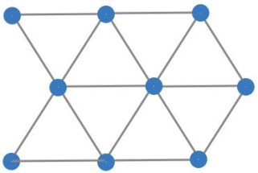
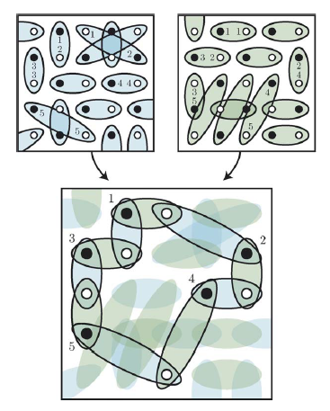
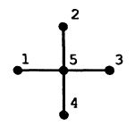
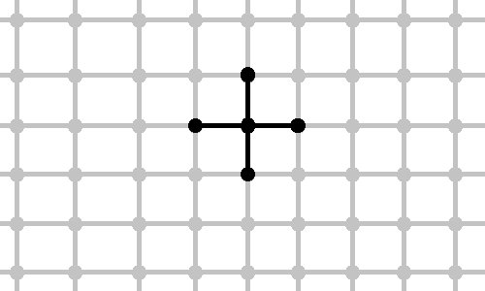

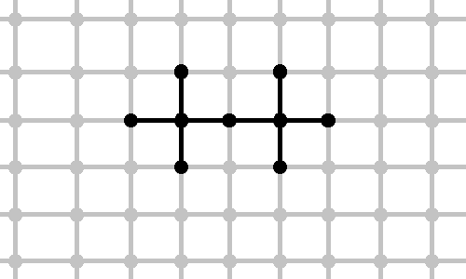




System of spins ½ with isotropic Heisenberg interaction:
density matrix parameterization, variational method, exact diagonalization
Filipp Uskov
Skoltech, Moscow State University
in collaboration with Oleg Lychkovsky and Elena Shpagina
Model
Challenge and main ideas
Hamiltonian:
<i, j> denotes neighboring sites
Scalar and mixed products of vectors of Pauli matrices:
Our challenge well known variational method
Divide full lattice to clusters:
N – number of spins in lattice
M – number of clusters
d - number of bonds per 1 spin
m – number of bonds in cluster
Schrödinger equation:
Variational method:
Squaring parameterization of density matrix [1]
Basis is overcomplete, but we can eject unwanted vectors:
- hypotesis, checked only up to 10 spins
Symbolic relations and simplifications
Algorithm which based on identity of Pauli ( )
was implemented in Wolfram Mathematica
Scalar product of matrices also was implemented in Wolfram Mathematica:
Illustration from [6]
Schrödinger equation
We take into account the symmetries of commutation of spins in cluster.
Example:
Variational method
Numeric method:
Lagrange method:
Results 1d:
cluster | E_{gs}/N >
 | -2.1547
 | -1.92789
 | -1.99486
 | -1.89083
 | -1.92853
2d:
E_{gs}/N > 3
E_{gs}/N > -2,9685
1d exact theoretical [7]: E_{gs}/N = 1 – 4 ln 2 = – 1.7725
N. Il'in, E. Shpagina, F. Uskov, O. Lychkovskiy. Squaring parametrization of constrained and unconstrained sets of quantum states. J. Phys. A: Math. Theor. 51(????):085301, 2018
R. Tarrah, R. Valenti. Exact lower bounds to the ground-state energy of spin systems: The two-dimensional S= 1/2 antiferromagnetic Heisenberg model. Physical review B , 41(13): 9611 , 1990
P. W. Anderson. Limits on the energy of the antiferromagnetic ground state. Physical Review, 83(6):1260, 1951
Tillmann Baumgratz and Martin B Plenio. Lower bounds for ground states of condensed matter systems. New Journal of Physics , 14(2): 023027, 2012
David A. Mazziotti. Variational minimization of atomic and molecular ground-state energies via the two-particle reduced density matrix. Phys.Rev.A, 65(6):062511, 2002
K.S.D. Beach, A.W. Sandvik. Some formal results for the valence bond basis. Nuclear Physics B, 750(3):142–178, 2006
Daniel C. Mattis, C. Y. Pan. Ground-State Energy of Heisenberg antiferromagnet for Spins s=1/2 and s=1 in d=1 and 2 Dimensions. Phys.Rev.Lett., 61(4): 463, 1988
Маттис. Теория магнетизма. Москва, Мир, 1967

