Slide 1
Bellman Ford Algorithm
Group 17

Slide 2
Edge Relaxation
Edge Relaxation is a technique used in graph theory to adjust the confidence or weight values of edges based on data dissemination within the graph.
It is commonly employed to find the shortest path or optimize data dissemination routes in networks by iteratively adjusting edge weights to align with the desired data distribution.
Through iterative adjustments, edge weights are tuned to better match the distribution of data in the graph, improving the reliability and efficiency of information dissemination.

Slide 3
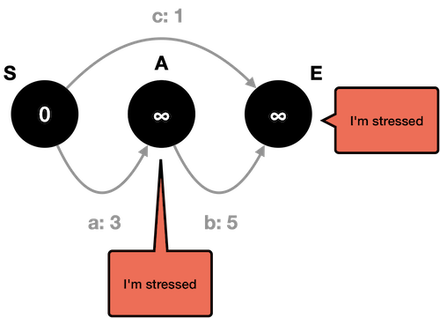

Slide 4
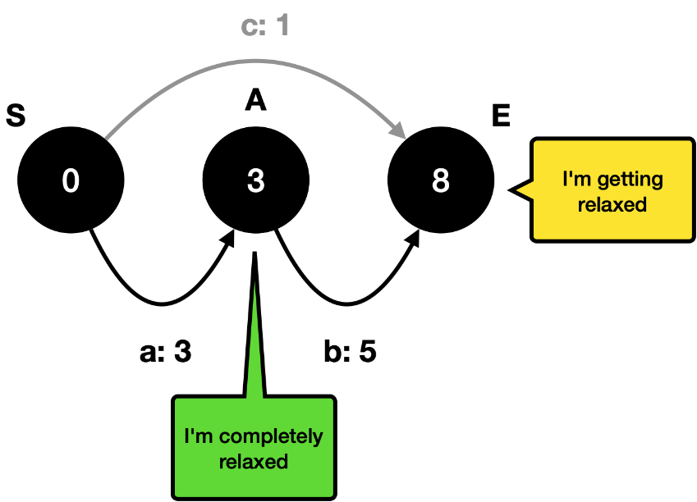

Slide 5
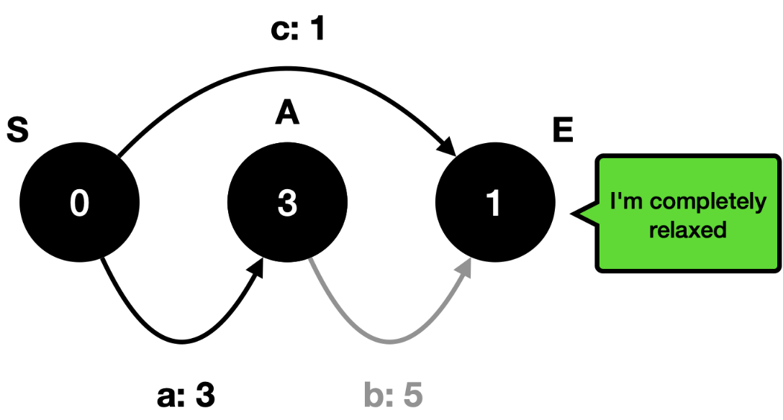

Slide 6
Bellman Ford Algorithm Details
The Bellman–Ford algorithm is an algorithm that use a edge relaxations techniques to determines shortest paths from a single source vertex to all other vertices in a weighted digraph.
As same as Dijkstra's algorithm !!!
So what is the difference between Bellman-Ford and Dijkstra's algorithm?

Slide 7
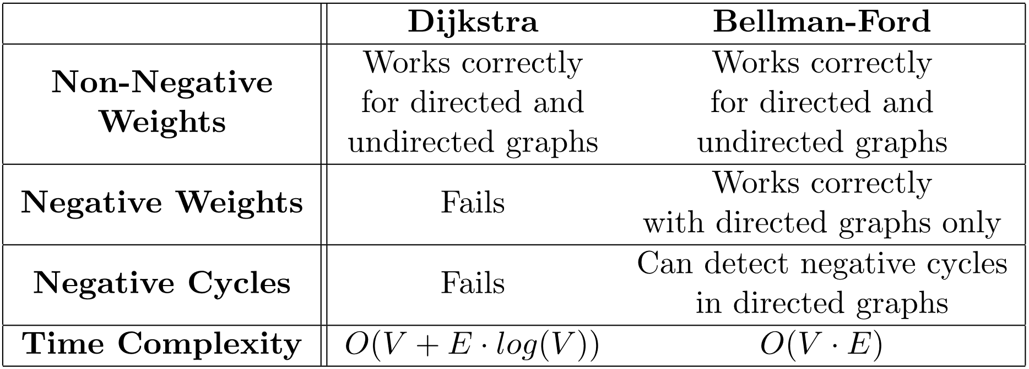
Bellman Ford vs Dijkstra's

Slide 8
Negative Weights
A
-3
C
2
S
-1
3
2
B
D
4

Slide 9
Negative Cycles
are loops in the graph that have a negative sum of weights
A
-3
C
Cycle value : -1+3-3 = -1 < 0
2
meaning that traversing the cycle reduces the total cost or distance.
S
So negative cycles make the shortest path undefined or infinite.
-1
3
2
B
D
4

Slide 10
Negative Cycles
are loops in the graph that have a negative sum of weights
A
-3
C
Cycle value : -1+3-3 = -1 < 0
2
For example, if there is a negative cycle, then you can always reduce the distance by going through the cycle one more time. Therefore, some algorithms, such as Dijkstra's algorithm, cannot handle negative cycles and may produce incorrect or inconsistent results.
S
-1
3
2
B
D
4

Slide 11
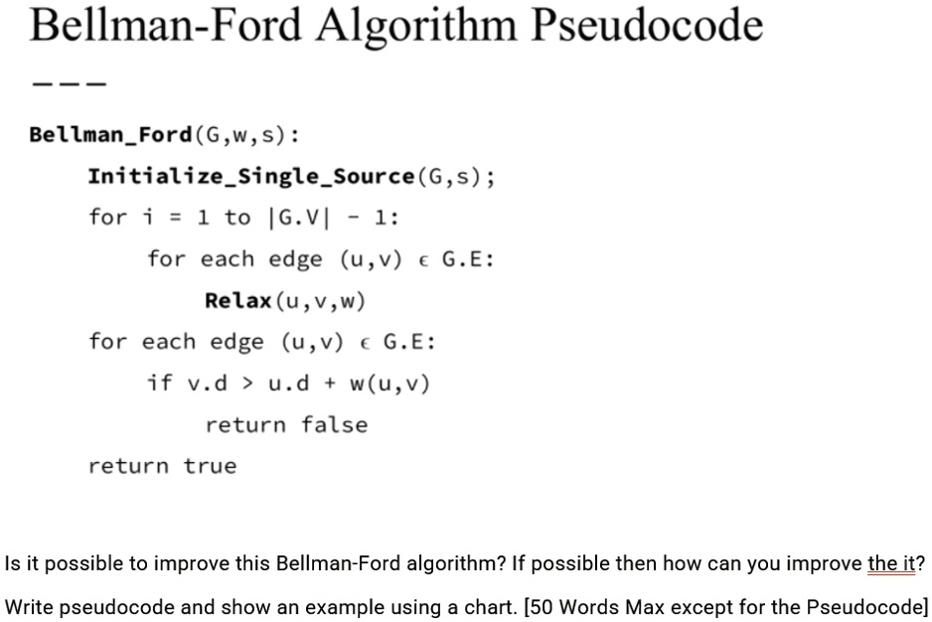

Slide 12
Edge Relaxation
No Negative Cycle

Slide 13
Initial Step
Bellman Ford Algorithm – Group 17
No Negative Cycle
A
-2
C
2
S
4
-1
5
Distance from source node(S)
S | A | B | C | D
0 | ∞ | ∞ | ∞ | ∞
-3
B
D
-4

Slide 14
Step #1
Bellman Ford Algorithm – Group 17
No Negative Cycle
A
-2
C
2
S
4
-1
5
Distance from source node(S)
S | A | B | C | D
0 | ∞ | ∞ | ∞ | ∞
-3
B
D
-4

Slide 15
Step #1
Bellman Ford Algorithm – Group 17
No Negative Cycle
A
-2
C
2
S
4
-1
5
Distance from source node(S)
S | A | B | C | D
0 | ∞ | ∞ | ∞ | ∞
-3
B
D
-4
Update Distance from source node of:
- Node A (Distance: 0+2 = 2)
- Node B (Distance: 0-3 = -3)

Slide 16
Step #1
Bellman Ford Algorithm – Group 17
No Negative Cycle
A
-2
C
2
S
4
-1
5
Distance from source node(S)
S | A | B | C | D
0 | 2 | -3 | ∞ | ∞
-3
B
D
-4
Update Distance from source node of:
- Node C (Distance: 2-2 = 0)
- Node B (Distance: 2+4 = 6) [Not update -3 < 6]

Slide 17
Step #1
Bellman Ford Algorithm – Group 17
No Negative Cycle
A
-2
C
2
S
4
-1
5
Distance from source node(S)
S | A | B | C | D
0 | 2 | -3 | 0 | ∞
-3
B
D
-4
Update Distance from source node of:
- Node C (Distance: -3-1 = -4)
- Node D (Distance: -3-4 = -7)

Slide 18
Step #1
Bellman Ford Algorithm – Group 17
No Negative Cycle
A
-2
C
2
S
4
-1
5
Distance from source node(S)
S | A | B | C | D
0 | 2 | -3 | -4 | -7
-3
B
D
-4
Update Distance from source node of:
- Node D (Distance: -4+5 = 1) [Not update 1>-7]

Slide 19
Step #1
Bellman Ford Algorithm – Group 17
No Negative Cycle
A
-2
C
2
S
4
-1
5
Distance from source node(S)
S | A | B | C | D
0 | 2 | -3 | -4 | -7
-3
B
D
-4
Update Distance from source node of:
- No update

Slide 20
Step #2
Bellman Ford Algorithm – Group 17
No Negative Cycle
A
-2
C
2
S
4
-1
5
Distance from source node(S)
S | A | B | C | D
0 | 2 | -3 | -4 | -7
-3
B
D
-4

Slide 21
Step #2
Bellman Ford Algorithm – Group 17
No Negative Cycle
A
-2
C
2
S
4
-1
5
Distance from source node(S)
S | A | B | C | D
0 | 2 | -3 | -4 | -7
-3
B
D
-4
Update Distance from source node of:
- Node A (Distance: 0+2 = 2) [Not update 2 = 2]
- Node B (Distance: 0-3 = -3) [Not update -3 = -3]

Slide 22
Step #2
Bellman Ford Algorithm – Group 17
No Negative Cycle
A
-2
C
2
S
4
-1
5
Distance from source node(S)
S | A | B | C | D
0 | 2 | -3 | -4 | -7
-3
B
D
-4
Update Distance from source node of:
- Node B (Distance: 2+4 = 6) [Not update 6 > -3]
- Node C (Distance: 2-2 = 0) [Not update 0 > -4]

Slide 23
Step #2
Bellman Ford Algorithm – Group 17
No Negative Cycle
A
-2
C
2
S
4
-1
5
Distance from source node(S)
S | A | B | C | D
0 | 2 | -3 | -4 | -7
-3
B
D
-4
Update Distance from source node of:
- Node C (Distance: -3-1 = -4) [Not update -4 = -4]
- Node D (Distance: -3-4 = -7) [Not update -7 = -7]

Slide 24
Step #2
Bellman Ford Algorithm – Group 17
No Negative Cycle
A
-2
C
2
S
4
-1
5
Distance from source node(S)
S | A | B | C | D
0 | 2 | -3 | -4 | -7
-3
B
D
-4
Update Distance from source node of:
- Node D (Distance: -4+5 = 1) [Not update 1 > -7]

Slide 25
Step #2
Bellman Ford Algorithm – Group 17
No Negative Cycle
A
-2
C
2
S
4
-1
5
Distance from source node(S)
S | A | B | C | D
0 | 2 | -3 | -4 | -7
-3
B
D
-4
Update Distance from source node of:
- No update

Slide 26
Step #3
Bellman Ford Algorithm – Group 17
No Negative Cycle
A
-2
C
2
S
4
-1
5
Distance from source node(S)
S | A | B | C | D
0 | 2 | -3 | -4 | -7
-3
B
D
-4

Slide 27
Step #3
Bellman Ford Algorithm – Group 17
No Negative Cycle
A
-2
C
2
S
4
-1
5
Distance from source node(S)
S | A | B | C | D
0 | 2 | -3 | -4 | -7
-3
B
D
-4
Update Distance from source node of:
- Node A (Distance: 0+2 = 2) [Not update 2 = 2]
- Node B (Distance: 0-3 = -3) [Not update -3 = -3]

Slide 28
Step #3
Bellman Ford Algorithm – Group 17
No Negative Cycle
A
-2
C
2
S
4
-1
5
Distance from source node(S)
S | A | B | C | D
0 | 2 | -3 | -4 | -7
-3
B
D
-4
Update Distance from source node of:
- Node B (Distance: 2+4 = 6) [Not update 6 > -3]
- Node C (Distance: 2-2 = 0) [Not update 0>-4]

Slide 29
Step #3
Bellman Ford Algorithm – Group 17
No Negative Cycle
A
-2
C
2
S
4
-1
5
Distance from source node(S)
S | A | B | C | D
0 | 2 | -3 | -4 | -7
-3
B
D
-4
Update Distance from source node of:
- Node C (Distance: -3-1 = -4) [Not update -4 = -4]
- Node D (Distance: -3-4 = -7) [Not update -7 = -7]

Slide 30
Step #3
Bellman Ford Algorithm – Group 17
No Negative Cycle
A
-2
C
2
S
4
-1
5
Distance from source node(S)
S | A | B | C | D
0 | 2 | -3 | -4 | -7
-3
B
D
-4
Update Distance from source node of:
- Node D (Distance: -4+5 = 1) [Not update 1 > -7]

Slide 31
Step #3
Bellman Ford Algorithm – Group 17
No Negative Cycle
A
-2
C
2
S
4
-1
5
Distance from source node(S)
S | A | B | C | D
0 | 2 | -3 | -4 | -7
-3
B
D
-4
Update Distance from source node of:
- No update

Slide 32
Step #4
Bellman Ford Algorithm – Group 17
No Negative Cycle
A
-2
C
2
S
4
-1
5
Distance from source node(S)
S | A | B | C | D
0 | 2 | -3 | -4 | -7
-3
B
D
-4

Slide 33
Step #4
Bellman Ford Algorithm – Group 17
No Negative Cycle
A
-2
C
2
S
4
-1
5
Distance from source node(S)
S | A | B | C | D
0 | 2 | -3 | -4 | -7
-3
B
D
-4
Update Distance from source node of:
- Node A (Distance: 0+2 = 2) [Not update 2 = 2]
- Node B (Distance: 0-3 = -3) [Not update -3 = -3]

Slide 34
Step #4
Bellman Ford Algorithm – Group 17
No Negative Cycle
A
-2
C
2
S
4
-1
5
Distance from source node(S)
S | A | B | C | D
0 | 2 | -3 | -4 | -7
-3
B
D
-4
Update Distance from source node of:
- Node B (Distance: 2+4 = 6) [Not update 6 > -3]
- Node C (Distance: 2-2 = 0) [Not update 0 > -4]

Slide 35
Step #4
Bellman Ford Algorithm – Group 17
No Negative Cycle
A
-2
C
2
S
4
-1
5
Distance from source node(S)
S | A | B | C | D
0 | 2 | -3 | -4 | -7
-3
B
D
-4
Update Distance from source node of:
- Node C (Distance: -3-1 = -4) [Not update -4 = -4]
- Node D (Distance: -3-4 = -7) [Not update -7 = -7]

Slide 36
Step #4
Bellman Ford Algorithm – Group 17
No Negative Cycle
A
-2
C
2
S
4
-1
5
Distance from source node(S)
S | A | B | C | D
0 | 2 | -3 | -4 | -7
-3
B
D
-4
Update Distance from source node of:
- Node D (Distance: -4+5 = 1) [Not update 1 > -7]

Slide 37
Step #4
Bellman Ford Algorithm – Group 17
No Negative Cycle
A
-2
C
2
S
4
-1
5
Distance from source node(S)
S | A | B | C | D
0 | 2 | -3 | -4 | -7
-3
B
D
-4
Update Distance from source node of:
- No update

Slide 38
Conclusion
Bellman Ford Algorithm – Group 17
No Negative Cycle
A
-2
C
Distance from source node(S)
S | A | B | C | D
0 | 2 | -3 | -4 | -7
2
This graph not contain negative cycles.
S
4
-1
5
For every edges in this graph (u, v)
If some edges have
distance of u + weight of (u, v)
less than distance of v
then that graph contains negative cycles.
-3
B
D
-4

Slide 39
Edge Relaxation
Negative Cycle

Slide 40
Initial Step
Bellman Ford Algorithm – Group 17
Negative Cycle
A
-3
C
2
S
-1
3
2
Distance from source node(S)
S | A | B | C | D
0 | ∞ | ∞ | ∞ | ∞
B
D
4

Slide 41
Step #1
Bellman Ford Algorithm – Group 17
Negative Cycle
A
-3
C
2
S
-1
3
2
Distance from source node(S)
S | A | B | C | D
0 | ∞ | ∞ | ∞ | ∞
B
D
4
Update Distance from source node of:
- Node A (Distance: 0+2 = 2)

Slide 42
Step #1
Bellman Ford Algorithm – Group 17
Negative Cycle
A
-3
C
2
S
-1
3
2
Distance from source node(S)
S | A | B | C | D
0 | 2 | ∞ | ∞ | ∞
B
D
4
Update Distance from source node of:
- Node B (Distance: 2-1 = 1)

Slide 43
Step #1
Bellman Ford Algorithm – Group 17
Negative Cycle
A
-3
C
2
S
-1
3
2
Distance from source node(S)
S | A | B | C | D
0 | 2 | 1 | ∞ | ∞
B
D
4
Update Distance from source node of:
- Node C (Distance: 1+3 = 4)
- Node D (Distance: 1+4 = 5)

Slide 44
Step #1
Bellman Ford Algorithm – Group 17
Negative Cycle
A
-3
C
2
S
-1
3
2
Distance from source node(S)
S | A | B | C | D
0 | 2 | 1 | 4 | 5
B
D
4
Update Distance from source node of:
- Node A (Distance: 4-3 = 1)
- Node D (Distance: 4+2 = 6) [Not update 6 > 5]

Slide 45
Step #1
Bellman Ford Algorithm – Group 17
Negative Cycle
A
-3
C
2
S
-1
3
2
Distance from source node(S)
S | A | B | C | D
0 | 1 | 1 | 4 | 5
B
D
4
Update Distance from source node of:
- No update

Slide 46
Step #2
Bellman Ford Algorithm – Group 17
Negative Cycle
A
-3
C
2
S
-1
3
2
Distance from source node(S)
S | A | B | C | D
0 | 1 | 1 | 4 | 5
B
D
4

Slide 47
Step #2
Bellman Ford Algorithm – Group 17
Negative Cycle
A
-3
C
2
S
-1
3
2
Distance from source node(S)
S | A | B | C | D
0 | 1 | 1 | 4 | 5
B
D
4
Update Distance from source node of:
- Node A (Distance: 0+2 = 2) [Not update 2 > 1]

Slide 48
Step #2
Bellman Ford Algorithm – Group 17
Negative Cycle
A
-3
C
2
S
-1
3
2
Distance from source node(S)
S | A | B | C | D
0 | 1 | 1 | 4 | 5
B
D
4
Update Distance from source node of:
- Node B (Distance: 1-1 = 0)

Slide 49
Step #2
Bellman Ford Algorithm – Group 17
Negative Cycle
A
-3
C
2
S
-1
3
2
Distance from source node(S)
S | A | B | C | D
0 | 1 | 0 | 4 | 5
B
D
4
Update Distance from source node of:
- Node C (Distance: 0+3 = 3)
- Node D (Distance: 0+4 = 4)

Slide 50
Step #2
Bellman Ford Algorithm – Group 17
Negative Cycle
A
-3
C
2
S
-1
3
2
Distance from source node(S)
S | A | B | C | D
0 | 1 | 0 | 3 | 4
B
D
4
Update Distance from source node of:
- Node A (Distance: 3-3 = 0)
- Node D (Distance: 3+2 = 5) [Not update 5 > 4]

Slide 51
Step #2
Bellman Ford Algorithm – Group 17
Negative Cycle
A
-3
C
2
S
-1
3
2
Distance from source node(S)
S | A | B | C | D
0 | 0 | 0 | 3 | 4
B
D
4
Update Distance from source node of:
- No update

Slide 52
Step #3
Bellman Ford Algorithm – Group 17
Negative Cycle
A
-3
C
2
S
-1
3
2
Distance from source node(S)
S | A | B | C | D
0 | 0 | 0 | 3 | 4
B
D
4

Slide 53
Step #3
Bellman Ford Algorithm – Group 17
Negative Cycle
A
-3
C
2
S
-1
3
2
Distance from source node(S)
S | A | B | C | D
0 | 0 | 0 | 3 | 4
B
D
4
Update Distance from source node of:
- Node A (Distance: 0+2 = 2) [Not update 2 > 0]

Slide 54
Step #3
Bellman Ford Algorithm – Group 17
Negative Cycle
A
-3
C
2
S
-1
3
2
Distance from source node(S)
S | A | B | C | D
0 | 0 | 0 | 3 | 4
B
D
4
Update Distance from source node of:
- Node B (Distance: 0-1 = -1)

Slide 55
Step #3
Bellman Ford Algorithm – Group 17
Negative Cycle
A
-3
C
2
S
-1
3
2
Distance from source node(S)
S | A | B | C | D
0 | 0 | -1 | 3 | 4
B
D
4
Update Distance from source node of:
- Node C (Distance: -1+3 = 2)
- Node D (Distance: -1+4 = 3)

Slide 56
Step #3
Bellman Ford Algorithm – Group 17
Negative Cycle
A
-3
C
2
S
-1
3
2
Distance from source node(S)
S | A | B | C | D
0 | 0 | -1 | 2 | 3
B
D
4
Update Distance from source node of:
- Node A (Distance: 2-3 = -1)
- Node D (Distance: 2+2 = 4) [Not update 4 > 3]

Slide 57
Step #3
Bellman Ford Algorithm – Group 17
Negative Cycle
A
-3
C
2
S
-1
3
2
Distance from source node(S)
S | A | B | C | D
0 | -1 | -1 | 2 | 3
B
D
4
Update Distance from source node of:
- No update

Slide 58
Step #4
Bellman Ford Algorithm – Group 17
Negative Cycle
A
-3
C
2
S
-1
3
2
Distance from source node(S)
S | A | B | C | D
0 | -1 | -1 | 2 | 3
B
D
4

Slide 59
Step #4
Bellman Ford Algorithm – Group 17
Negative Cycle
A
-3
C
2
S
-1
3
2
Distance from source node(S)
S | A | B | C | D
0 | -1 | -1 | 2 | 3
B
D
4
Update Distance from source node of:
- Node A (Distance: 0+2 = 2) [Not update 2 > -1]

Slide 60
Step #4
Bellman Ford Algorithm – Group 17
Negative Cycle
A
-3
C
2
S
-1
3
2
Distance from source node(S)
S | A | B | C | D
0 | -1 | -1 | 2 | 3
B
D
4
Update Distance from source node of:
- Node B (Distance: -1-1 = -2)

Slide 61
Step #4
Bellman Ford Algorithm – Group 17
Negative Cycle
A
-3
C
2
S
-1
3
2
Distance from source node(S)
S | A | B | C | D
0 | -1 | -2 | 2 | 3
B
D
4
Update Distance from source node of:
- Node C (Distance: -2+3 = 1)
- Node D (Distance: -2+4 = 2)

Slide 62
Step #4
Bellman Ford Algorithm – Group 17
Negative Cycle
A
-3
C
2
S
-1
3
2
Distance from source node(S)
S | A | B | C | D
0 | -2 | -2 | 1 | 2
B
D
4
Update Distance from source node of:
- Node A (Distance: 1-3 = -2)
- Node D (Distance: 1+2 = 3) [Not update 3 > 3]

Slide 63
Step #4
Bellman Ford Algorithm – Group 17
Negative Cycle
A
-3
C
2
S
-1
3
2
Distance from source node(S)
S | A | B | C | D
0 | -2 | -2 | 1 | 2
B
D
4
Update Distance from source node of:
- No update

Slide 64
Conclusion
Bellman Ford Algorithm – Group 17
Negative Cycle
A
-3
C
Distance from source node(S)
S | A | B | C | D
0 | -2 | -2 | 1 | 2
2
This graph contain negative cycles.
S
-1
3
2
For every edges in this graph (u, v)
If some edges have
distance of u + weight of (u, v)
less than distance of v
then that graph contains negative cycles.
B
D
4
At edges (A, B)
Distance of A + weight of (A, B)
less than distance of B
[-2 + -1 < -2]

