Slide 1
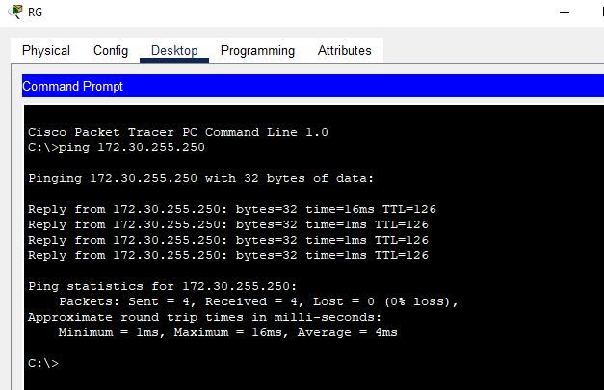
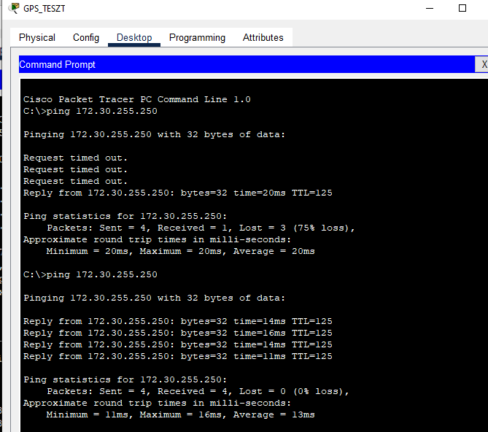
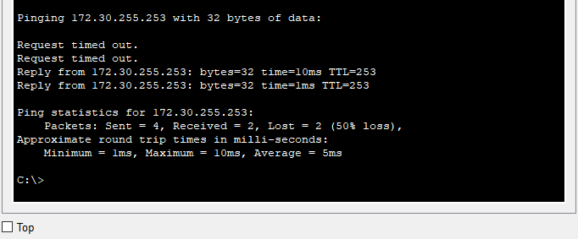

Slide 2
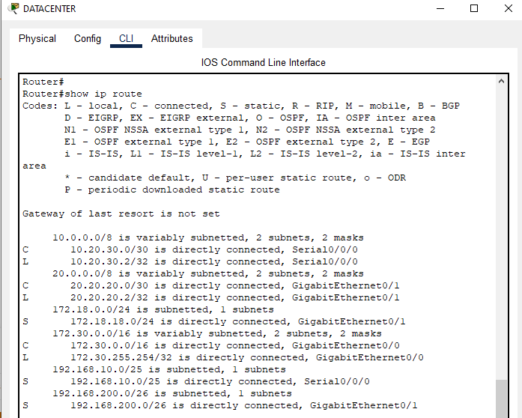
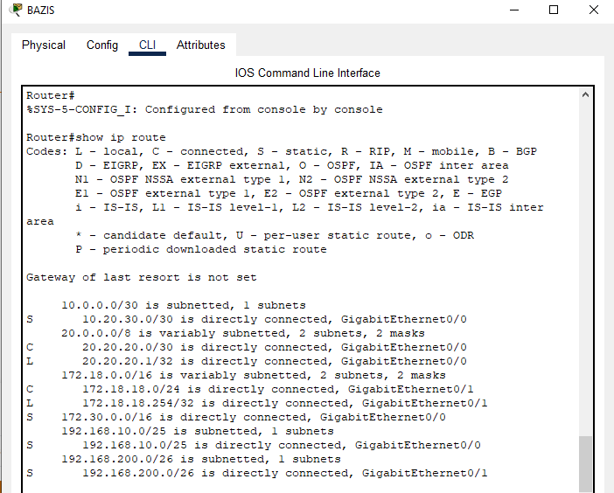
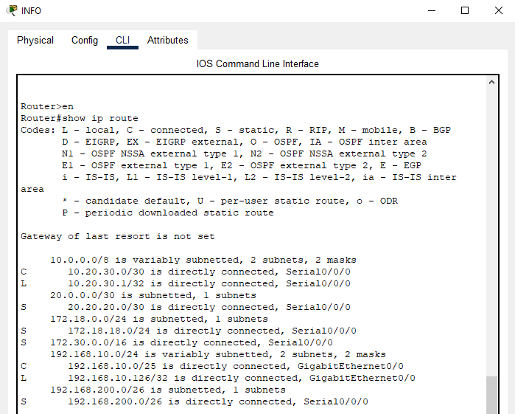

Slide 3
!
version 15.1
no service timestamps log datetime msec
no service timestamps debug datetime msec
no service password-encryption
!
hostname Router
!
!
!
enable password informatika
no ip cef
no ipv6 cef
!
!
!
username info
license udi pid CISCO1941/K9 sn FTX1524SJ2J-
spanning-tree mode pvst
interface GigabitEthernet0/0
ip address 172.30.255.254 255.255.0.0
duplex auto
speed auto
!
interface GigabitEthernet0/1
ip address 20.20.20.2 255.255.255.252
duplex auto
speed auto
!
interface Serial0/0/0
ip address 10.20.30.2 255.255.255.252
!
interface Serial0/0/1
no ip address
clock rate 2000000
shutdown
!
interface GigabitEthernet0/1/0
no ip address
shutdown
!
interface Vlan1
no ip address
shutdown
!
ip classless
ip route 192.168.10.0 255.255.255.128 Serial0/0/0
ip route 172.18.18.0 255.255.255.0 GigabitEthernet0/1
ip route 192.168.200.0 255.255.255.192 GigabitEthernet0/1
!
ip flow-export version 9
!
!
!
!
!
!
!
line con 0
!
line aux 0
!
line vty 0 4
password informatika
login local
line vty 5 15
password informatika
login local
!
!
!
end

