Slide 1
INFO6023 – Gems
Week 5:
LOD (Level of Detail)

Slide 2
Larger model LOD
What if you have a single large model, like Hogwarts or the Death Star?
You could:
Divide the object into large parts and store various LODs of those parts
Store information of what parts you can see from what location – if you are in a room of Hogwarts, you can only see “these” other parts, for instance

Slide 3
Terrain and other continuous things
We are often very near the surface
Do very distant terrain mesh isn’t visible at that distance.
BUT the mesh nearest to us IS at high res.

Slide 4
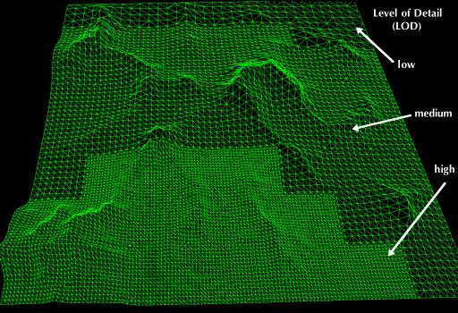
Terrain and other continuous things
Geo MipMapping and variations
https://gengamedev.blogspot.com/2009/03/real-time-terrain-with-geo-mipmapping.html

Slide 5
Terrain and other continuous things
ROAM:
https://en.wikipedia.org/wiki/ROAM
https://www.osti.gov/servlets/purl/632827

Slide 6
L-Systems
It’s also a form of compression where you store the information in some “short-hand”
https://en.wikipedia.org/wiki/L-system

