Slide 1
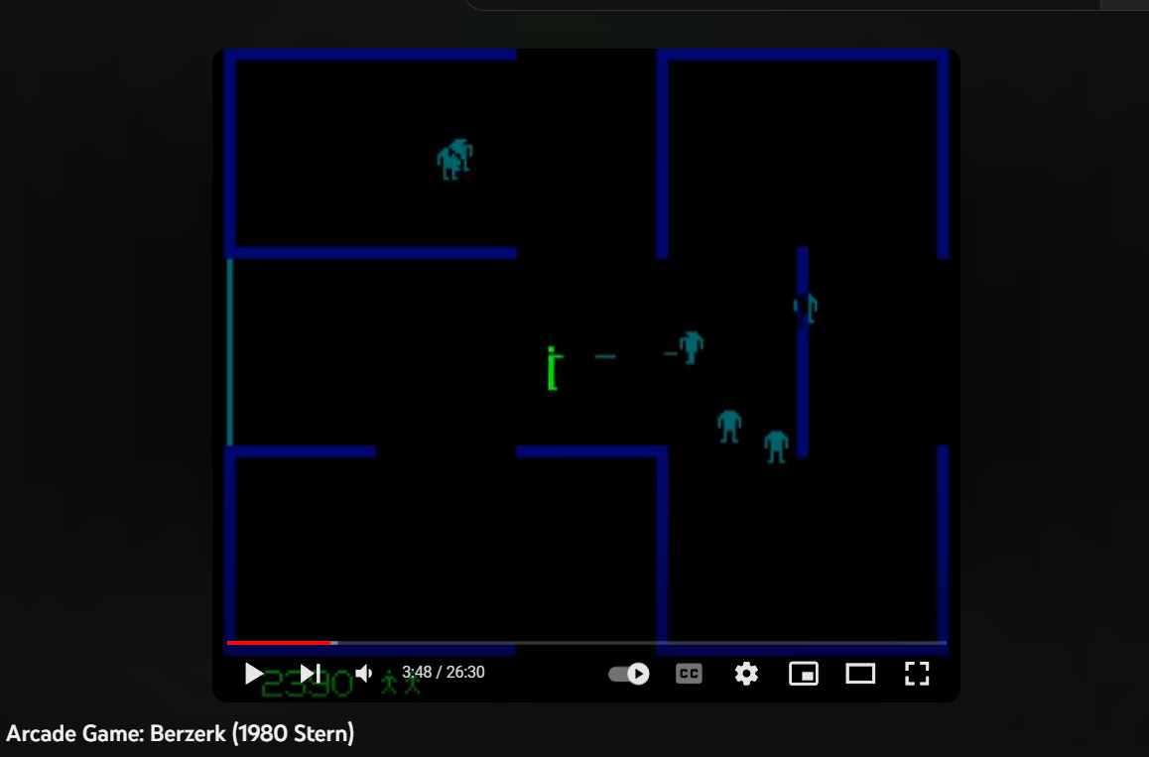
player
robots
Walls
Bullet
Animation

