Slide 1
INFO6019 Physics & Simulation 1
Day 2: Numerical robustness

Slide 2
Numbers, etc.
Many people think computers are amazing. I do.
And many people think that computers store numbers in the same way that you or I do
But they don’t.
Normally this isn’t a Big Freaking Deal
But for us, as game developers, it is.
Why?
Well, we’ll see

Slide 3
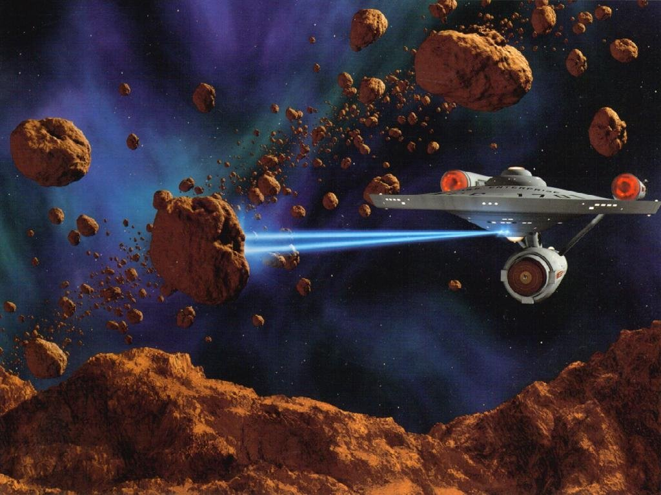
Plan for today (and point)
But I hate Star Trek…

Slide 4
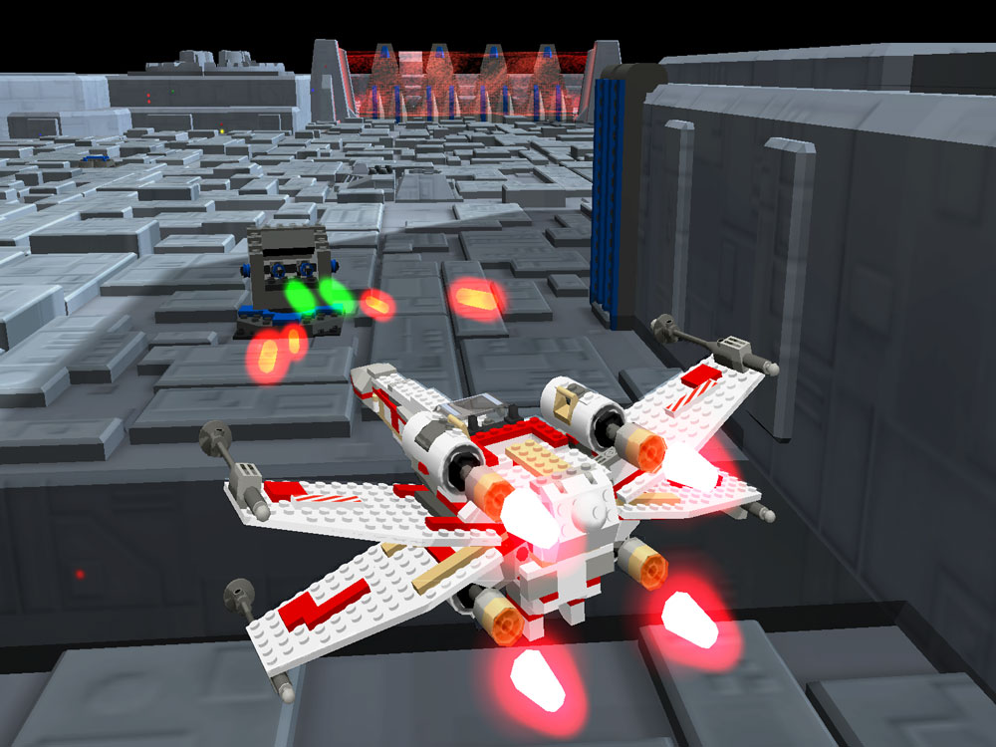
Plan for today (and point)
Fine.

Slide 5
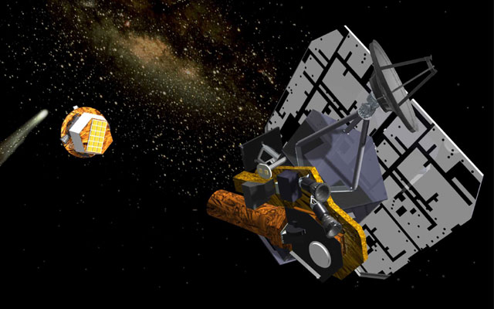
Plan for today (and point)
Or this...

Slide 6
Plan for today (and point)
We are going to create a program to:
Demonstrate some of the problems with math on the computer
Then we are going to fix it
We’re going to simulate “shooting” something deep into space and attempting to “hit” something
Hence the cool pictures involving space, space ships, projectiles, and hitting stuff…

Slide 7
Numbers on the computer
Integer
Floating point (decimal)
Perhaps some other (like “Currency” in .NET), or you could make your own (like BigNumber class)
No matter what we pick, we have some nasty trade-offs unless we are very careful
And, that’s just “the way it is.”
i.e. There’s no “magic” way around it; it’s just part of the way modern computer work, and it’s not likely to change in the near future (if ever)

Slide 8
Numbers on the computer
Integers:
Precise (that’s good)
Limited range (that’s potentially bad)
Specified as number of bits (power of 2)
Number of bits needed = log(YerRange)/log(2)
8 bits ➔ 256 (-128 to +127) ... 0 to 255
16 bits ➔ 64,000
32 bits ➔ 4 billion (-2 billion to 2 billion)
64 bits ➔ 4 billion * 4 billion = 16 billion billion
128 bits ➔ 3.4028236692093846346337460743177e+38

Slide 9
Floating point (float and double):
Virtually all computers nowadays use the IEEE-745 floating point format
A “float” is a 32-bit value
with a range from about 1x10⁻³⁸ to 1x10³⁸
A “double” is at least 64-bit value
With a range from about 1x10⁻³⁰⁸ to 1x10³⁰⁸
“double” can also be 80 bit representation (x87)
Note that there’s negatives too, of course.

Slide 10
Limits:
Now those are pretty freaking big
Even if you had 1x10³⁸ pennies, you’d be rich.
Really rich. There isn’t that much money on Earth!
And 1x10³⁰⁸ is possibly bigger than the number of atoms in the universe (did someone count them?).
But, as Peter Parker’s uncle said: “With great power comes great responsibility.”
(Peter Parker is Spiderman. Shhhh, don’t tell anyone.)

Slide 11
Problems:
The main problem is that floating point numbers are not accurate, they are approximate.
Now, they can be completely accurate, but only for very specific, certain numbers.
Like 1.0, for example. That’s accurate.
Most other numbers aren’t.
And that’s an understatement... ... they are wildly inaccurate in fact

Slide 12
Other types:
Even using floats for a person’s bank account can be dangerous.
For the average person, a float may be precise and accurate enough.
But what about Bill Gates?
And what about the Gross National Product of China?
The distance between the Earth and the Moon
...in km? What about in centimeters?
What about shooting a bird into a house to kill a pig?

Slide 13
Other types:
So there are other types, which have arbitrary precision and arbitrary range
But, they are implemented in software, so they are slow, likely very, very, very slow compared with the “built in” (hardware) numbers
But, that’s the cost you have
These are no good for games (usually, unless it’s a game that doesn’t “care” about performance).

Slide 14
Why do you care?
Because simulation code tends to not be very happy when we deal with approximations.
And you are dealing with approximations when you use floating point.
Again, that’s just The Way It Is.
Sorry.

Slide 15
Overview of IEEE-754
Also note that there is WAY more “precision” than “range” (in terms of number of digits)
32 bit (aka “float”)
Sign (1 bit)
Exponent (8 bits)
Fraction (23 bits)
64 bit (aka “double”)
Sign (1 bit)
Exponent (11 bits)
Fraction (52 bits)
The numbers are stored in a sort of “scientific” format, like 1.16473 x 10⁴⁵
Note that the exponent controls precision (number of digits), but the fraction controls range (smallness and bigness of the number)

Slide 16
Hold on there...
Exponent controls “precision” (accuracy)?
How’s that work? What do you mean by that?
Well, which is more precise?
1.16473 x 10¹
1.16473 x 10¹⁰
1.16473 x 10⁴⁵

Slide 17
Inaccurate to begin with
Also note that, since the “Fraction” portion is being stored as a binary number, and it can’t represent (accurately) all numbers.
This is the case with regular, base-10 numbers:
Represent 1/3?
Represent ¶ (pi) (and irrational number)?
It’s impossible

Slide 18
Accuracy vs. Precision
Accuracy = how close the actual number it is
Precise = how many reliable digits you give
Example:
3.141
3.1829388345
Note that the first example is actually more “accurate” (i.e. more correct), even though it’s far less “precise.”
More accurate
More precise (but less accurate)

Slide 19
Other problems with floating point
Representation error:
Basically accuracy of the number
Overflow and Underflow
When numbers go outside (too big or too small) of the range that can be represented
Round-off
When subsequent truncations or rounding build up
Digit-cancellation
When working with very big with very small numbers
“Adding a drop of water to the ocean”
Input errors:
Based on inaccuracy of measurements or input data

Slide 20
Not all numbers of equal
With “real” numbers (and integers), the number of numbers between two numbers is equal
Huh? Wait for it.
This isn’t the case with floating point
Floating point has more numbers closer to zero, and has fewer numbers as you move farther away.
i.e. the accuracy of the number decreases as you move away from zero.

Slide 21
Not all numbers of equal
0
Regular number line
0
Floating point
Notice that there are more numbers, so a greater potential accuracy nearer to zero.

Slide 22
Comparisons
Since float (or double) numbers aren’t necessarily accurate, you can’t compare them for equality.
Note that “==“ will work, but after some calculations, then numbers will almost never be “equal.”
So DON’T use “==“ for floating point. Ever.
Use epsilons
Use comparisons

Slide 23
NaN and Infinity
Infinity (and –Infinity) are defined for certain cases:
Going over range (too big)
Certain operations ( number / really small number)
NaN (“not a number”) happens when the number doesn’t make sense (mathematically), or can’t be represented
Division by Zero for example
Operations involving other NaN

Slide 24
Comparison gotchas!
Note:
If ( (val < min) || (val > max) ) return true;
Won’t work if one of these is a NaN
This will:
If ( (val >= min) && (val <= max) ) return true;

Slide 25
Comparisons and epsilon
Instead of comparing for equality, compare by a tolerance, or “epsilon”
If ( abs(x – y) <= epsilon ) then “they’re equal”
But there’s a potential problem there
Since the numbers “get bigger” as you move away from zero, the epsilon may have to get bigger, too
However, there are other ways around this
Because comparing with a constant epsilon is “best”

Slide 26
Double vs. Float
But I’ll just use doubles!! That will “fix it”!!!
Sometimes you can’t (PS3, most shaders)
Note: shaders also have half-precision (16 bit FP), which are 2x the speed, approximately
Doubles are slower (potentially)
Will still cause problems, just “later”
As we’ll see…

Slide 27
The “artillery” game (aka “Angry Birds”)
How is the cannon ball path calculated?
By an equation (“continuous”)?
By little steps, each based on last step (“discrete”)?

Slide 28
Discrete (vs. continuous):
We could use a “continuous” math (aka “an equation”) to calculate position, etc.
It would be repeatable and accurate...
...but that’s not how (most) game simulations work.
They are discrete.
In other words, in the artillery game, we would advance our shell one “step” in time, updating the position of the shell in space.
we would never have an absolute, continuous (and therefore accurate) function

Slide 29
Today (1 of 7):
It’s Battlestar Galactica time!
In the show (either one), the “Vipers” (the little fighter ships) land on the Galactica all the time
You are going to simulate this numerically, specifically, you are going to simulate a Viper, on auto-pilot, landing in the landing bay.
Here’s a clip (not from the movie; the landing is about a minute in...): http://www.youtube.com/watch?v=T0l0ZlK9KBo

Slide 30
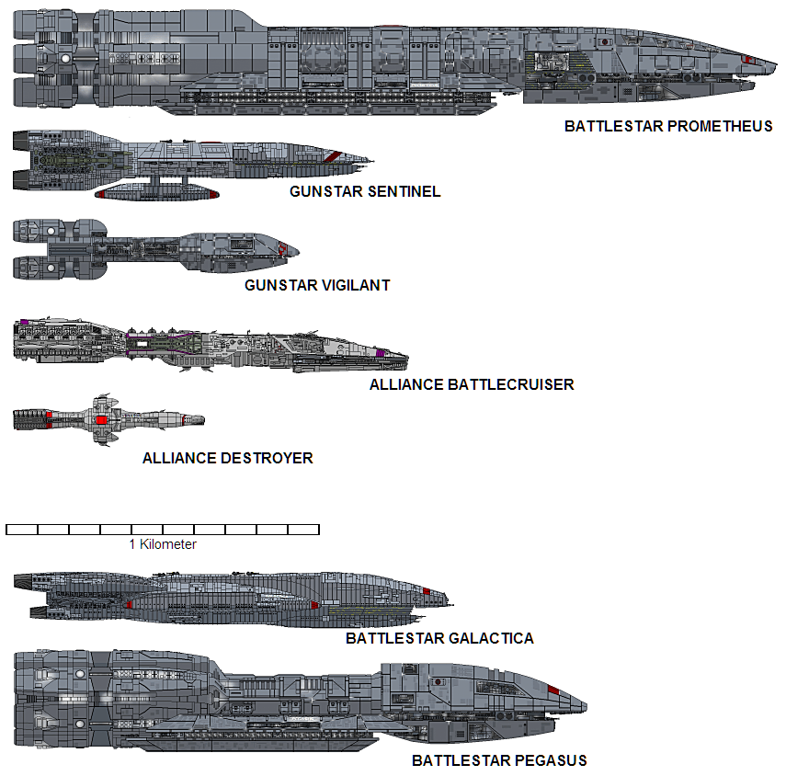
Today (2 of 7):
The sizes (from http://i49.photobucket.com/albums/f252/CanisD/Shipyard/Board/Prom_Size.png):
This means that the Galactica is about 1300 meters (or so).
The Viper is much smaller, something like 6 meters long (?)

Slide 31
Today (3 of 7):
To simplify things, we are going to assume:
The Viper is just a point (x,y, and z)
It can move in any direction at any time
The Galactica landing bay is simplified by a box (length, width, and height) located at a certain location in space; the Viper needs to get inside this box, at some minimum distance from the “bottom” (say 0.5 meters), to “land”
Assume the Galactica is at the origin (0,0,0) – note that the landing bay won’t be at the origin... (see picture)
The Viper should be some distance away, say 5-10 km away
Remember that the Galactica is supposed to be 1.3 km long(!)
BUT, you have to pick a random location for the Viper

Slide 32
Today (4 of 7):
The simulation is going to be a loop:
the position of the Viper is going to up updated by a certain amount (based on “speed,” so X m/s)
At each step, check to see if we have “landed” yet
When we’ve landed, stop.
Print out the position of the Viper at each step

Slide 33
Today (5 of 7):
You have a number of design problems
How “fast” does the Viper have to go each step?
Remember, this is supposed to be part of an interactive game. Looking at the video, are you measuring in km? Meters? Centimeters? Millimetres? Parsecs?
To simplify, let’s say that you are measuring in meters... ...and you want to know the position in at least cm (for landing, when you are going really slowly... hopefully)
Is it going in the right direction? How can you tell?
Should you just “shoot” the Viper in the right direction, or should you adjust the speed as we get closer?

Slide 34

BUT WAIT! THERE’S MORE!!!
Pay attention, this is serious stuff. Just look at my face:
Serious.

Slide 35
Today (6 of 7):
Now that you so proud of yourself, things are going to get very bad...
The Galactica isn’t going to be at the origin
Let’s say that we are just going to simulate our solar system, with the Sun at the origin
The Galactica is tough, but not tough enough to sit at the centre of the sun. Plus that would be bad for the crew...
You need to place the Galactica in orbit around one of the planets. Pick one.

Slide 36
Today (7 of 7):
Here’s a link for planetary distances in our solar system:
http://curious.astro.cornell.edu/question.php?number=564
If it is easier, you can assume that the simulation is only 2D
So only x & y, and not x, y, and z
Place the Viper... anywhere.
If you place it really far away from the Galactica, your simulation will just take longer.
Now run the simulation...
Evil laugh...

Slide 37
Some things to think about...
If you increase the speed of the viper (each step moves the viper further):
The time to land decreases...
...but the accuracy also decreases
If it’s too big, then you overshoot the Galactica entirely
Does it matter where the Galactica is?
In other words, what happens when the Galactica is near the Sun vs. far away, like at Jupiter?
Can you even tell if you’ve landed the Viper?
What do I mean by this?

Slide 38
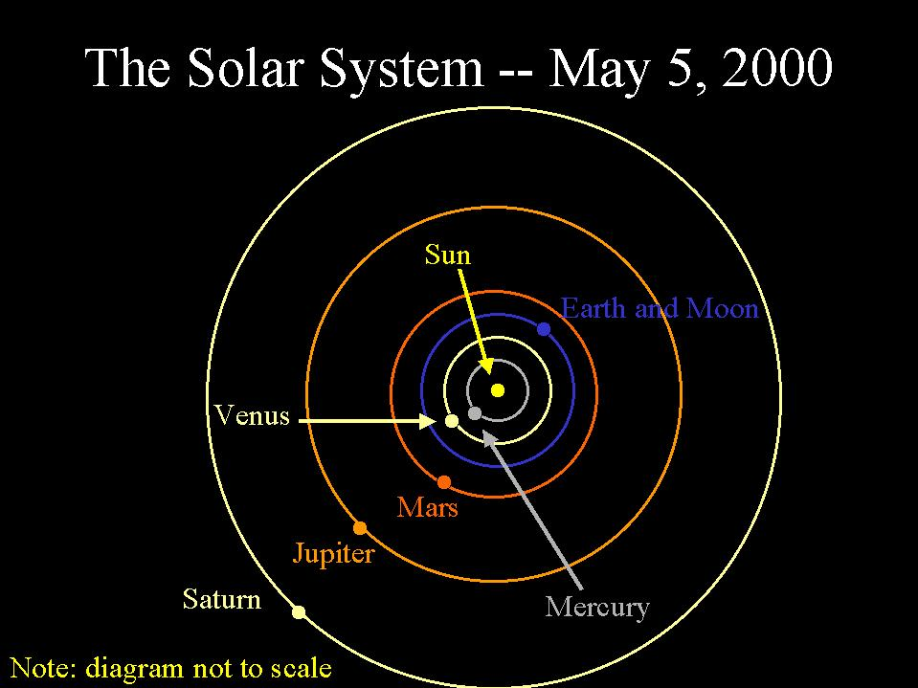

Slide 39
“Project” clarification
To simplify the simulation, you could just print out the position and/or distance every so often (like every 1000 steps or whatever).
Keep in mind that the Viper is going to “fly” around 6 billion km at some “reasonable” speed, then slow down to “land”
i.e. You aren’t going to land on the Galactica at the same speed as the New Horizons or June spacecraft (you’d be a “splat” on the landing deck!)
This “assignment” isn’t “due”. It’s “homework”.
i.e. I won’t be “marking” it.

Slide 40

Farnsworth?
Oh my, is that all there is? Too bad.

