Slide 1
Deferred rendering

Slide 2
What’s the issue?
Each pixel going to the fragment shader must be “processed”
It might be blocked through the depth buffer
But it still has to be sent through the pipeline
But it likely won’t be (or we can’t control it), so worst case, a LOT of pixels are calculated (i.e. the lighting is calculated) and then discarded (blocked by other geometry)

Slide 3
Some simple things
Divide the scene into parts and control what lights are being used in what parts (and control the order the geometry is drawn)
Complicated to set this up
There’s a limit to how much better

Slide 4
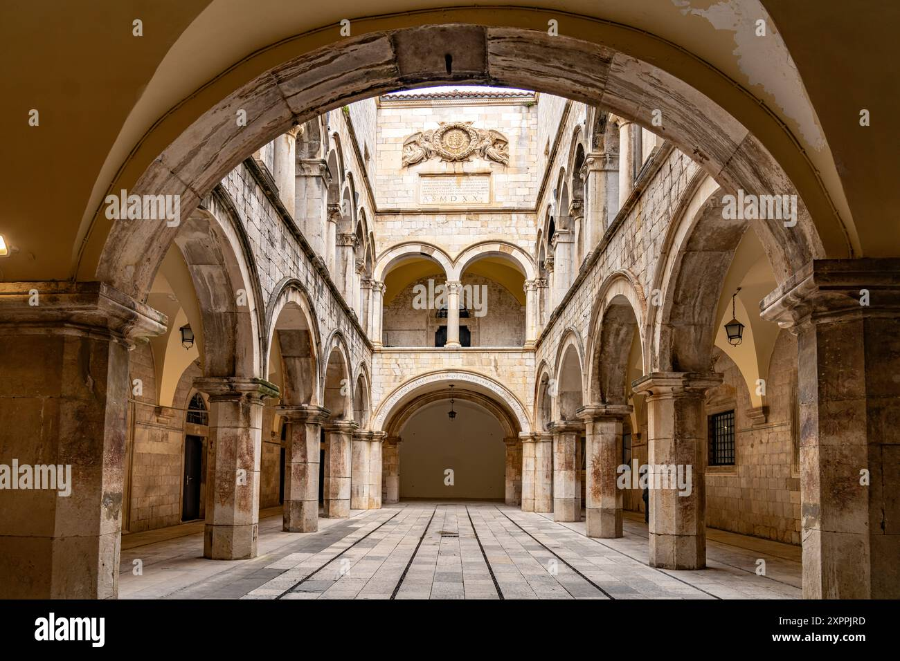
In this case, we could limit the distance the light goes, but that won’t really work for a light like this – what distance do we set?

Slide 5
Lights & Geometry
The more triangles we have, the longer it will take to process the scene.
The more lights we have, the longer it will take to process the scene.
Total time = #lights * #vertices
Vertices: 1,000,000
Lights from 10 to 20:

Slide 6
Couple general solutions
Deferred rendering (really: deferred lighting)
Forward+
Both of these essentially this interplay between lights and geometry
Deferred:
Instead of cost = lights * vertices
We have cost: lights + vertices

Slide 7
Doom 3 had something like this
Only calculate lighting on the “closest 3 lights”
This explains both how it looks so good (remember this was 2003) and how it could perform so well
BUT, how do you “calculate the closest 3 lights??”
They key is to limit the number of lights, specifically lights that don’t contribute anything

Slide 8
Deferred Rendering
2 passes
One writes to the “geometry buffer” (G buffer)
Vertex location
Vertex normal
Colours Lambertian (diffuse colours, essentially)
Other things (specular, whatever
2nd pass:
Run the regular lighting calculation, but using these values in the G buffer, NOT the original vertex information
The amount of geometry is tied to the size of the G buffer
So, if it’s 1920x1080 → then that’s the number of vertices (2 million)

Slide 10
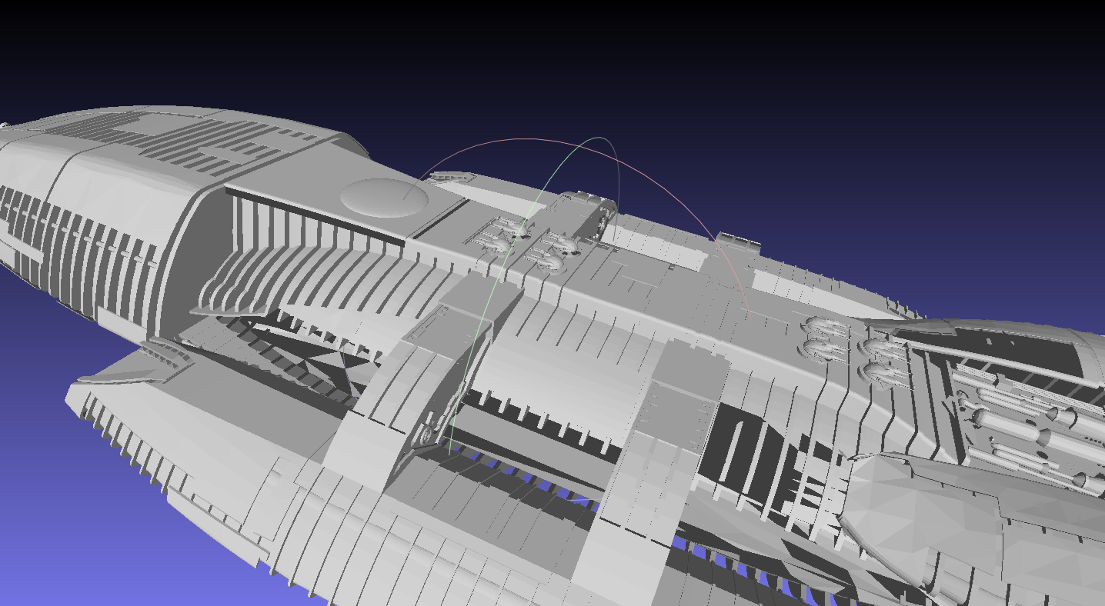

Slide 11
Forward+ (AMD alternative)
3 passes
1st writes to the “geometry buffer” (G buffer)
2nd pass: compute
Calculate which lights are where – close to the geometry
3rd pass:
Regular lighting pass

Slide 12
So, what are WE doing?
2 pass deferred, rendering to a full screen quad
Pass #1:
Output: vertex position, normal, colours (material), maybe other things…
Pass #2:
Read the FBO and run the light calculation.
Question:
Do we do 2 separate shaders, or 1 “uber” shader with two “states” or passes? We’ll do it with ONE shader to simplify the uniforms
…but that will make the shader a little stranger

Slide 13
Our G buffer:
“w” of normal = 0 → NOT lit on 2nd (lighting) pass

Slide 14
The “renderPassNumber”
We only output the things to the G buffer
We don’t output any lighting information here
This means you’re 1st pass is likely a simpler sort of shader
We are using the uniform int renderPassNumber to indicate which “pass” we are doing:
0 : Regular forward rendering (note we had to change our colour output variable from “finalPixelColour” to “vertexWorldLocationXYZ” which might be a little confusing.
I used “0” (zero) so that if we forgot to set the renderPassNumber it would still work.
1: 1st pass of the deferred, rending to the G buffer
2: Optional 2nd pass which we aren’t using at the moment
3: Lighting pass (this can also be the “2nd pass”/”effects” pass, too)
This will output to the colour buffer (i.e. the screen)

Slide 15
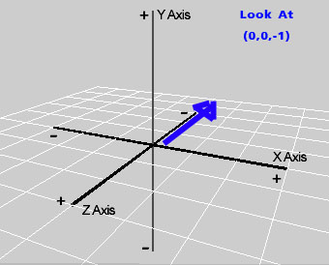
FSQ
Place at the origin (0,0,0)
Lined up on the XY plane, with the centre at 0,0,0
Camera
0, 0, +10

Slide 16
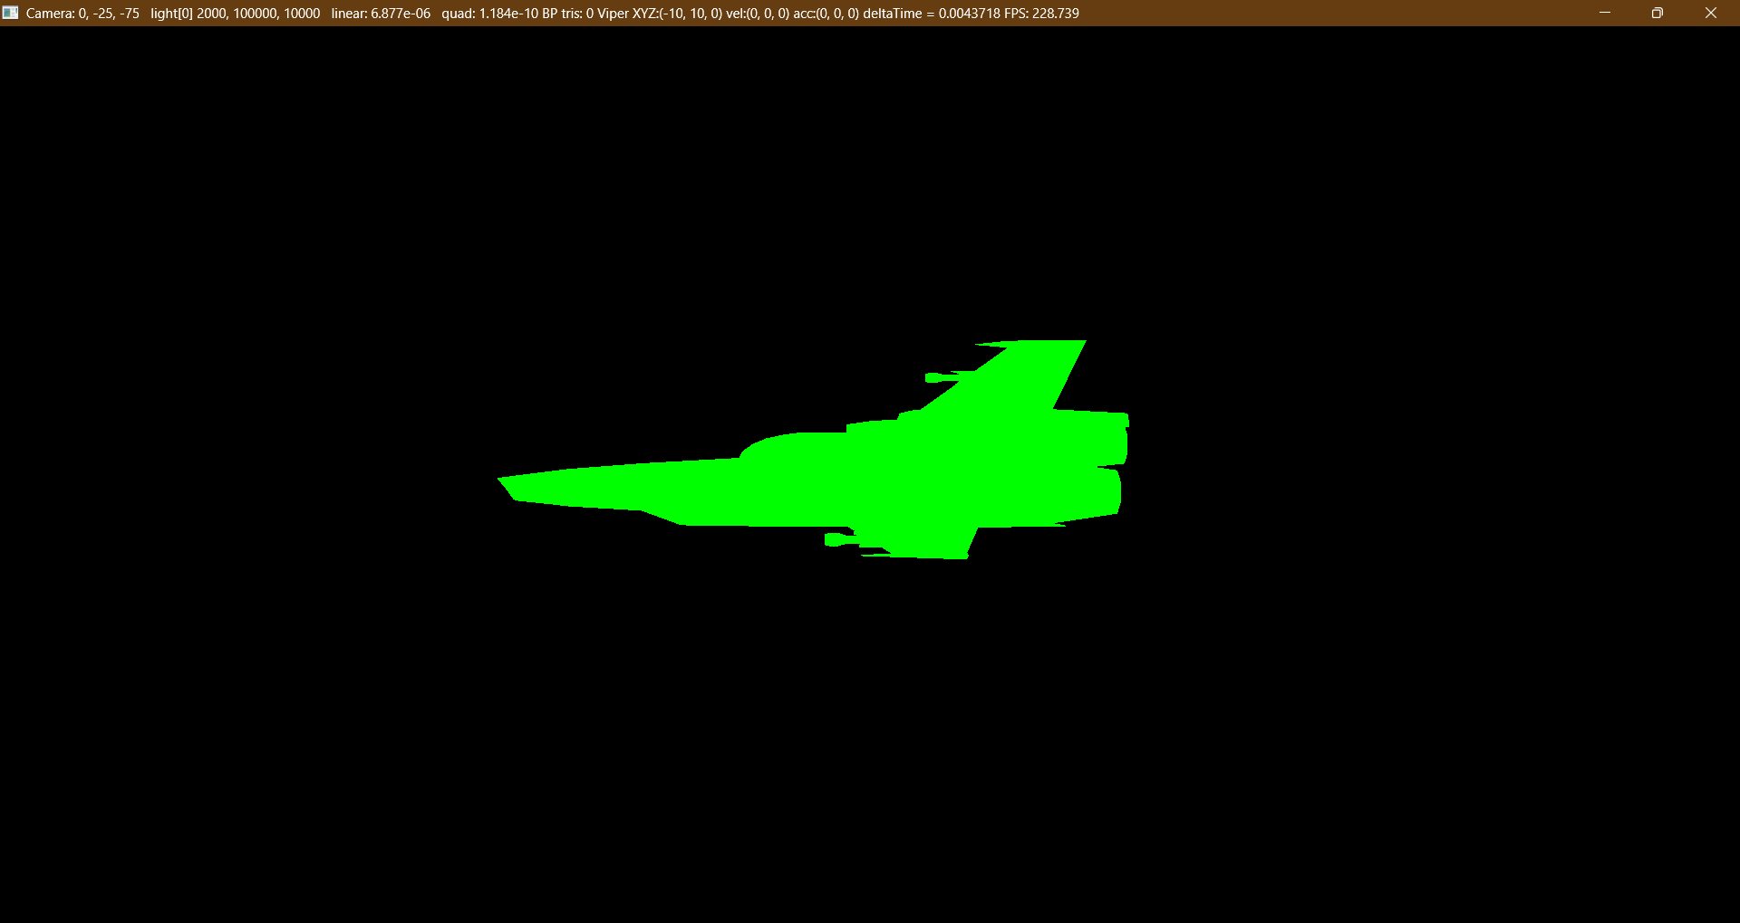

Slide 17
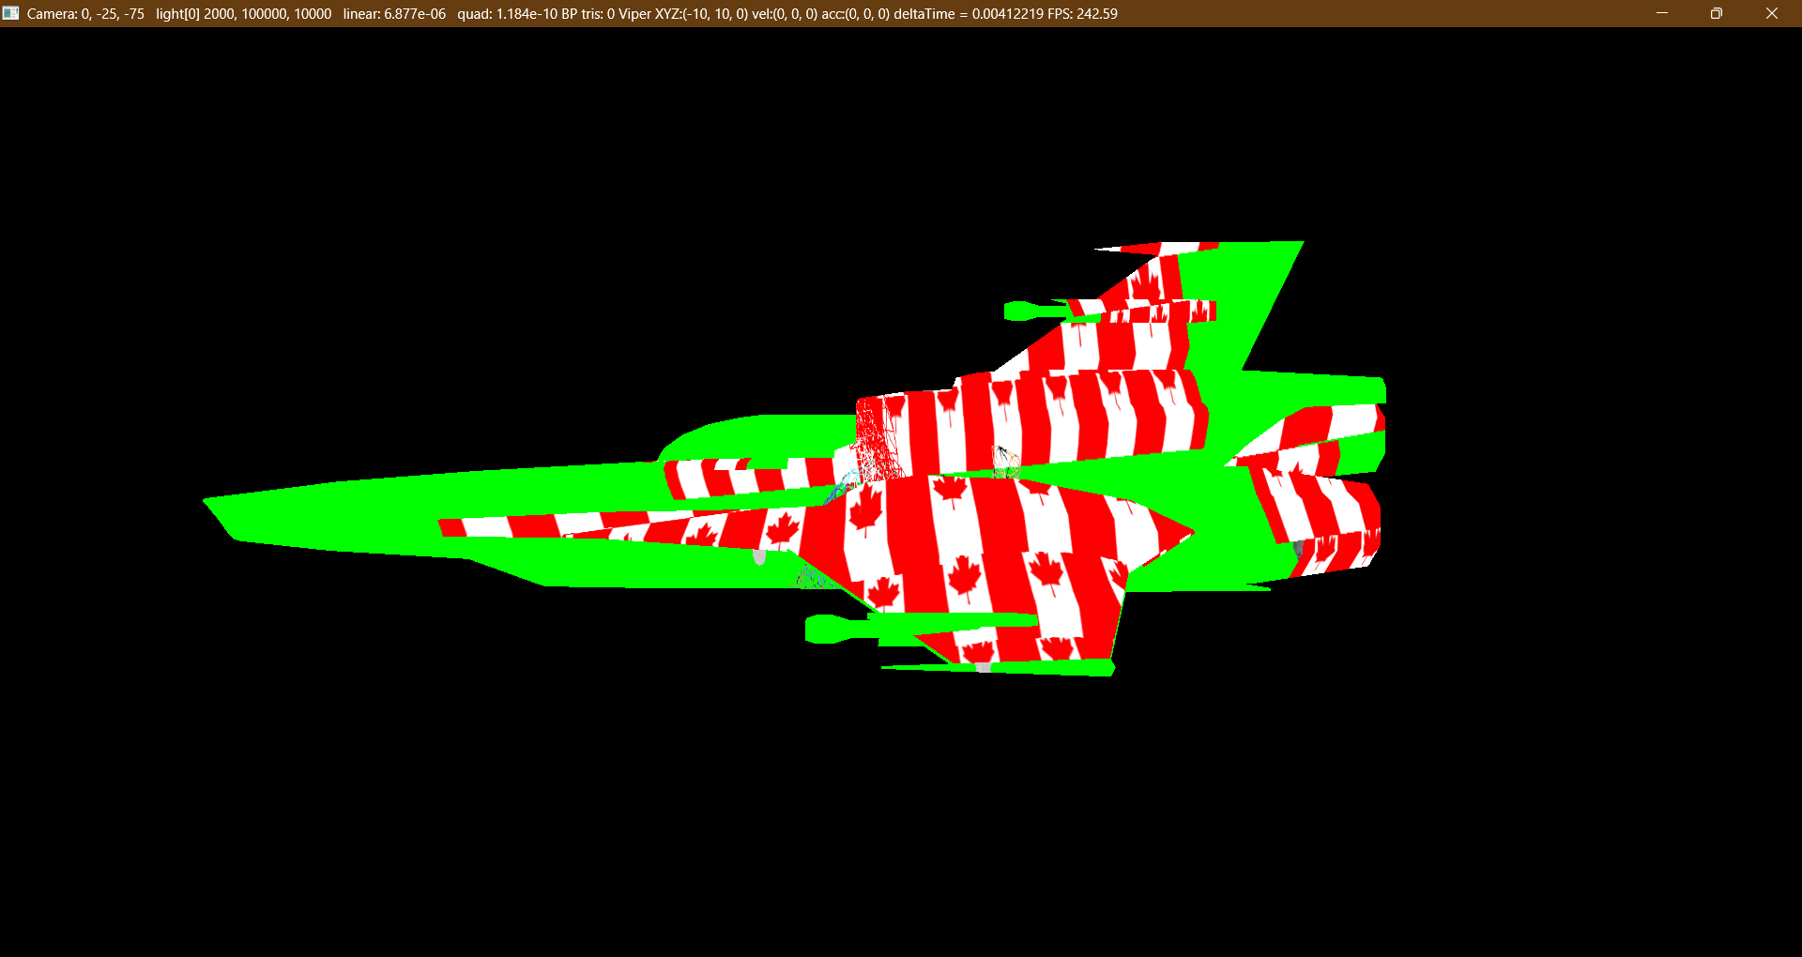
Here the 1st pass is being shown on the viper model, but it’s using the Vipers UV coordinates, so it’s distorted…
But you can move the mouse around and do all the things you did with the forward rendering pass

Slide 18
Using the actual pixel locations
The 'catch' is the gl_FragCoord.xy is pixel locations, not 0.0 to 1.0
We'll use the: uniform vec2 screenSize_width_height to calculate the UV sampler values:
vec2 screenUV = vec2( gl_FragCoord.x / screenSize_width_height.x,
gl_FragCoord.y / screenSize_width_height.y );
(note the “fradment coordinate” is in pixel location (integer)
Get the vertex colour from the 1st pass
Note this:
vec3 vertexDiffuseRGB = texture( vertexDiffuseRGB_texture, fUV.st ).rgb;
But this:
vec3 vertexDiffuseRGB = texture( vertexDiffuseRGB_texture, screenUV.st ).rgb;

Slide 19
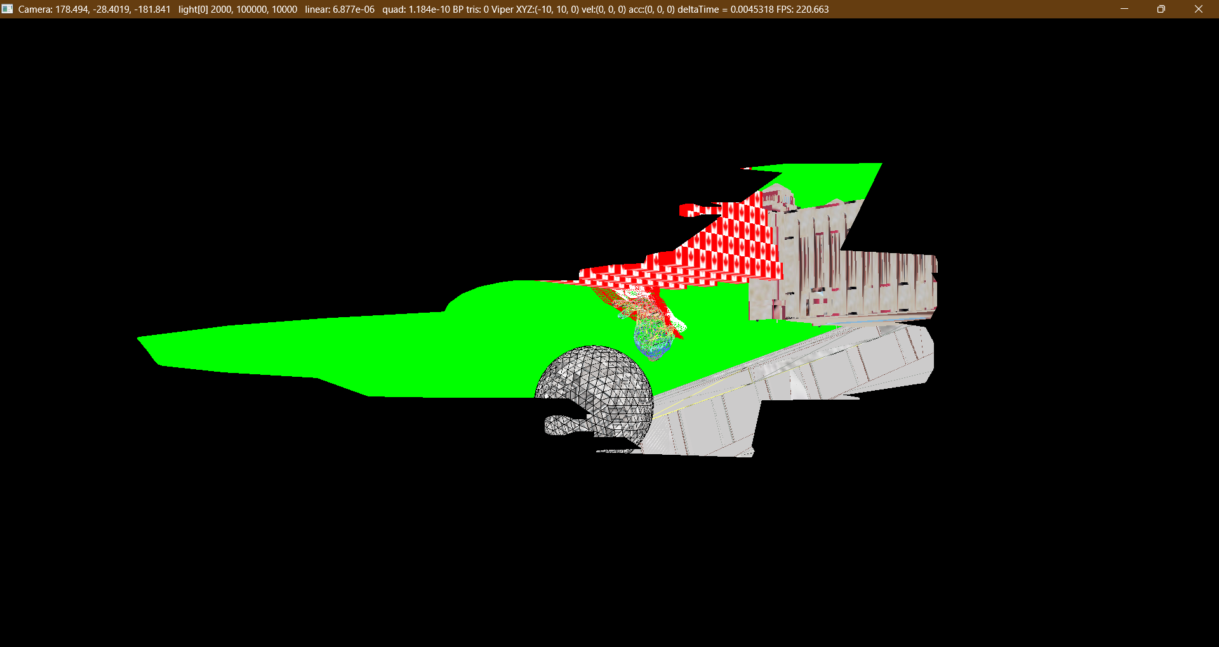
The scene is now like we are looking through a “viper shaped” window
It’s NOT using the viper model UV, but the screen coordinates

Slide 20
Note that the black area is where the fragment shader DOESN’T run (is black because of the clear screen colour)
This means we can know EXACTLY how many times we call the fragment shader and it’s consistent on this pass (it’s not consistent with forward rendering because we don’t know how many times the fragment shader will be called in the original scene)

Slide 21
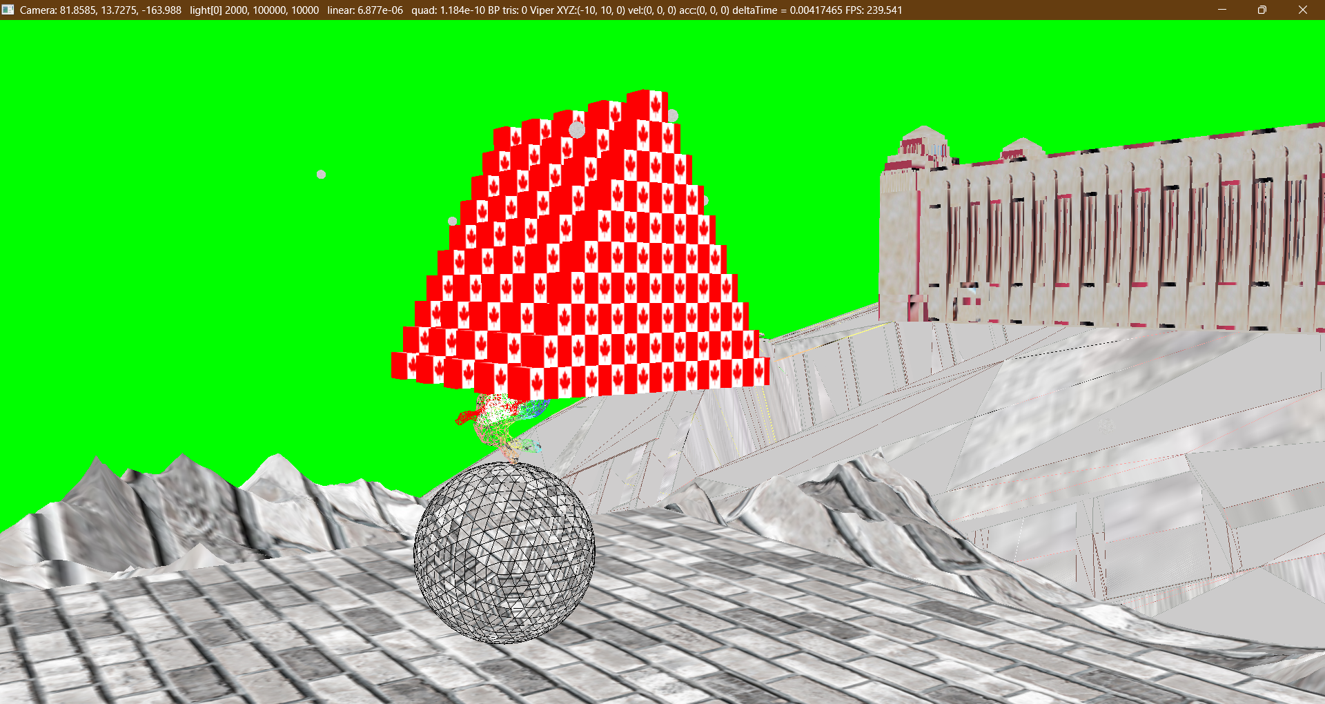
This is STILL the Viper model, but it’s very large, taking up the entire screen…

Slide 22
“Full Screen Quad”
There’s no point in drawing the viper as our “full screen” mesh
Often, we’ll refer to a “full screen quad” that covers the entire scene in the last pass, but:
We can use anything (like a Viper!)
Or a single triangle? (recommended by nVidia and AMD, actually)
We’ll use a two triangle mesh, though (as it’s a “quad”)
Keep this idea that we can use whatever shape we want to control when the fragment shader runs as it’ll come up with “light volumes” – i.e. we will draw a specific light in the scene and use a specific shape that matches where we want that light to go (like spot light cones, “god rays”, etc.)

Slide 23
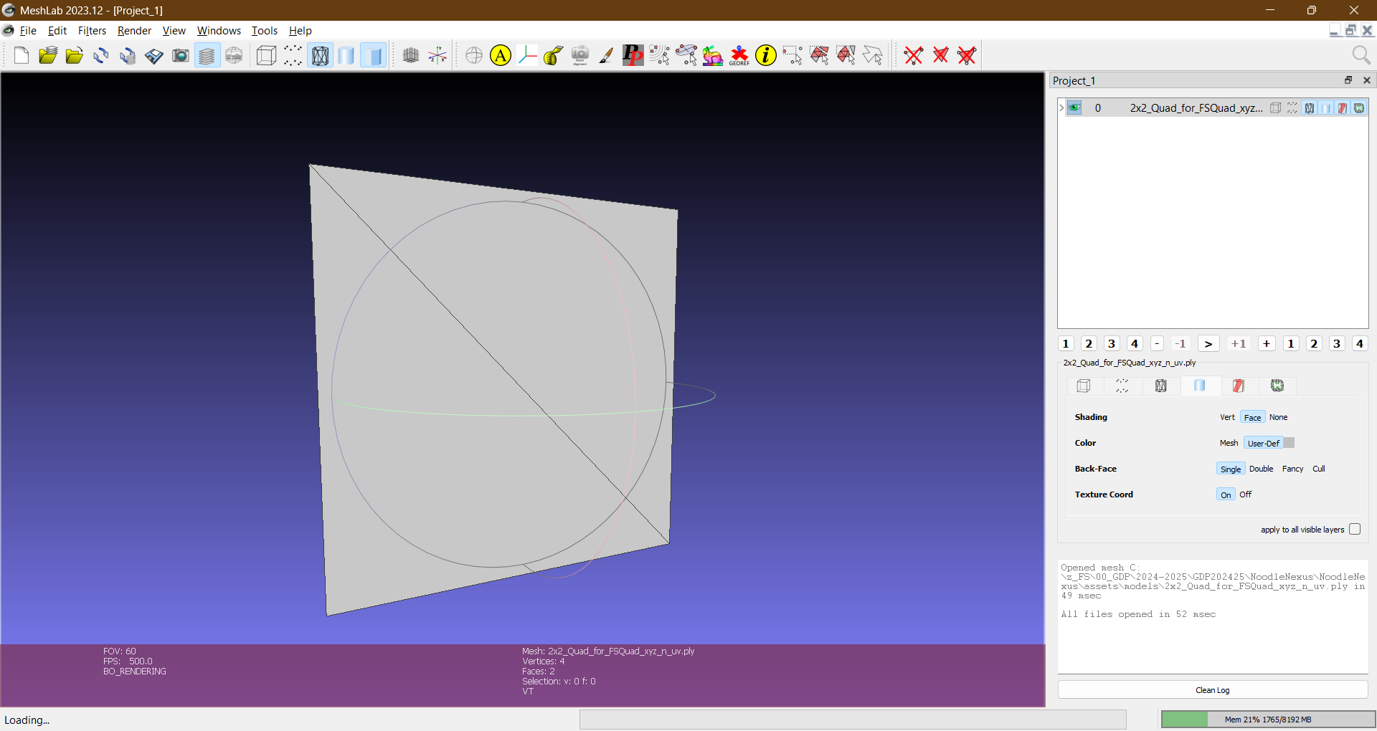
Here’s the “full screen quad” model we’ll use...

