Slide 1
INFO6022 PHYSICS & SIMULATION
2
INFO6019 post mortem
Course overview
Dynamic Intersection
(aka “continuous collision detection”)
Week 1, Day 1

Slide 2
Text book (same as INFO6019)
Christer Ericson, Real-Time Collision Detection, Morgan Kaufmann, 2005, ISBN-10: 1558607323, ISBN-13: 978-1558607323
Note: that’s “Christer” not “Christopher”
Works for SONY, Santa-Monica

Slide 3
How we do it…
Mainly in C/C++ (more “classic” than “modern”)
Using Visual Studio 2022
Using OpenGL 4.5 for graphics and animation
Later integrating some 3rd party physics engines (Bullet/PhysX/Havok).

Slide 4
The course
This course is a continuation of “Physics and Simulation Level 1” exploring the implementation of more advanced physical simulation topics such as: dynamic intersection, soft body, physical based motion (both biologic and vehicular), physics based animation, explosions, particle systems and effects, preventing tunnelling, hardware-accelerated physics systems, and integration with existing third party tools and middleware.

Slide 5
Evaluation
There will be three (3) projects (worth 60%):
(Continuous collision detection → possible Game Jam)
1st : Soft body (cloth, rope, Jell-O, Wheels…)
2nd : Constraints using own + 3rd party middle-ware
3rd : “more” project is also your Game Jam submission
There will be a mid-term and a final exam (40%).
(The “Final” can be combined with your final project)
As with most other courses, you must pass the “exam” portion to pass the course.

Slide 6
INFO-6019 post-mortem
Questions?
Overview?
Post mortem?
Tears shed?
Stop? Start? Continue?

Slide 7
Very rough course breakdown:
(Weeks) Topic
(1) Dynamic collision (“continuous collision detection”)
(2-3) Soft bodies (springs, cloth, etc.)
(1) Rotations (momentum, rotational velocity, torque, etc.)
(2) Constraints (Rigid)
Middleware introduction and integration
(1) Islands/stacked objects/stability
(1) Forward Kinematics (this will carry over, though)
(optional) Fluid simulation
(optional) Vehicular motion

Slide 8
Amazing, interactive tunneling issue graphic!

Slide 9
And now…
Dynamic Intersection tests
Aka “continuous collision detection”

Slide 10
The problem: Tunnelling
Depending on the sampling rate, a “fast” moving object (relative to the sampling rate) can pass through another object
This is called “tunnelling”
Collision missed…

Slide 11
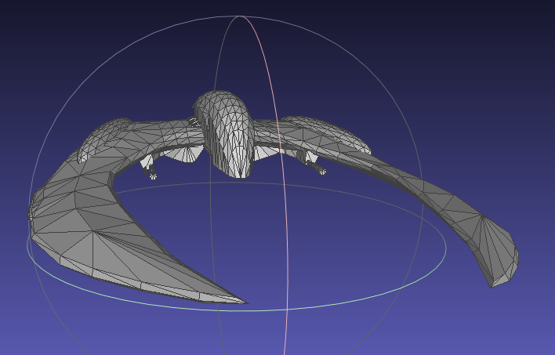
Possible solution #1
Assuming a complicated model (like the Cylon →)
Keep track of the “last” location of the object
Note the direction of the normal of the “closest” triangles that we are about to collide with
If the object is on the “other” side of the triangle (i.e. the normal is now facing the other way – use the dot product to determine this), then we’ve passed “through” the triangle.
Issues:
If we are going REALLY fast, we can go right through, or get closer to the opposite side, etc.

Slide 12
A solution: Higher sampling rate
You might thing that increasing the sampling rate will prevent tunnelling.
You would be wrong.
The faster an object moves, the smaller the samples have to be. At some point, this prevents real-time.
Also, you still don’t really know “when” the object collided, so you don’t know exactly “where” the object collided, only penetration

Slide 13
A solution: Higher sampling rate
However, if your sample size it at most ½ the size of the object, this is a practical solution
The ½ size is related the thy “Nyquist” frequency of sampling a signal (sampling frequency must be 2x maximum sampled frequency)

Slide 14
A solution: Volumes
The idea solution would be to create a “swept volume” of the area that the object moved in the last time period, then test for intersections between the colliding object and the swept volume

Slide 15
For points:
For two points, the “last” and the “current” (or the “current” and the “next/future” location, you can use a ray/triangle (or ray/whateverShape) intersection
This will check if there has been a collision
BUT it doesn’t help you find out exactly when the collision took place. (It could tell you where the collision took place – the intersection of the ray/shape)
If you are doing a swept volume of an arbitrary shape, this can become complex – i.e. not really useful for real-time

Slide 16
A solution: Volumes
This has some problems:
Very difficult to generate “general” swept volume
More difficult (impossible) to do in real-time
Difficult to determine actual point of intersection
However, it’s the “ideal”

Slide 17
Multiple moving bodies
Another complication is that of multiple moving bodies
There are other ways that they can “miss” each other
A simplification is to assume that one object is stationary, and one is moving
This is done by calculating the “difference” vector of the bodies velocities, adding this to one body, and setting the other body’s velocity to zero (stationary) for the collision detection calculation

Slide 18
Multiple moving bodies
Instead of creating an exact swept volume, a simplification is to generate simplified volumes, like a sphere or AABB, then test for collision/penetration in ½ steps until the actual point of penetration is found
The sphere or AABB is generated based on the time step and velocity, giving a distance the object has travelled in one step.
This leads to the size of the sphere/AABB

Slide 19
Multiple moving bodies
63% of the frame

Slide 20
Key concept
You need to find out where and when the collision took place.
Let’s assume we’re using this “sphere” solution from the previous slide:
We then have to iteratively repeat the collision test until we get to the resolution we require – i.e. it’s “close enough” to the resolution we want
You likely want to do this calculation during the update – i.e. calculate where the object is going to be and handle any possible collisions before setting the final (“next frame”) location.
You will have to handle these “in between” time and location situations.

Slide 21
Bouncing ball
t = 16.0 ms
t + 7.04ms
t = 24.96 ms
or 8.96 ms
t = 32.0 ms

Slide 22
Bouncing ball
t = 16.0 ms
t + 7.04ms
t = 24.96 ms
or 8.96 ms
t = 32.0 ms

Slide 23
Bouncing ball
1
2
2
2

Slide 24
1
1
2
2

Slide 25
2
1
1
2

Slide 26
AABBs
An AABB can be used in place of a sphere for this
The size of the AABB is the projection of the path the object will take.
Again, we adjust the velocity calculation by making one object stationary.
As you reduce the search space by ½, you eventually find the time (and so the position) that the objects have collided

Slide 27
For you
Based on the code in the text book (“Real Time Collision Detection”), implement the example of either the spherical or AABB collision detection code
You can either use the 2D “ball and triangle” project #1 from Physics & Simulation 1
Or
Do a sort of “asteroids” thing where you shoot a 3D point into space (see video from last year…).

Slide 28
For you
Based on the code in the text book (“Real Time Collision Detection”), implement the example of either the spherical or AABB collision detection code
Note that you do not have to deal with response at this point
Combining this with your hierarchical AABB code, you now have very robust (and fast) dynamic collision detection for arbitrary shapes

Slide 29
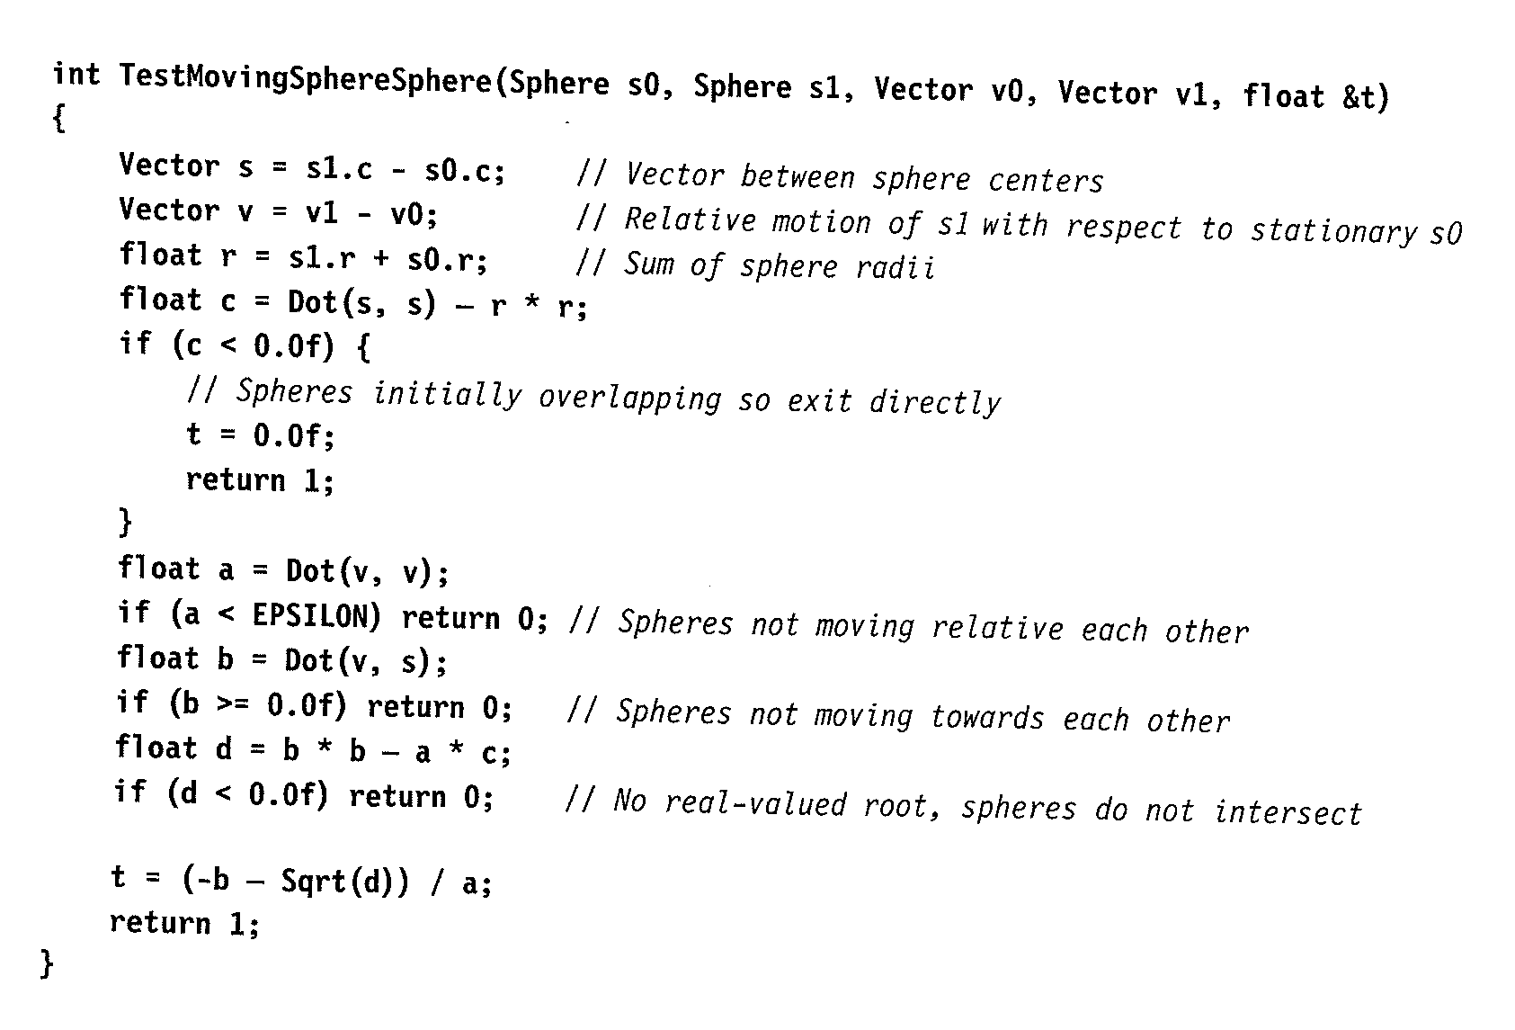

Slide 30
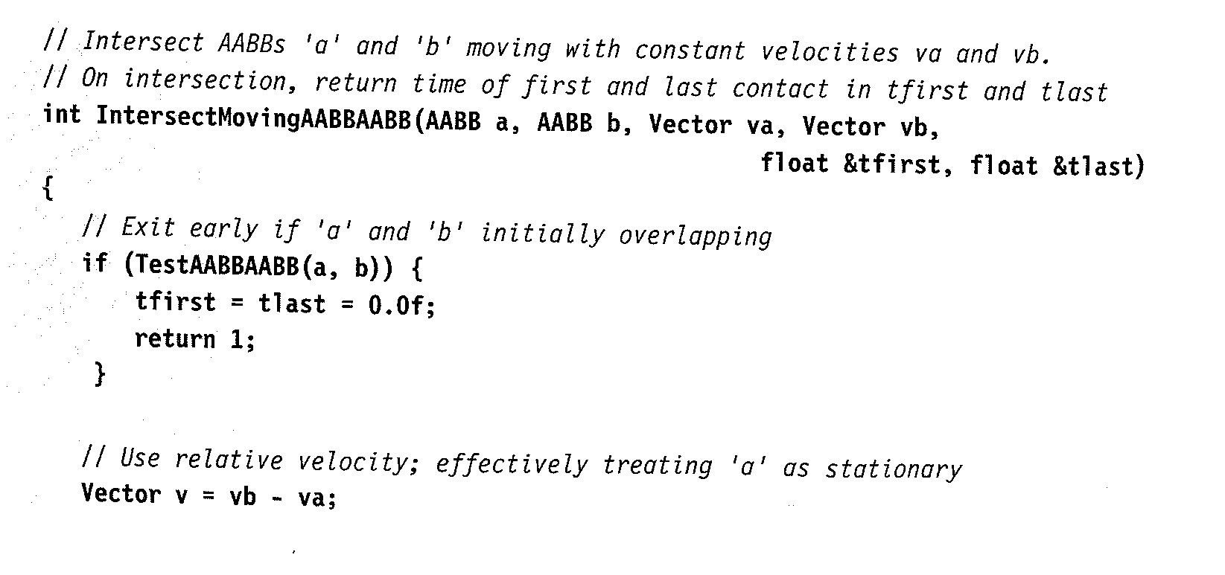
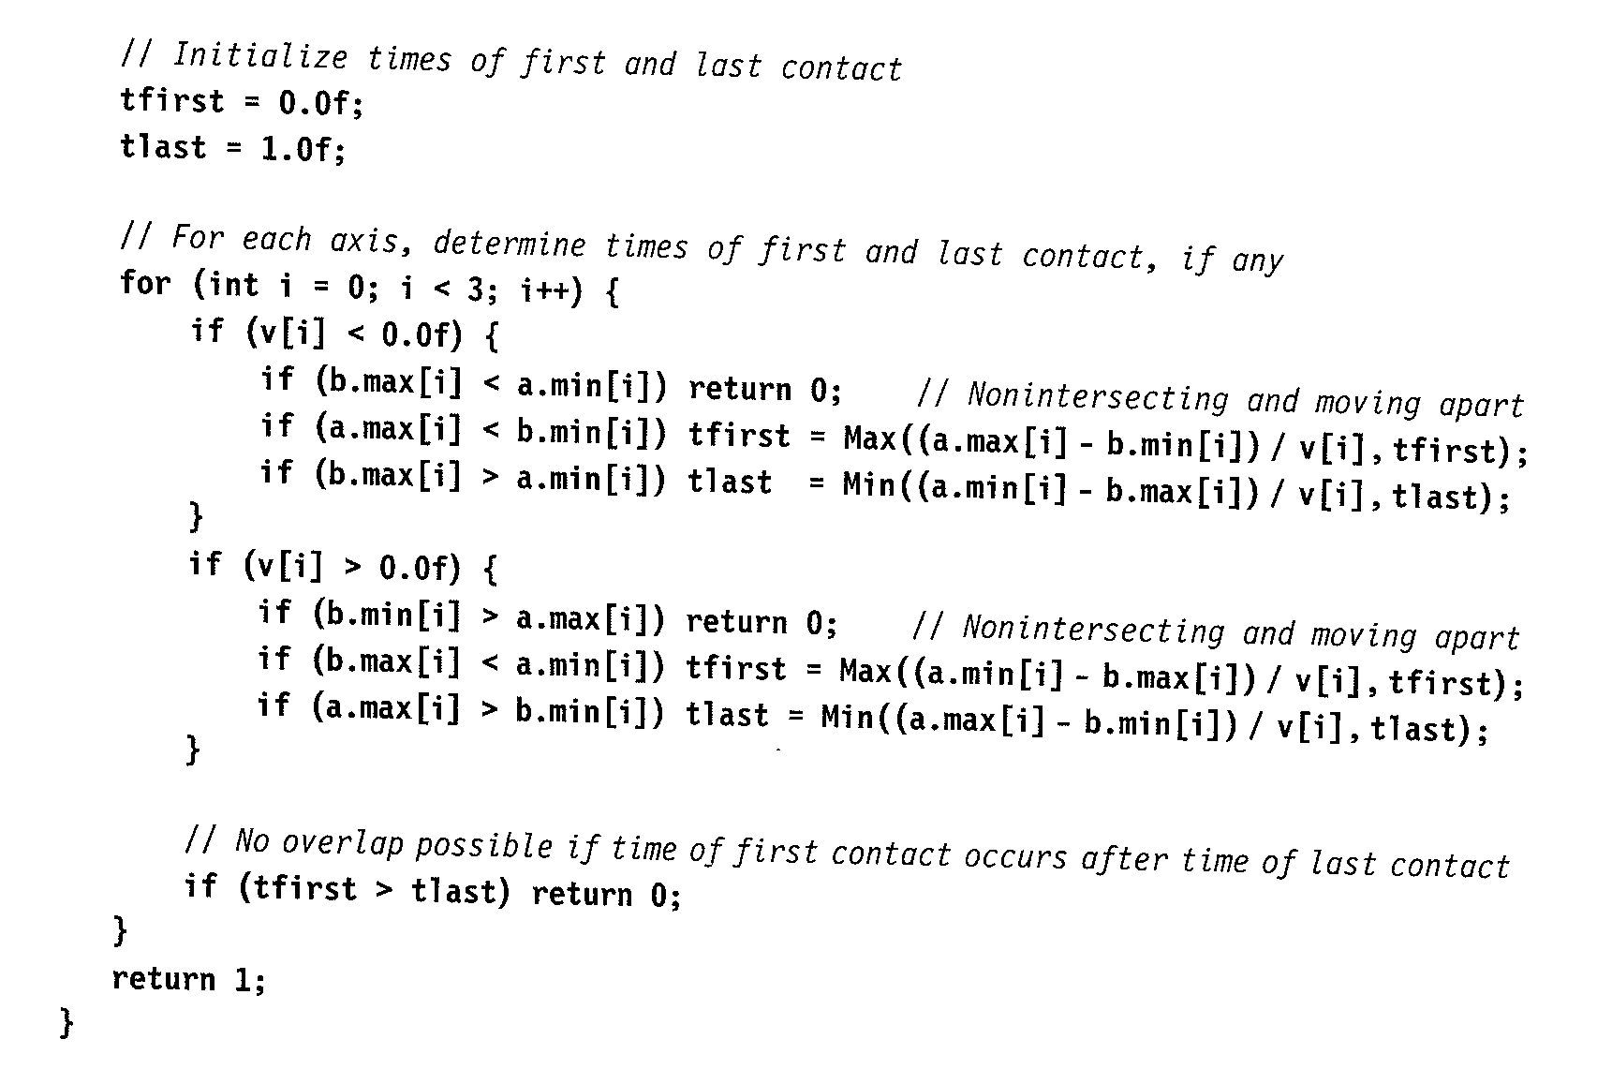

Slide 31


