Slide 1
Narrow vs Broad

Slide 2
Narrow
The actual contact determination
AABB-sphere
Triangle-Line
Whatever
This has to be happen or you can’t tell the collision
We already have this
IsCollision( cSphere, cAABB ), etc.

Slide 3
Broad
Determining if objects are even close to colliding.
If they are “far away” or “too far away” that they are never colliding, then just don’t do the narrow
Only do Narrow on things that are “close”

Slide 4
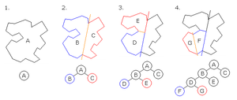
We are going to do Spatial subdivision
Slicing the world into regions and deciding what objects are where.
Doom (the original) did BSP (binary space partition)

Slide 6
Broad
3D oct-tree
In 2D, imagine we are slicing the world into a grid of squares that are all the same size.

Slide 7
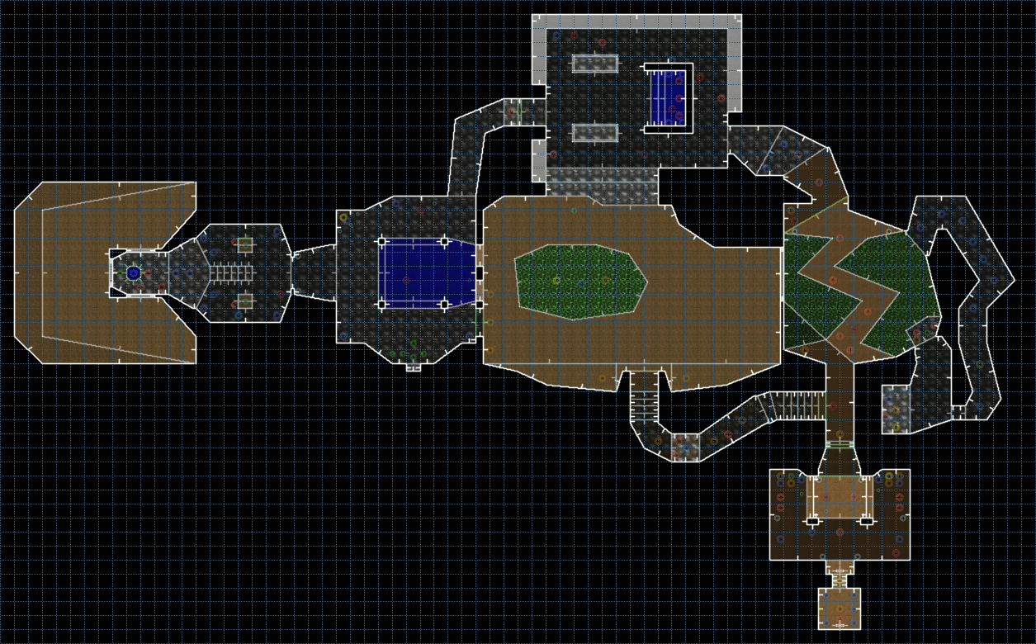
2, 3
0, 2
0, 1
1, 1
0, 0
1, 0

Slide 8
struct sSquare {
// vector< cTriangles* > vecTriangleInThisSquare
glm::vec2 minXY;
glm::vec2 maxXY;
float width;
};
sSquare grid[10][10];
float sqaureWidth = 10;
for (unsigned int x = 0; x < 10; x++)
{
for (unsigned int y = 0; y < 10; y++)
{
grid[x][y].width = sqaureWidth;
grid[x][y].minXY.x = sqaureWidth * x;
grid[x][y].minXY.y = sqaureWidth * y;
grid[x][y].maxXY.x = sqaureWidth * x + sqaureWidth;
grid[x][y].maxXY.y = sqaureWidth * y + sqaureWidth;
}
int xIndex, yIndex;
calcBoxXYFromCoord(5.0f, 15.0f, xIndex, yIndex, sqaureWidth);
std::cout << xIndex << ", " << yIndex << std::endl;
Box at [2][3] if the box is 10 units wide & high
Extents would be:
x: 20 to <30
y: 30 to <40
We’re looking for a way to go from the x, y location in space to the box index values.
One way is pick the lowest (“bottom left”) coordinate and figure out what grid ID

Slide 9
In 2D, imagine we are slicing the world into a grid of squares that are all the same size.
// x = 5, y = 15 --> 0, 1
void calcBoxXYFromCoord(float x, float y, int &xIndex, int &yIndex, float boxSize)
{
xIndex = (int)(x / boxSize);
yIndex = (int)(y / boxSize);
return;
}

Slide 10
2, 3
0, 2
0, 1
1, 1
0, 0
1, 0

Slide 11

Using the Galactica as an example
444,000 faces
500,000 vertices (but they are shared)
AABB: approximately
X: -18,740 to 18,740
Y: -6,300 to 6,300
Z: -49,000 to 49,000
How many cubes (AABBs) are we planning on using? → how big should they be?
I want 10 cubes per axis → some size
I want them some uniform size

Slide 12
Using the Galactica as an example
AABB: approximately
X: -18,740 to 18,740 → 40,000
Y: -6,300 to 6,300 → 12,000
Z: -49,000 to 49,000 → 100,000
size of 1,000 on each side: [40][12][100] → 48,000x faster
Size of 100 on each side: [400][120][1000] → 48 million x faster
We want 10 boxes per side, but square:
Largest side is 100,000 long, so each cube is 10,000 on each side: [4][2][10]
80x faster

Slide 13
Using the Galactica as an example
Another aspect is how many triangle do you want in each AABB
Warehouse is about 30,000 triangles and we can do a full ray-cast into multiple warehouses on a single thread with 60 HZ framerate.
How many triangles / AABB
Do we want like 100 triangles in each AABB? → seems silly
We can give a rough estimate that 30,000 triangle/AABB is “fine”
The Point is: it’s not a one-size-fits-all situation
You have to balance how large the model is, how many triangles per AABB, etc.

Slide 14
Using the Galactica as an example
We will pick an AABB size of 1,000 on each side because:
That’s reasonable (# if triangle per box)
It’s a nice round number:
[40][12][100] → 48,000 AABBs to hold the Galactica
[100][100][100] if we wanted each side to be symmetrical
Most of the boxes will be empty
Gives us 10’000’000 AABBs.

Slide 15
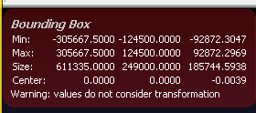
Issues with this large structure
cAABB myGrid[100][100][100];
Static array, might fit in the stack, but might easily be too large
10’000’000 AABBs → stack is usually something like 1 MB
PowerPlant model is 200,000 units wide
100 AABBs per side → 14M / 10K = 1,400
1000 AABBs per side → 14M / 10M = ?
Even something like this has two issues:
Takes up too much memory
Is likely “sparse” (i.e. many AABBs are empty)

Slide 16
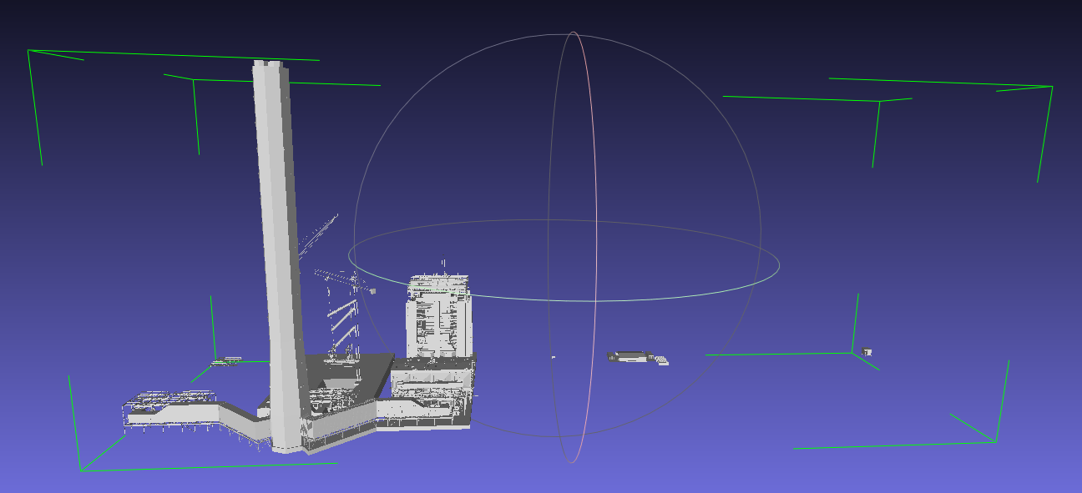
Imagine this is a 100x100x100 AABB grid: MOST of it doesn’t have anything in it.

Slide 17
Issues with this large structure
A solution is to use something like a “sparse grid” of these items. In other words, only make the AABBs that we need.
The trick is how do we know if they are there or not.
cAABB* gridArray[100][100][100];
Set the “empty” ones to NULL → if NULL, there’s no AABB
But we still have make 10,000,000 NULL values

Slide 18
Storing this in a map (a binary tree)
std::map< int, cAABB > mapGrid
Idea is that the 1st value is the index and this points to an AABB
If there’s no match for that index, then there’s no AABB
BUT we have to pick the index value
We could use a “hash” to calculate this, for example:
But finding a perfect hash function is very tricky

Slide 19
Storing this in a map (a binary tree)
Instead, we are going to use the index this way:
Say we want 100x100x100 grid locations
The ID = z + (y * 100) + (z * 100 * 100)
0 to 10,000,000
Really get is this:
XXYYZZ
000000
Grid location [15][67][45] → 156745
std::map< unsigned long long, cAABB > mapGrid
Unsigned long long is 64 bit → 16 billion billion

Slide 20
Storing this in a map (a binary tree)
Say we want 100x100x100 grid locations
[00] → [99]
000000 → 999999
32 bit → 4,000,000,000 → 000,000,000 each one being 3 digits
64 bit → 4 billion * 4 billion (2^64)
16,000,000,000,000,000,000
xxx,xxx yyy,yyy zzz,zzzz
Our “hash function” basically shifts the x, y, z locations to each part of the 64 bit index.
We are using 64 bit ints anyway, so the lookup is really fast
There’s no size issue, because the 64 system is going to store the index as 64 bit numbers anyway (not 32 bits)

Slide 21
Storing this in a map (a binary tree)
Unsigned long long
Each axis is 1,000,000 in size
unsigned long long caclHash( int x, int y, int z) { return x * 1,000,000 * 1,000,000 + y * 1,000,000 + z; }

Slide 22
Storing this in a map (a binary tree)
For –ve (negative) numbers, we can use the 1st digit to indicate if this was negative or not:
X = 6,000 → ID = 006000
X = -6,000 → ID = 106000
(the 1 meaning it’s negative index)

Slide 23
Storing this in a map (a binary tree)
[0] = {x=-4,958.16211, y = -840.004578, z = -35,312.1016
vert0_AABB_ID = 100004-100000-100035
minXYZ = {x=-5000.0, y = -1000.0, z = -36000.0}
maxXYZ = {x=-4000.0, y = 0.0, z = -35000.0}

Slide 24
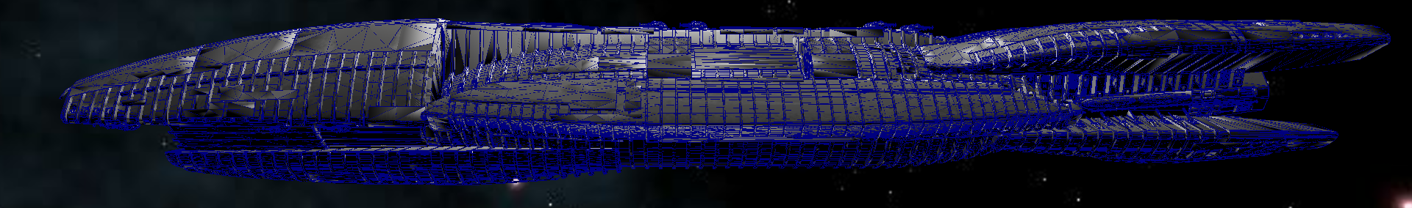
Can do a single ray-cast on the Warehouse model, which is 30,000 triangles with no issues.
That should help decide how large this region should be…
← 380,000 →
The smaller the cubes, the more of them there are and that can lead to a memory issue.
The larger they are, the more triangle per cube

Slide 25
Let’s make these cubes 1000x1000x1000 in size
← 380,000 (or 38 cube wide) →
The smaller the cubes, the more of them there are and that can lead to a memory issue.
The larger they are, the more triangle per cube

Slide 26
Storing this in a map (a binary tree)
Some models, like the Galactica, “fit” into the bounding box so that most of the smaller cube/regions have triangles in them.
But other models, like the Power Plant, the vast majority of the cubes/regions don’t have anything in them.
cAABB [100][100][100] → All cubes are present, taking up memory even though they have nothing in them
Look ups in an array are the fastest – just an index lookup
But, you are wasting (using up) memory that you don’t need (if the model is mostly empty)

Slide 27
Dense vs sparse:
Index | Data
0 | 343
1 | 0
2 | 2234
3 | 0
4 | 112
5 | 0
6 | 0
Index | Data
0 | 343
2 | 2234
4 | 112
cAABB [100][100][100]
If most of these are empty, then use can use a “sparse” container that doesn’t have all the items.

Slide 28
Dense vs sparse:
Index | Data
0 | 343
1 | 0
2 | 2234
3 | 0
4 | 112
5 | 0
6 | 0
Index | Data
0 | 343
2 | 2234
4 | 112
Left structure:
vector<cAABB> vecData
vecData[2]
vecData[1] → returns 0 items
Right:
map<int, cAABB> mapData
mapData[2]
mapData[1] → isn’t there

Slide 29
1000.0 units wide
0.0 to < 1000.0
1000.0 units wide
1000.0 to <2000.0
1000.0 units wide
2000.0 to < 3000.0
0,0
1000,0
2000,0
If ( x >= 0.0 && x < 1000.0f) then it’s inside the AABB

Slide 30
17
Triangle: 17
17
17

Slide 31
The issue is the triangle is WAY larger than the AABB, so it’s only registering that the triangle is in the AABBs where the vertices are.
OR, any one side of the triangle is larger than the side of the AABB.
We could:
Tesselate the entire model, making the triangles small enough to register with the ABBB, but that means we draw more triangles
Pre-process this where we do this tessellation off-line and store that information when we load the model
We only tessellate temporarily while we are doing the AABB look up.
17
Triangle: 17
17
17

Slide 32
1
Don’t do this
Centre (“C”) is the average of all three vertices, or:
(V0 + V1 + V2 ) / 3.0f
T0: V0, V1, C
T1: V1, V2, C
T2: V2, V0, C
We want to be sure that the winding is the same (generally a good idea)
Note that the normal of the new triangles is the same as the original because triangles are always flat.
C
2
0
This will keep the long side lengths… 😱

Slide 33
1
Pick 3 points along the edges (mid-way)
A = (V0 + V1) / 2.0f
B = (V1 + V2) / 2.0f
C = (V2 + V0) / 2.0f
T0: V0, A, C
T1: A, V1, B
T2: B, V2, C
T3: A, B, C
We want to be sure that the winding is the same (generally a good idea)
Note that the normal of the new triangles is the same as the original because triangles are always flat.
B
A
2
C
0

