Slide 1
INFO6028: Graphics #1
Goal: Show a bunny (or whatever)
How? Vertex & Index buffers, shader & shader layouts, view “frustum” & perspective transform, world & camera transforms
Also, learning to enjoy the Magic of Matrix Math

Slide 2
Graphics “pipeline”
This is a simplified (but correct) view of the progression of vertex information to the screen in OpenGL 4.x (or DirectX 11)
In INFO3111, we won’t deal with the geometry or tessellation shaders
Vertices
Tessellation Shader
Vertex Shader
Geometry Shader
Fragment (pixel) Shader
Pixel coordinates
and colours
(Note: in DirectX, the order is reversed)
Also note that there are “Compute Shaders” in GL 4.3 (this is The Future)

Slide 3
Graphics “pipeline”
Adds or deletes vertices and/or primitives “on the fly”
Vertices
Transforms object vertex locations to screen pixel locations;
Tessellation Shader
(optional)
Vertex Shader
Geometry Shader
(optional)
Fragment (pixel)
Shader
Subdivides (“tessellates”) surfaces by adding LARGE numbers of triangles to “smooth” surfaces
Combines with lighting and textures to determine the colour of each pixel
Pixel coordinates
and colours

Slide 4
Graphics “pipeline”
We will only deal with the Vertex and Fragment shaders in INFO3111.
Vertices
Tessellation Shader
(optional)
Vertex Shader
Geometry Shader
(optional)
Fragment (pixel)
Shader
Pixel coordinates
and colours

Slide 5
Vertices loaded in…
Dynamic memory allocation
int* pX = new int();
delete pX;
Cninja* pBob = new CNinja();
delete pBob;

Slide 6
Vertices loaded in…
Dynamic memory allocation
int* pX = new int();
int* pX = new int[10]; // array
delete pX; // **MEMORY LEAK!!**
delete [] pX;

Slide 7

Transformations
The 3D models we are loading (the “ply” models, have vertices that are “hard coded” for particular locations, orientation, and size
In theory, this is fine, but it’s unlikely that we want the object “that” size, location, or orientation.
It’s almost a certainly that we have to change the vertices, or “transform” them, to something else

Slide 8
Transformations
How do we do this?
It’s a serious question, so let’s think about it…
Scale?
How about we multiply all the vertices by a value?
Reposition or placement (“translation”)?
How about we add a value to all the vertices?
Simple, right?

Slide 9

Transformations
Do this for every vertex…
Scale:
Vert_XYZ_new = Vert_XYZ_old * someScale;
Translation (placement):
Vert_X_new = Vert_X_old + newOffset_X;
Vert_Y_new = Vert_Y_old + newOffset_Y;
Vert_Z_new = Vert_Z_old + newOffset_Z;
It’s almost too easy…

Slide 10
Transformations
What about rotation?
Oh no.
Yes, that’s right, kids!! It’s trigonometry time!!!
You LOVED it in High School!!!
You’ll LOVE IT even MORE now!!!!!!

Slide 11
Rotations
And wait! There’s even MORE!
Rotations aren’t straight forwards at all!
They can be:
Separated by axis!
Combined on an arbitrary axis!
Converted into 4-D space, then back (quaternions)
AREN’T commutative!! (Well that’s not strictly true…)

Slide 12
Rotations : how the example does them
We will end up using the OpenGL Math library for virtually all of this stuff
But it’s not “rocket surgery” (it’s just a really nicely written, and commonly used, library for OpenGL)
But where did this wizards get this awesome power?
Well, let’s try Wikipedia, the Source of All Knowledge
(Ironically, I’m not really being sarcastic for once…)

Slide 13
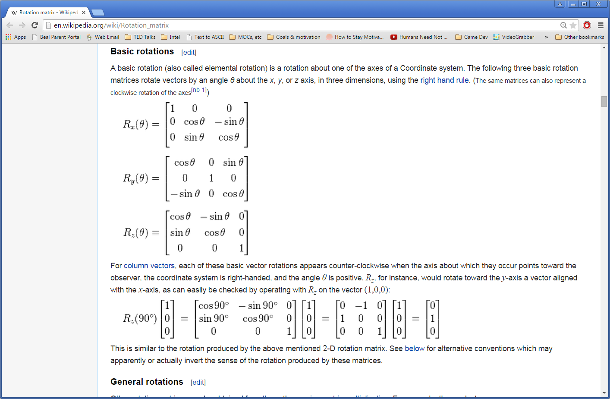
Fun fact #1: A rotation matrix only requires a 3x3 matrix
Fun fact #2: Since we are doing MORE than rotation, we will be using 4x4 matrices

Slide 15
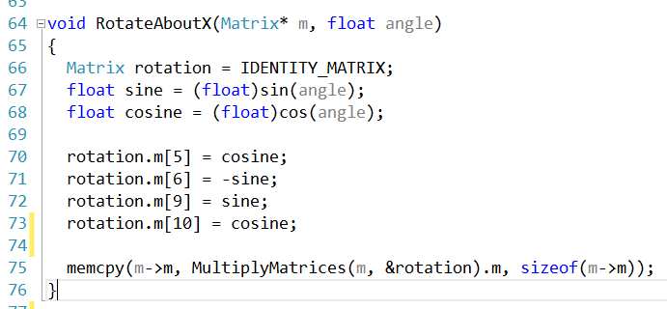
The “matrix” is really a 1D array.
Top-left (convention), so 0,0 is element[0]
(Note: this changes if it’s “row” or “column” major)
Element “0”
Element “2”
Element “3”
Element “1”
Rotation around X
Element “4”

Slide 16

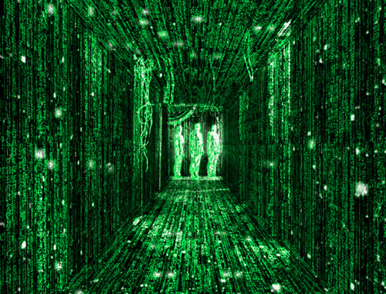
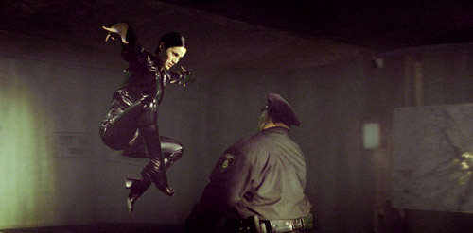
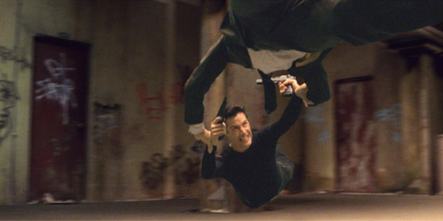
matrices
Sorry, it’s not that exciting.
To understand the camera better, you should understand what a ‘matrix’ is:

Slide 17
Matrix
No, not Neo
Many, many years ago, mathematicians discovered that some mathematical functions can be quickly solved by placing the numbers into a special format, called a matrix, and performing calculations in certain order (matrix math)

Slide 18
Matrix
A “matrix” is simply a set of rows and columns of numbers
Really, that’s it.
The “trick” is how the numbers are processed.

Slide 19
Vertex transformation pipeline
You can picture the transformation of the vertex data as going down a series of mathematical processes, or a “pipeline”
Vertices
World
Transform
View
Transform
Projection
Transform
Screen
coordinates

Slide 20
Vertex transformation pipeline
This is essentially the camera. Alter this to change what you are looking at
Changed for each object in your world every time they move
Usually set once. Allows 2D/3D/fish-eye, etc.
Vertices
World
Transform
View
Transform
Projection
Transform
Screen
coordinates

Slide 21
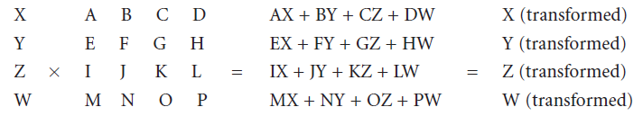
Matrix
Here is a matrix multiply:
Fun stuff, eh?

Slide 22
Matrix
Why do this?
Believe it or not, it’s way, way faster than doing it any other way
Also, you can combine a number of transformations (translate, rotation, scale) into one matrix, then reuse that matrix over and over.

Slide 23
Matrix
An interesting thing is that the order of the operations really matters
For example:
A * B * C doesn’t = C * B * A
This is a problem later…
Another interesting problem is not all mathematical operations can be done with matrices.
For example, there is no such thing as “matrix division.” Really. It’s impossible.

Slide 24
Matrix
super exciting
Do we have to actually have to perform these?
Nope.
DirectX/OpenGL will do it for you
Kazaa!
But that doesn’t mean you are off the hook…
…enter the boring theory

Slide 25
Vectors and Matrices
Remember ‘vectors?’ (not STL ones) from math?
They were two ways to represent them:
Direction and distance
Displacement in x and y (and z)
1.0 right
1.41 @ 45 degrees
1.0 down
Remember, these are the same…
…meaning that you get to the same place

Slide 26
Vectors and Matrices
x
1.0 x
y
-1.0 y
1.0
-1.0
Guess what?
There is a third way to represent a vector
It’s called a matrix
You write it like this:
So a vector like this:
Would be written like this:

Slide 27
Vectors and Matrices
2.0 x
2.0
=
=
2.0
-1.0
-1.0
-1.0 y
The way you write it is not that important, so you may see this, too:
(remember, these are all the same vector)

Slide 28
Vectors and Matrices
Remember, these are the same…
1.5 x
1.5
=
=
1.5
-1.0
2.0
-2.0 z
-1.0
-1.0 y
-2.0
Now that we are in 3D, there are 3 coordinates in out vector:
(very cheezy 3D drawing)

Slide 29
Vectors and Matrices
So what?
Remember, these are the same…
1.5 x
1.5
=
=
1.5
-1.0
2.0
-2.0 z
-1.0
-1.0 y
-2.0
Now that we are in 3D, there are 3 coordinates in out vector:
(very cheezy 3D drawing)

Slide 30
Vectors and Matrices
Remember that there are three main things you will do with your objects:
Translate (i.e. move them)
Rotate (spin or ‘orbit’ around something)
Scale (make bigger or smaller)
These are all call ‘transforms’

Slide 31
Vectors and Matrices
1.5
-1.0
-2.0
What’s that got to do with this?
Well, there are mathematical formulas to perform these transformations.
If the objects we are using are in ‘matrix’ format, the math is more flexible.

Slide 32
Vectors and Matrices
For example, to Translate, you multiply EACH ONE of you vertices by this (4x4) matrix:
1
0
0
x
0
1
0
y
0
0
1
z
0
0
0
1

Slide 33

Vectors and Matrices
Yes, this does involve a multiply of a 3x1 matrix by a 4x4 matrix
For example:
Move 2.0 in x, 1.5 in y
You original point is 3.5, 2.0, 6.0
1
0
0
2.0
3.5
5.5
0
1
0
1.5
=
2.0
X
3.5
0
0
1
0
6.0
6.0
0
0
0
1
Egads! It actually works!

Slide 34
1
0
0
0
0
1
0
0
0
0
1
Rotation around x
0
0
0
0
1
0.5 Radians
1
0
0
0
1
0
0
0
0
cos
-sin
0
0
0.875
-0.479
0
0
sin
cos
0
0
0.479
0.875
0
0
0
0
1
0
0
0
1

Slide 35
Vectors and Matrices
Yes, this does involve a multiply of a 3x1 matrix by a 4x4 matrix
For example:
Move 2.0 in x, 1.5 in y
You original point is 3.5, 2.0, 6.0
Yikes!
1
0
0
2.0
3.5
5.5
0
1
0
1.5
=
2.0
X
3.5
0
0
1
0
6.0
6.0
0
0
0
1
Egads! It actually works!

Slide 36
Vectors and Matrices
Yes, this does involve a multiply of a 3x1 matrix by a 4x4 matrix
Also, keep in mind that we have to do this for every single vertex in the model. Really.
That’s a lot of math...
For example:
Move 2.0 in x, 1.5 in y
You original point is 3.5, 2.0, 6.0
1
0
0
2.0
3.5
5.5
0
1
0
1.5
=
2.0
X
3.5
0
0
1
0
6.0
6.0
0
0
0
1
Egads! It actually works!

Slide 37
Vectors and Matrices
Rotation and scaling involve the same process:
Rotation matrix
Around X axis
Around Y axis
Around Z axis
Scaling matrix
X direction only shown

Slide 38
Combining
Hey, not so fast!
What’s the answer?!?!
But what if you want to do more than one transform?
Good question.
For example:
rotate around X, Y, and Z at the same time
To do this (in one step), you would combine (multiply) the matrices together. For the example above:

Slide 39
Combining matrices
If you are going to do several transformations (and you will), you can:
Do them one at a time (slow)
Do them at once with a ‘magic-do-it-all’ single transformation
To get the transformation, multiply all the transformation matrices together.

Slide 40
DirectX to the rescue!
Did I duck out of the answer?
Yes. I have no idea what the “master rotation matrix” is
But I don’t have to know
You still have to combine these matrices
But the graphics API it does it for you (sort of)
BUT, again:
Remember that the key thing about matrices is that you can combine them together, making the calculations incredibly fast.

Slide 41
Combining matrices
For example, let’s say you want to:
Move your spaceship to orbit the moon
Face 30 degrees from straight up
Assume that earth is at 0,0,0
You would:
Draw the ship at 0,0,0
Rotate it 30 degrees from straight up
Translate it to the moon’s coordinates
Translate it to a height above the moon

Slide 42
Combining matrices
You could determine the matrices and do the multiplications yourself…
Or you could use glm/DirectX to combine the matrices together and end up with the result.
i.e. use one of these:
glm::scale/D3DXMatrixScaling()
glm::rotate/D3DXMatrixRotationX()
glm::rotate/D3DXMatrixRotationY()
glm::rotate/D3DXMatrixRotationZ()
glm::rotate/D3DXMatrixRotationAxis()
glm::translate/D3DXMatrixTranslation()

Slide 43
The "Normal"

Slide 44
Combining matrixes
Also note that, while you can use a single matrix to calculate something, you can combine them (multiply them) into a single ‘master’ matrix.
if you rotate, translate, rotate, then scale
You create each one of these, then combine them into one matrix to give to the shader
Vertices
World
Transform
View
Transform
Projection
Transform
Screen
coordinates

Slide 45
Identity matrix
Since every transformation call ‘adds’ (actually multiplies) to the ‘current’ matrix, you have to be careful.
Be sure you are adjusting the correct matrix
Be sure to ‘clear’ the matrix before you start
Note that this isn’t a big performance hit as it only clears the matrix.

Slide 46
“gotcha” #1: Multiple rotation
Imagine this scenario:
The earth revolves around the sun, at a certain distance, spinning around.
This involves:
Rotation around the sun (say the sun is at 0,0,0)
Translation away from the sun
Rotation around the Earth’s axis
Simple!:
Rotation, then Translation, then Rotation
Perhaps not…

Slide 47
“gotcha” #1: Multiple rotation
?
Rotate the Earth on axis
Translate to orbit
Rotate around Sun
Rotate around Sun
Translate to orbit
Rotate the Earth on axis
The matrix calculations assume that the application is at the origin (0,0,0)
Also, the order that the matrices are applied are IN REVERSE in APIs like OpenGL
This is because the last matrix is applied “first” mathematically.
So the order may be not what you expect…
Which one is it?

Slide 48
“gotcha” #2: Scaling
Be very, very careful with scaling
Also, unless you are going for some fancy effect, you should always scale evenly
i.e. the same amount across very axis (x,y,z)
If you don’t, you will distort the “normal” and the lighting (and other things) may screw up
We’ll talk about “normals” very soon, but later…
Also, combined with the “matrix order” gotcha, you can have some unexpected effects.

Slide 49
Multiple objects: the pattern
It’s unlikely that you will have only one object
With multiple objects, each in a different part of the world, you do the following (each frame)
Clear the Model matrix
Set the transforms you want
Draw your object
Repeat for next objet
Basically, you want each object to have it’s “own” MODEL matrix when it’s drawn

Slide 50
The camera (again)
Remember, by default, the camera is at the origin (0,0,0) and looking “down” the z-axis with “up” along the y-axis
This is pretty boring
If you want to move the camera (and you probably do), you can either:
Create a matrix and apply it to the VIEW matrix (yikes)
Use the built in function: LookAt

Slide 51
The "Normal"

Slide 52
Something to remember:
What you see on the screen is an illusion/simulation of the ‘real’ world
It’s based on simplified mathematical calculations on the effects of light on material surfaces and how humans see and perceive
It’s not perfect, but “good enough”

Slide 53
Vertex Array Object (VAO)
Shader “Program”
Index Buffer
Vertex Buffer
Vertex Attribute array & pointer
Vertex Shader
Vertex attributes
Vertex Attribute array & pointer
(Possibly other shaders)
Fragment Shader
Just to be confusing, this is a “VBO” or “Vertex Buffer Object”

Slide 54
Vertex Array Object (VAO)
Shader “Program”
Index Buffer
Vertex Buffer
Vertex Shader
Bunny
(indices)
Bunny
(vertices)
Vertex Attribute array & pointer
Vertex attributes
Vertex Attribute array & pointer
Here, the VAO holds only 1 model.
(Possibly other shaders)
Point to VAO, will draw that model
Fragment Shader
VOA tied to specific shader, though...

Slide 55
Vertex Array Object (VAO)
Shader “Program”
Index Buffer
Vertex Buffer
Vertex Shader
Bunny
(indices)
Bunny
(vertices)
Vertex Attribute array & pointer
Vertex attributes
Vertex Attribute array & pointer
Here, the VAO holds multiple models, but also keeps track of the START of BOTH the index and vertex arrays.
Fish
(vertices)
Fish
(indices)
(Possibly other shaders)
Fragment Shader

