Slide 1
INFO3111: C++ Graphics
Day 5
Lighting (part 1 of….)

Slide 2
The "Normal"

Slide 3
Something to remember:
What you see on the screen is an illusion/simulation of the ‘real’ world
It’s based on simplified mathematical calculations on the effects of light on material surfaces and how humans see and perceive
It’s not perfect, but “good enough”
i.e. it’s ALL A LIE! A pretty, pretty lie!

Slide 4
The "Normal"

Slide 5
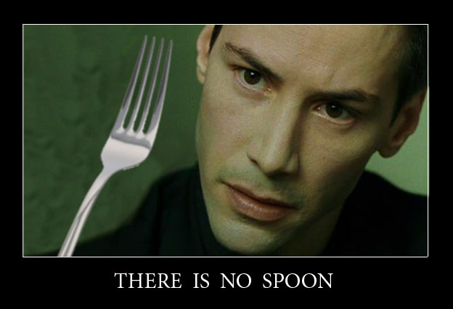
4 Types of lights*
Ambient
Light all around
Diffuse
The ‘colour’ of something
Specular
The ‘shininess’ of something
Emissive (luminance)
The ‘glow’ of a light source
* This is a total lie. Remember, there are no actual lights… but these are typical conventions that we are going to use

Slide 6
The
"Normal"

Slide 7
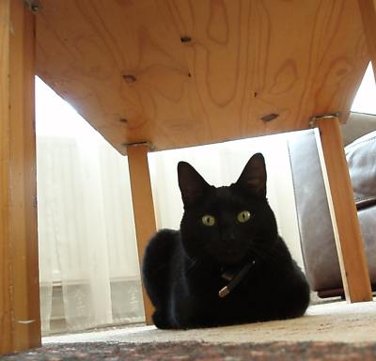
Ambient (reflection)
Unless you on the moon, if you can see anything, there is always ambient light.
This light isn’t direct, but reflected off all the surfaces in the environment.
Notice that the underside of this table is visible, though there are no lights shining directly on it.

Slide 8
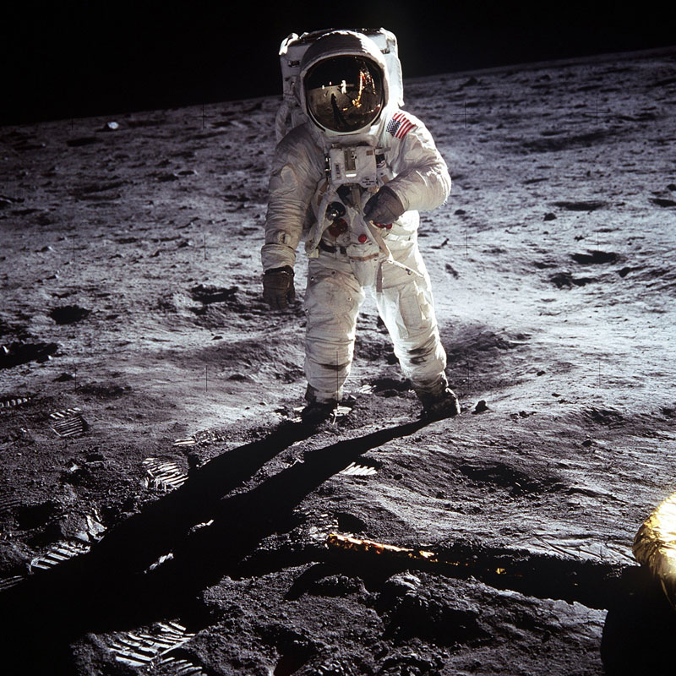
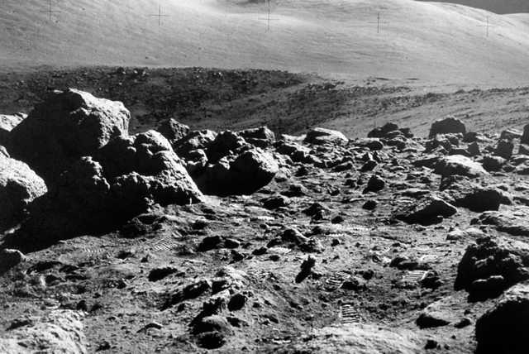
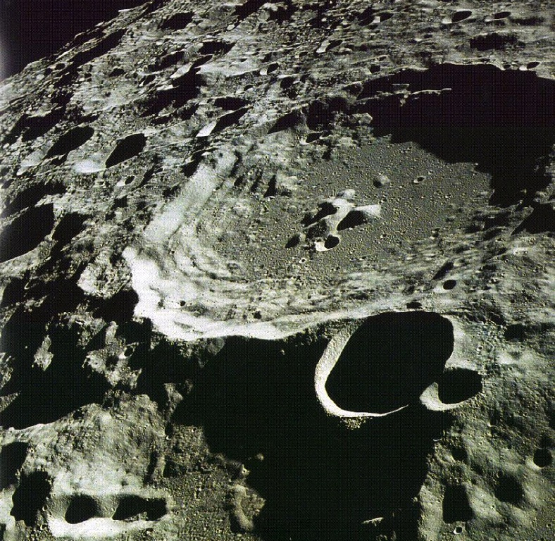
Ambient
Notice even Neil Armstrong’s shadow is completely black. If you put something in here, you couldn’t see it all. Can you see any of the surface in shadow?
This doesn’t happen on Earth. Even in a “shadow,” you can see something because of the “ambient” light.
Notice from these pictures of the moon, that the shadows are black. Not “dark,” but actually black with no light at all.

Slide 9
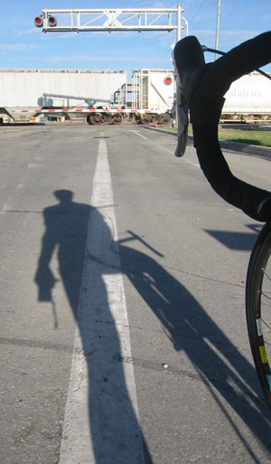

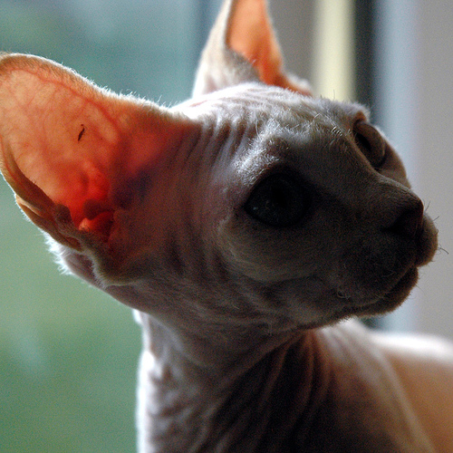
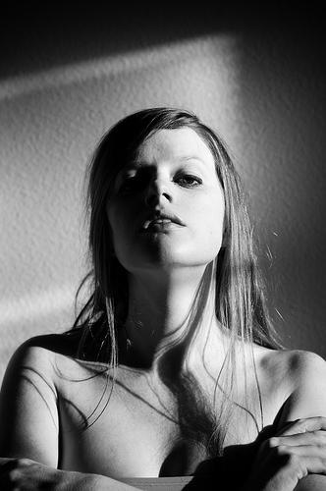
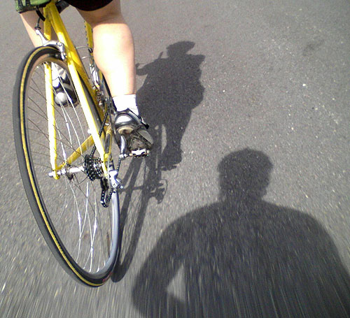
Ambient
This is the ambient light in the real world. Notice that it’s virtually impossible to get shadows that have no ambient component (that are completely black). In other words, if there is any light, then there is ambient.

Slide 10
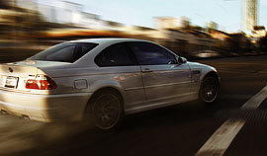

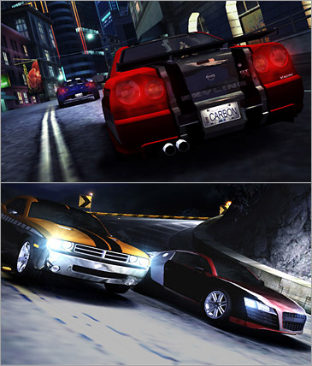
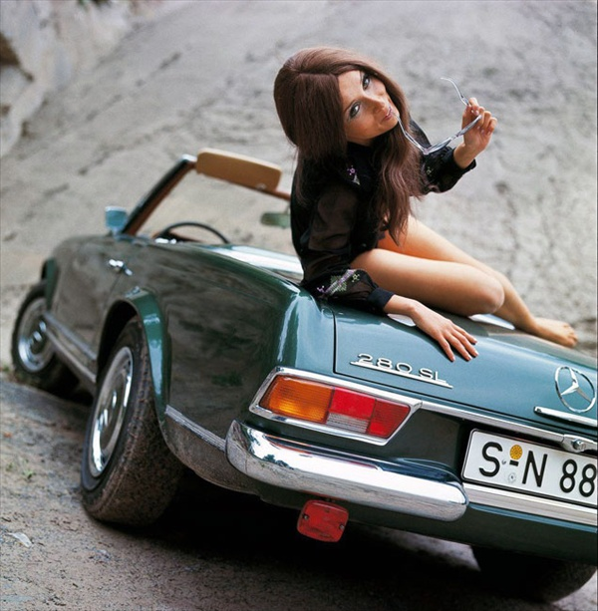
Ambient
The point is that ambient light is ‘always’ there, even in the ‘dark’ – notice how night-time lighting often appears ‘blue’ on TV.
But it’s not pitch black.
In fact, humans are very sensitive to this, and this “lack” or “wrong” ambience is often used in the entertainment and advertizing world…

Slide 11
Ambient light in graphics
You set the ambient light to be the lighting that is there when there is no other lights.
With ambient light set to zero:
You can’t see anything at all
You can only see items that are lit by other types of lights (directional, spots, etc.)
Without it, the lighting appears harsh or night-like

Slide 12
Diffuse (reflection)
Diffuse is the colour of something depending on the light that is reflected off
The colour is scattered evenly, so you can’t tell the light direction
In perfect diffuse reflection, the amount of light is even in all directions. This is why most things seem the same colour from any angle.

Slide 13
Diffuse (reflection)
The intensity can be based on the angle the light hits the surface, where the shallower the angle, the less light is reflected (but the colour stays the same).
This is also called Lambertian reflection

Slide 14
Diffuse and Ambient
Often the diffuse and ambient lights are often set to the same colour in the computer.
There are some exceptions…we’ll see them later (mainly metals, etc.)

Slide 15
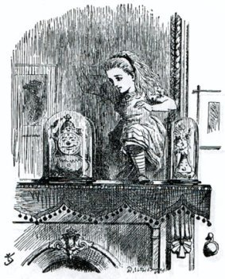
Specular
The ‘shininess’ or ‘luster’ of something
A mirror has perfect specular reflection
The light entering is perfectly reflected
Reflection exits at same angle as enters
Same angle

Slide 16
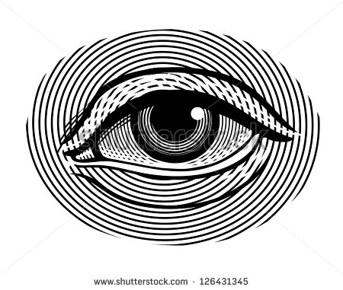
Extreme case: Jerk kid with LASER*
Ouch! Stupid little @^$%#!!
*also: LASER is an acronym, people!

Slide 17
Extreme case: Jerk kid with LASER*
Angle | Intensity
0 | 0
5 | 0
10 | 0
15 | 0
20 | 0
25 | 0
30 | 0
35 | 0
40 | 10
45 | 100
50 | 10
55 | 0
60 | 0
65 | 0
70 | 0
75 | 0
80 | 0
85 | 0
90 | 0
*also: LASER is an acronym, people!

Slide 18
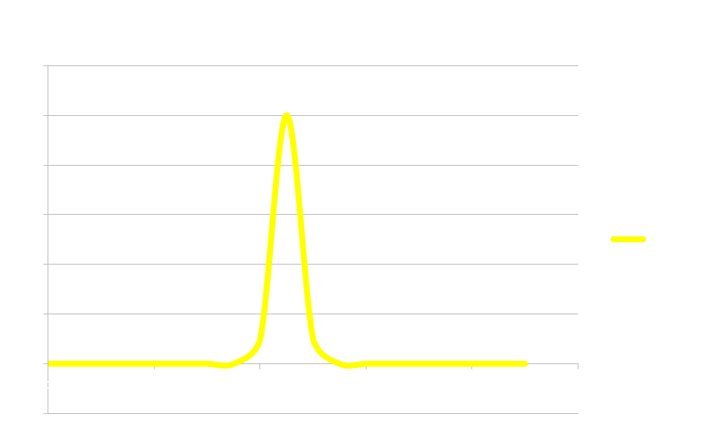
Extreme case: Jerk kid with LASER
Angle | Intensity
0 | 0
5 | 0
10 | 0
15 | 0
20 | 0
25 | 0
30 | 0
35 | 0
40 | 10
45 | 100
50 | 10
55 | 0
60 | 0
65 | 0
70 | 0
75 | 0
80 | 0
85 | 0
90 | 0

Slide 19
Now, instead of LASER, is flashlight...
Angle | Intensity
0 | 0
5 | 0
10 | 0
15 | 0
20 | 3
25 | 10
30 | 30
35 | 60
40 | 90
45 | 100
50 | 90
55 | 60
60 | 30
65 | 10
70 | 3
75 | 0
80 | 0
85 | 0
90 | 0

Slide 20
1.0
0.0
0.0
-1.0

Slide 21
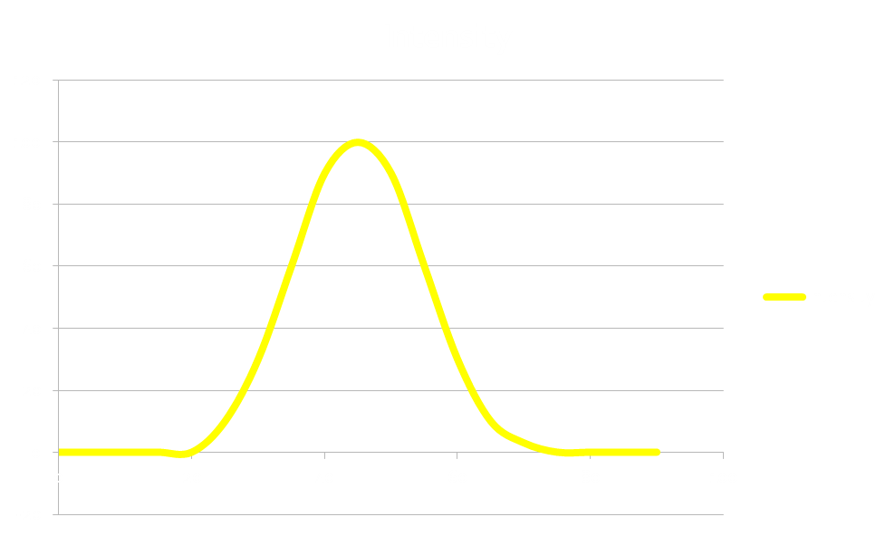
Now, instead of LASER, is flashlight...
Angle | Intensity
0 | 0
5 | 0
10 | 0
15 | 0
20 | 3
25 | 10
30 | 30
35 | 60
40 | 90
45 | 100
50 | 90
55 | 60
60 | 30
65 | 10
70 | 3
75 | 0
80 | 0
85 | 0
90 | 0

Slide 22
LASER v Flashlight: what’s the difference???

Slide 23
The
"Normal"

Slide 24
Vnorm = Cross(AB, AC)
B
Vnorm = Cross(B, C)
X = Cross(BA, BC,)
N
A
C
A = 5, -6, 27 → 0,0,0

Slide 25
Shader “Program”
Vertex shader
Fragment Shader

Slide 26
Normal
Notice that the angle is based on an imaginary plane exactly perpendicular (90°) from the surface.
This is the ‘normal’ to the surface

Slide 27
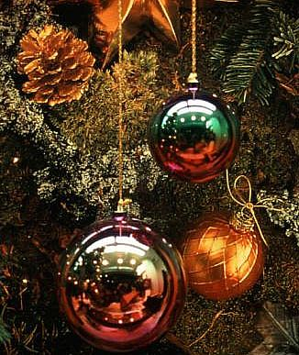
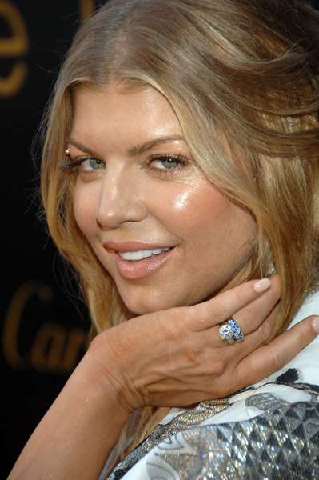
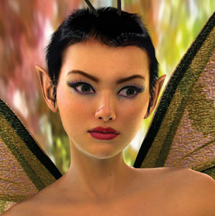
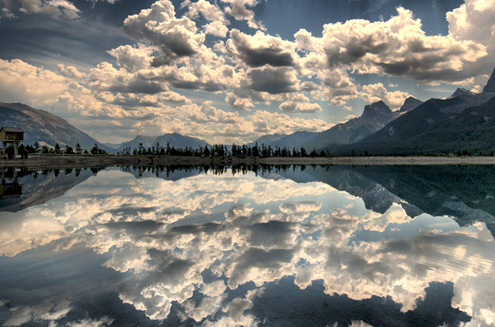

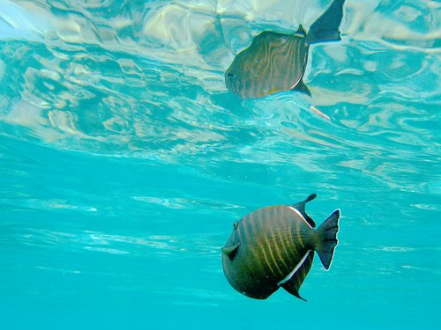
Specular
Other things have this property, too.
Water (at shallow angles)
Shinny things
Even your face…
This is the nVidia “Dawn” demo. A great deal of the realism is from the specular component.
(See “GPU Gems”)

Slide 28
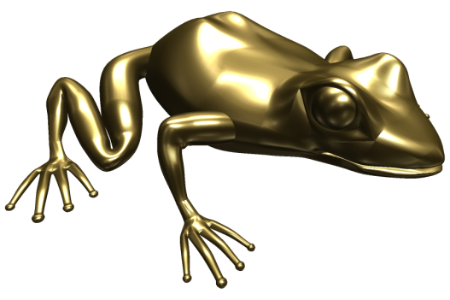
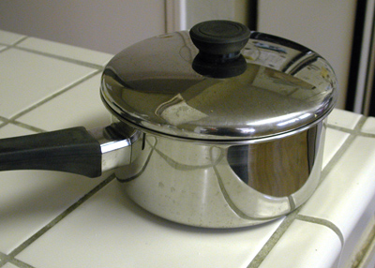
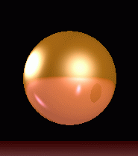
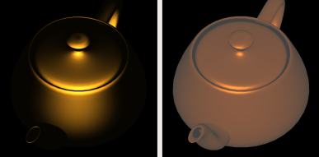
Specular
Look! A Cook-Torrance ‘solid gold’ frog!!
Most things are not mirror like, though
Based on the angle:
The reflected colour can change
metals exhibit this
The intensity (‘bright spot’) can change
Notice this teapot looks ‘gold’ because of the reflection colour and size (this uses the ‘Cook-Torrance’ lighting model)

Slide 29
Emissive
The light that ‘emits’ from a source
Note that in the real world, all lights are emissive when looked at. In computer graphics, emissive lights don’t’ actually give any light
Remember, what you are seeing is just an approximate mathematic model of how light interacts

Slide 30
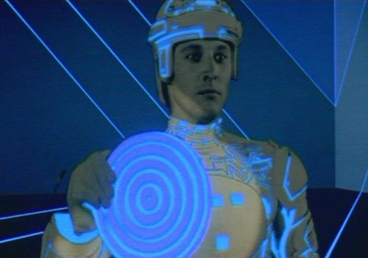
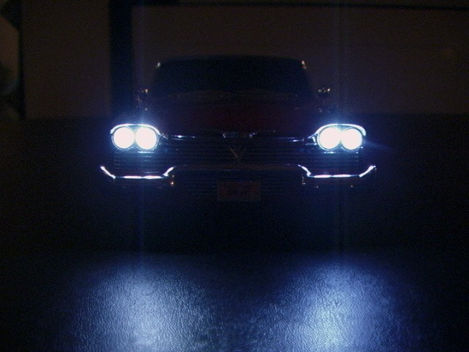
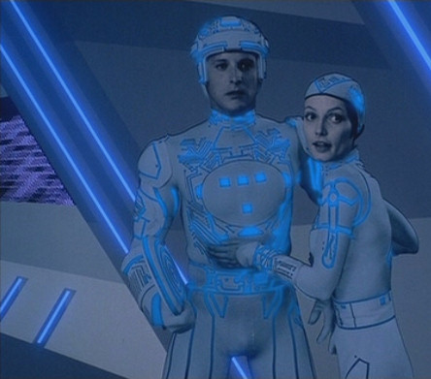
Emissive
Some examples:

Slide 31
Notice the emissive lights in the these screen captures from “Halo” and “Bioshock 2:”

Slide 32
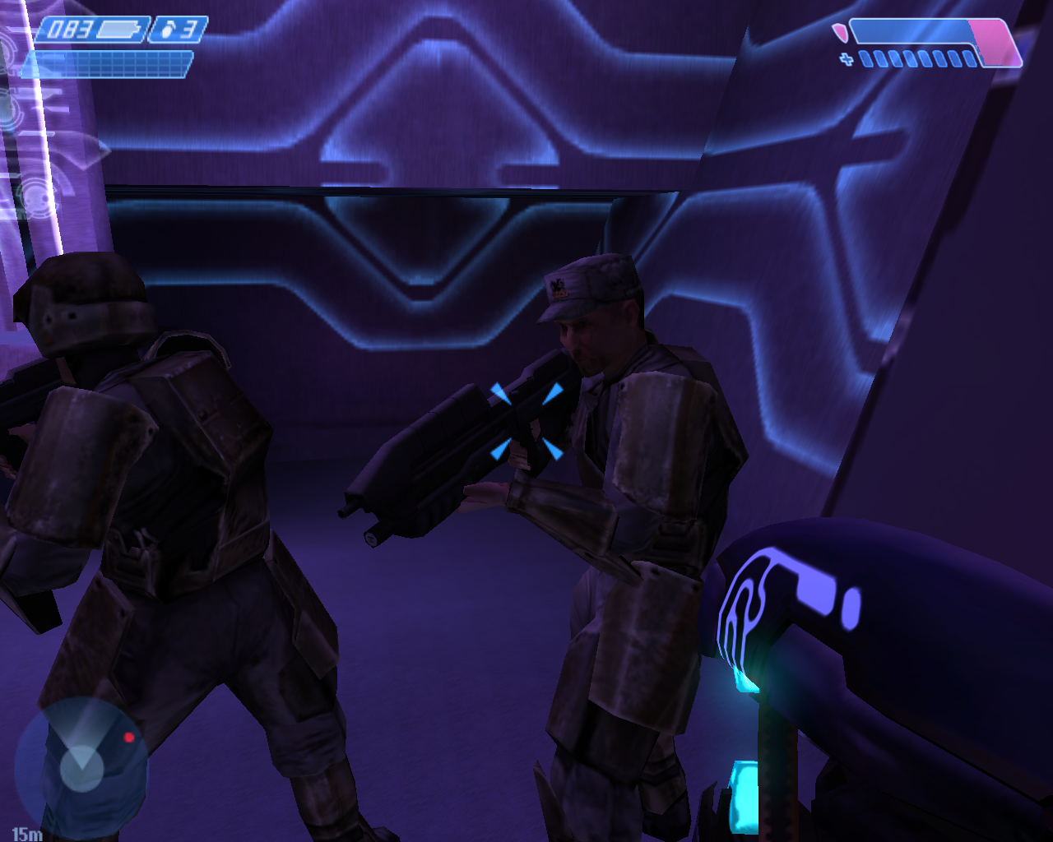

Slide 33
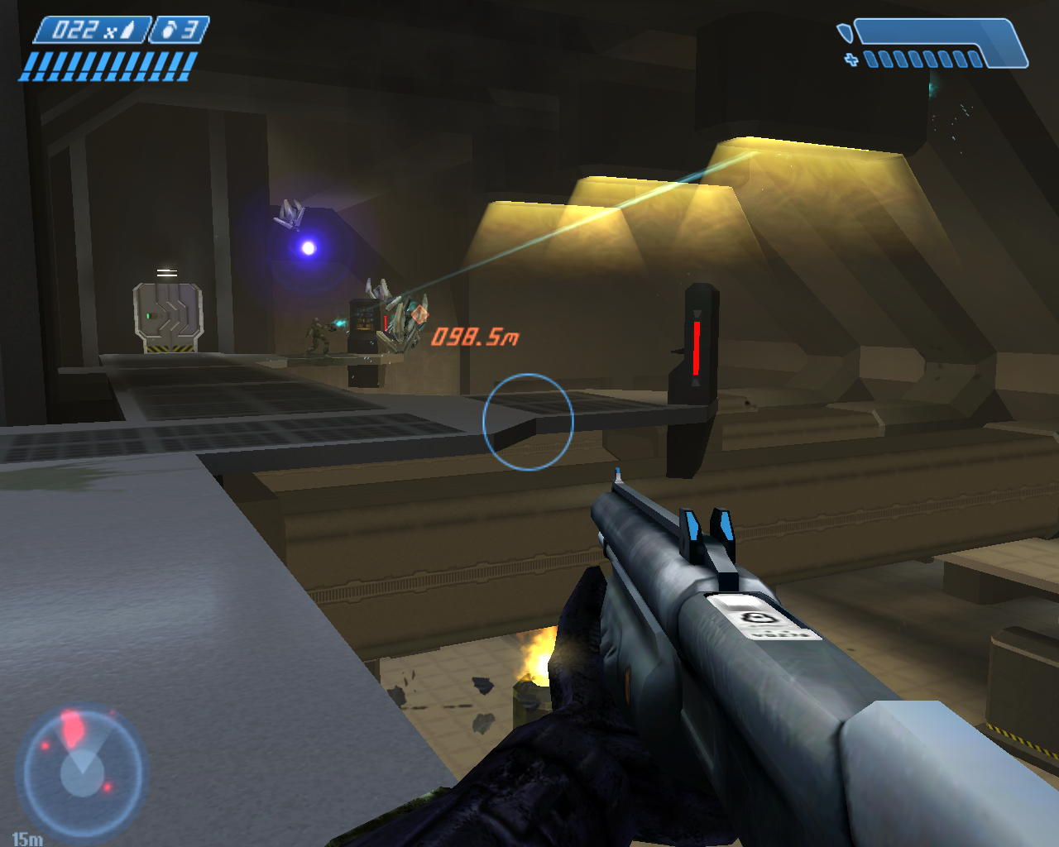

Slide 34
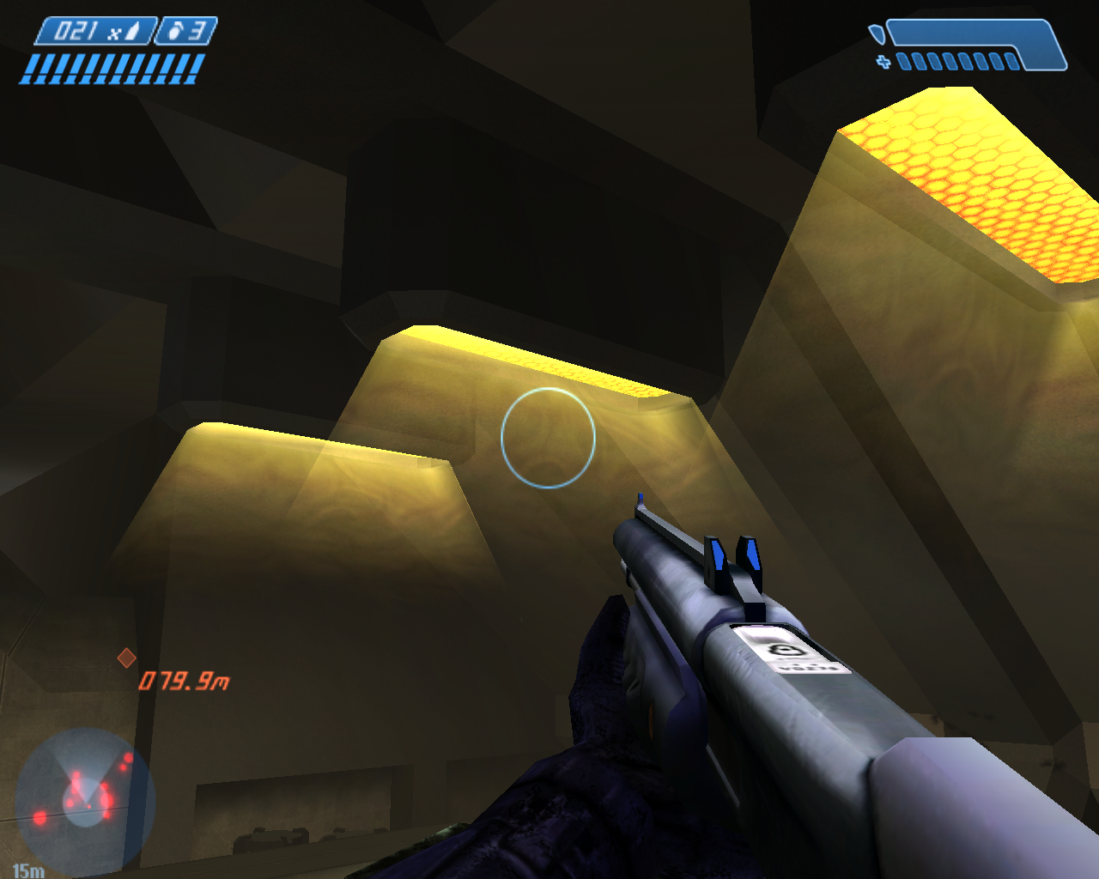

Slide 35
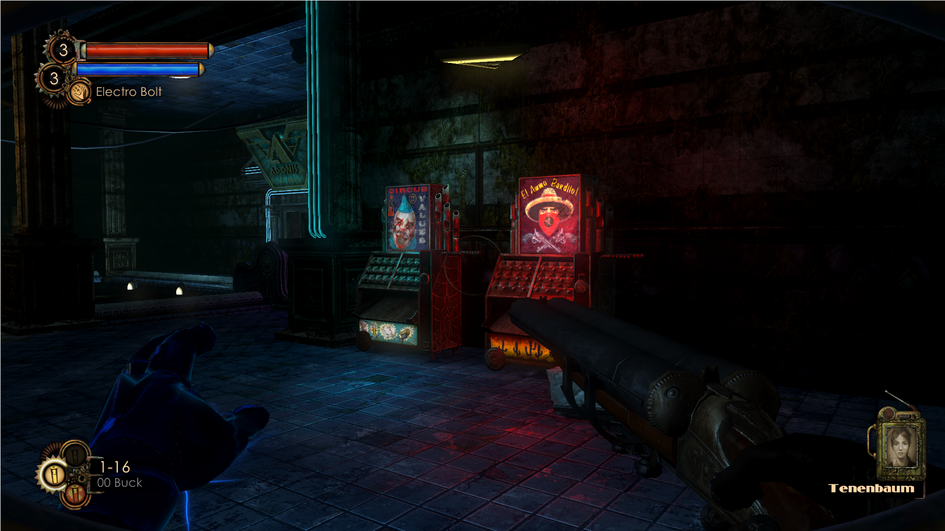

Slide 36
Now, OpenGL (or DirectX)
There is no lighting by default
Well, that’s not 100% true…
… there isn’t anything by default; we have to put that functionality into the shader
This means that if you want to see something, you have to specify or calculate the final colour of the pixels
Later, we will look at texturing
OpenGL/DirectX runs through some calculations to determine the colour of the surface (fragment/pixel)
NOTE: this is based on the surface colour and/or texture though

Slide 37
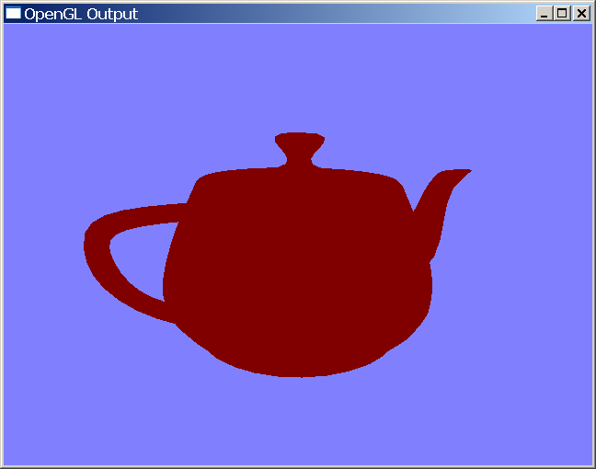
Ambient:
Lighting is everywhere
Independent of direction
Can’t see much
No details
You set it for the entire scene if you’d like:

Slide 38
Basic lights: Directional:
Comes from one direction
No ‘distance’ – infinitely far away
Simulates sun
Only specify direction and angle
Can specify distance – i.e. light only works within this distance, then gets ‘dark’

Slide 39
Basic lights: Point:
Light a light bulb
A specific location
Light spreads all around
Can’t specify direction, but can specify distance (i.e. where it gets ‘dark’)
More expensive than directional

Slide 40
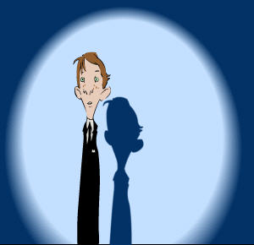
Basic lights: Spot:
Most expensive light
Like a point light, but also calculates umbra and penumbra (where the light hits, etc.)
penumbra

Slide 41
Material (aka “fancy colour”):
Specifies the interplay of the light with the geometry of the model
Specifies all the lighting characteristics (ambient, diffuse, specular, emissive)
Combines with colour, texture, and other things (bump, etc.) to calculate colour

Slide 42
Cross and dot product
Remember the ‘normal?”
Remember how you can’t (yet) see the lighting on the bunny?
That’s because the bunny doesn’t have any ‘normal’ vectors defined.
Also, you aren’t specifying any when you render them

Slide 43
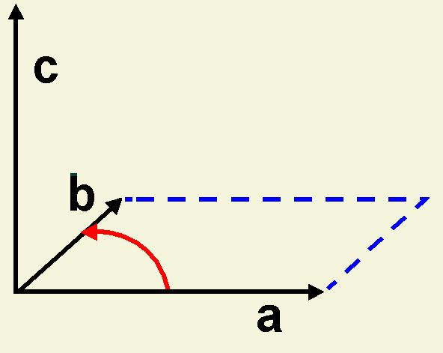
Cross Product
The cross product is a matrix calculation that allows us to generate the normal vector.
Neat.

Slide 44
Cross Product
But how do you calculate it?
Here’s the formula:
a X b = (ya zb- yb za) i + (za xb- zb xa) j + (xa yb- xb ya) k
Where a and b are the two vectors that you are getting the normal too

Slide 45
Cross Product
But how do you calculate it?
Here it is in code:
x0 = vertexA.x - vertexB->x;
y0 = vertexA.y - vertexB->y;
z0 = vertexA.z - vertexB->z;
x1 = vertexA.x - vertexC->x;
y1 = vertexA.y - vertexC->y;
z1 = vertexA.z - vertexC->z;
x = y0 * z1 - z0 * y1;
y = z0 * x1 - x0 * z1;
z = x0 * y1 - y0 * x1;
Final x,y,z is the vertex of the normal
B
A
C

Slide 46
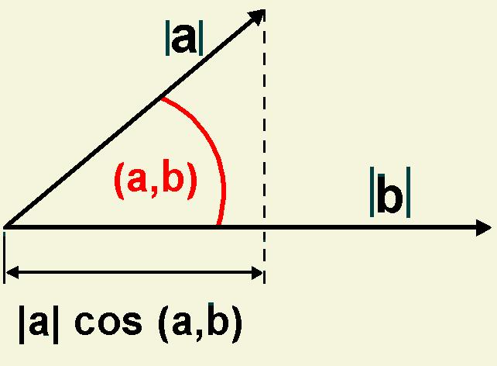
Dot product
The cross product produces a vector
The dot product produces a scalar
a single number, not three
Also called the “scalar” product
Represents the line along one vector ‘projected’ onto another

Slide 47
Dot product
a·b = xa xb + ya yb + za zb
Or:
(a,b) = arcos(a·b / |a| |b|)
Or:
Use GLM/DirectX/some other library

Slide 48
Dot product
Why do we care?
The sign of the dot product indicates if the triangle is facing away or towards us.
If we compare the dot product of a light with the surface, we can see if the light is hitting the ‘front’ or the ‘back’ of a triangle.
If it’s hitting the back, we don’t have to light it.
We can also figure out which way the triangle is

Slide 49
The bunny
The bunny has no normals.
We want to calculate the normals at each vertex.
But we only have triangle (face) information
i.e. we can only calculate the normal to the face?
Why?

Slide 50
The bunny
One way (not correct):
Calculate the normal at each face, and save it in all of the vertices
Overwrite them if needed.
Result: OK, but rough looking bunny

Slide 51
The bunny: correct
For each face:
Calculate the normal.
Use the dot product to see if it’s facing the centre (origin) or not (positive or negative)
If it’s negative, reverse it (1 – vector)
Add normal to current vertex normals (for all three vertices)
For each vertex:
Add up all the normals
“Normalize” them (to unit length of 1.0f)

Slide 52
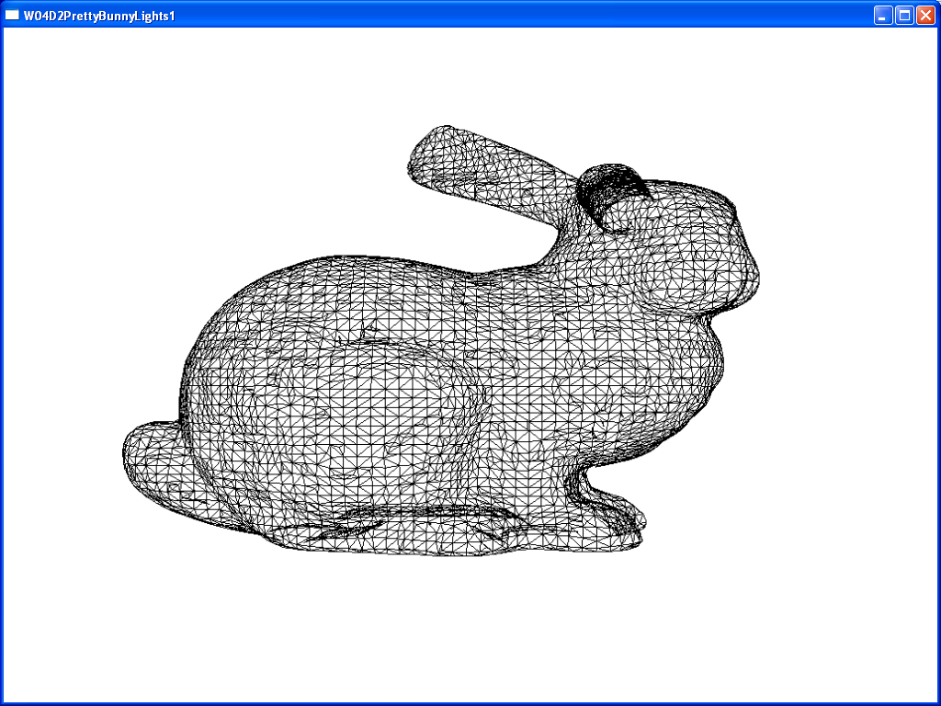
The bunny, with just the triangle edges (aka “wireframe”)

Slide 53
Turning on lighting
Recall:
There is no lighting
You need to create a shader file
You need to create the mathematical calculations that determine the colour of the vertex (or pixel) and place them into the shader
Decide if you want “per vertex” or “per pixel/fragment” lighting

Slide 54
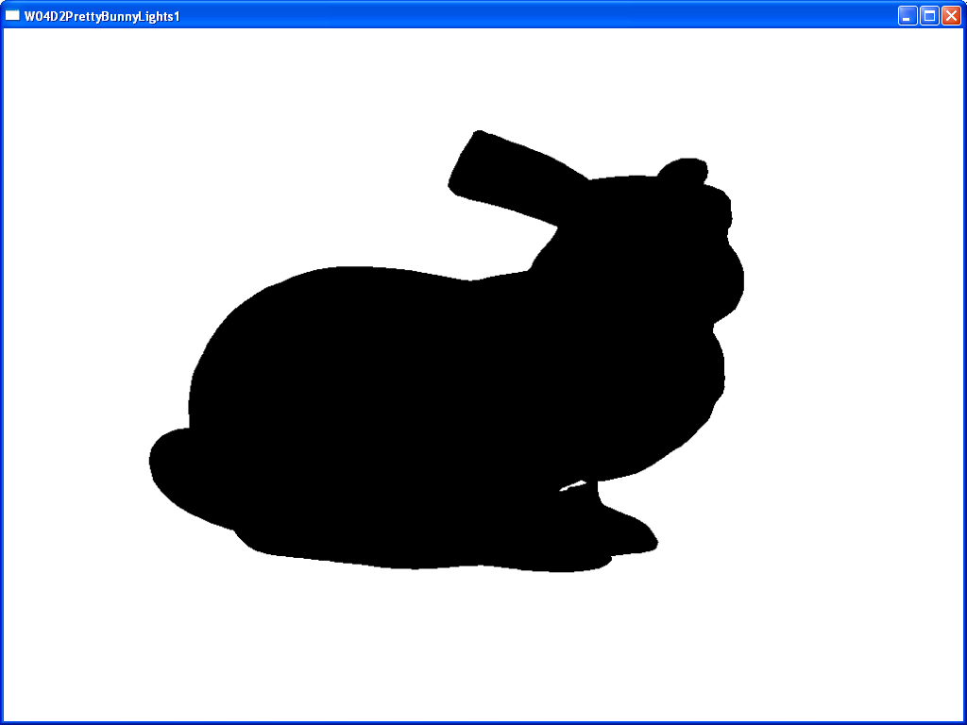
You get…
A bunny in the dark. Great.

Slide 55
What’s wrong?
Most of the lighting calculations (except for ambient and emissive) rely on the interaction with the normal
But, the bunny has no normals.
Curses!
We need to calculate the normal and we need to calculate it at each vertex

Slide 56
How to calculate?
The “cross product” will do it
Recall that a cross product returns the vector perpendicular to the plane made by two other vectors…
Normal
vec1
V2
90°
V1
V3

Slide 57
How to calculate?
Normal
vec1
V2
90°
V1
V3
vec1 = difference between V2 and V1
vec2 = difference between V3 and V1
Note that vectors are only direction and distance
i.e. there is no absolute starting or ending point
They are ‘relative’ to some starting point
you can assume the starting is anywhere
These ‘vectors’ have only a single x,y,z because we assume that the ‘start’ is at 0,0,0 (the origin)
vec2

Slide 58
“Identity” matrix and “normalization”
An “identity” matrix is a matrix where the numbers on the diagonal are 1.0 and everything else is 0.0
Say what?
It’s like the number 1.0, where anything multiplied by 1.0 will be the same number
Any matrix multiplied by an “identity” matrix will be the same matrix
So it’s a good thing to start with an identity matrix.
Notice that we passed the world matrix to a DirectX “identity” function before we first used it?
What would the values be if we didn’t? Think about it.

Slide 59
“Identity” matrix and “normalization”
A ‘normalized’ vector is one that “fits” into an identity matrix
In other words, the vector is scaled so that the length of the vector is 1.0
V2
Vector length = 5.6
Vector length = 1
V2
V1
V1
Note that this coordinate will change (be scaled) so that the length “fits”

Slide 60
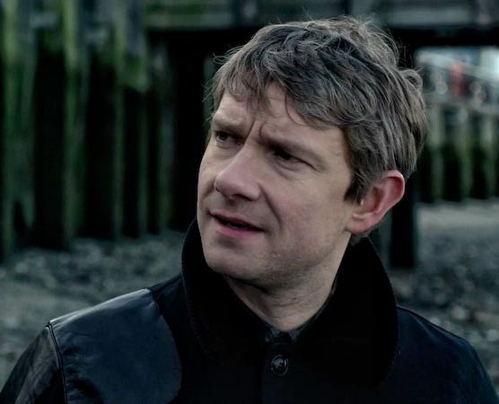
“Identity” matrix and “normalization”
How do you get the length of a vector?
Length = (z₂-z₁)²+(y₂-y₁)²+(x₂-x₁)²
“Good gracious my dear Holmes, that looks like Pythagoras…”
Assuming that your vector starts at 0,0,0 (which our normals do), then you divide each coordinate by the length:
x_{normalized} = x / length
y_{normalized} = y / length
z_{normalized} = z / length

Slide 61
Vertex normal
There’s a teeny, weeny, little problem is that the “normal” is calculated from the face (triangle) not the vertex, but the lighting is based on the normal to the vertex
Say what?
Well, a vertex can’t really have a normal, only a face (triangle) can
What vector (line) is perpendicular to this point?
Remember, it’s a point, not a circle.
How would you even calculate it? Does it even make any sense?

Slide 62
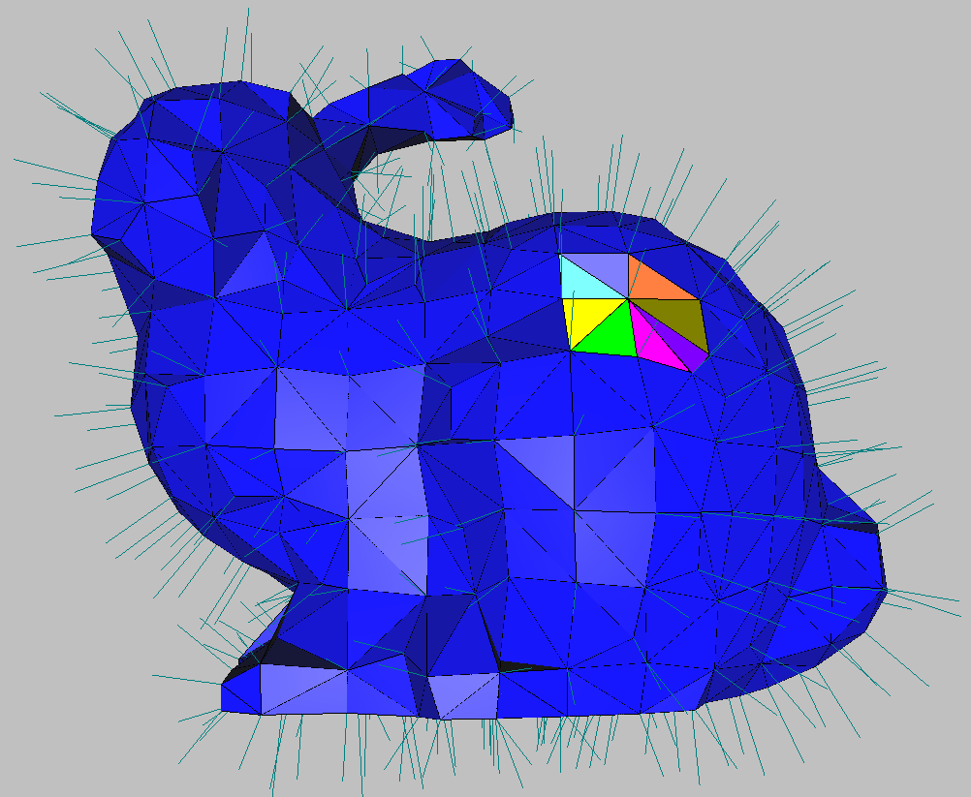
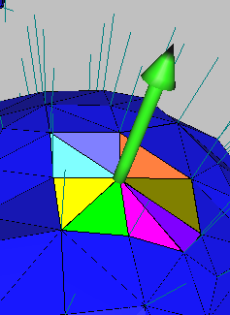
The vertex normals are the average of all the face normals around them

Slide 63
Normal calculation (good enough for rock-n-roll)
The ply model has only triangles and vertices, but we need normals.
One simple/easy way is to go through all the faces, calculate the normal to that face,
and store the normal with the vertices of that face.
Face Normal
V2
V1
V3

Slide 64
Normal calculation (good enough for rock-n-roll)
Pro: Simple.
Con: Later normal calculations overwrite previous calculations & all vertices of a face point exactly the same way
But is that really so bad?

Slide 65
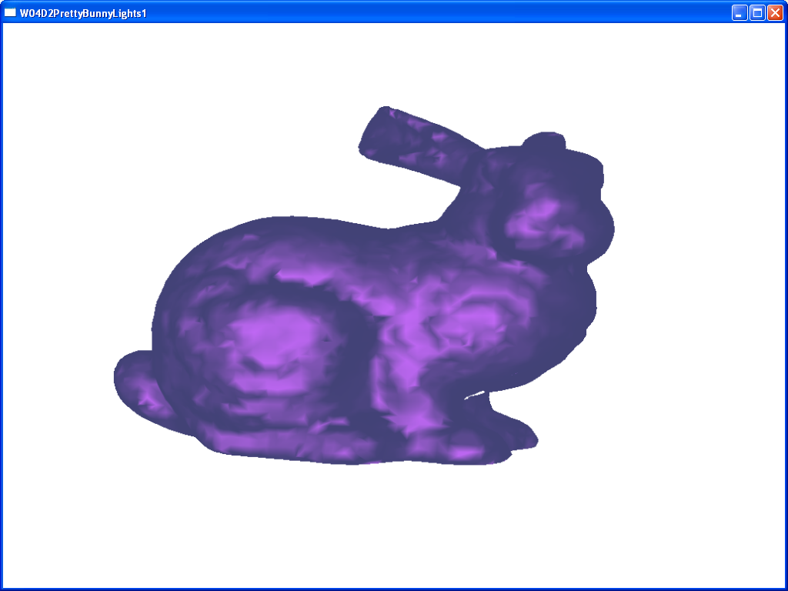
That doesn’t look too bad, does it?
Notice that this model has specular highlighting enabled to accentuate the surface normals.

Slide 66
Vector math
If you add a bunch of vectors, you get a resultant vector.

Slide 67
y
c
C = sqrt(x^2 + y^2 + z^2)
000
X

Slide 69
Vector math
You can think of this as tacking the vectors end to end, then seeing where you end up.
Going from the start to the end is the resultant.

Slide 70
Vector math
Now, if you ‘normalize’ the resultant, you get the average of all the vectors.
Pretty neat, huh?
Normalized resultant

Slide 71
Normal calculation (A better way)
The vertex normal is an average of all the face normals around it
You can add all the normals up, then, at the end, take the average (“normalize”) them

Slide 72
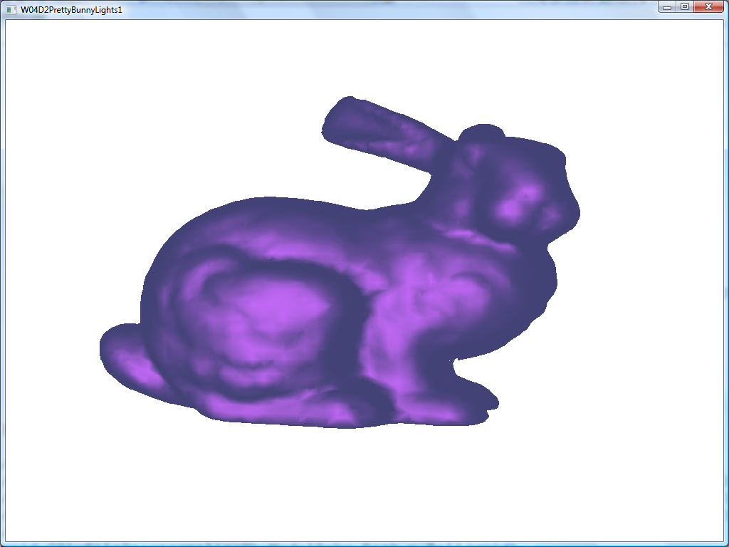
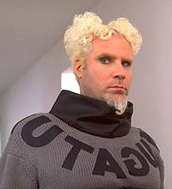
It’s…it’s…so beautiful…

Slide 73
Shading
The ‘shading model’ is how the insides of the triangles are drawn.
More specifically, what type of mathematical trickery is being done to give the illusion that there is a surface
Three common “classic” ones are:
Flat, Gouraud, and Phong, or
Flat, Per Vertex, and Per Pixel

Slide 74
Flat
Before a line of pixels is being drawn inside of a triangle, the normal for the face (used for lighting) is calculated based on the average of its normals
i.e. we get back to a ‘face’ normal
The lighting is calculated and a colour is chosen.
Then the entire face is drawn in that colour.
Pro: Very, very fast
Con: Looks, well, flat.
NOTE: With a programmable shader, you would have to add vertices to get this same effect.

Slide 75
Gouraud
Discovered by Mr. … you can guess
Take the normal value at each vertex, then calculate the colour at that point
Linearly interpolate from one end to the other as we draw
Pro: Looks better, not too bad on CPU/GPU
Con: Low poly count = missed highlights
Note: Gouraud is still used for interpolation across the primitive surface (even now in OpenGL 4.5!)

Slide 76
Phong
Discovered by Mr. … you can guess
Like Gouraud, but instead of interpolating the calculated colour, interpolate the actual normal, then calculate the colour
Pro: Looks much better than Gouraud
Con: Expensive (not implemented in the fixed function shader, for example, but commonplace in shader based lighting)

Slide 77
Blinn-Phong
An optimization of Phong, where part of the calculation is reused or interpolated (rather than calculated per pixel fragment)
Can be faster
Almost the same look, but may have to increase the specular value to get similar looking results

Slide 78
Z/depth buffer
As the triangles are drawn, the render needs to determine which triangles are in front of other ones.
This is quite complex.
We could draw from back to front
But this is quite complex, too (see above)
Or we could store the Z location (depth) for each pixel and only overwrite if the pixel is closer
This is a Z-buffer

Slide 79
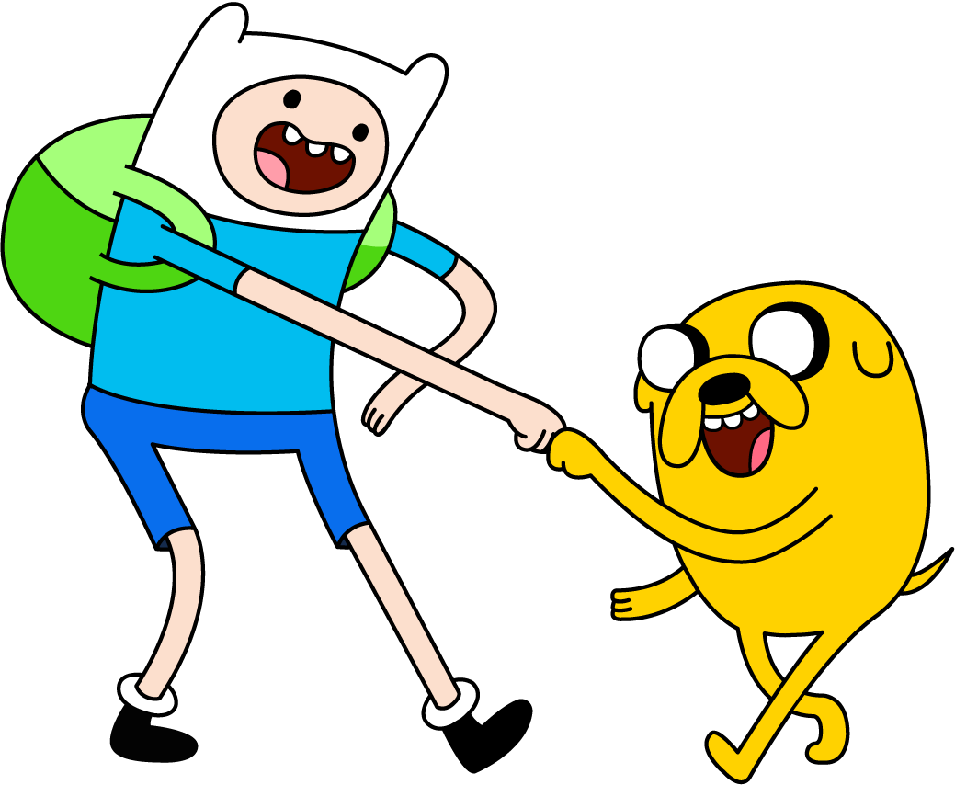
The adventure continues...

