Slide 1

Long Island Real Estate History
Playing the Data Cleanup and Presentation Games
By Sonia Tan & Fernando Hernandez

Slide 2
The Process
F
1: Collect & Filter Raw Data
However, these datasets were nationwide.
Tools Used: Personal SQL-Like Function
2: Review & 3: Cleanup Data
Filter out columns we weren’t using, parse potential relations
Tools Used: Pandas & Numpy
4: Python Analysis
Make (Nice Looking) plots and regression analysis
Tools Used: Seaborn & SciKit-Learn

Slide 3
1: Collect Raw Data
F
We began this project thinking we could analyze Year-over-Year trends in the housing market using Zillow’s ZTRAX Dataset. Formerly made freely available to academic, non-profit and government researchers, the only possible access to the dataset now lies behind paywalls.
We’ve scoured the web for resources, and found two major resources for datasets:
Both datasets had a problem: Filtering for Long Island specifically
Redfin’s Metrics Data
Nearly clean dataset to parse thru.
Info on how fast houses left the market.
Added avg interest rates per period from Freddie Mac
Consumer Financial Protection Bureau
We’ve obtained very, very large (5+GB) datasets.
For computing plots and regressions,
I kept the dataset limited to 2022

Slide 4
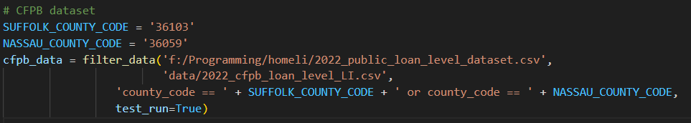
Filtering for Long Island
F
Fernando created a filtering function to automatically filter a given dataset by SQL-like Filters.
https://github.com/Fefe-Hern/Living/blob/master/csv_query_filter.py
Can be used as a function, or in the command line:
python csv_query_filter.py input.csv output.csv ‘region == “Suffolk County, NY” | region == “Nassau County, NY”
data_prep.py

Slide 5
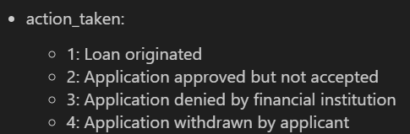
2: Review Data
S
Sonia reviewed each dataset and provided insight on each csv
Roper was cut out as public opinion datasets was difficult to work with and constrained to June 2022
Freddie Mac had too many irrelevant columns, and we were left with something identical to CFPB.
CFPB was a large dataset consisting of 99 columns. Fernando had to run it on his PC to clear out irrelevant columns like applicant_age_3 (_4, _5). He found references to some field values in a databook

Slide 6
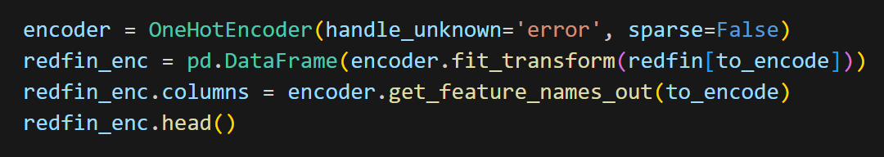
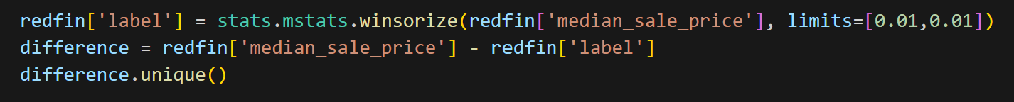
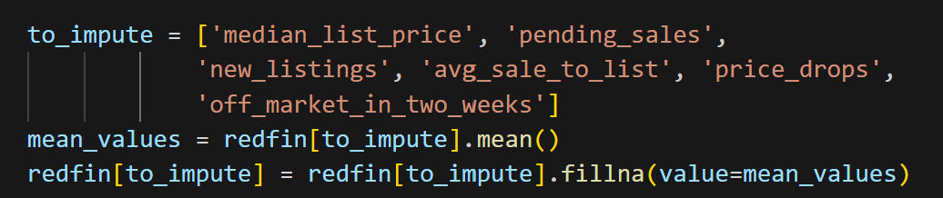
3: Data Cleanup
S
The main challenges we faced while cleaning the data were:
Null values
String object columns
Irrelevant or repetitive columns
Outliers

Slide 7
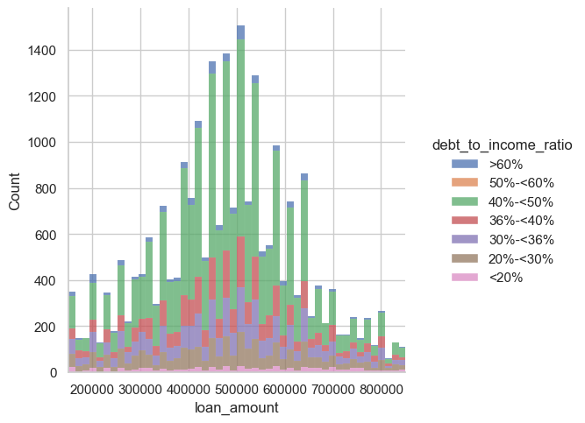
4: Python Analysis (CFPB)
F
The most loans being processed are for $450k-$550k
From my experience: A proper Debt-To-Income Ratio is 36% or less.
Half or more of each loan amount meets or exceeds this ratio.

Slide 8
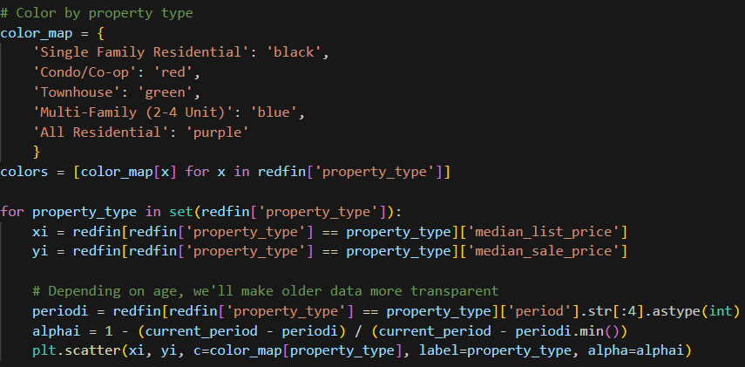
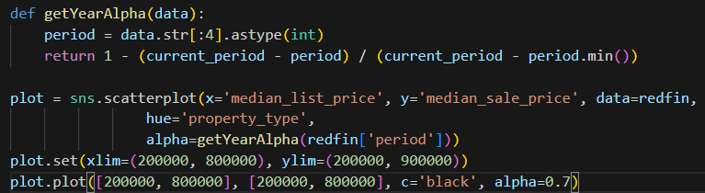
4: Python Analysis (Redfin)
F
We’ve used Seaborn, a wrapper around MatPlotLib that gives an easier interface to display data.
MatPlotLib plotting: (Not all the code) Seaborn Plotting:

Slide 9
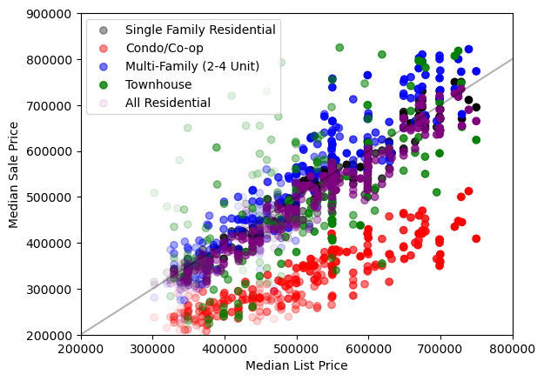
F

Slide 10
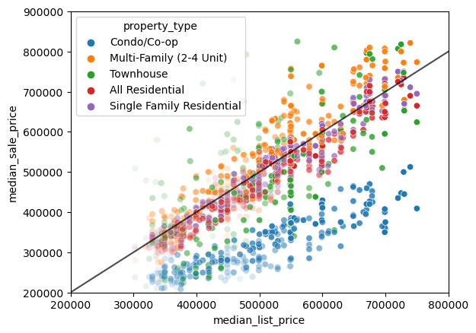
Takeaways
F
People are listing Condos and Co-ops at a higher price then they are being sold for.
Multi-Family homes are either being sold at the listing price, or generally higher. Faded (historical) points show this wasn't always the case.
As time went on, house prices trended both upwards and more towards the listing price rather than listed high / sold low.

Slide 11
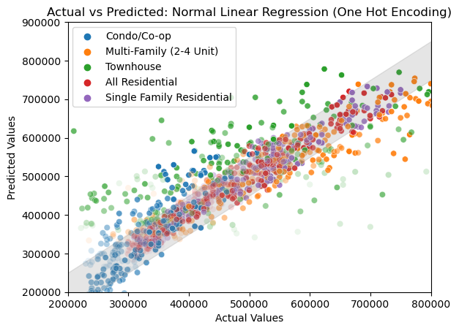
Regression Analysis (Post One-Hot Encoding)
S
Linear Regression Model (R²=0.64)
Fernando’s Raw Data
Final Features: List Price, Property Type, Timestamp, Interest
Pros: Appeared to fit single family homes well, likely due to little variance between list price and sale prices.
Cons: Condos and Townhouses were overestimated
Before One Hot Encoding: Little weight was placed on property type. Every single condo was predicted higher

Slide 12
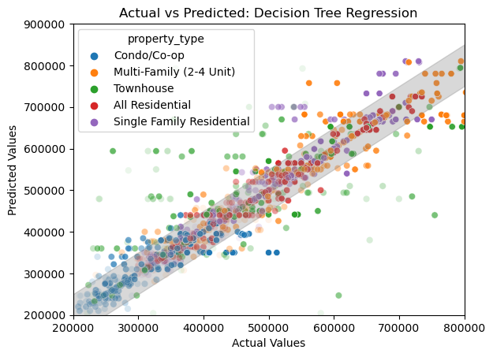
Regression Analysis
S
Decision Tree (R²=0.51)
Pros: Near 1-1 prediction for some homes. Single Family nearly all fit within expected parameters
Cons: Townhouses, and newer data typically miss the mark by wide margins of error.
This calls for fine tuning our models…

Slide 13


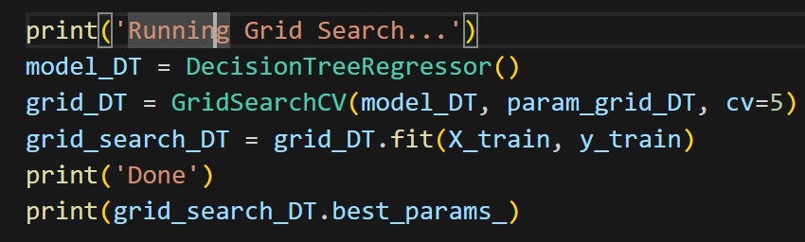
Hyperparameter Tuning and Model Validation
S
Models have hyperparameters that can be changed to increase model performance
One method of finding the optimal hyperparameter is using grid search
The grid search we used also implements cross validation

Slide 14
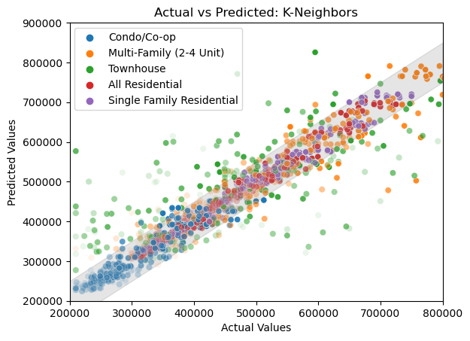
Regression Analysis (Post Grid Search)
S
K-Nearest Neighbors (R²=0.758)
Pros: Nearly all types of houses within prediction margins. Less variance for predictions.
Cons: Townhouses still fall outside margins of error. They may have sporadically different features.
Ranked the highest out of all model performances

Slide 15
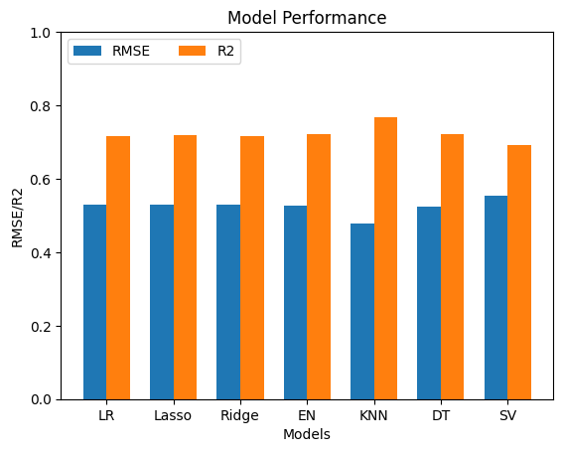
Model Performance Evaluation
S
Some metrics we used to evaluate our models were:
Root Mean Squared Error
R2
Mean Absolute Error

Slide 16
To Summarize
F
Yes, Long Island has seen a distinct price increase, with more people looking to apply for a loan more than the recommended Debt-To-Income Ratio (DTI)
The median condo will typically be listed much higher than they are sold for. This means they will drop in price, or a lower offer could be accepted.
Programming Concepts
Sonia’s cleaned datasets provided a more accurate linear regression fit than any strategy using the basic dataset.
By creating a numerical-focused dataset and normalizing features, we were able to achieve higher accuracy for prediction models.
Git with .ipynb’s have issues with the metadata, making it difficult to view merge changes on VS Code.

