Slide 1
PermitLink
Event-Driven Integration of the Permit Application, Treasury, and Notification Systems for LGU Business Permits
Project Lead / Architect: Jose Arym Diaz III
Integration Developer: Princess Haneen Dibarosan
Data and Security Lead: Jericho M. Fegason
QA and Documentation Lead: Hannah L. Alcantara
Team Nexora · Prefinal Project Proposal · ITPC 313 – System Integration and Architecture · November 2026
Notes:
Introduce PermitLink and the team in under 30 seconds. One line to remember: PermitLink connects the permit office, the treasury and the notification service so applicants stop carrying paper receipts between offices. Introduce each member with their role.

Slide 2
The problem
Slide 2 · 0:4
Presenter: Hannah L. Alcantara
1 File at the BPLO
2 Get an order of payment
3 Pay at the Treasurer's Office
4 Carry the paper receipt back
5 Staff retype the receipt
Siloed
Payment is recorded only in the Treasury System. The permit system cannot see it.
Re-encoded by hand
Staff retype receipt number, amount and date from paper: typos and mismatches.
The cost
Repeat trips, queues and delayed permits. Applicants learn of approval only by calling.
The applicant is the messenger between two systems that cannot talk.
Notes:
Set in a generic Philippine LGU. The applicant files at the BPLO, gets an order of payment, pays at the Treasurer's Office, then brings the paper receipt back. BPLO staff re-encode the receipt number, amount and date by hand. The two systems cannot see each other, so the applicant is the messenger. Result: repeated trips, queues, typing errors and delayed permits. Applicants only learn of approval by returning or calling. All data in the project is synthetic.

Slide 3
Systems involved
Slide 3 · 0:
Presenter: Princess Haneen Dibarosan
System | Owner | Data held | Interface
Permit Application System | BPLO | Applications, status, assessed amount | REST API; consumes payment.posted; publishes permit.approved
Treasury System | Treasurer's Office | Payments, receipt numbers | GET /payments/{id}; publishes payment.posted
Notification Service | LGU IT/MIS Office | Notification log | Consumes permit.approved; no public API
Message Broker (RabbitMQ) | Shared / IT/MIS | Messages in transit only | AMQP publish/subscribe
Notes:
Four systems. Permit Application System (BPLO): Node.js/Express with PostgreSQL; receives applications, tracks status, approves permits. Treasury System (Treasurer's Office): Python/FastAPI with PostgreSQL; records payments and issues receipts. Notification Service (LGU IT/MIS): Node.js worker; sends notices when events occur. Message Broker: RabbitMQ; carries payment.posted and permit.approved reliably. Each system owns its own database and the systems never share one.

Slide 4
Objectives and scope
Slide 4 · 1:0
Presenter: Hannah L. Alcantara
General objective: remove the need for applicants to carry proof of payment between offices, using REST, a message broker and events.
95%
of REST replies under 500 ms at 50 users
99%
of payments synced within 5 s, none lost
10 s
to send the approval notice
0
extra personal fields cross systems
<5 min
to start with one command
In scope
3 flows, error handling, service tokens, audit log
Out of scope
Real data, payment gateways, fee computation
Mocked
Both systems, mail sink, fake data
Notes:
General objective: design and demonstrate an integration of the Permit Application System, Treasury System and Notification Service that removes the need for applicants to carry proof of payment. Five measurable objectives: (1) REST status check, 95% of requests under 500 ms at 50 concurrent users; (2) payment.posted reflected within 5 seconds for 99% of payments, zero lost or duplicated; (3) approval notice within 10 seconds; (4) data minimization, 0 extra personal fields; (5) start everything with docker compose up in under 5 minutes. In scope: the three flows, a simplified workflow, API contracts and event schemas, error handling, service-to-service authentication and audit logging. Out of scope: real LGU systems or data, full permit requirements, payment gateways, fee computation, renewals, production hosting. Mocked: both business systems as simplified services, the mail sink, all identities and payments. Limitation: lab numbers will not match a real LGU network; one payment per application and one permit type.

Slide 5
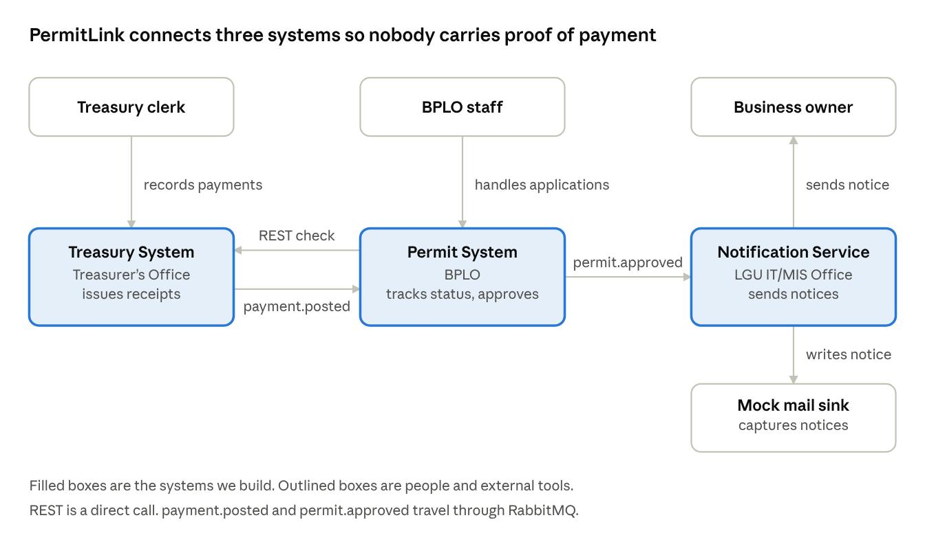
C4 Context diagram
Slide 5 · 1:15
Presenter: Jose Arym Diaz III
Hybrid integration
REST for the instant status check
Durable queue for payments
Pub/sub event for approvals
Hub-and-spoke through RabbitMQ
Notes:
Three people, three systems, one external tool. The Treasury clerk records payments in the Treasury System. BPLO staff handle applications in the Permit System. The Business owner receives the notice from the Notification Service, which writes to a mock mail sink. REST is a direct call from Permit to Treasury; payment.posted and permit.approved travel through RabbitMQ. Style: hybrid integration. Topology: hub-and-spoke for the two asynchronous flows plus one point-to-point REST call.

Slide 6
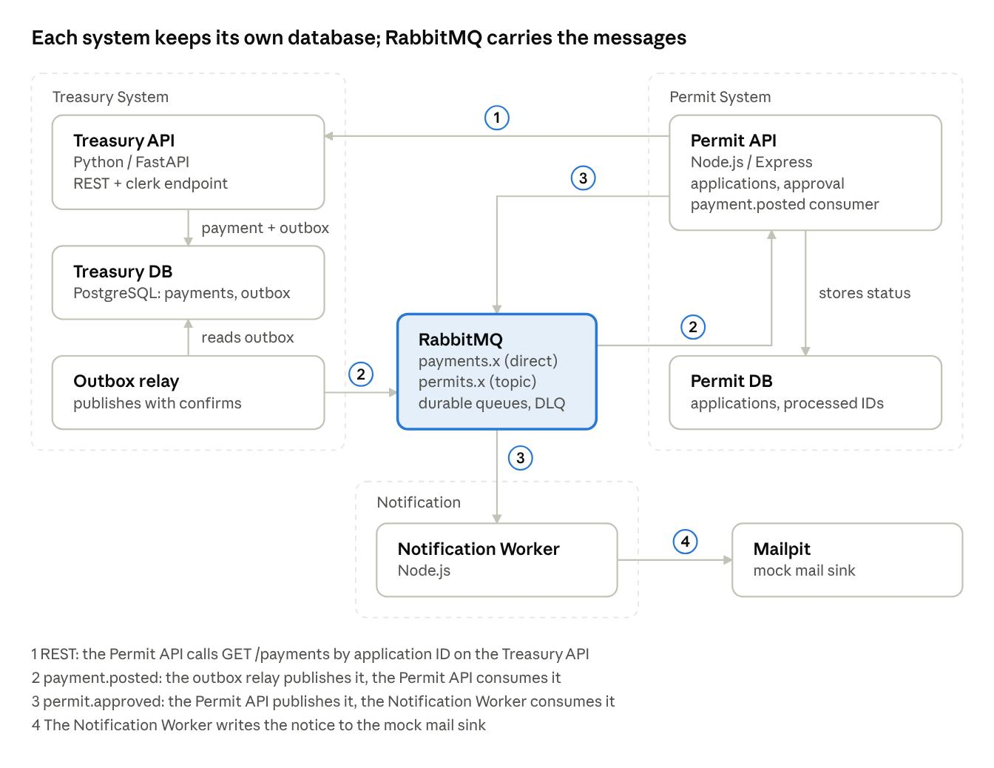
C4 Container diagram and topology
Slide 6 · 1:15
Presenter: Jose Arym Diaz III
Rejected | Why not
REST only | May lose payments
Shared database | Breaks ownership
Webhooks | No durability
Kafka / ESB | Too heavy
Chosen: REST + durable queue + topic exchange
Notes:
Seven containers in three system boundaries. Treasury: FastAPI API, PostgreSQL database and an outbox relay. Permit: Express API and PostgreSQL database. Notification: a Node.js worker writing to Mailpit, the mock mail sink. RabbitMQ in the middle with a direct exchange for payments, a topic exchange for permits, durable queues and a dead-letter queue. Four numbered flows: (1) REST check, (2) payment.posted, (3) permit.approved, (4) notice to the mail sink. Alternatives rejected: REST only could lose payment notices; a shared database breaks ownership and exposes extra fields; webhooks have no durability or replay; batch files are too slow for the 5-second target; an enterprise service bus is too heavy for a laptop; Kafka is more than needed for about 50 messages a minute. The whole prototype runs as seven containers on one laptop with Docker Compose.

Slide 7
Integration flows
Slide 7 · 1:30
Presenter: Princess Haneen Dibarosan
Flow | Style | Direction | Payload
1 Payment status check | REST GET | Permit → Treasury | status, amount, receiptNo
2 payment.posted | Durable queue | Treasury → Permit | applicationId, amount, receiptNo, postedAt
3 permit.approved | Pub/sub topic | Permit → Notification | applicationId, businessName, ownerName
Submitted
Payment pending
Payment confirmed
Approved
Notice sent
Every message: messageId · type · occurredAt · schemaVersion · correlationId
Notes:
Flow 1, REST: the Permit System calls GET /payments/{applicationId} on the Treasury System and gets PAID, UNPAID or NOT_FOUND with amount and receipt number; used when a current answer is needed right now. Flow 2, payment.posted: when the clerk records a payment, Treasury publishes to payments.x and the Permit System consumes it from a durable queue and marks the application PAID; payments must never be lost. Flow 3, permit.approved: when a permit is approved, Permit publishes to permits.x (topic) and the Notification Service consumes it and sends the notice; approval must not depend on notification, and new channels like SMS can be added without touching the publisher. Application status moves from SUBMITTED to PAYMENT_PENDING, PAYMENT_CONFIRMED, APPROVED, then NOTICE_SENT. Approval happens only if payment is confirmed and the amount matches the assessed amount. Canonical data model: Application, Payment, ProcessedMessage, NotificationLog, AuditLog. A JSON Schema per message forbids extra fields. Every message carries an envelope with messageId, type, occurredAt, schemaVersion and correlationId.

Slide 8
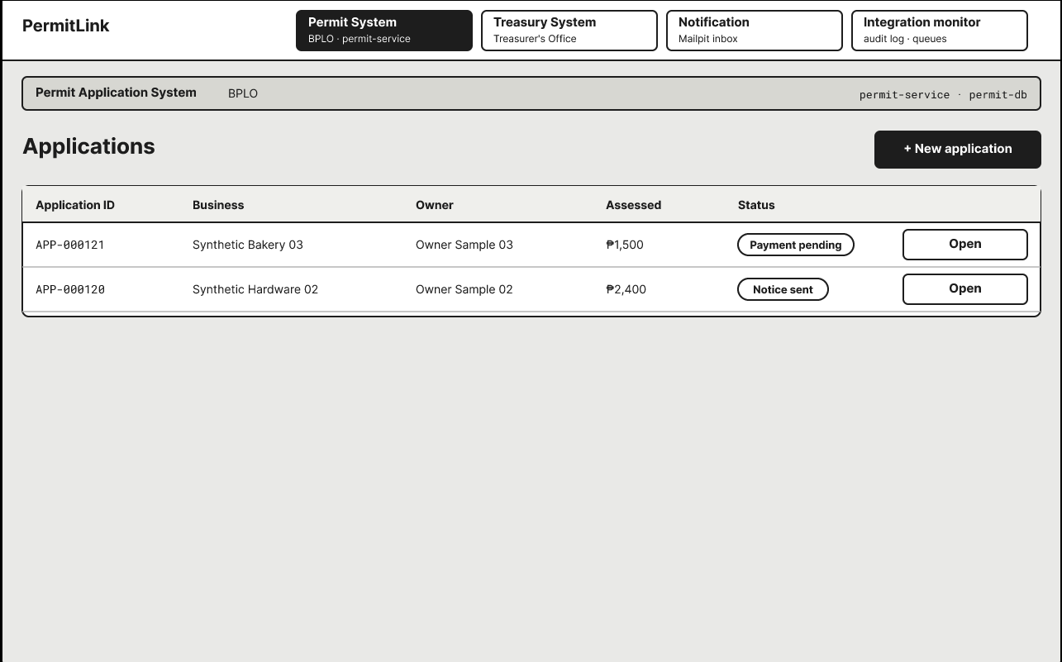
Notes:
Flow 1, REST: the Permit System calls GET /payments/{applicationId} on the Treasury System and gets PAID, UNPAID or NOT_FOUND with amount and receipt number; used when a current answer is needed right now. Flow 2, payment.posted: when the clerk records a payment, Treasury publishes to payments.x and the Permit System consumes it from a durable queue and marks the application PAID; payments must never be lost. Flow 3, permit.approved: when a permit is approved, Permit publishes to permits.x (topic) and the Notification Service consumes it and sends the notice; approval must not depend on notification, and new channels like SMS can be added without touching the publisher. Application status moves from SUBMITTED to PAYMENT_PENDING, PAYMENT_CONFIRMED, APPROVED, then NOTICE_SENT. Approval happens only if payment is confirmed and the amount matches the assessed amount. Canonical data model: Application, Payment, ProcessedMessage, NotificationLog, AuditLog. A JSON Schema per message forbids extra fields. Every message carries an envelope with messageId, type, occurredAt, schemaVersion and correlationId.

Slide 9
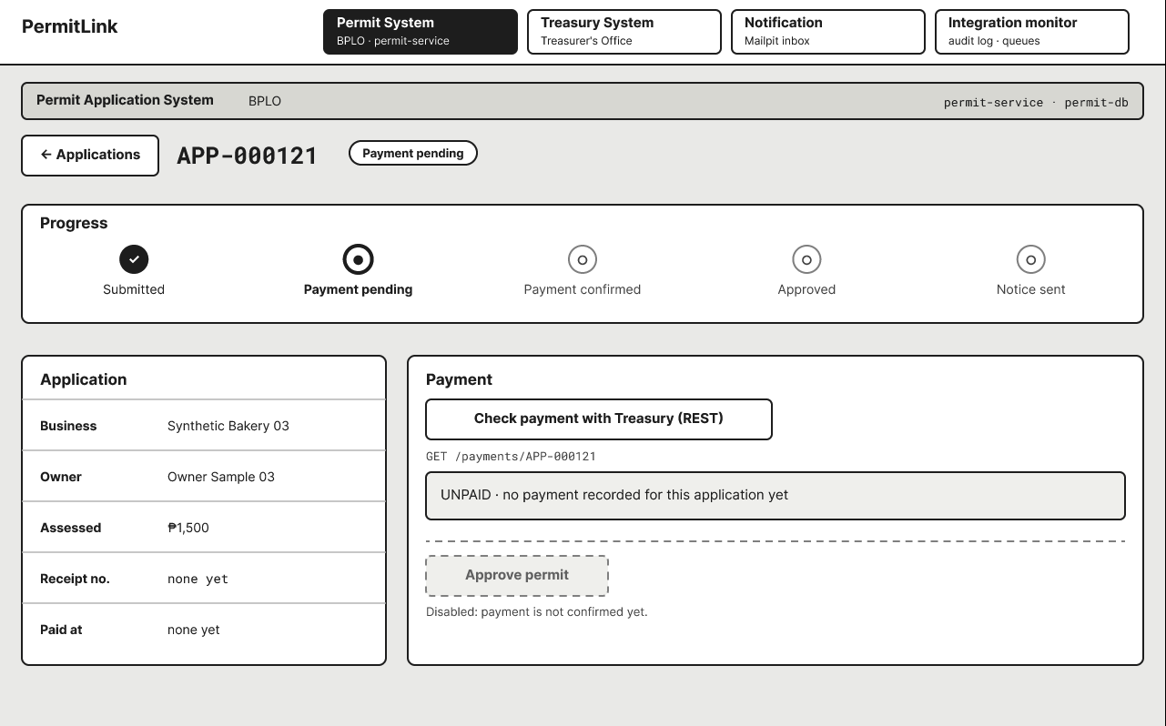
Notes:
Flow 1, REST: the Permit System calls GET /payments/{applicationId} on the Treasury System and gets PAID, UNPAID or NOT_FOUND with amount and receipt number; used when a current answer is needed right now. Flow 2, payment.posted: when the clerk records a payment, Treasury publishes to payments.x and the Permit System consumes it from a durable queue and marks the application PAID; payments must never be lost. Flow 3, permit.approved: when a permit is approved, Permit publishes to permits.x (topic) and the Notification Service consumes it and sends the notice; approval must not depend on notification, and new channels like SMS can be added without touching the publisher. Application status moves from SUBMITTED to PAYMENT_PENDING, PAYMENT_CONFIRMED, APPROVED, then NOTICE_SENT. Approval happens only if payment is confirmed and the amount matches the assessed amount. Canonical data model: Application, Payment, ProcessedMessage, NotificationLog, AuditLog. A JSON Schema per message forbids extra fields. Every message carries an envelope with messageId, type, occurredAt, schemaVersion and correlationId.

Slide 10
Security, privacy, and reliability
Slide 8 · 1:00
Presenter: Jericho M. Fegason
Security
Signed JWT service tokens
Only the treasury-clerk role can POST /payments
No token: 401. Wrong role: 403
Schemas reject extra fields
Privacy
Synthetic data only
Only business name, owner name and amount cross systems
No address, phone, email, ID or bank details
Follows RA 10173 principles
Reliability
Permit down: payment waits in the queue
Notification down: approval still completes
Broker down: outbox holds, relay resumes
Duplicates skipped; bad messages dead-lettered
Known limits: no TLS between containers, shared token key, no formal audit
Notes:
Authentication: every endpoint except /health needs a signed JWT service token with a role claim. A missing or invalid token returns 401; only the treasury-clerk role can POST /payments, other roles get 403. Threat model follows the OWASP API Security Top 10 (2023): rate limits, JSON Schema validation, the default RabbitMQ guest account disabled, management page on localhost only, least-privilege broker users per service. Privacy: only synthetic business name, owner name and payment amount, plus link IDs, cross system boundaries. No address, phone, email, government ID, TIN, birth date or bank details are collected. The design follows Data Privacy Act (RA 10173) principles of transparency, legitimate purpose and proportionality; the team will verify exact section numbers before citing them in the final paper. Reliability: Treasury down during the REST call returns 'payment status unavailable' and nothing is approved; Permit down means the message waits in the durable queue; Notification down means approval still completes and the notice goes out after recovery; Broker down means the payment and an outbox row are saved in one transaction and a relay publishes when the broker returns; duplicates are skipped by messageId; invalid messages go to the dead-letter queue after 3 tries. Residual risks stated honestly: no TLS between containers, a shared token signing key, and no formal security audit (only an OWASP checklist and a ZAP baseline scan).

Slide 11
Technology stack and testing plan
Slide 9 · 1:00
Presenter: Hannah L. Alcantara
Layer | Choice
Permit System | Node.js + Express
Treasury System | Python + FastAPI
Notification | Node.js worker
Broker | RabbitMQ
Databases | PostgreSQL, one per service
Packaging | Docker Compose
Test type | Tool
Unit | pytest, Jest
Contract | Newman, Schemathesis
Integration | Docker Compose scripts
Fault injection | docker stop / start
Load | k6
Security | OWASP ZAP baseline
12 tests cover every flow and all 10 quality scenarios. Software cost: ₱0.
Notes:
Stack: Permit System in Node.js with Express (amqplib for AMQP), Treasury System in Python 3.12 with FastAPI (auto-generated OpenAPI docs), Notification Service as a Node.js worker, RabbitMQ with the management plugin, one PostgreSQL database per business service, Mailpit as the mock mail sink, Docker Compose for one-command start-up, OpenAPI 3 with Swagger UI for contracts, and GitHub or GitLab for source control. All free and open source, so software cost is zero pesos. Testing plan: unit tests (approve only when paid, amount match, duplicate check); API and message contract tests against the OpenAPI file and JSON Schemas; integration tests across real containers; fault injection with docker stop and start; performance with k6 and log timestamps; security with curl or Newman and an OWASP ZAP baseline. Twelve tests T-1 to T-12 map to the flows and the quality attribute scenarios, for example T-1: 95% of GET /payments calls under 500 ms at 50 users; T-4: Permit stopped 2 minutes, 100 payments posted, 0 lost; T-5: same message redelivered 3 times, 0 duplicate records; T-12: docker compose up on a clean laptop, all healthy within 5 minutes.

Slide 12
Work plan and top risks
Presenter: Jose Arym Diaz III
PW2–3
F1
F2
F3
F4
Work underestimated
Build the thinnest path first
Design
Build 1: APIs
Docker fails on a laptop
Pin versions; test in Build 1
Build 2: flows
Build 3: security
Wrap-up: tests
Lost or duplicate messages
Outbox, acks; run T-4 and T-5 early
Diaz: lead · Dibarosan: build · Fegason: security · Alcantara: QA
Notes:
Design is done in prefinal weeks 2 to 3 (diagrams, API and event drafts, slides). The build runs over four Final weeks: F1 Docker Compose with health checks, databases, Treasury API with outbox, Permit API; F2 the payment.posted and permit.approved flows and the Notification Service; F3 service tokens, broker permissions, schema validation, audit log, and the start of testing; F4 tests T-1 to T-12, the final paper and demo rehearsal. Week labels will be replaced with calendar dates once the instructor confirms the schedule. Roles: Diaz is Project Lead and Architect, Dibarosan is Integration Developer, Fegason is Data and Security Lead, Alcantara is QA and Documentation Lead. Top risks and responses: (1) work underestimated across three services plus a broker, so build the thinnest path first: REST, then payment.posted, then permit.approved; (2) Docker Compose not starting cleanly on every laptop, so pin versions, add health checks and test on every laptop in Build 1; (3) lost or duplicate messages from bugs, so use the outbox, publisher confirms, manual acks and a unique messageId, and run tests T-4 and T-5 early. Other risks in the paper: performance targets missed on laptops, real personal data entering the project, a member being absent, and scope creep.

Slide 13
Questions
Thank you · Team Nexora · 10:00 of questions from the instructor and classmates
Notes:
Any member may be asked about any part of the proposal. Answer briefly and point back to the slide that supports your answer.

