Slide 1
A prototype for an Autocamper Rental system
Group: Andrej Simionenko, Raheela Tasneem, Fei Gu
Notes:
Show the application run the program and insert some data.
Show the code part.
Start the ppt.

Slide 2
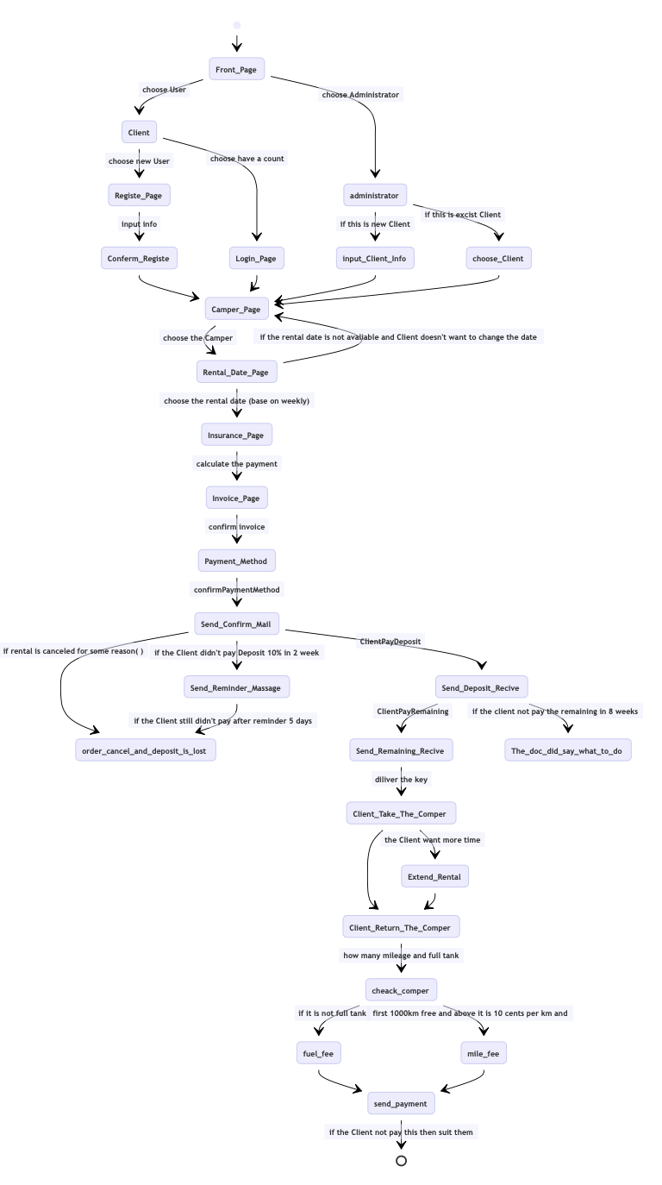
Precess Flow

Slide 3
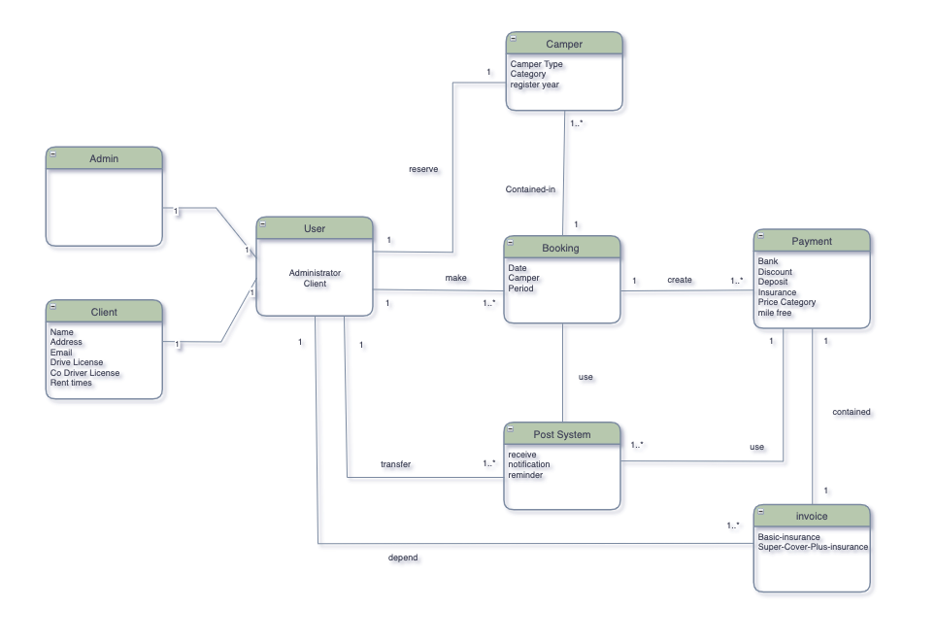
Domain Model

Slide 4
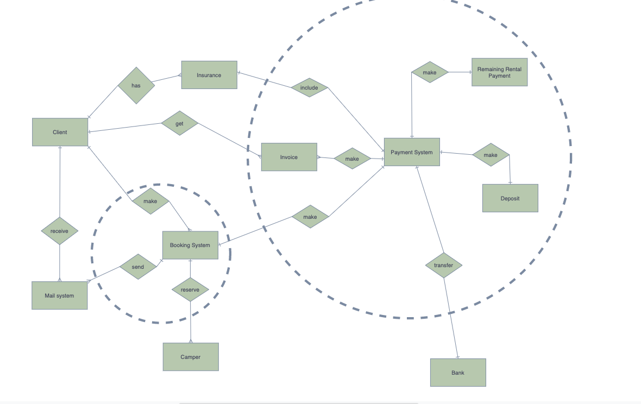
ERD

Slide 5
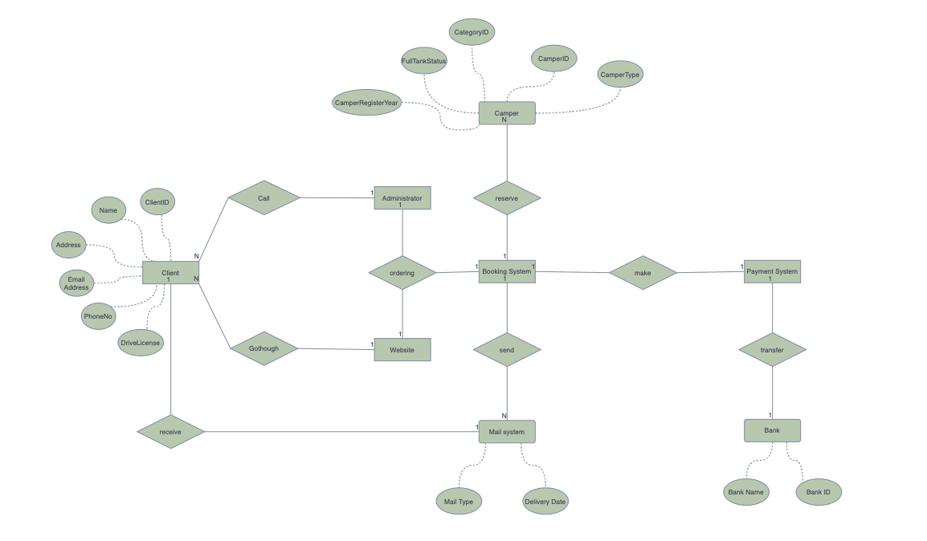
DFD

Slide 6
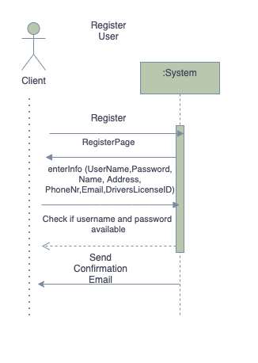
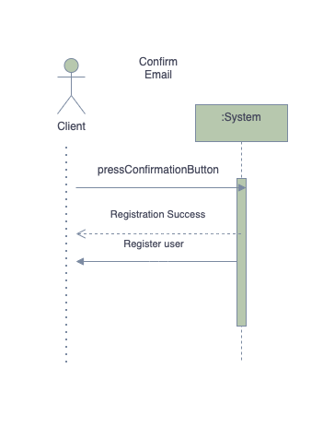
SSDs

Slide 7
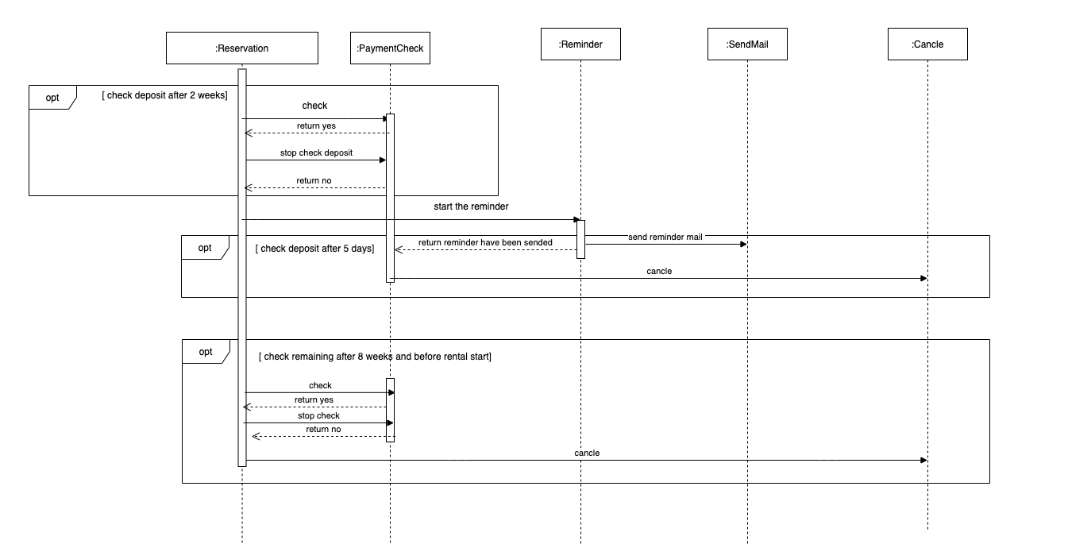
SD

Slide 8
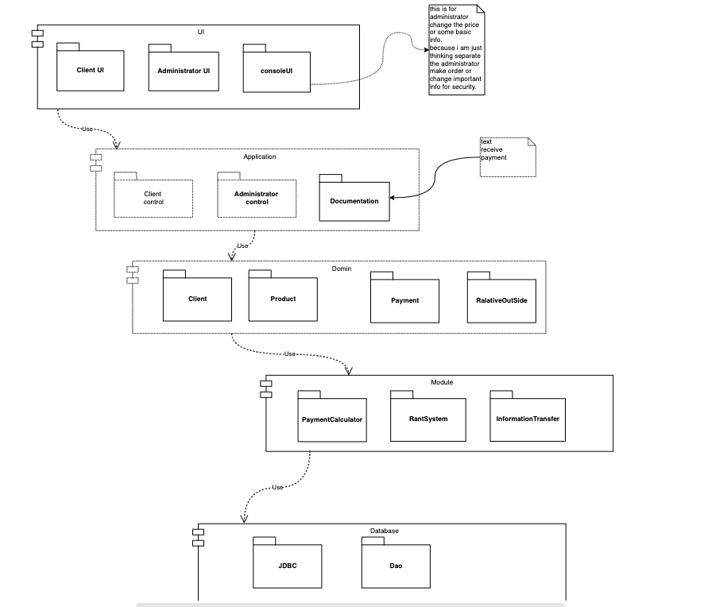
Architecture

Slide 9
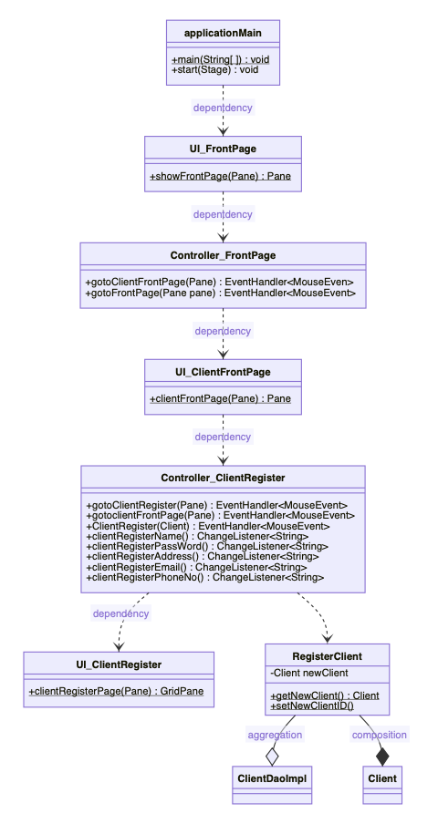
Class Diagram UI

Slide 10
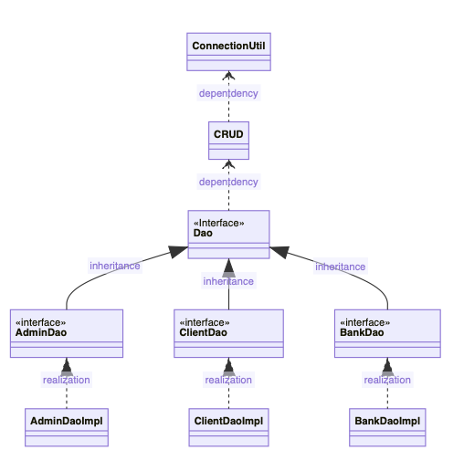
Class Diagram Database User

Slide 11
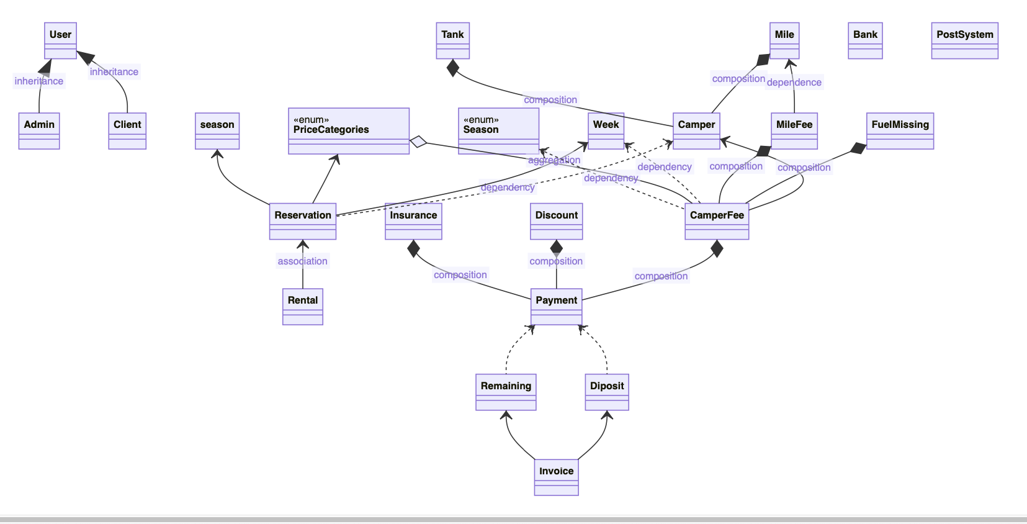
Class Diagram Domain

Slide 12
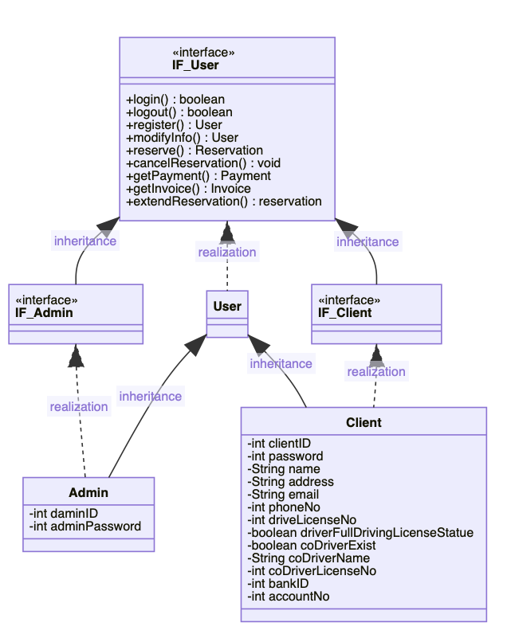
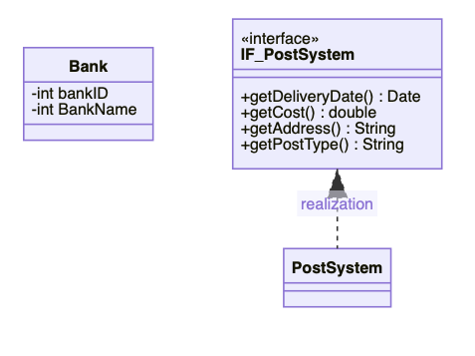
Class Diagram Domain.User & RelativeOutSide

Slide 13
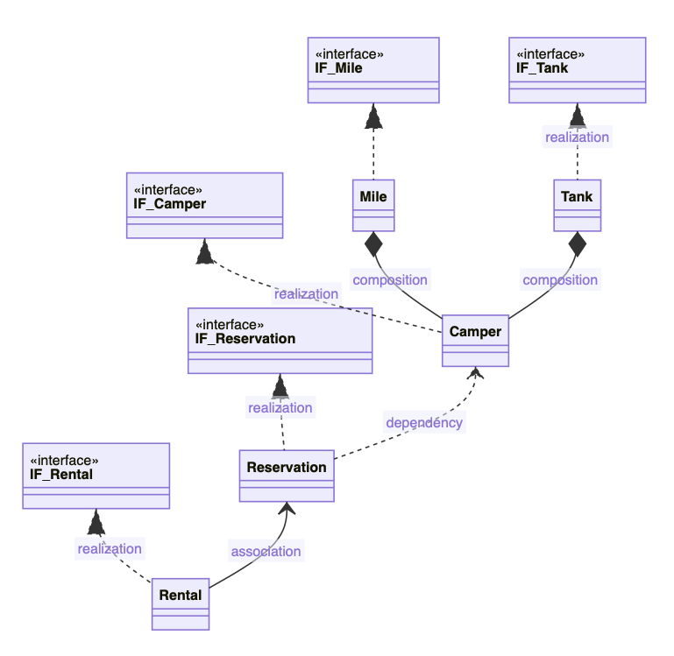
Class Diagram Domain.Product

Slide 14
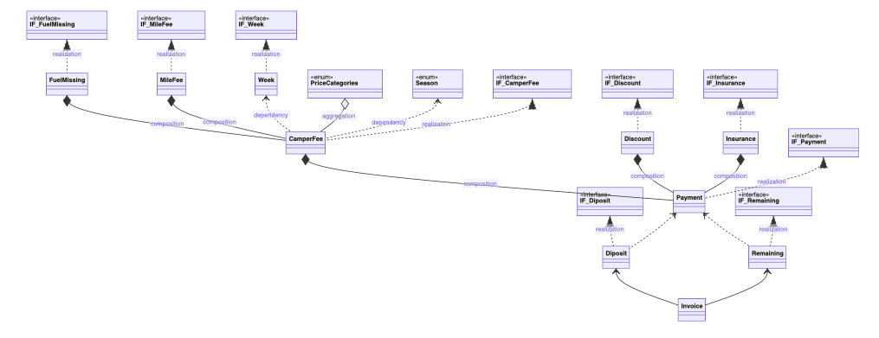
Class Diagram Domain.Payment

