Slide 1

W07 MIDTERM MILESTONE
Product Review Analysis
& Issue Discovery
A working review-processing path with persisted evidence
and bounded retries
FEI, Wenxiang / XIANG, Ke / XU, Chao / ZHANG, Mingyang
feature/r2-worker · Snapshot 41585d9 · 30 October 2026
Notes:
Repository: https://github.com/Fei-stack-wq/maie6000c-PRI/tree/41585d96058fa85c185f7ff05fb3d19360670d05
Background: generated with OpenAI image generation for this presentation.

Slide 2
Project scope at midterm
User need
Working today
Staff need a way to organise product reviews and trace each detected issue back to the original wording.
The separate bilingual demo calls the real ingestion API, Worker and rule service, then reads saved results from PostgreSQL.
Current product boundary
Rule extraction and category grouping are available. LLM analysis, semantic grouping and staff review actions remain in development.
02
Notes:
https://github.com/Fei-stack-wq/maie6000c-PRI/blob/41585d96058fa85c185f7ff05fb3d19360670d05/README.md
https://github.com/Fei-stack-wq/maie6000c-PRI/blob/41585d96058fa85c185f7ff05fb3d19360670d05/templates/submissions/week07/README.md
The original five-page frontend still uses mock data. The separate midterm demo uses real backend services and an independent database. The system does not determine defects, liability or root causes.
Background: generated pastel paper artwork, used as decoration only.

Slide 3
The required system path
Requirement | System evidence | Where to inspect
1 Input | Review submitted through the demo | /lesson/import
2 Saved state | Comment + pending job in PostgreSQL | Comment / Job
3 Async step | Separate Worker calls analysis over HTTP | process_job(claim)
4 Saved output | Result, issue evidence and analysis history | AnalysisRun / CommentIssue
5 Operational signal | Attempts, status, logs and metrics | /lesson/state + metrics
Evidence combines repository code, the saved result screenshot and documented verification runs.
03
Notes:
https://github.com/Fei-stack-wq/maie6000c-PRI/blob/41585d96058fa85c185f7ff05fb3d19360670d05/templates/submissions/week07/README.md
https://github.com/Fei-stack-wq/maie6000c-PRI/blob/41585d96058fa85c185f7ff05fb3d19360670d05/demo/midterm/app.py
Background: generated pastel paper artwork, used as decoration only.

Slide 4
1 Review input
English demo
Request used by the demo
Open localhost:18717/en
Select “Normal analysis”
Click “1. Submit review”
POST /lesson/import
{
"body":
"The zipper gets stuck halfway.",
"scenario": "normal"
}
Actual backend integration
The demo converts the review to CSV and calls POST /review-batches. The ingestion service saves the comment and its analysis job.
04
Notes:
https://github.com/Fei-stack-wq/maie6000c-PRI/blob/41585d96058fa85c185f7ff05fb3d19360670d05/demo/midterm/app.py
https://github.com/Fei-stack-wq/maie6000c-PRI/blob/41585d96058fa85c185f7ff05fb3d19360670d05/demo/midterm/check_demo.py
Request example reproduces the English normal-analysis acceptance case. This is a documented request example, not a captured response. The demo assigns unique product and source-review IDs.
Background: generated pastel paper artwork, used as decoration only.

Slide 5
2 A persisted state change
Before analysis
After the Worker claims the job
Job: pending
Comment: queued
Attempts: 0
Job: claimed
Comment: analyzing
Attempts: 1
Database assertions in the acceptance test
assert db.get(Comment, initial["comment_id"]).analysis_status == "queued"
assert db.get(Job, initial["job_id"]).status == "pending"
jobs.py commits the claimed state before the analysis request begins.
05
Notes:
https://github.com/Fei-stack-wq/maie6000c-PRI/blob/41585d96058fa85c185f7ff05fb3d19360670d05/demo/midterm/check_demo.py
https://github.com/Fei-stack-wq/maie6000c-PRI/blob/41585d96058fa85c185f7ff05fb3d19360670d05/services/worker/app/jobs.py
Background: generated pastel paper artwork, used as decoration only.

Slide 6
3 Background processing
A separate Worker process
python -m services.worker.app.main
01 Claim a due job
02 Call the analysis service
Keep the original JobClaim and a fixed input snapshot.
Use HTTP without holding the database transaction lock.
03 Validate the response
04 Save under ownership checks
Check identifiers, versions, categories and source evidence.
Reject stale claims and requeue changed input.
06
Notes:
https://github.com/Fei-stack-wq/maie6000c-PRI/blob/41585d96058fa85c185f7ff05fb3d19360670d05/demo/midterm/app.py
https://github.com/Fei-stack-wq/maie6000c-PRI/blob/41585d96058fa85c185f7ff05fb3d19360670d05/services/worker/app/main.py
https://github.com/Fei-stack-wq/maie6000c-PRI/blob/41585d96058fa85c185f7ff05fb3d19360670d05/docs/r2-implementation.md
Background: generated pastel paper artwork, used as decoration only.

Slide 7
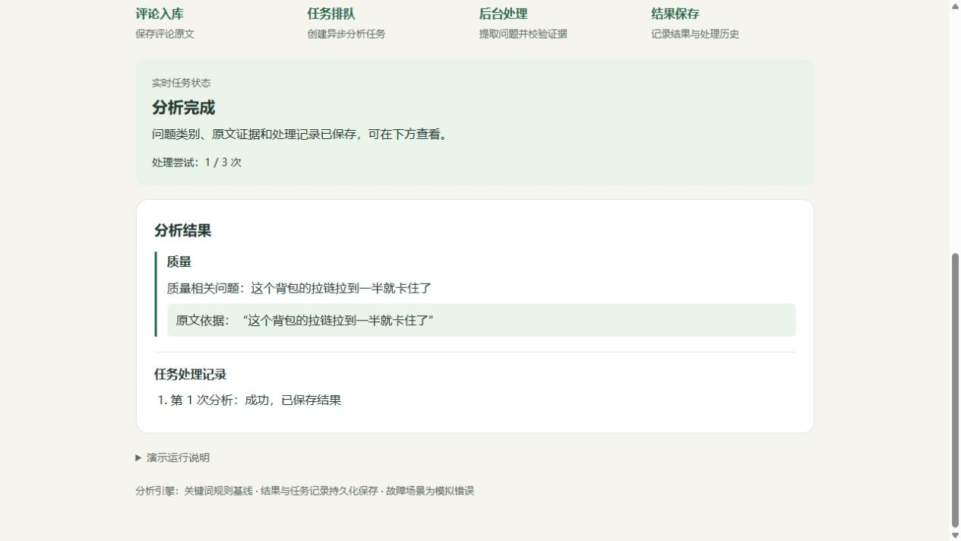
4 Saved output in the demo
Saved result
Completed
First attempt: 1 / 3
Category: Quality
Original evidence
A zipper gets stuck halfway
Saved attempt history
07
Notes:
https://github.com/Fei-stack-wq/maie6000c-PRI/blob/41585d96058fa85c185f7ff05fb3d19360670d05/templates/submissions/week07/assets/verification.md
https://github.com/Fei-stack-wq/maie6000c-PRI/blob/41585d96058fa85c185f7ff05fb3d19360670d05/templates/submissions/week07/assets/demo-result-zh.jpg
Original repository screenshot, Chinese interface, preserved without altering its content. English explanations translate the visible evidence. This is an existing repository capture, not a fresh execution in this presentation authoring session.
Background: generated pastel paper artwork, used as decoration only.

Slide 8
Result persistence and traceability
One successful transaction
Implementation excerpt
AnalysisRun records the response.
CommentIssue stores source evidence.
Comment points to its current analysis.
Job reaches completed.
save_issue_links(
db, snapshot, verified, run.id
)
comment.has_issue = verified.has_issue
comment.current_analysis_run_id = run.id
job.status = JobStatus.COMPLETED.value
# ...
db.commit()
Starting a new round preserves earlier database records. A documented restart check retained five jobs and eight analysis runs from an earlier five-case run.
08
Notes:
https://github.com/Fei-stack-wq/maie6000c-PRI/blob/41585d96058fa85c185f7ff05fb3d19360670d05/services/worker/app/jobs.py
https://github.com/Fei-stack-wq/maie6000c-PRI/blob/41585d96058fa85c185f7ff05fb3d19360670d05/demo/midterm/check_demo.py
https://github.com/Fei-stack-wq/maie6000c-PRI/blob/41585d96058fa85c185f7ff05fb3d19360670d05/templates/submissions/week07/assets/verification.md
Code excerpt from complete_job, abbreviated with an explicit omission marker. The five jobs/eight runs count belongs to an earlier isolated restart check and must not be presented as the latest bilingual acceptance count.
Background: generated pastel paper artwork, used as decoration only.

Slide 9
Bounded retries and final failure
Scenario | Expected execution | Stored terminal state
Normal analysis | Attempt 1 succeeds | completed
Fail once, then retry | Attempt 2 succeeds | completed
Fail until the attempt limit | Three failed attempts | failed
The demo injects HTTP 503 failures. Each analysis call pauses for three seconds. Retry waits are three and six seconds.
09
Notes:
https://github.com/Fei-stack-wq/maie6000c-PRI/blob/41585d96058fa85c185f7ff05fb3d19360670d05/demo/midterm/README.md
https://github.com/Fei-stack-wq/maie6000c-PRI/blob/41585d96058fa85c185f7ff05fb3d19360670d05/demo/midterm/app.py
https://github.com/Fei-stack-wq/maie6000c-PRI/blob/41585d96058fa85c185f7ff05fb3d19360670d05/demo/midterm/check_demo.py
Failure cases deliberately simulate service faults. The actual R2 Worker processes these responses. The demo shortens delays without replacing the production processing logic. Outcomes are expected scenarios backed by repository acceptance records, not new screenshots.
Background: generated pastel paper artwork, used as decoration only.

Slide 10
5 Operational signals
Visible on the demo page
Worker instrumentation
Current state
Attempt count and limit
Retry wait and error code
Saved analysis history
worker_job_events_total
worker_attempt_duration_seconds
worker_jobs
worker_last_poll_timestamp_seconds
Acceptance checks
The test reads /metrics and checks worker_job_events_total. It also verifies saved job states and analysis-run counts.
10
Notes:
https://github.com/Fei-stack-wq/maie6000c-PRI/blob/41585d96058fa85c185f7ff05fb3d19360670d05/services/worker/app/metrics.py
https://github.com/Fei-stack-wq/maie6000c-PRI/blob/41585d96058fa85c185f7ff05fb3d19360670d05/services/worker/app/main.py
https://github.com/Fei-stack-wq/maie6000c-PRI/blob/41585d96058fa85c185f7ff05fb3d19360670d05/demo/midterm/check_demo.py
Worker port 8200 stays internal in the Compose configuration. The metrics server starts with the Worker. Metric names shown are code evidence, not fabricated measured values. Worker logs emit job_claimed, job_attempt_finished and worker_stopped.
Background: generated pastel paper artwork, used as decoration only.

Slide 11
Recorded verification results
Repository verification record, 29 October 2026
94
5
Unit and integration tests
Real HTTP smoke tests
Earlier full run, including six
real PostgreSQL cases
API, rule AI, Worker and fault proxy
Graceful shutdown also passed
10
92%
Bilingual demo cases
R2 statement coverage
Five scenarios in each language
Saved states, evidence and metrics
Unit/integration process only
This is not analysis accuracy
11
Notes:
https://github.com/Fei-stack-wq/maie6000c-PRI/blob/41585d96058fa85c185f7ff05fb3d19360670d05/templates/submissions/week07/assets/verification.md
https://github.com/Fei-stack-wq/maie6000c-PRI/blob/41585d96058fa85c185f7ff05fb3d19360670d05/.github/workflows/ci.yml
All numbers are repository-reported results dated 29 October 2026. They were not rerun during deck preparation. Python 3.11.16, PostgreSQL 16, isolated Docker resources. CI config covers lint, migrations and unit/integration tests, not the live demo. Later delivery-rule regression checks: 78 analysis unit tests and four live demo regressions, separate from the earlier full suite.
Background: generated pastel paper artwork, used as decoration only.

Slide 12
Known limits and remaining work
Current limitation | Next step | Owner
Rules can miss warranty complaints | Build a labelled quality evaluation | R3
Grouping uses categories | Evaluate LLM and semantic grouping | R3
Product UI still uses mock data | Connect reads, review writes and follow-up | R4
Platform samples need validation | Confirm source data and ingestion scope | R1
No manual replay API or audit | Add controlled operations and regression tests | R2
A “no” or “unknown” result does not prove that a review has no complaint. Verbatim evidence checks confirm location, not interpretation.
12
Notes:
https://github.com/Fei-stack-wq/maie6000c-PRI/blob/41585d96058fa85c185f7ff05fb3d19360670d05/README.md
https://github.com/Fei-stack-wq/maie6000c-PRI/blob/41585d96058fa85c185f7ff05fb3d19360670d05/templates/submissions/week07/README.md
https://github.com/Fei-stack-wq/maie6000c-PRI/blob/41585d96058fa85c185f7ff05fb3d19360670d05/docs/r2-implementation.md
Owner mapping follows R1 data/ingestion, R2 reliability, R3 AI/evaluation and R4 product/review responsibilities. Sequencing is a proposed follow-through based on repository next work. Multi-platform ingestion, model training and automated platform actions remain outside scope.
Background: generated pastel paper artwork, used as decoration only.

Slide 13
Reproducing the demonstration
Start Docker Desktop and run these commands at the repository root.
Windows
.\scripts\start_midterm_demo.ps1
macOS / Linux
docker compose -f compose.midterm.yaml up --build -d --wait
Open the English page
http://localhost:18717/en
13
Notes:
https://github.com/Fei-stack-wq/maie6000c-PRI/blob/41585d96058fa85c185f7ff05fb3d19360670d05/demo/midterm/README.md
https://github.com/Fei-stack-wq/maie6000c-PRI/blob/41585d96058fa85c185f7ff05fb3d19360670d05/compose.midterm.yaml
Prerequisites: download feature/r2-worker and start Docker Desktop. Run commands at repository root. The macOS/Linux command is shown across two visual lines for readability; execute it as one command: docker compose -f compose.midterm.yaml up --build -d --wait. No .env or model API key is needed. First build downloads dependencies. Normal, fail-once and fail-until-limit scenarios share one local round. Use one presenter at a time. docker compose -f compose.midterm.yaml down preserves the database volume.
Background: generated pastel paper artwork, used as decoration only.

Slide 14
Evidence index and project team
Reviewable evidence
Team responsibilities
Demo instructions
demo/midterm/README.md
Submission narrative
templates/submissions/week07/README.md
Verification record and screenshot
templates/submissions/week07/assets/
FEI, Wenxiang
R1 Data and ingestion
XIANG, Ke
R2 Worker reliability
XU, Chao
R3 AI and evaluation
ZHANG, Mingyang
R4 Product and review
AI assistance: Used ChatGPT to structure the content, polish the wording, and revise the text.
14
Notes:
https://github.com/Fei-stack-wq/maie6000c-PRI/blob/41585d96058fa85c185f7ff05fb3d19360670d05/templates/submissions/week07/README.md
https://github.com/Fei-stack-wq/maie6000c-PRI/blob/41585d96058fa85c185f7ff05fb3d19360670d05/templates/submissions/week07/assets/verification.md
https://github.com/Fei-stack-wq/maie6000c-PRI/blob/41585d96058fa85c185f7ff05fb3d19360670d05/demo/midterm/README.md
Snapshot: 41585d96058fa85c185f7ff05fb3d19360670d05. Repository URL: https://github.com/Fei-stack-wq/maie6000c-PRI. All supporting source URLs are included in each slide’s notes. Test results and original screenshot come from the repository. The AI Use Statement in the submission records ChatGPT support for documentation, code scaffolding and testing.
Background: generated pastel paper artwork, used as decoration only.

