Slide 1
Description of Timer Visualization of Executable Code
Student: Pengcheng Liu
ID Number: 201298383
Primary Supervisor:
Keith Dures
Secondary Supervisor:
Shagufta Scanlon

Slide 2

Outline
Overview
Background Study
Data Formatting
Search Time Comparison
Delete Time Comparison
Huge Data Testing
Tree Structure Comparison
Practical Comparison: Boggle Game
Summary
Q&A

Slide 3
Overview
Programme Language: Python
Aim: Demonstrate comparison time of different data structures in different data operation
Mission Purpose: Make it easier for programmers to compare different uses of different data structures in the execution of Python code, so as to optimize quality of Python code.

Slide 4
Background Study
Data structure is a data organization, management and storage format that enables efficient access and modification.
Data structure is a collection of data values, the relationships among them, and the functions or operations that can be applied to the data.
Different types of data structures are suited to different kinds of applications, and some are highly specialized to specific tasks.

Slide 5
Background Study
We will see some basic data structures we will use in this project:
List/Double List
Stack
Tree
Set
Dictionary(Hash)

Slide 6
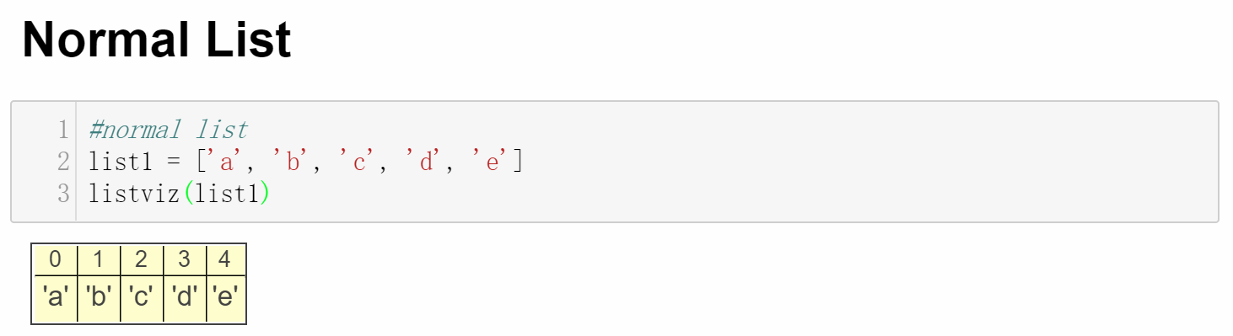
Background Study: List
List is the basic data structure in Python:
A collection which is ordered and changeable. Allows duplicate members.
Access the list items by referring to the index number

Slide 7
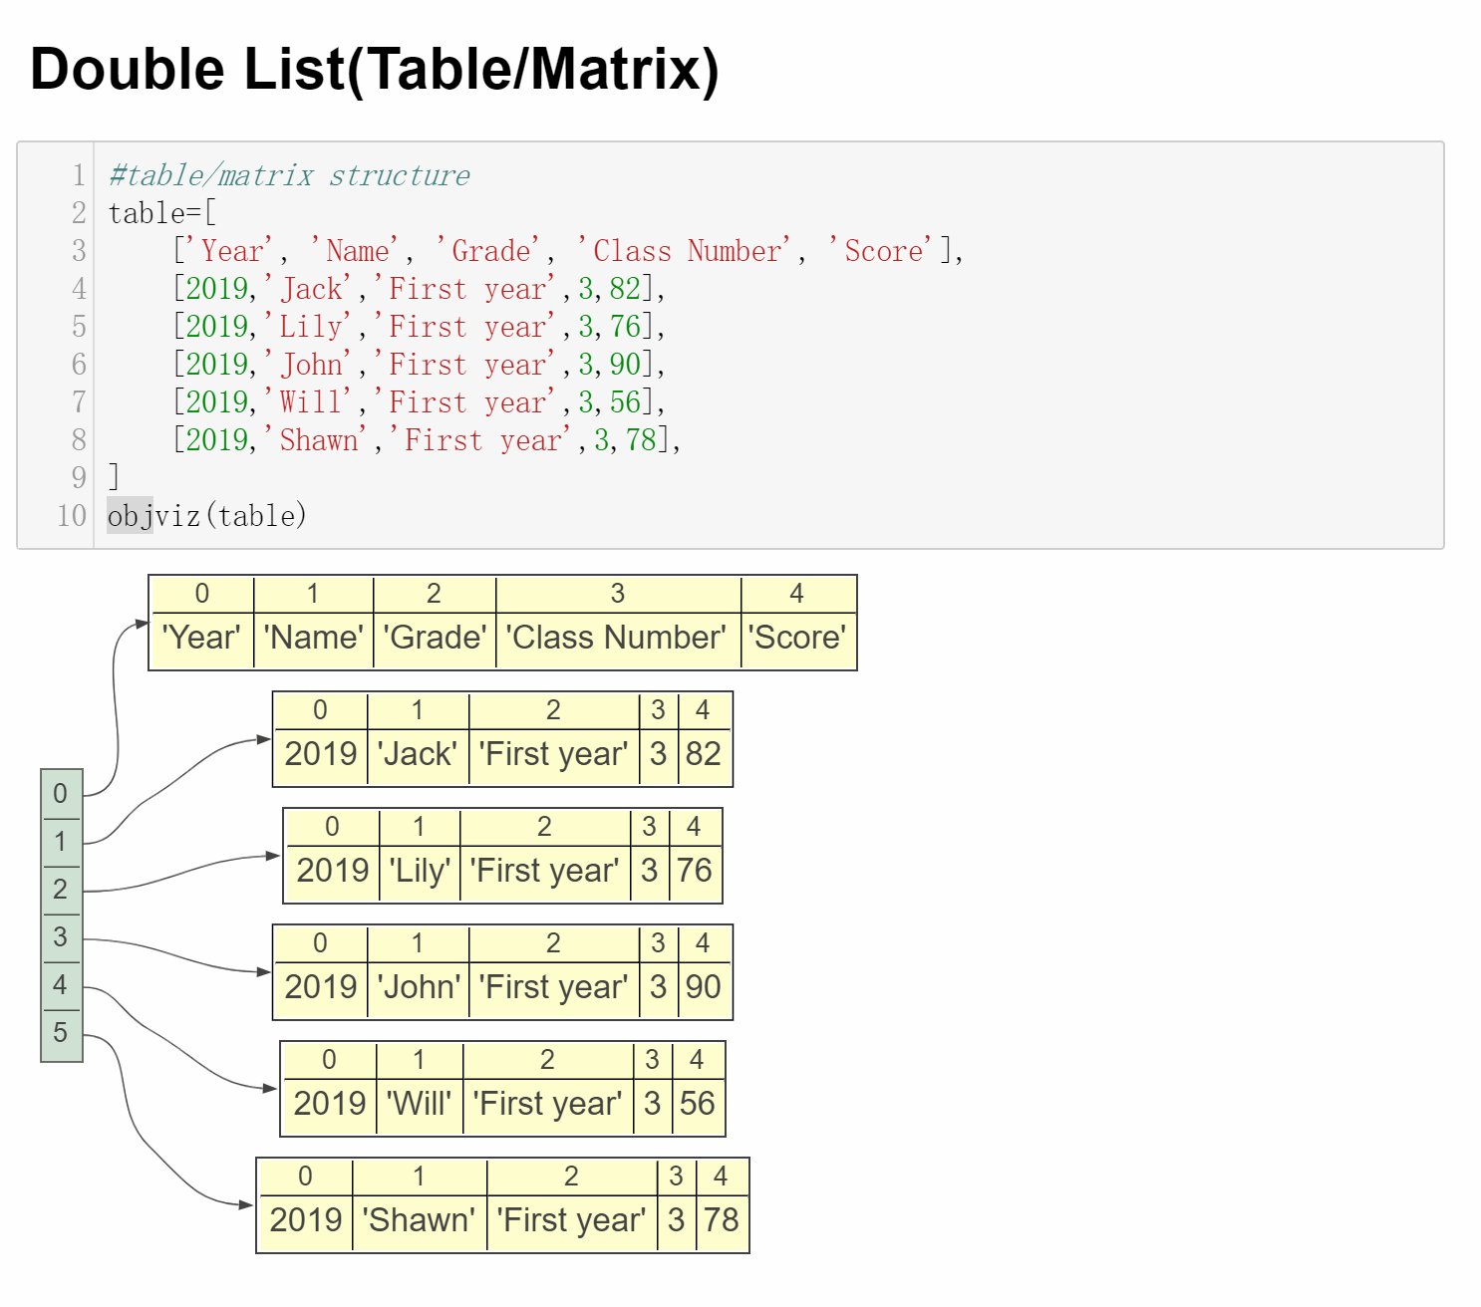
Background Study: Double List
Two dimensional list:

Slide 8
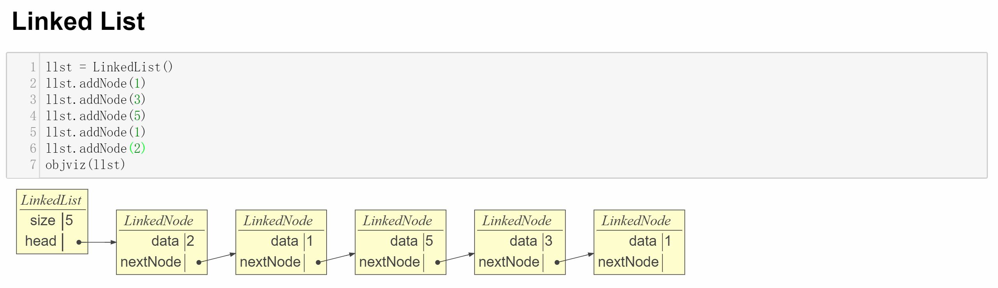
Background Study: Linked List
A linked list is a linear data structure where each element is a separate object. Linked list elements are not stored at contiguous location; the elements are linked using pointers.

Slide 9
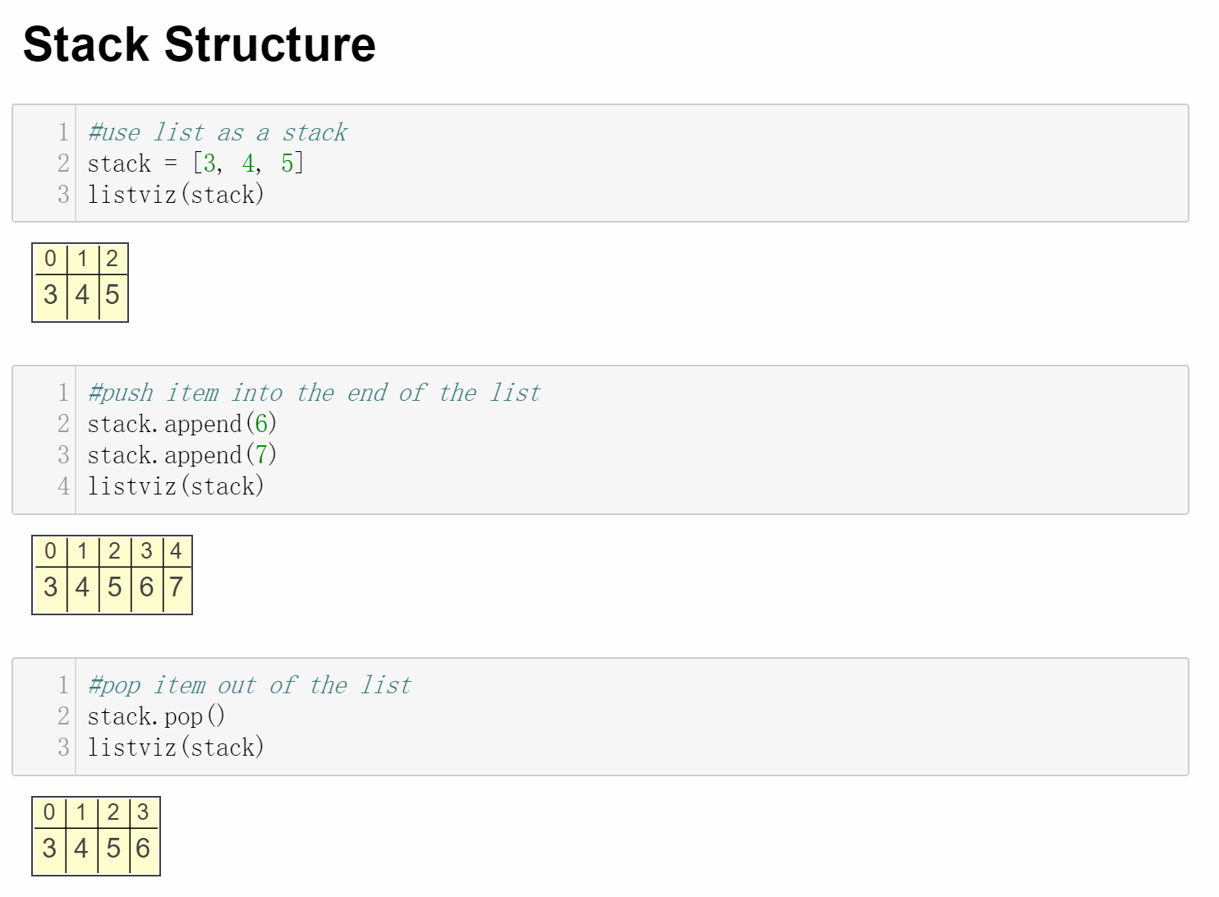
Background Study: Stack
Stack in Python is implemented by List to fulfil FILO(First in Last out):

Slide 10
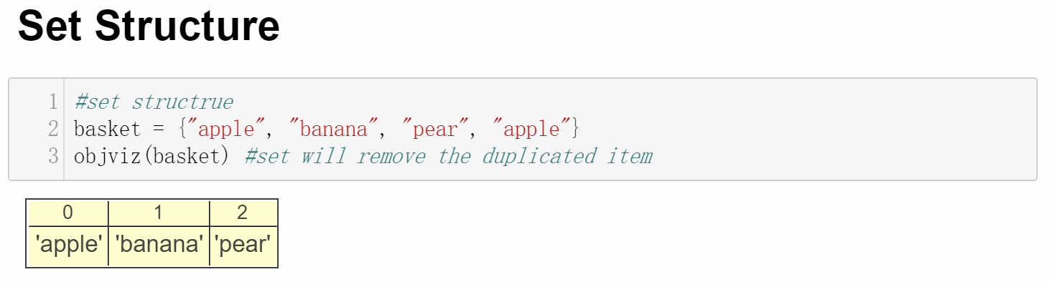
Background Study: Set
Set is a collection which is unordered and unindexed.
No duplicate members.

Slide 11
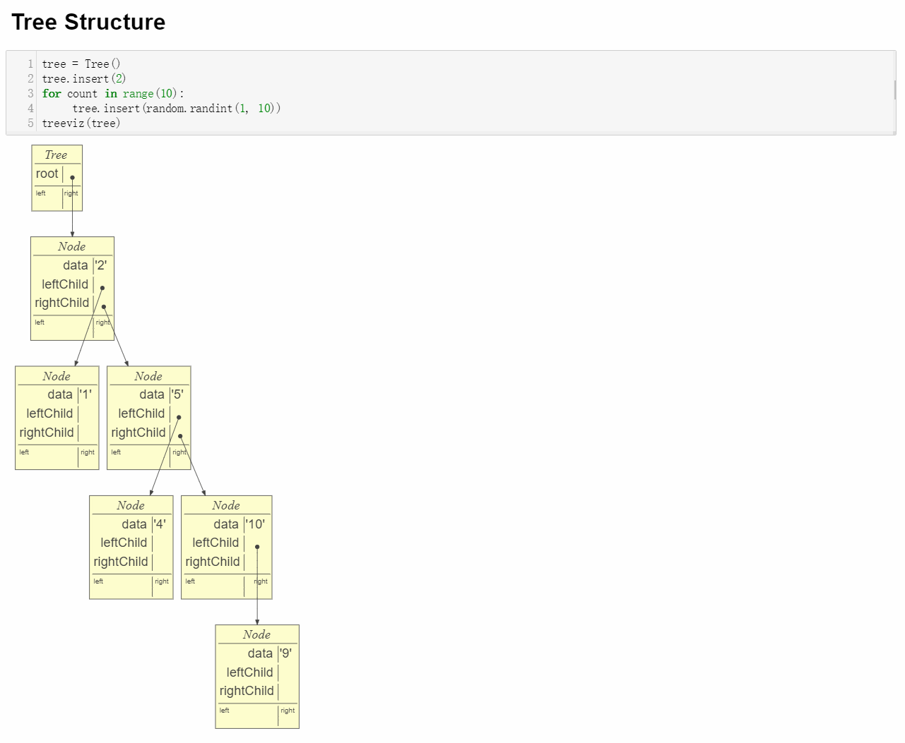
Background Study: Tree
Tree is a rooted tree, whose internal nodes each store a key and each have distinguished sub-trees, commonly denoted left and right.

Slide 12
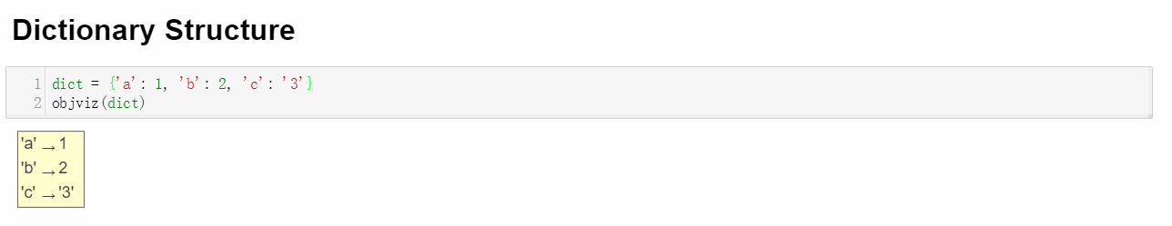
Background Study: Dictionary
Dictionary is a collection which is unordered, changeable and indexed.
No duplicate members.
Accessing each value data by their corresponding key

Slide 13
Data Formatting
We will use 1 million data to insert to the data structures to build the whole data structure for searching and deleting operation afterwards. These data structures are showed below:
1.List
2.Sorted List
3.Tree
4.Set
5.Dictionary
6.LinkedList

Slide 14
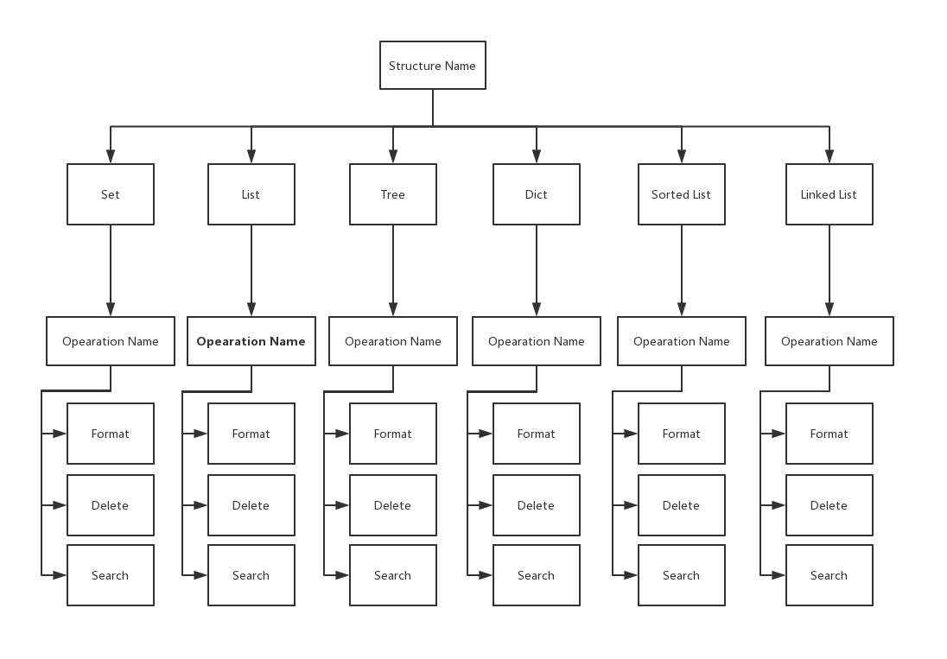
Data Formatting: Helper Class
For object oriented purpose and writing some reusable methods, I wrote a class called Runner which contains all the required operations: Formatting, Searching and Deleting for all kinds of data structures.
A controller method will lead the program to return the wanted results by a decision tree:

Slide 15
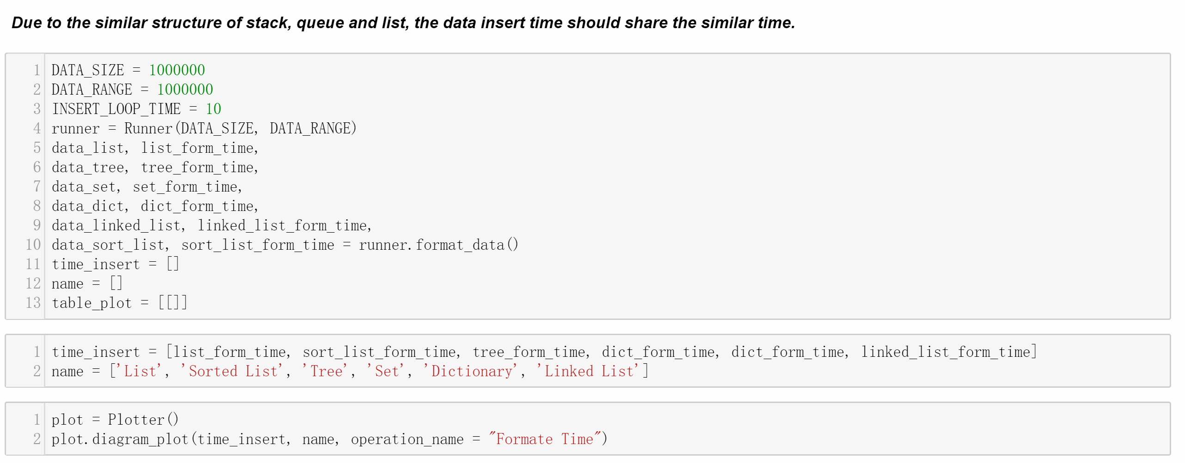
Data Formatting: Code

Slide 16
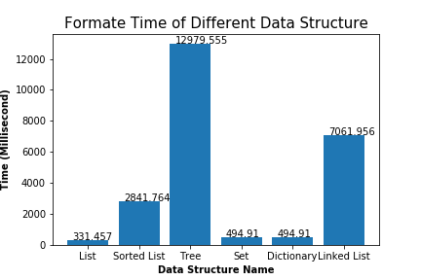
Data Formatting Comparison

Slide 17
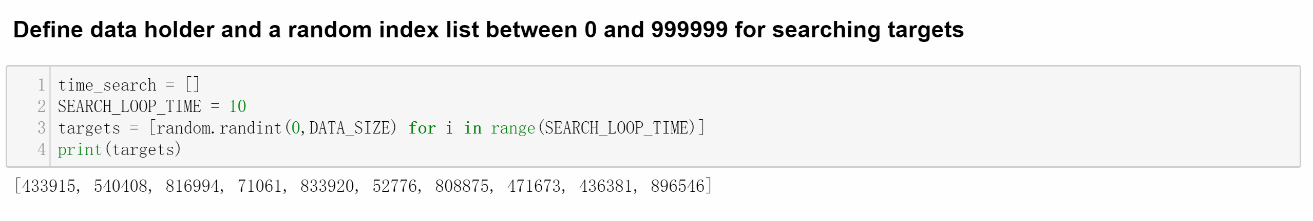
Search Time Comparison: Preparation
We will generate 10 random position of whole data to be the targets, and we will add all these target search time and then divided by 10 to retrieve the average time of each data structure

Slide 18
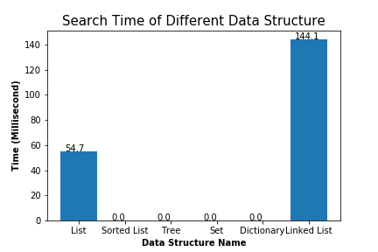
Search Time Comparison

Slide 19
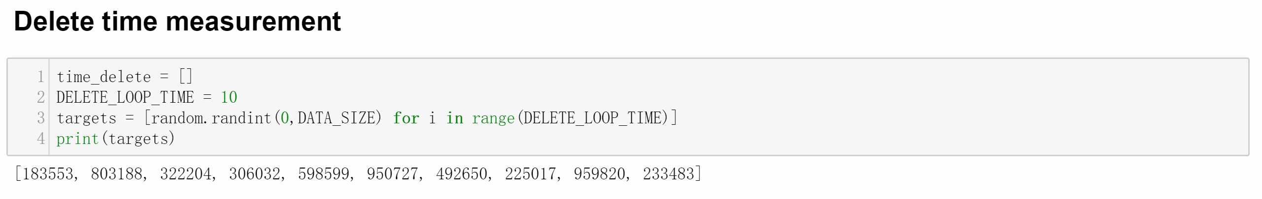
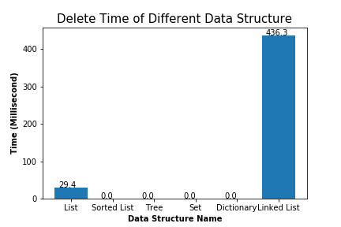
Delete Time Comparison
Similar to Search stage, we use 10 random target for deleting:

Slide 20
Huge Data Testing
Due to the search and delete time of tree, set and hash is too short, actually almost 0, let’s try a super huge data with size of 1 billion to redo this test:

Slide 21
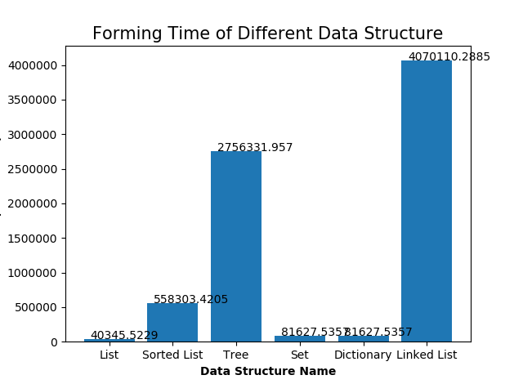
Huge Data Testing

Slide 22
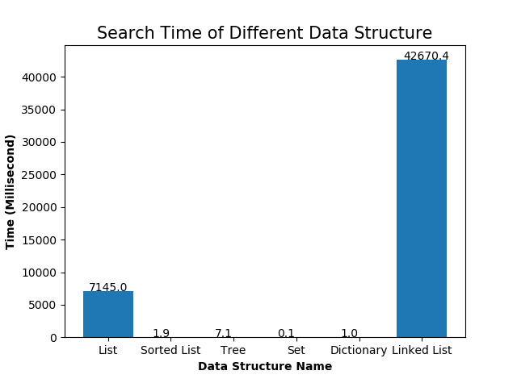
Huge Data Testing

Slide 23
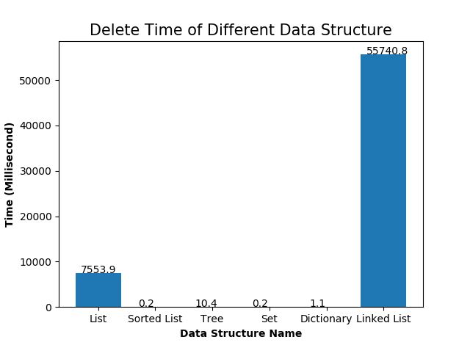
Huge Data Testing

Slide 24
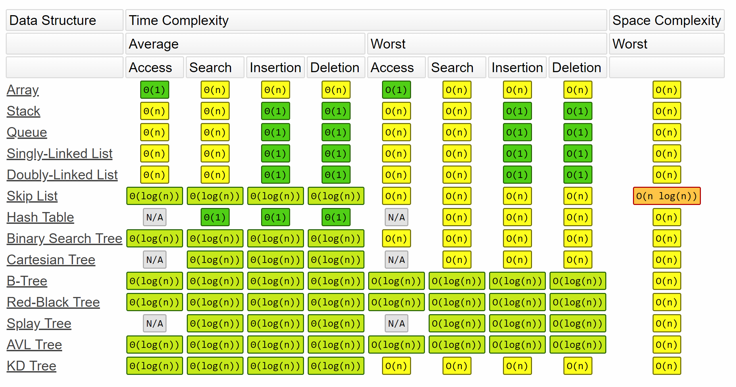
Analysis:

Slide 25
Analysis:
Sorted List can have the similar operation with Binary Search Tree is due to that it can be applied with Binary Search to improve the time
Set data is retrieved by hash which has the similar access method to Dictionary(Hash Table)

Slide 26
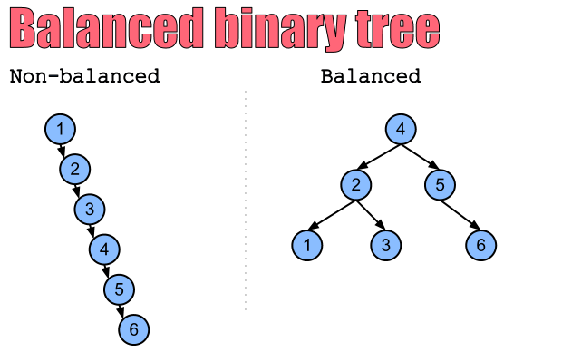
Tree Structure Comparison
For tree structure, if we insert sorted list, then the tree will degenerate to Linked List.
So what we need to do is try to make the tree balanced:

Slide 27
Tree Structure Comparison
Normal Binary Search Tree
AVL Tree
Red-Black Tree

Slide 28
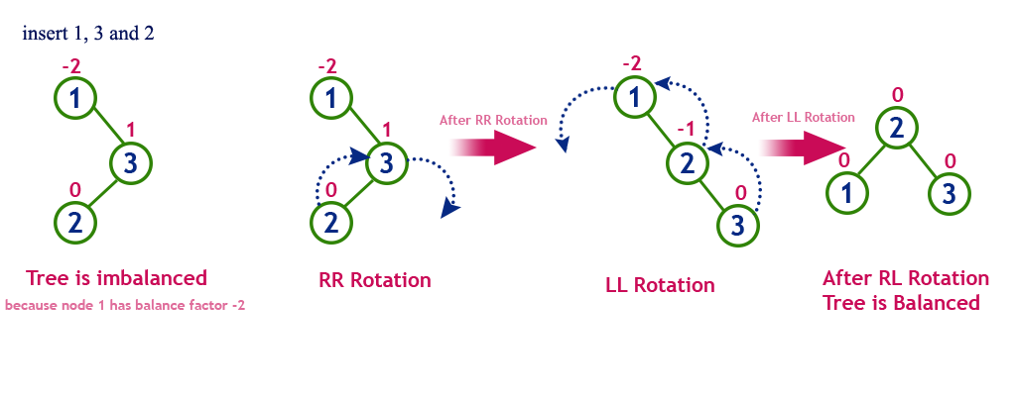
AVL Tree:
AVL tree is a self-balancing Binary Search Tree(BST) where the difference between heights of left and right subtrees cannot be more than one for all nodes.

Slide 29
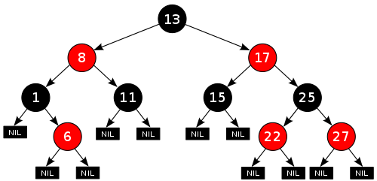
Red-Black Tree
Red-Black Tree:
Red–black tree is a kind of self-balancing binary search tree
Each node of the binary tree has an extra bit, and that bit is often interpreted as the color (red or black) of the node.
These color bits are used to ensure the tree remains approximately balanced during insertions and deletions

Slide 30
Red-Black Tree and AVL Tree
Red Black Trees provide faster insertion and removal operations than AVL trees as fewer rotations are done due to relatively relaxed balancing.
AVL trees store balance factors or heights with each node, thus requires storage for an integer per node whereas Red Black Tree requires only 1 bit of information per node.

Slide 31
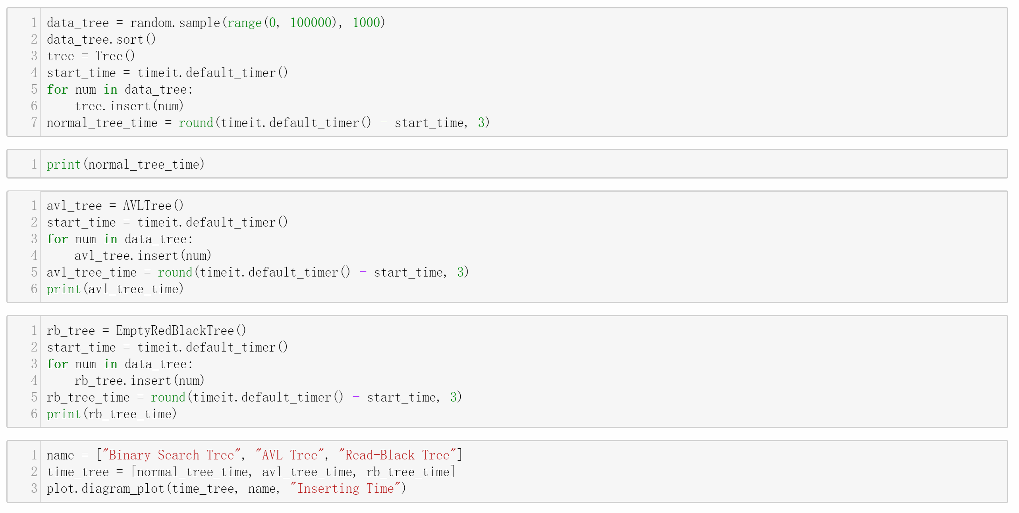
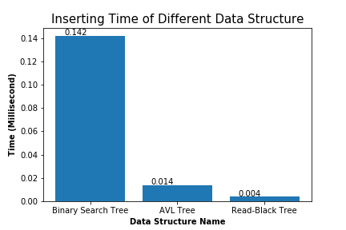
Tree Structure Comparison
So I wrote three kinds of tree and compare these 3 tree with searching time:

Slide 32
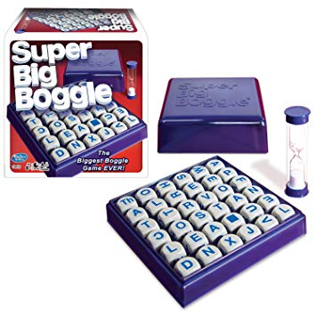
Practical Comparison: Boggle Game
For Practical Application to compare different data-structure’s real life use, I wrote a interesting game: Boggle.

Slide 33
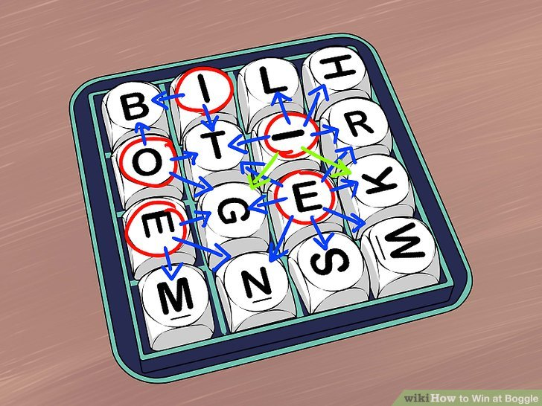
Practical Comparison: Boggle Game

Slide 34
Practical Comparison: Boggle Game
For board, I wrote a python code to generate random board stored in Two Dimensional List, whose size is defined by user.
For Dictionary, I download a txt file which contains 47k words splited by “\n”
Then the problem is how to load the dictionary into some data structure

Slide 35
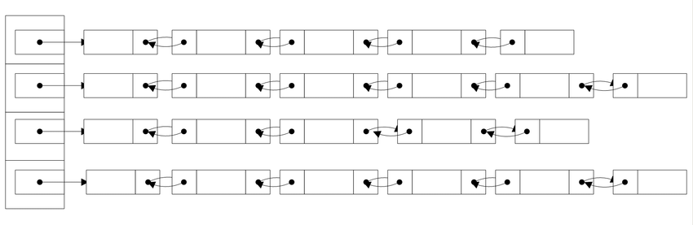
Practical Comparison: Boggle Game
There are 3 kinds of data structures to store the data:
List
Dictionary to store first character as key, and all the words start with this character into a list

Slide 36
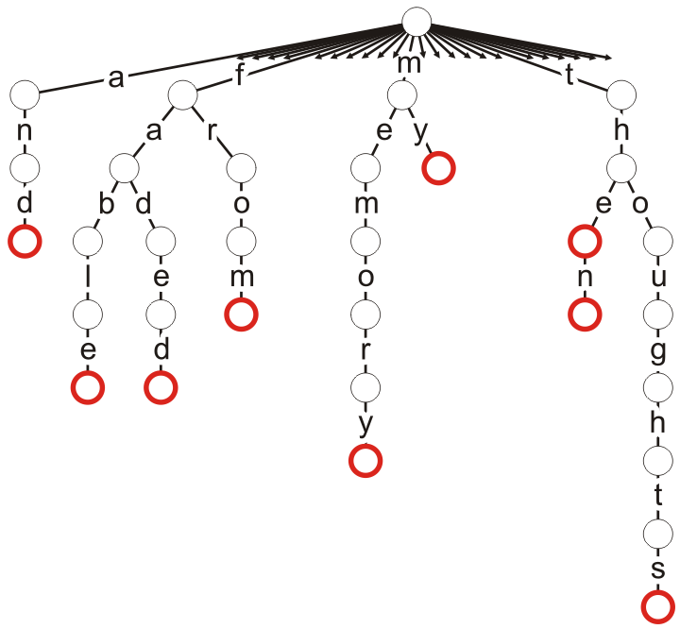
Practical Comparison: Boggle Game
Trie

Slide 37
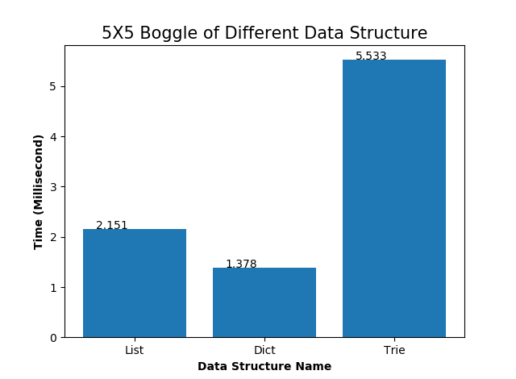
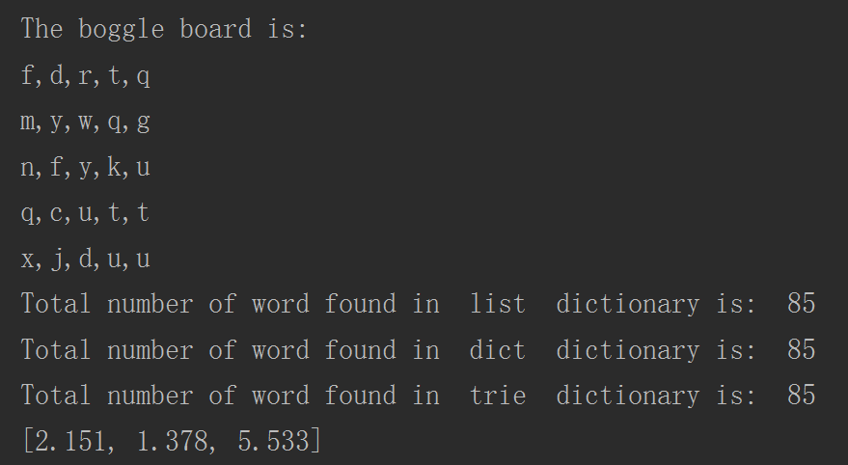
Practical Comparison: Boggle Game

Slide 38
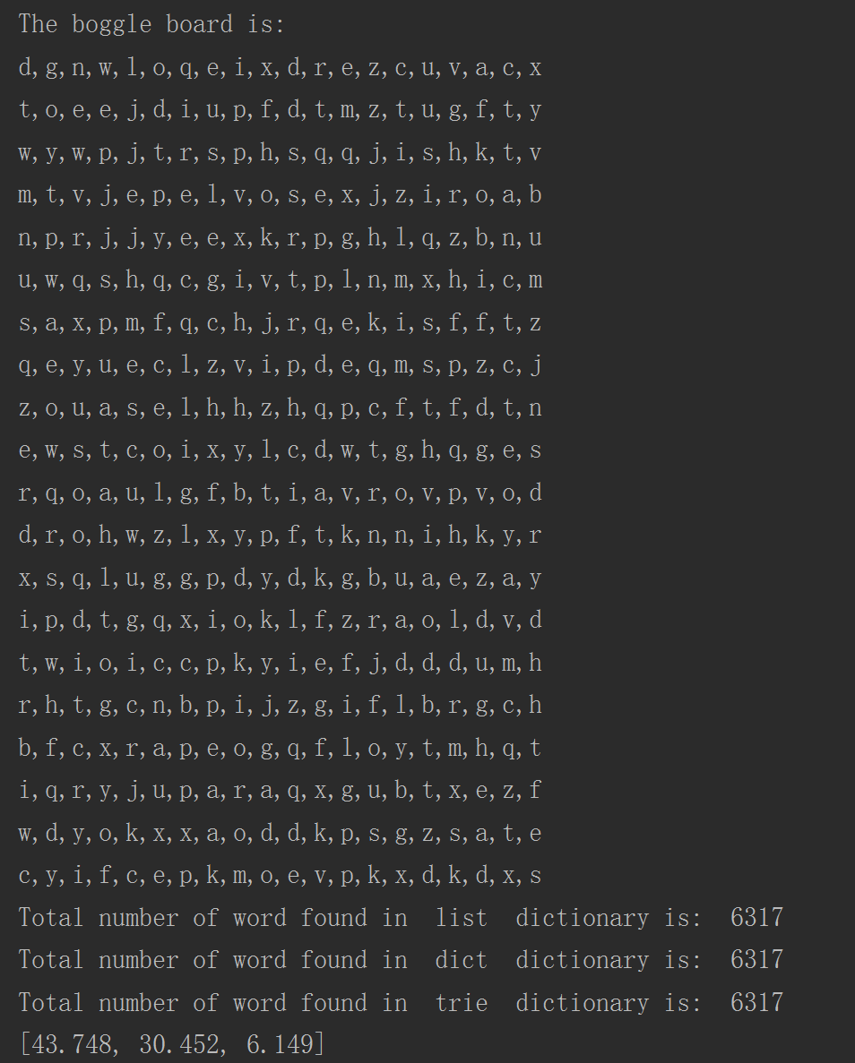
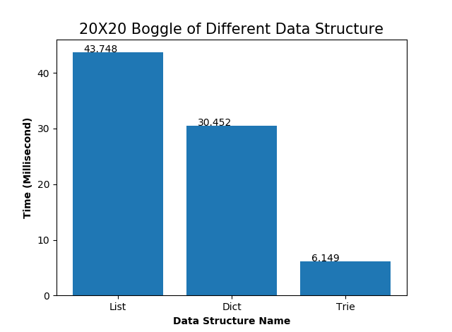
Practical Comparison: Boggle Game

Slide 39
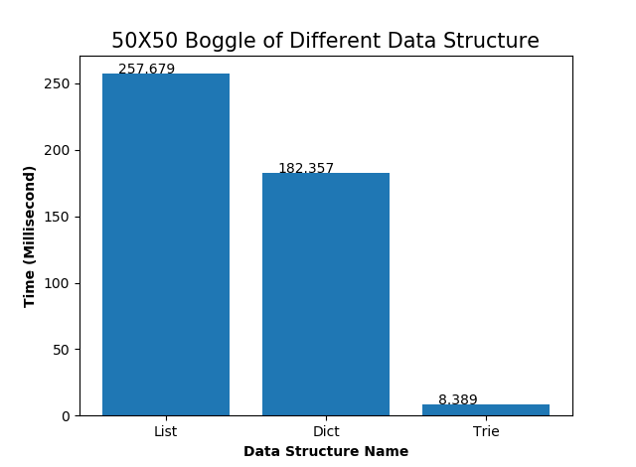
Practical Comparison: Boggle Game

Slide 40
Summary
For normal condition, the basic data structure of List(Array) is enough due to its requiring tiny memory chunk and accessing by index which is quick. However, they are bad on flexibility of data size(inserting and deleting in the middle or head).
When we do not consider about the memory size we should try to use hash data structure(set, dictionary) as most because it’s fastest accessing time for searching and deleting.
For some situations, we need specialized data structure to specific tasks, such as words reading and retrieving requiring a Trie structure to optimize.

Slide 41
Q&A

