Slide 1
Lane Detection
Fei-Fei Zheng

Slide 2
Motivation
Self-driving
Build from scratch
Integration
Practice with learned knowledge

Slide 3
Algorithm
L*A*B* color space and Sobel filter
Perspective Transformation
Histogram peaks
Sliding Windows
Polynomial Fit
Radius of Curvature

Slide 4
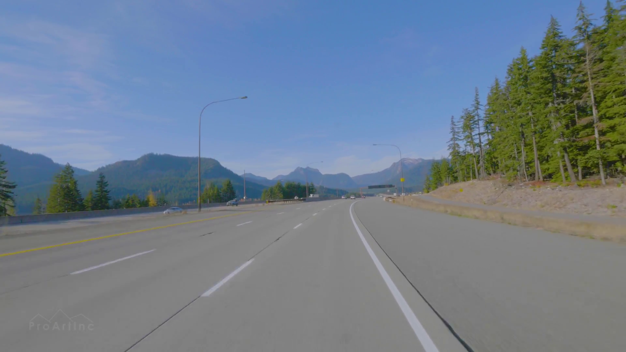
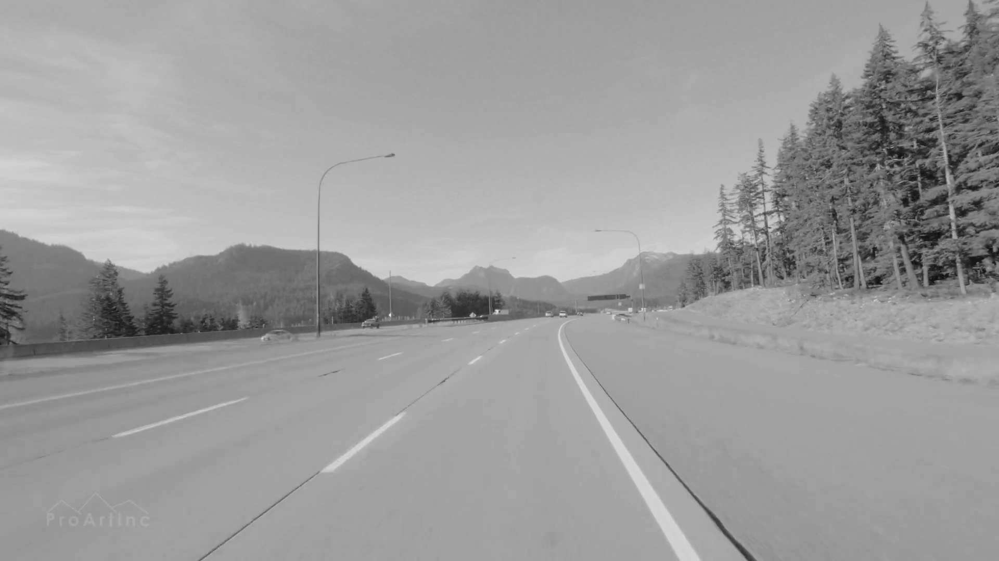
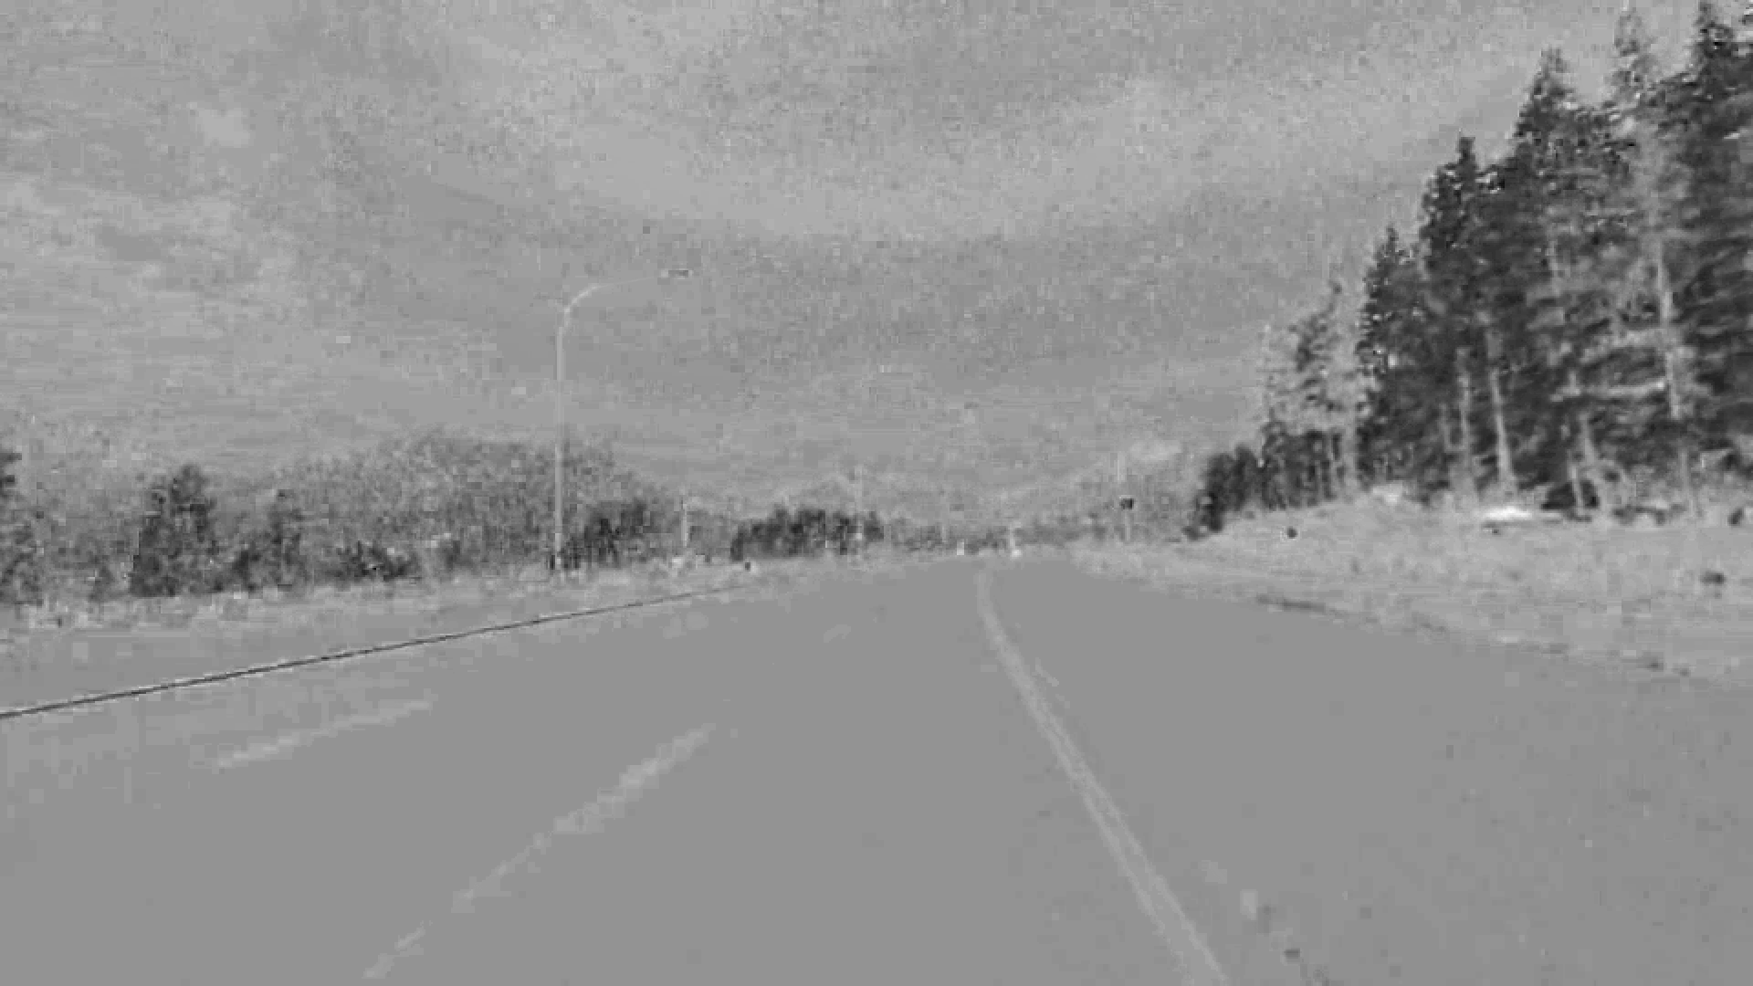
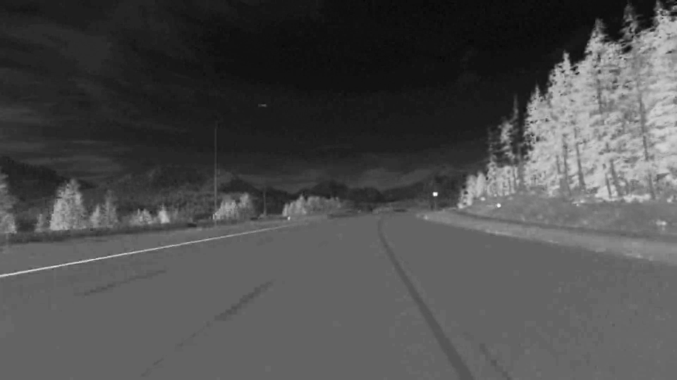
Step by Step
Original Image
L* Channel
A* Channel
B* Channel

Slide 5
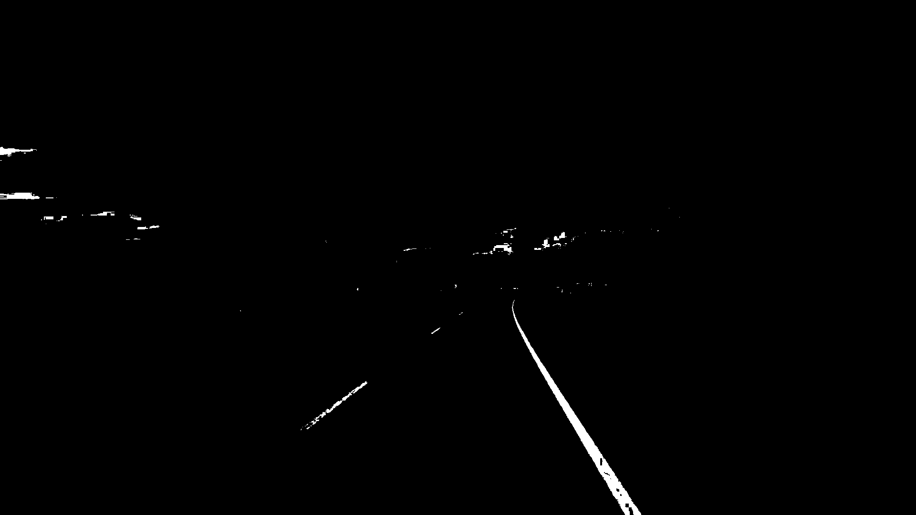
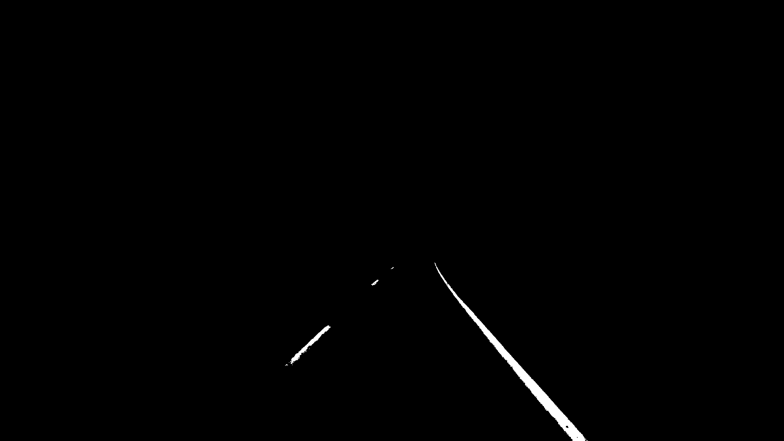
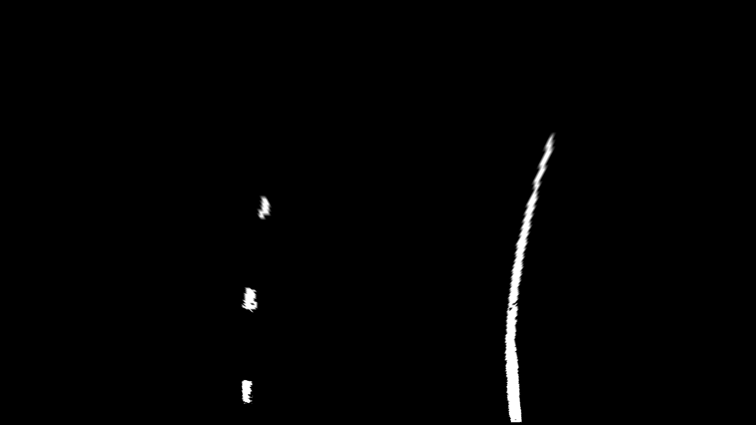
Step by Step
Original Image
Apply Multi-thresholds on L channel
Region of Interest
Warp Binary Image

Slide 6
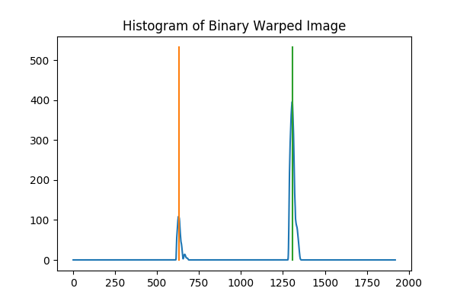
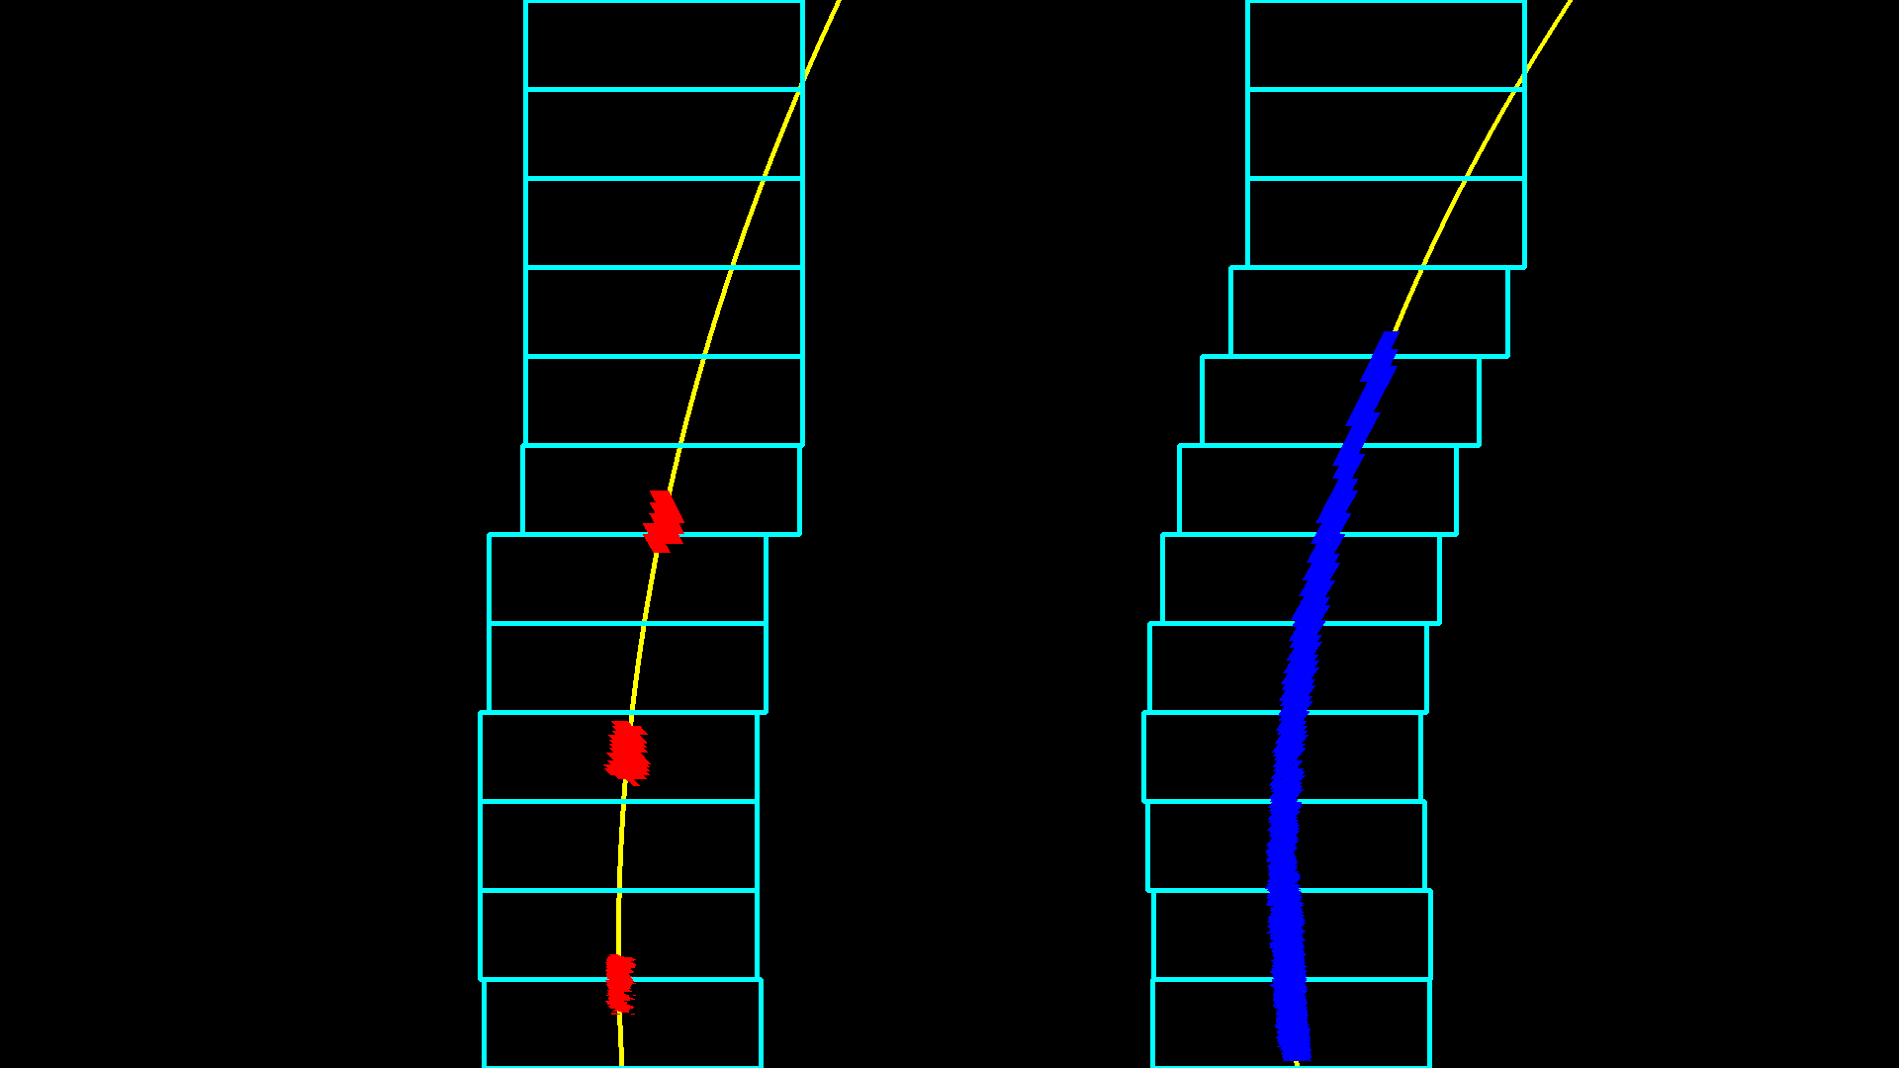

Step by Step
Warp Binary Image
Sliding Windows & Polynomial Fit
Draw Detected Lane Lines

Slide 7
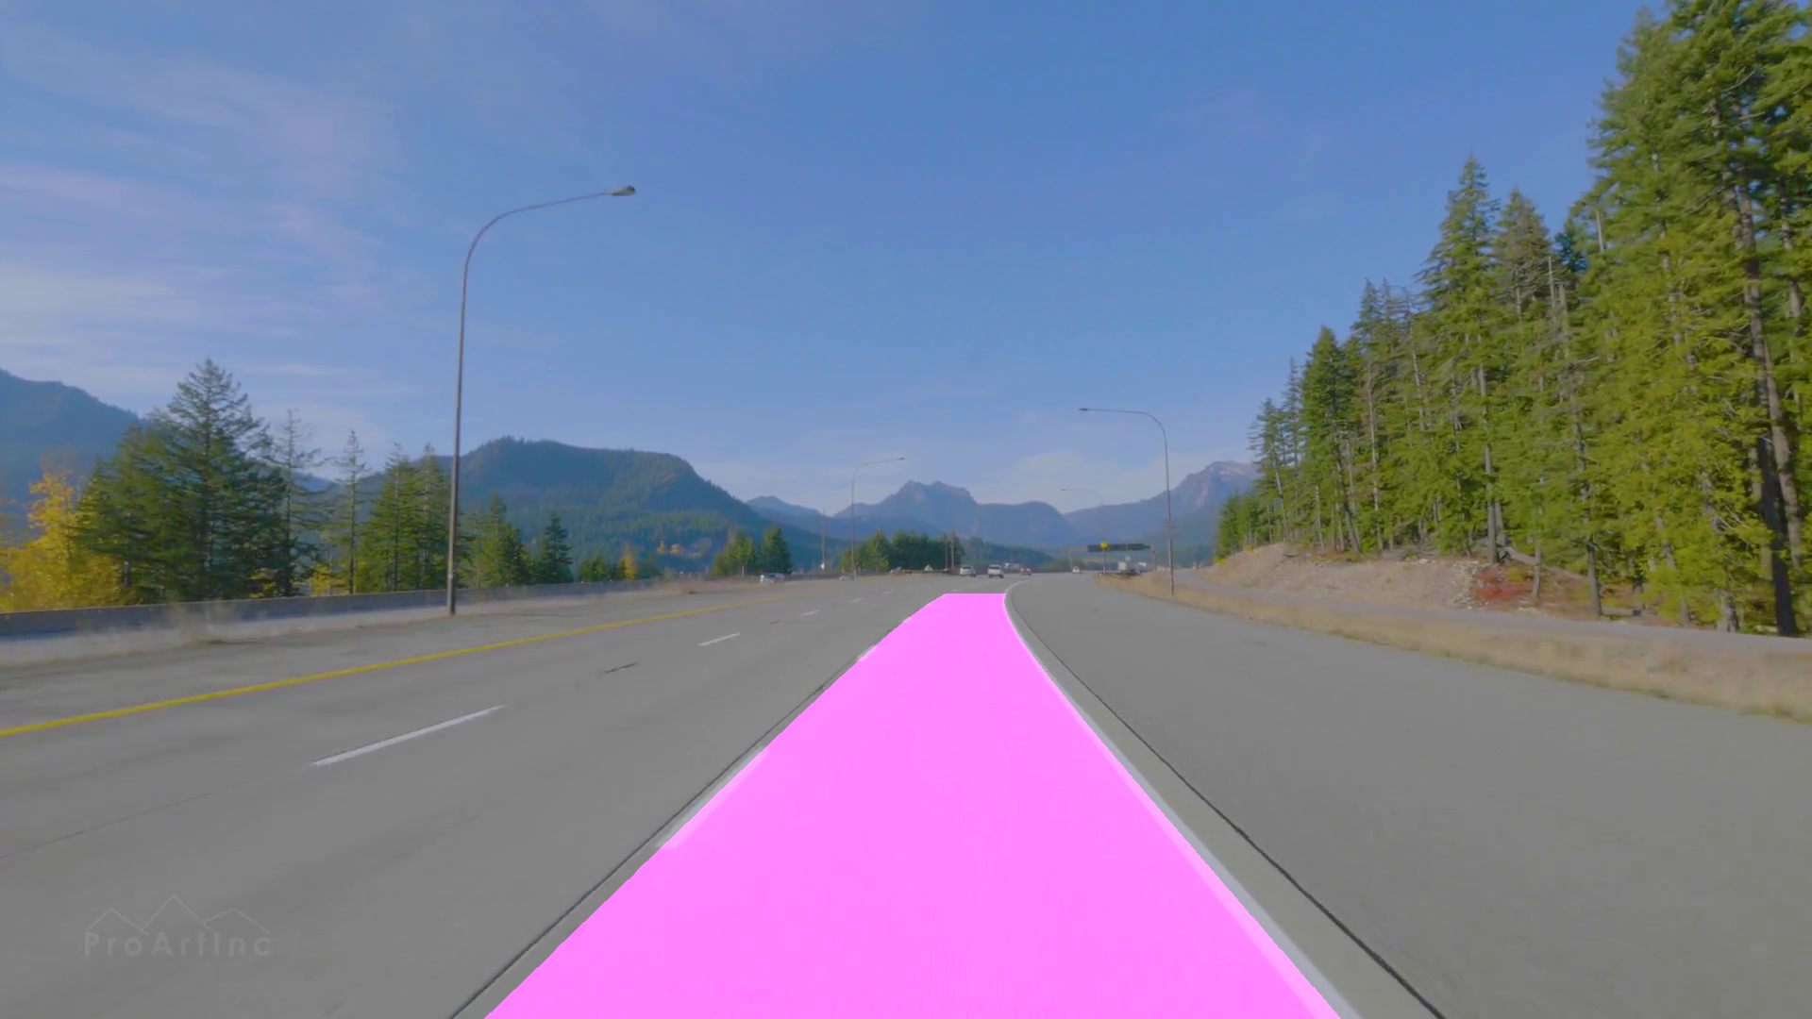
Step by Step
Original Image
Detected Lane Area

Slide 8
Difficulties
Integrate all parts into one
Changing lane or deviation
Extract lane with different colors (Yellow & White)
Lane width may change
Efficiency

