Slide 1



Integrating Simulations and Observations: A Foundation Model Approach for Estimating Aerosol Mixing State Index
Fei Jiang¹, Zhonghua Zheng¹, Hugh Coe^{1,2}, David Topping¹, Nicole Riemer³, Matthew West⁴
¹Department of Earth and Environmental Sciences, The University of Manchester, Manchester M13 9PL, UK
²National Centre for Atmospheric Sciences, The University of Manchester, Manchester M13 9PL,UK
³Department of Climate, Meteorology and Atmospheric Sciences, University of Illinois Urbana-Champaign, Urbana IL, 61801, USA
⁴Department of Mechanical Science and Engineering, University of Illinois Urbana-Champaign, Urbana IL 61801, USA

Slide 2
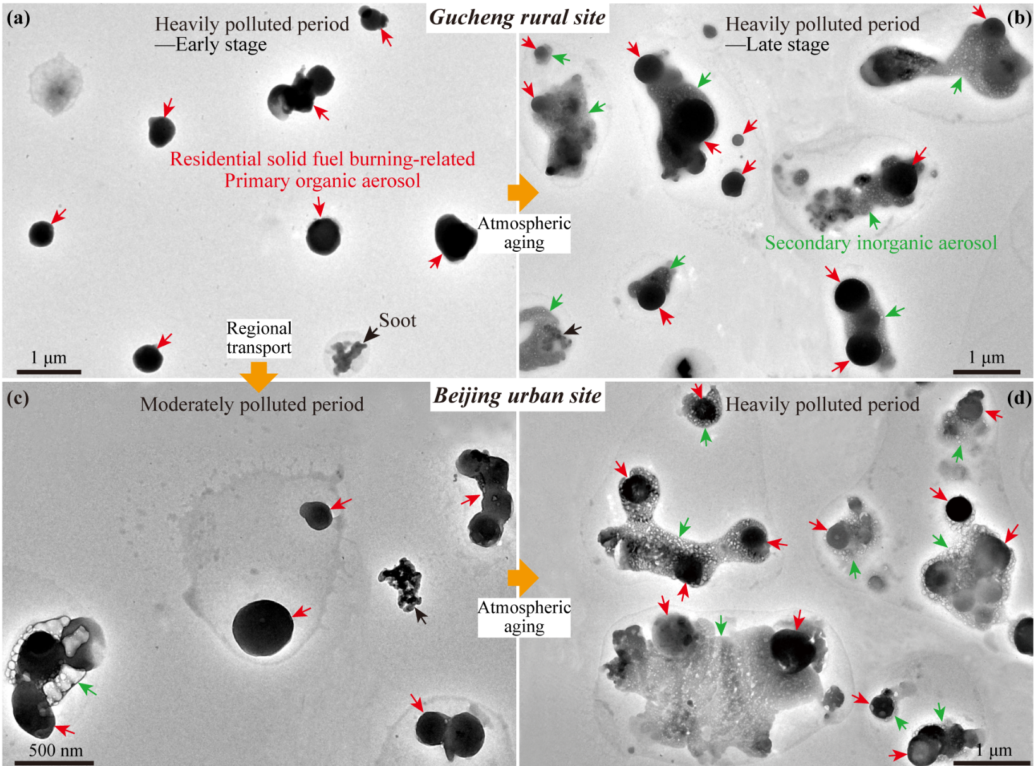
Population Mixing State
E.g.
TEM images showing individual particles collected in the different stages of the heavily polluted period
Species A
Species B
Species C
Fully Externally Mixed Population
Fully Internally Mixed Population
Real World Population
Liu, et al., Atmos. Chem. Phys., 2021
Differences in chemical composition across an aerosol in the bulk --- Population mixing state

Slide 3
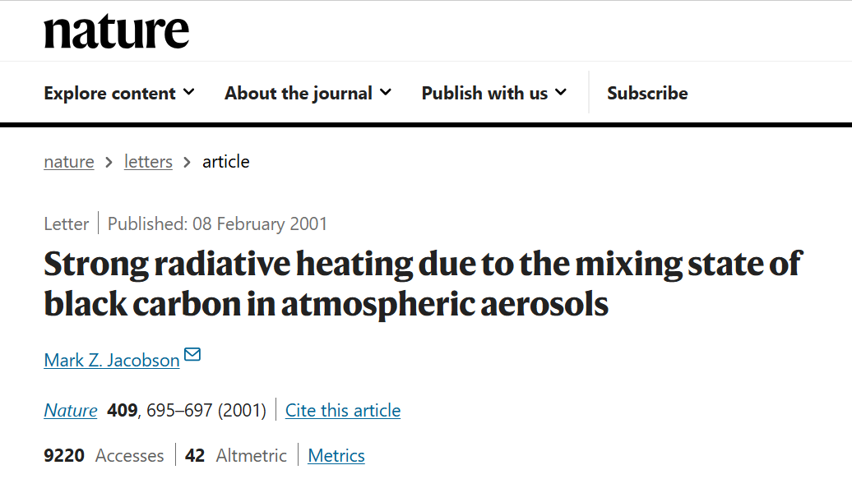
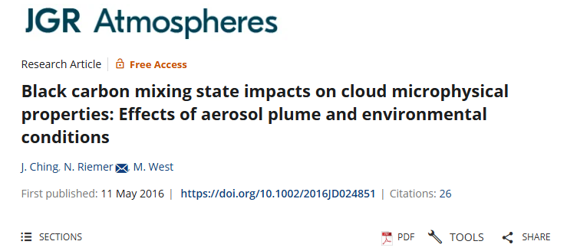
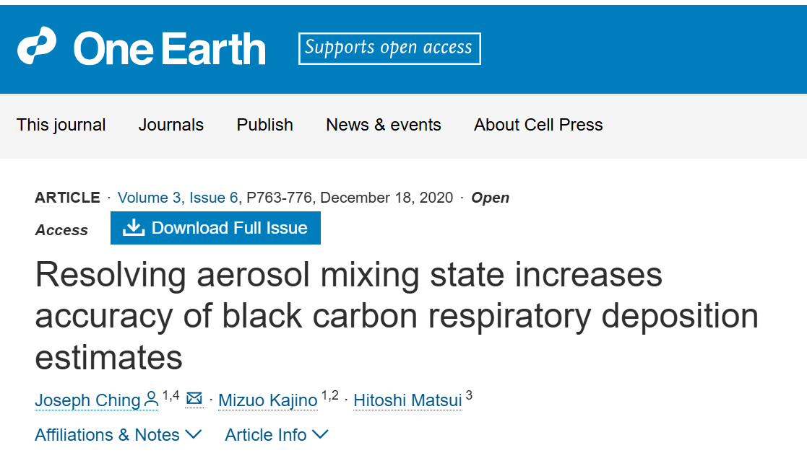
Population Mixing State
The Population Mixing State Impact
Indirect impact on climate
Direct impact on climate
Effect on human health

Slide 4
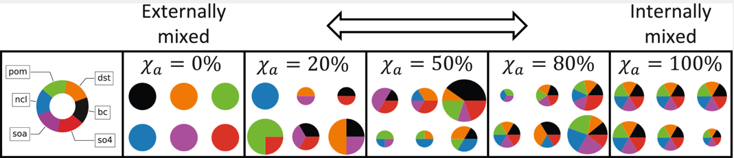

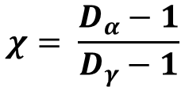

Population Mixing State Calculation
Quantify the Population Mixing State by Aerosol Mixing State Index ($χ$)
The Chemical Mixing State Index ($χ$): Account for differences in chemical composition across an aerosol.
$$χ= \frac{D_{α}−1}{D_{γ}−1}$$
$$D_{α}:Particle diversity based on particles′ Shannon entropy$$
$$D_{γ}:Bulk diversity based on {bulk}^{′}s Shannon entropy$$
$$(χ varies from 0\% to 100\%)$$
Riemer et al., Atmos. Chem. Phys., 2013
Zheng et al., Earth and Space Science., 2020

Slide 5
Current Research Methods
Observation
Aerosol mixing state calculation
Single Particle Mass Spectrometer (SPMS)
Limitations:
Constrained by spatial and temporal coverage
Expensive
Mass fractions of chemical species in each single particle

Slide 6
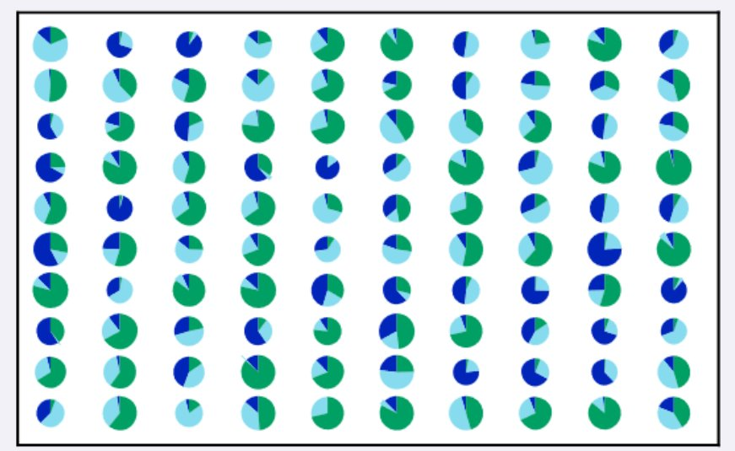
Current Research Methods
Modelling
Aerosol mixing state calculation
Particle-resolved model PartMC-MOSAIC
Limitations:
Mass fractions of chemical species in each single particle
Lack detail emission inventories, initial and background condition for model setup
High computation resource requirements

Slide 7
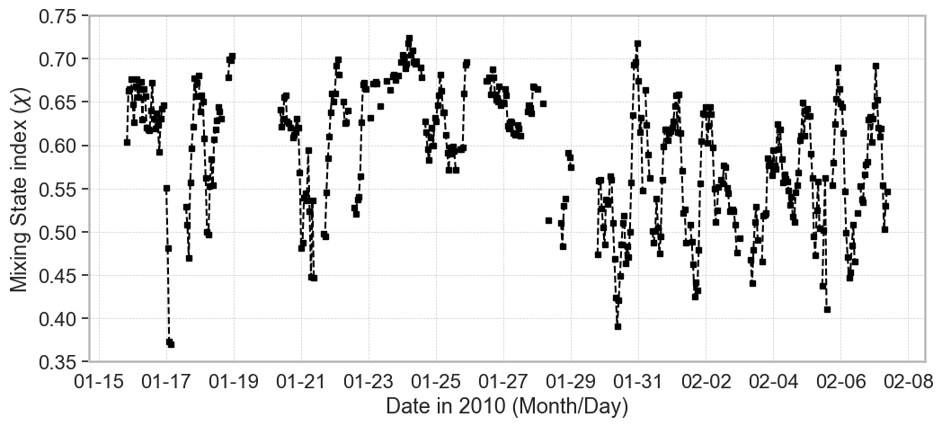
Methodological Challenges
How to simulate the real-world aerosol mixing state index?
390 observational datasets for MEGAPOLI winter Campaign in Paris, France from 15 January − 11February 2010

Slide 8

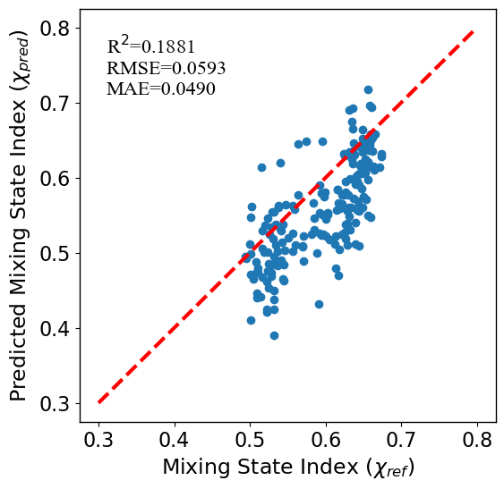

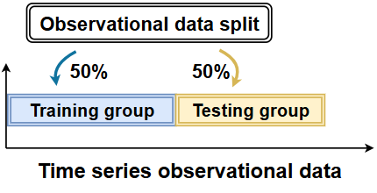

Methodological Challenges
Traditional data-driven methods
E.g. XGBoost results
390 observational datasets for MEGAPOLI Campaign
ML and DL training
Core Issue:
Small Sample Trap

Slide 9
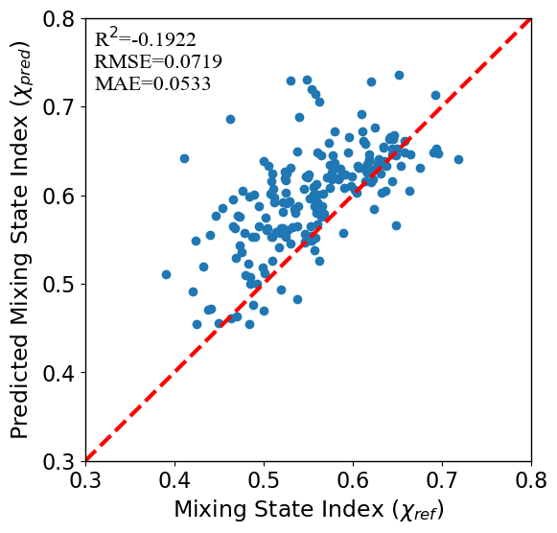
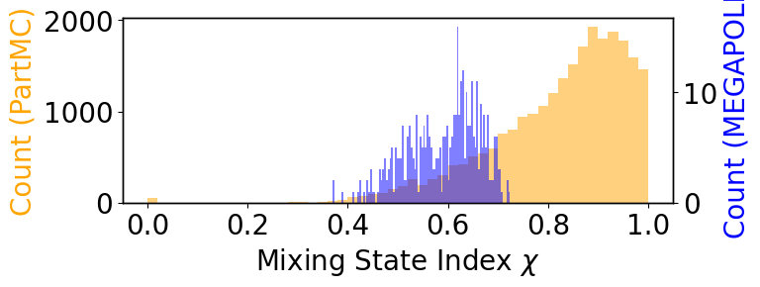

Methodological Challenges
Numerical methods (PartMC)
Hybrid approach (PartMC + ML)
Core Issue:
Input bias propagation
Model simplification
Core Issue:
Domain shift failure (Distribution mismatch)
Domain shift between PartMC simulations and MEGAPOLI observations limits generalization
E.g. Model trained by PartMC, test on MEGAPOLI data

Slide 10














Foundation Model Approach
Traditional ML model
Foundation model (pre-trained model)
Training data
ML model
Large datasets
Fine-tune
Task1
Task1
Pre-trained model
(foundation model)
Task2
Task2
Pre-train
Task3
Task3
Task4
Task4
Task5
Task5
E.g.
Fine-tune
Conversation task
ChatGPT
GPT-3.5 (Foundation model)

Slide 11
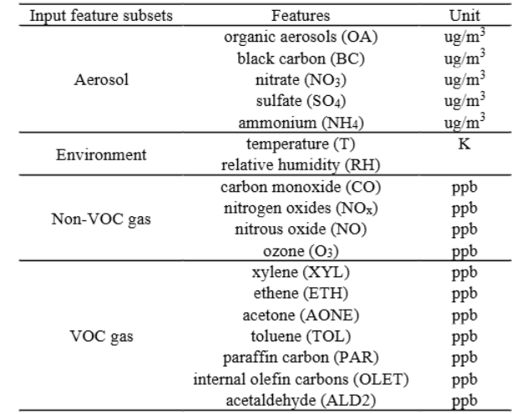


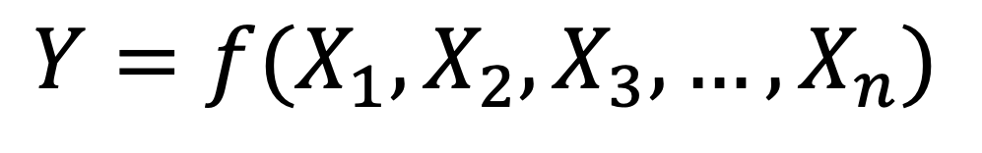
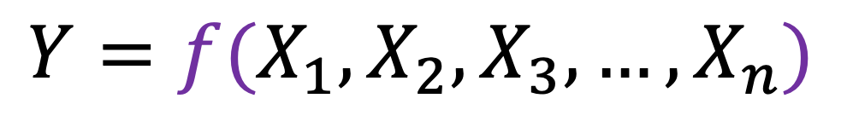

Methodology
PartMC data
(General task)
$$χ$$
Pre-training
$$Y=f(X_{1},X_{2},X_{3},…,X_{n})$$
Fine-tuning
$$Y=f(X_{1},X_{2},X_{3},…,X_{n})$$
Observational data (downstream task)

Slide 12


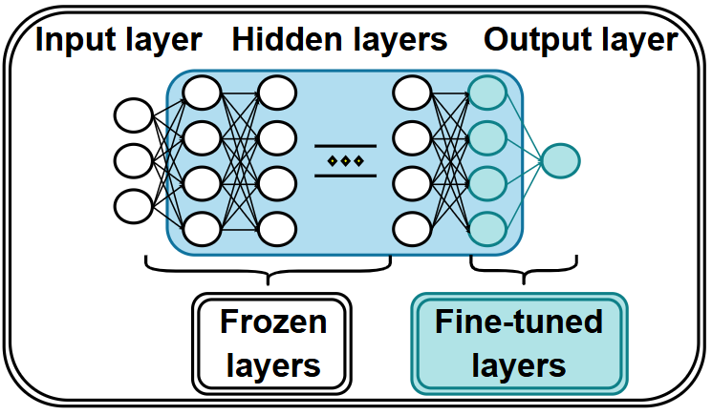
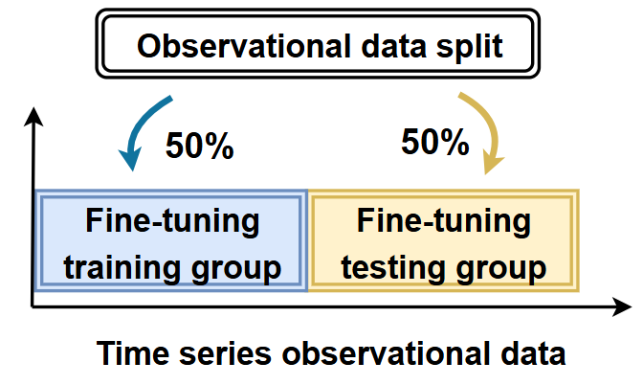
Methodology
Pre-training data
~25000 samples
The pre-trained model
The fine-tuned model
PartMC-MOSAIC
Pre-training
Fine-tuning
Fine-tuning target
Observational data
~390 samples

Slide 13
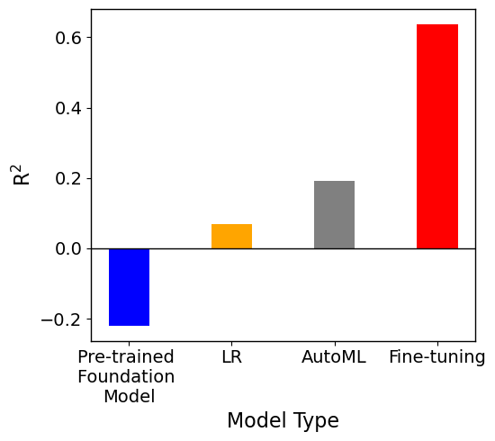
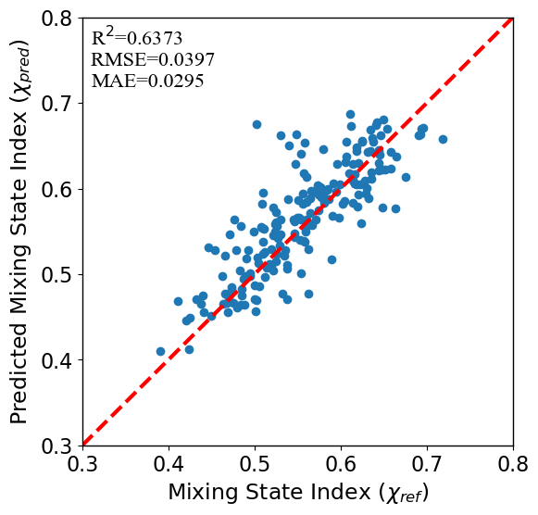
Results: Model Performance
Traditional data-driven methods using observational data
Pre-training + Fine-tuning
Hybrid approach (PartMC + ML)

Slide 14
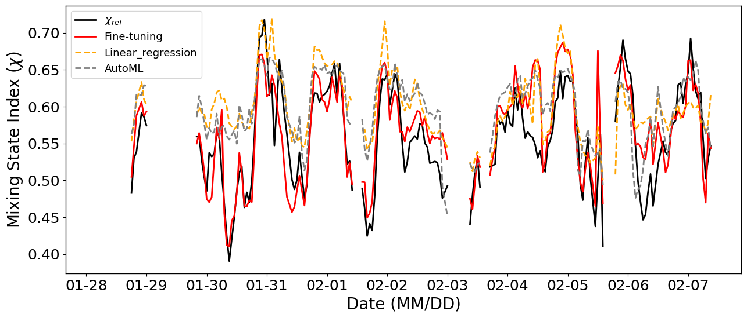
Results: Model Performance
Comparison of predicted mixing state index (χpred) across different methods with the MEGAPOLI observational data (χref) over time

Slide 15
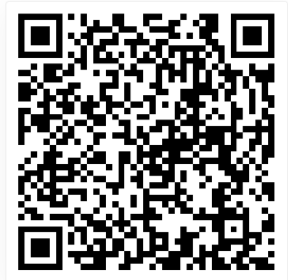
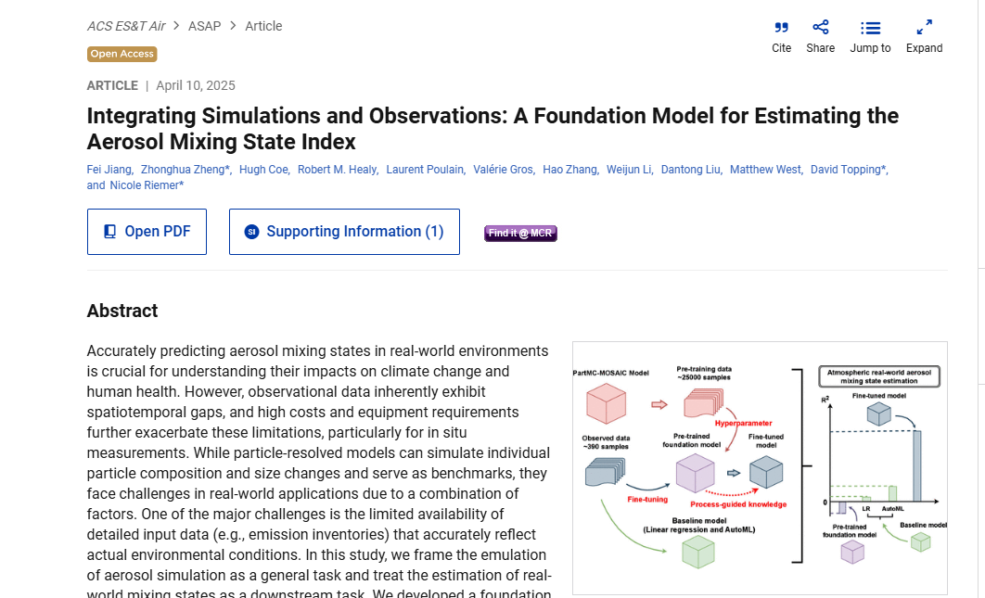

DOI: https://pubs.acs.org/doi/10.1021/acsestair.4c00329
Paper QR code
Personal homepage QR code
Fei Jiang, Email: fei.jiang-4@postgrad.manchester.ac.uk

