Slide 1
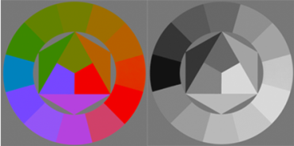
Decolorization: Is rgb2gray()out?
Yibing Song, Linchao Bao, Xiaobin Xu and Qingxiong Yang
City University of Hong Kong

Slide 2
Decolorization: Is rgb2gray()out?

Slide 3

Decolorization: Is rgb2gray()out?
1. Background introduction
2. Motivation
3. Multi-scale contrast preservation
4. Experiments
5. Future Work

Slide 4
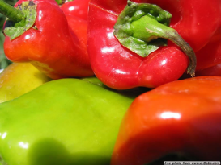
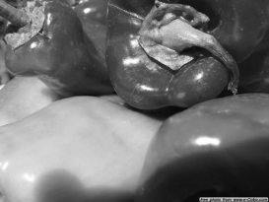
Background introduction
Decolor
Color Image
Grayscale Image
Several applications: black-white printer, TV guidance for the color blind, etc.

Slide 5
Background introduction
Decolorization is a dimensionality reduction process which maps multiple input channel values into one output value in each pixel location in the image.
Image structures and color contrast should be preserved in the grayscale image.

Slide 6
Decolorization: Is rgb2gray()out?
1. Background introduction
2. Motivation
3. Multi-scale contrast preservation
4. Experiments
5. Future Work

Slide 7
Motivation
“Traditional luminance conversion fails for preserving color contrast in the iso-luminant regions of the color image.”
This sentence appears in the introduction of almost every decolorization paper.
The luminance conversion seems to be a limitation beaten by various decolorization methods which propose new models and parameter solvers.

Slide 8
Motivation
Thus there is a trend that to solve the decolorization problem, luminance conversion (i.e., rgb2gray()function in Matlab) is not promising and research should focus on proposing new decolorization models and solving the parameters for different color images, correspondingly.
However, is it really the case?

Slide 9
Motivation
Existing decolorization methods lack robustness: failure cases can easily be found, which prevents these methods from being practical applications.
Luminance conversion: $g=0.299∗R+0.587∗G+0.114∗B$ performs well in practice, only with occasionally failures on iso-luminant regions.
A thought-provoking question is naturally raised: can we reach a robust solution by simply modifying the rgb2gray() to avoid failures in the iso-luminant regions?

Slide 10
Motivation
RGB2GRAY conversion model:
$$g=w_{r}I_{r}+w_{g}I_{g}+w_{b}I_{b}$$
$$s.t. w_{r}+w_{g}+w_{b}=1$$
$$w_{r}≥0, w_{g}≥0, w_{b}≥0$$

Slide 11
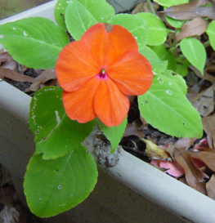
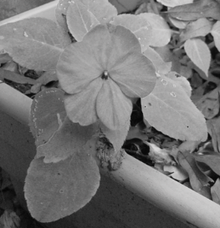
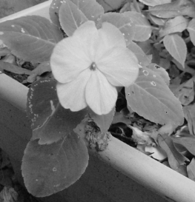
Motivation
Some empirical comparison results:
Color Image
Gooch et al. 2005
RGB2GRAY
GOOCH, A., OLSEN, S., TUMBLIN, J., AND GOOCH, B. 2005 Color2gray: salience-preserving color removal. In SIGGRAPH.

Slide 12
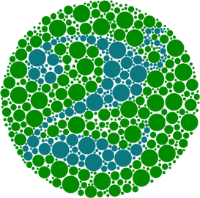
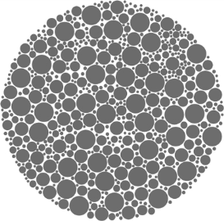
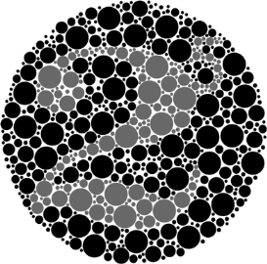
Motivation
Some empirical comparison results:
Color Image
Kim et al. 2009
RGB2GRAY
KIM, Y., JANG, C., DEMOUTH, J., AND LEE, S. 2009. Robust color-to-gray via nonlinear global mapping. In SIGGRAPH ASIA.

Slide 13
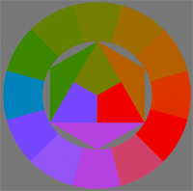

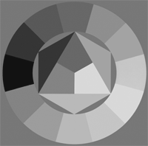
Motivation
Some empirical comparison results:
Color Image
Lu et al. 2012
RGB2GRAY
LU, C., XU, L., AND JIA, J. 2012. Real-time contrast preserving decolorization. In SIGGRAPH ASIA Technical Briefs.

Slide 14
Motivation
How to choose proper $(w_{r},w_{g},w_{b})$ for each color image?
This is difficult because of human visual perception.
Observers tend to pay more attention on preservation of multi-scale contrast in spatial and range domains for different image structures.

Slide 15

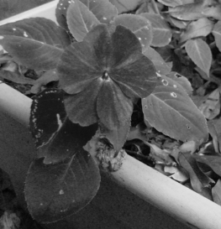
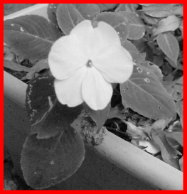
Motivation
Spatial domain:
Color Image
Small scale
Large scale
Preserving color contrast in small spatial scale produces more details of flower petal while large scale preservation makes contrast of flower and leaves prominent, which is user-preferred.

Slide 16
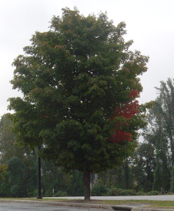
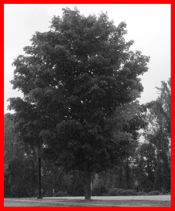
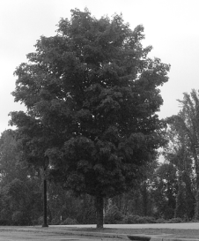
Motivation
Spatial domain:
Color Image
Small scale
Large scale
Small spatial scale preservation produces user-preferred contrast of red and green leaves, which is lost in large scale preservation.

Slide 17

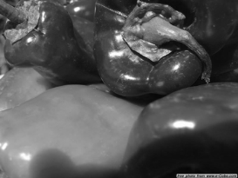
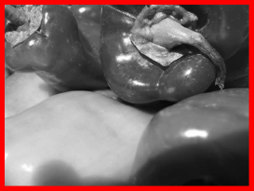
Motivation
Range domain:
Color Image
Small scale
Large scale
Preserving color contrast in small range scale produces small color variation within one pepper while weakens contrast between different peppers, which is user preferred.

Slide 18


Motivation
Range domain:
Color Image
Small scale
Large scale
Preserving color contrast in small range scale produces contrast of adjacent regions in the color wheel, which is user-preferred.

Slide 19
Motivation
The diversity of user preferences in the contrast preservation in both spatial and range domain makes decolorization difficult to consistently produce high-quality results.
How to alleviate this problem?

Slide 20
Decolorization: Is rgb2gray()out?
1. Background introduction
2. Motivation
3. Multi-scale contrast preservation
4. Experiments
5. Future Work

Slide 21

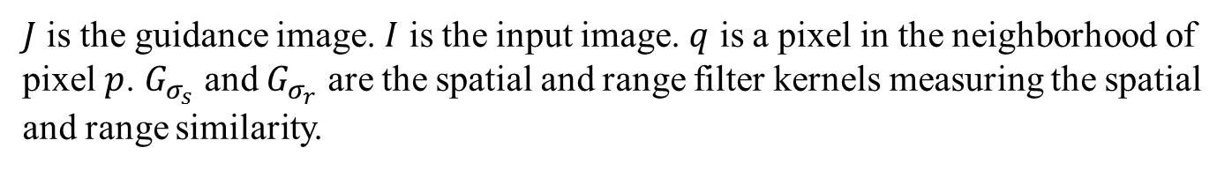
Multi-scale contrast preservation
Contrast preservation using joint bilateral filtering:
Define $I(p)$ the value at pixel $p$ and $I^{J}(p)$ the filtered value.
$$I^{J}\left(p\right)=\frac{\sum_{q∈Ω_{p}}{G_{σ_{s}}\left(∥p−q∥\right)}G_{σ_{r}}\left(∥J\left(p\right)−J(q)∥\right)⋅I(q)}{\sum_{q∈Ω_{p}}{G_{σ_{s}}\left(∥p−q∥\right)}G_{σ_{r}}\left(∥J\left(p\right)−J(q)∥\right)}$$
$J$ is the guidance image. $I$ is the input image. $q$ is a pixel in the neighborhood of pixel $p$. $G_{σ_{s}}$ and $G_{σ_{r}}$ are the spatial and range filter kernels measuring the spatial and range similarity.

Slide 22
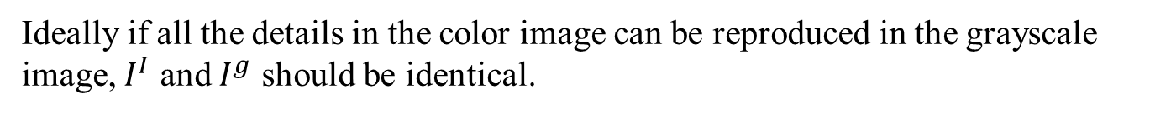
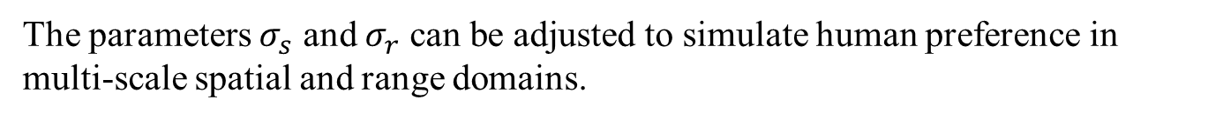
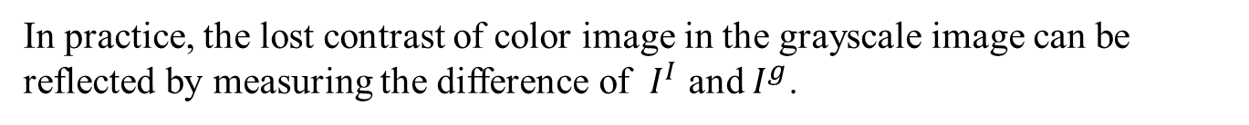
Multi-scale contrast preservation
Ideally if all the details in the color image can be reproduced in the grayscale image, $I^{I}$ and $I^{g}$ should be identical.
In practice, the lost contrast of color image in the grayscale image can be reflected by measuring the difference of $I^{I}$ and $I^{g}$.
The parameters $σ_{s}$ and $σ_{r}$ can be adjusted to simulate human preference in multi-scale spatial and range domains.

Slide 23
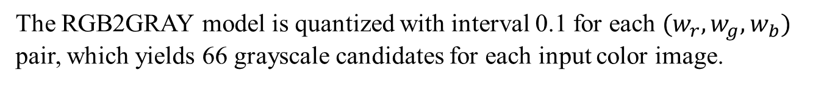
Multi-scale contrast preservation
The RGB2GRAY model is quantized with interval 0.1 for each $(w_{r},w_{g},w_{b})$ pair, which yields 66 grayscale candidates for each input color image.
The (joint) bilateral filtering is adopted to decide which candidates are user-preferred from the perspective of multi-scale contrast in spatial and range domains.

Slide 24
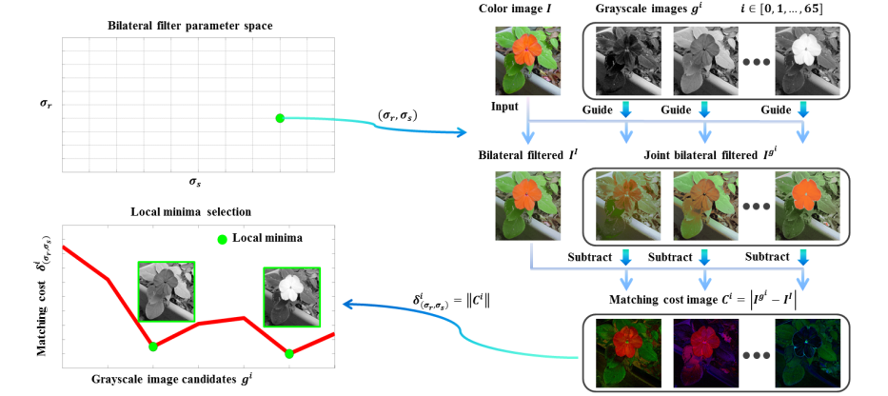
Multi-scale contrast preservation
The proposed pipeline:

Slide 25
Decolorization: Is rgb2gray()out?
1. Background introduction
2. Motivation
3. Multi-scale contrast preservation
4. Experiments
5. Future Work

Slide 26
Experiments
User study is conducted in the quantized 66 candidates.
The user-preferred one can be consistently found among the auto generated results.

Slide 27
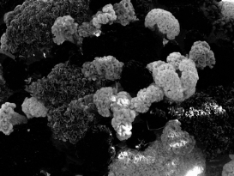
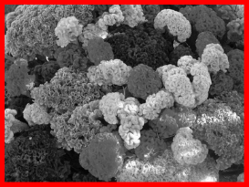
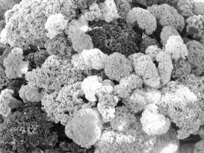
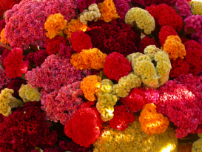
Experiments

Slide 28



Experiments

Slide 29
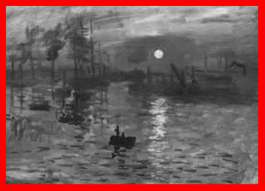
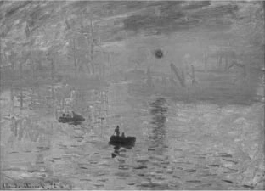
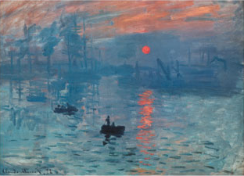
Experiments

Slide 30
Decolorization: Is rgb2gray()out?
1. Background introduction
2. Motivation
3. Multi-scale contrast preservation
4. Experiments
5. Future Work

Slide 31
Conclusion
The final grayscale output can be selected by further involving knowledge from human perceptual preference depending on specific applications.
CALL FOR ATTENTION: For decolorization, more focus should be put on the RGB2GRAY model since it is robust and simplifies the problem.

Slide 32
Thanks ☺

