Slide 1

Real-Time Exemplar-Based Face Sketch Synthesis
Pipeline illustration
Yibing Song¹
Linchao Bao¹
Qingxiong Yang¹
Ming-Hsuan Yang²
¹City University of Hong Kong
²University of California at Merced
Note: containing animations

Slide 2
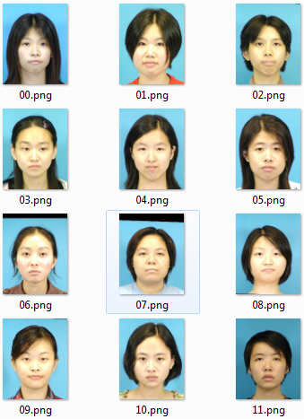
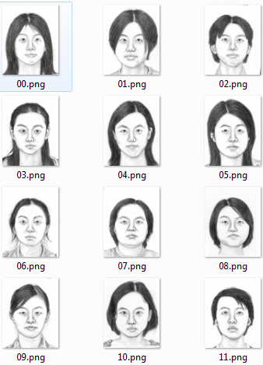
Our assumption: a database containing photo-sketch pairs
1. photo database
2. sketch database
Aligned

Slide 3













Coarse Sketch Generation
Step 1: KNN search
Test photo
Test photo patch $T_{p}$
p
Relative
position
Relative
position
$$∆_{p}^{K}$$
$∆_{p}^{1}$
$∆_{p}^{2}$
$$∆_{p}$$
=
[
Similarly
]
Training photo dataset
$$T_{p}$$
$$T_{p}$$
$$T_{p}$$
Matched photo patch $I_{P}^{1}$
Matched photo patch $I_{P}^{2}$

Slide 4











Coarse Sketch Generation
Step 2: Linear Estimation from Photos
Test photo patch $T_{p}$
$∆_{p}^{1}$
$∆_{p}^{2}$
$∆_{p}^{K}$
$$x_{p}^{1}∙$$
$$+x_{p}^{2}∙$$
$$+x_{p}^{K}∙$$
$$=$$
Matched photo patch $I_{P}^{1}$
Matched photo patch $I_{P}^{2}$
Matched photo patch $I_{P}^{K}$
2. Compute linear mapping function defined by $\left\{x_{p}^{1},x_{p}^{2},⋯,x_{p}^{K} \right\}$

Slide 5













Coarse Sketch Generation
Step 3: Apply Linear Mapping to Sketches
Test photo
Coarse sketch
Repeat for every pixel
p
$∆_{p}^{1}$
$∆_{p}^{2}$
$∆_{p}^{K}$
$$x_{p}^{1}∙$$
$$+x_{p}^{2}∙$$
$$+x_{p}^{K}∙$$
$$=$$
$$E_{p}$$
Estimation on pixel p
Matched sketch pixel
Matched sketch pixel
$$S_{P+∆_{p}^{1}}^{}$$
$$S_{P+∆_{p}^{2}}^{}$$
Matched sketch pixel
$$S_{P+∆_{p}^{K}}^{}$$

Slide 6



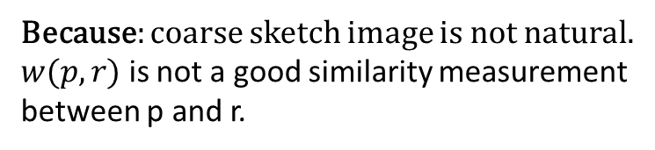






Denoising: State-of-the-art Image Denoising Algorithms
Coarse sketch
Nonlocal Means (NLM)
r
q
$$w(p,r)$$
p
$$S_{p}^{NLM}=$$
$$E_{r}$$
$$+$$
$$w(p,q)$$
$$E_{q}$$
$$+⋯$$
After NLM
For all pixels in the neighbor of p: $Ψ_{p}$
Little improvement
Because: coarse sketch image is not natural.
$w(p,r)$ is not a good similarity measurement
between p and r.
[NLM] A. Buades, B. Coll and J.-M. Morel, A non-local algorithm for image denoising, CVPR 2005.

Slide 7
Motivation – BM3D
BM3D groups correlated patches in the noisy image to create multiple estimations.
How BM3D works
Our idea for sketch denoising: group highly similar sketch estimations.
[BM3D] K. Dabov, A. Foi, V. Katkovnik, and K. Egiazarian, “Image denoising by sparse 3D transform-domain collaborative filtering,” IEEE Trans. Image Process., vol. 16, no. 8, pp. 2080-2095, August 2007.

Slide 8




























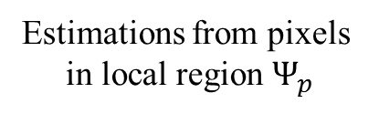



Proposed Spatial Sketch Denoising Algorithm (SSD)
Estimations from pixels
in local region $Ψ_{p}$
Test photo
r
q
$$E_{p}^{r}$$
p
p
Averaging estimations to
generate output sketch value.
$∆_{q}^{1},x_{q}^{1}$
$∆_{q}^{2}$, $x_{q}^{2}$
$∆_{q}^{K}$, $x_{q}^{K}$
Similarly
Matched sketch
$$x_{q}^{1}∙$$
$$S_{q+∆_{q}^{1}}^{}$$
$$+x_{q}^{2}∙$$
$$S_{q+∆_{q}^{2}}^{}$$
$$+x_{q}^{K}∙$$
$$S_{q+∆_{q}^{K}}^{}$$
$$=$$
$$S_{p+∆_{q}^{1}}^{}$$
$$S_{p+∆_{q}^{2}}^{}$$
$$S_{p+∆_{q}^{K}}^{}$$
$$E_{p}^{q}$$
Nonlocal Means (NLM):
$$S_{p}^{NLM}=$$
$$w(p,q)∙$$
$$E_{q}$$
$$w(p,r)∙$$
$$+⋯$$
$$+$$
$$E_{r}$$
Proposed SSD:
$$S_{p}^{SSD}=$$
$$1∙$$
$$E_{p}^{q}$$
$$+$$
$$1∙$$
$$E_{p}^{r}$$
$$+⋯$$

Slide 9
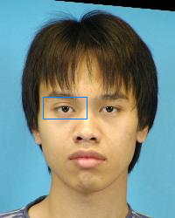
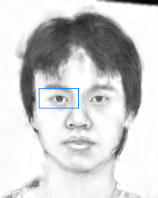
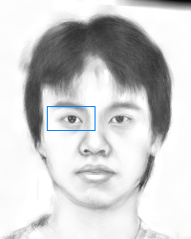
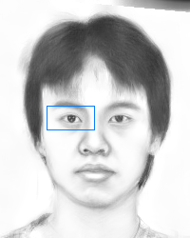











Robustness to the region size $\left|Ψ_{p}\right|$ - the only parameter involved
p
Proposed SSD is robust to $\left|Ψ_{p}\right|$
Input
5x5 local region
$\left|Ψ_{p}\right|=25$
11x11 local region
$\left|Ψ_{p}\right|=121$
17x17 local region
$\left|Ψ_{p}\right|=289$
23x23 local region
$\left|Ψ_{p}\right|=529$
Note: When $Ψ_{p}$ is sufficient large (i.e., $\left|Ψ_{p}\right|$>100), the proposed SSD can effectively
suppress noise while preserving facial details like the tiny eye reflections (see close-ups).

