Slide 1
Fast Preprocessing for Robust Face Sketch Synthesis
Yibing Song¹
Jiawei Zhang¹
Linchao Bao²
Qingxiong Yang³
¹City University of Hong Kong
²Tencent AI Lab
³University of Science and Technology of China
Notes:
In this video we are going to illustrate the motivation and general idea of our work, which is efficient and robust face sketch synthesis.

Slide 2
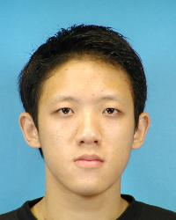
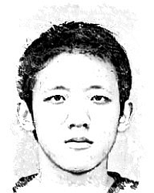
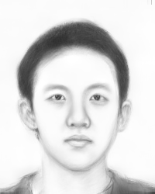
Motivation:
Input image
Image-based method
Exemplar-based method
Notes:
Face sketch synthesis simulates the drawing style of artist on generating face photos automatically. Existing achievements can be categorized as image based methods and exemplar based methods. While image based methods typically produce strokes and shadings according to image edges, exemplar based methods reconstruct new sketches from existing ones. For face photos exemplar based methods have advantages to synthesize stylistic sketches through learning from the data set.

Slide 3
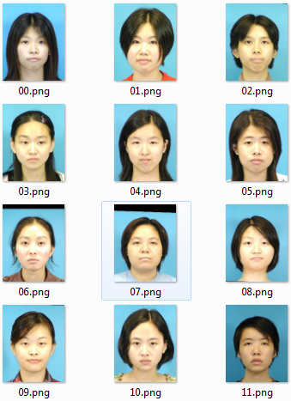
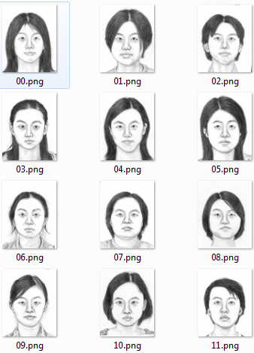
Exemplar-based framework:
1. photo dataset
2. sketch dataset
Aligned
Notes:
In the exemplar-based methods a training photo-sketch dataset is involved. The sketches are drawn by the artist and aligned well with face photos.

Slide 4
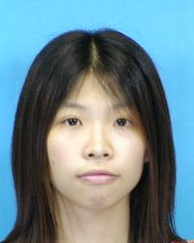
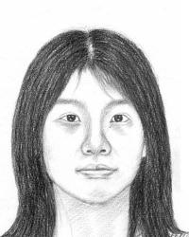
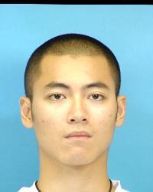
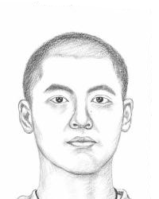
Exemplar-based framework:
K-NN matched candidate
Photo-sketch patches
Training photo-sketch dataset
Testing photo
Testing photo patch
Notes:
The testing photo is divided into local patches. For each patch a K nearest neighbor search is performed between testing and training photos. The similarity measurement is based on pixel luminance difference. After K N N search candidate photo sketch pairs can be identified.

Slide 5
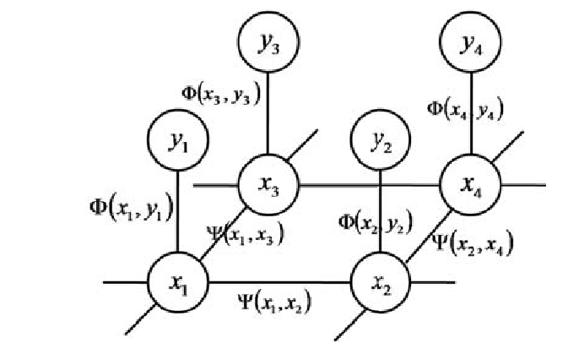
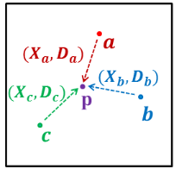
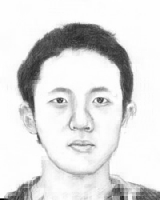
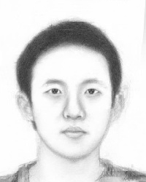
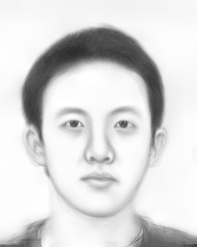
Exemplar-based framework:
Markov Random Field
Sketch denoising
Testing photo
MRF
MWF
SSD
Notes:
After selecting candidate photo-sketch patches, existing methods either involve Markov Random Field or sketch denoising scheme to combine sketch patches into output result.

Slide 6
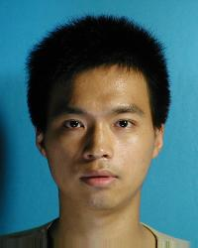
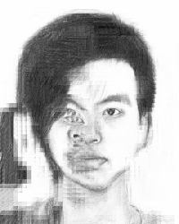
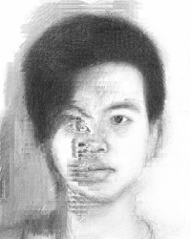
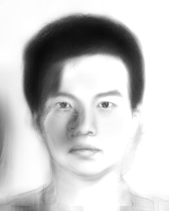
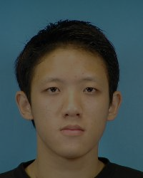
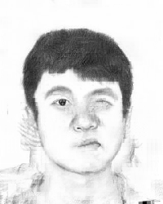
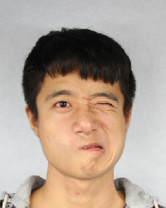
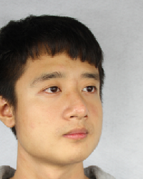
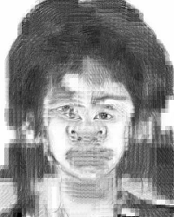
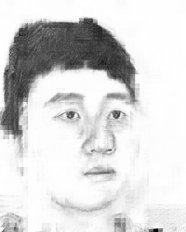
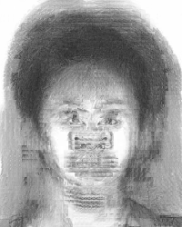
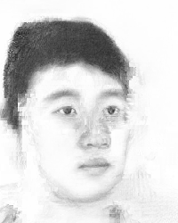
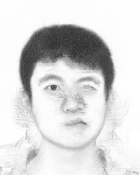
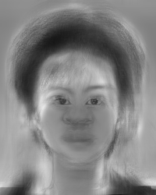
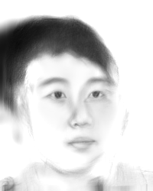
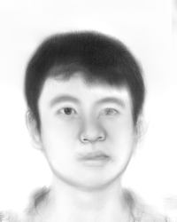
Limitations:
Training dataset
Ideal testing photo
In practice
Varying pose
Side lighting
Different foreground and background lighting
Different expression
Testing photo
MRF
MWF
SSD
Notes:
The quality of the synthesized sketch hinges on whether correct candidate patches can be obtained through K N N search step. For ideal case where both testing and training photos are captured in frontal view, normal lighting and neutral expression, pixel luminance based distance metrics enable correctly matched patches to synthesize high quality sketches. However, in practice when testing photo is captured in different lighting or poses, original metrics can not find correctly matched patches, which lead to blurry and artifact on the synthesized sketches. Meanwhile the luminance invariant patch distance like normalized cross correlation will fail when local contrast within a patch changes due to varying lighting conditions.

Slide 7
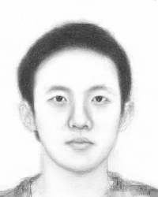
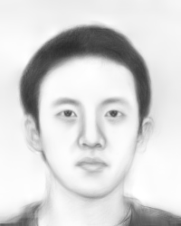
Our contributions: robust to different foreground and background lighting
MRF
MWF
SSD
Testing photo
Ours + MRF
Ours + MWF
Ours + SSD
Notes:
Inspired by the previous achievements, we in this work propose two algorithms to remap testing and training photos into similar condition, which enables correct K N N search and existing methods will become robust. In case of varying lighting conditions, we jointly adapt both testing and training photos to make their lighting conditions similar to each other. In case of pose and expression variations, we estimate the local projective mapping to remap testing photos, which reduces three D facial deformation and perspective change. The proposed algorithms can be directly integrated with existing methods with ignorable computational cost.

Slide 8
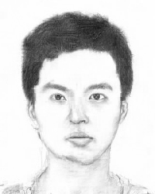
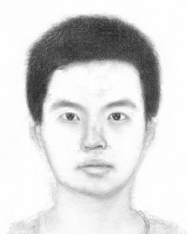
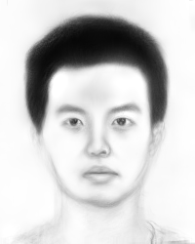
Our contributions: robust to side lighting
MRF
MWF
SSD
Testing photo
Ours + MRF
Ours + MWF
Ours + SSD

Slide 9
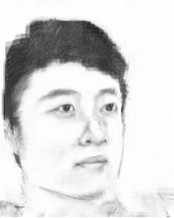
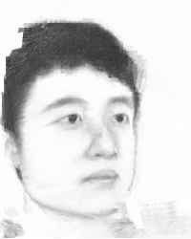
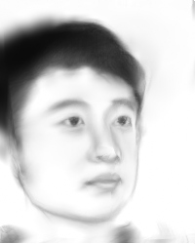
Our contributions: robust to varying pose
MRF
MWF
SSD
Testing photo
Ours + MRF
Ours + MWF
Ours + SSD

Slide 10
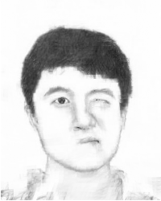

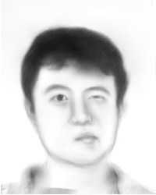
Our contributions: robust to multiple expressions
MRF
MWF
SSD
Testing photo
Ours + MRF
Ours + MWF
Ours + SSD

Slide 11
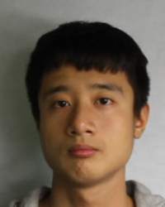
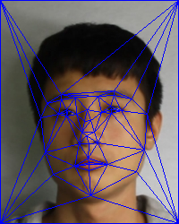
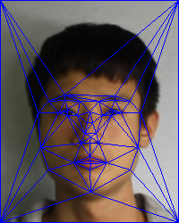
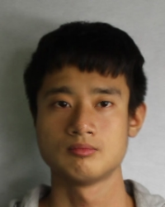
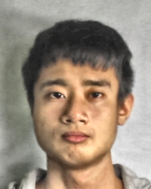
Proposed algorithms:
Adaptive Histogram Equalization
Testing photo
Local affine remapping
Corrected
Notes:
Our algorithms first involves landmarks to detect facial components and use pre defined non overlapping triangles to cover the test photo. Then local affine remapping is performed to correct test photo into frontal view and neutral expression, which is similar to the training photos.

Slide 12
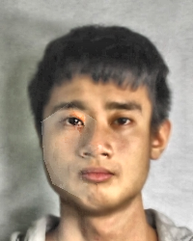

Proposed algorithms:
Adaptive Histogram Equalization
Side lighting reduction
Notes:
Then we detect whether side lighting exists through measuring the intensity difference between left part and right part of face region. If side lighting exists we first use adaptive histogram equalization to reduce its effect. Notice that cast shadows still exist around facial component we try to further reduce its effect using facial symmetric information. For each pixel in the shadow region we perform a K N N search around its symmetric position. After K N N search we can identify the best matched patch and use it to adjust the lighting of current pixel. We perform this operation densely and relight the shadow around facial component.

Slide 13
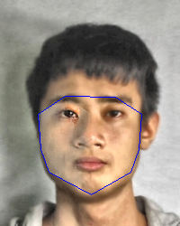
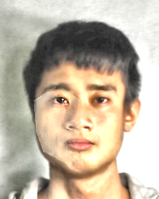

Proposed algorithms:
Foreground adaptation
Side lighting reduction
Testing photo
Training photo
Adapted testing photo

Slide 14
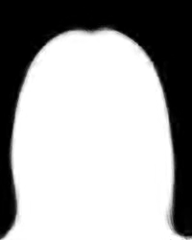

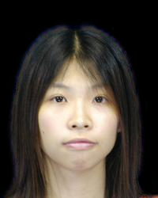

Proposed algorithms:
Testing photo
Training photo
Adapted
Background
Adapted testing photo
Foreground
Alpha map
Background

Slide 15

Proposed algorithms:
Testing photo
Training photo
Adapted
Background
Adapted testing photo
Foreground
Alpha map
Adapted training photo
Notes:
After side lighting reduction we adjust both testing and training photos through proposed bidirectional luminance remapping. The remapping algorithm is performed in two steps. First we globally linear remap testing photo according to the foreground intensity of both testing and training photos. The foreground is approximated using pre defined facial region according to landmarks. Second we adjust the background luminance of each training photo to make he overall statistics of training photos consistent with adapted testing photo in the first step. The background can be pre computed using off line alpha matte. Then we combine foreground, alpha matte and transformed background into new training photos. Together with adapted testing photo, the new training photos will be provided to state of the art methods for sketch synthesis.

Slide 16




Proposed algorithms:
Testing photo
Synthesized sketch
Notes:
The advantage of the proposed algorithm is that it does not require online segmentation or matting for testing photos and thus is efficient and robust. After obtaining the synthesized sketches we map it back using local affine remapping to yield the final sketch result.

Slide 17
Take-home messages:
1. Exemplar-based framework enriches the artistic style of face sketch synthesis.
2. Correspondence establishment suffers from lighting and pose variance effects.
3. We integrate our method into existing methods to ensure accurate correspondence.
4. Robustness to overcome challenging scenarios in real world demos.

Slide 18

Project website:
www.cs.cityu.edu.hk/~yibisong/ijcai17_sketch/index.html
Thanks ☺
Questions?

