Slide 1









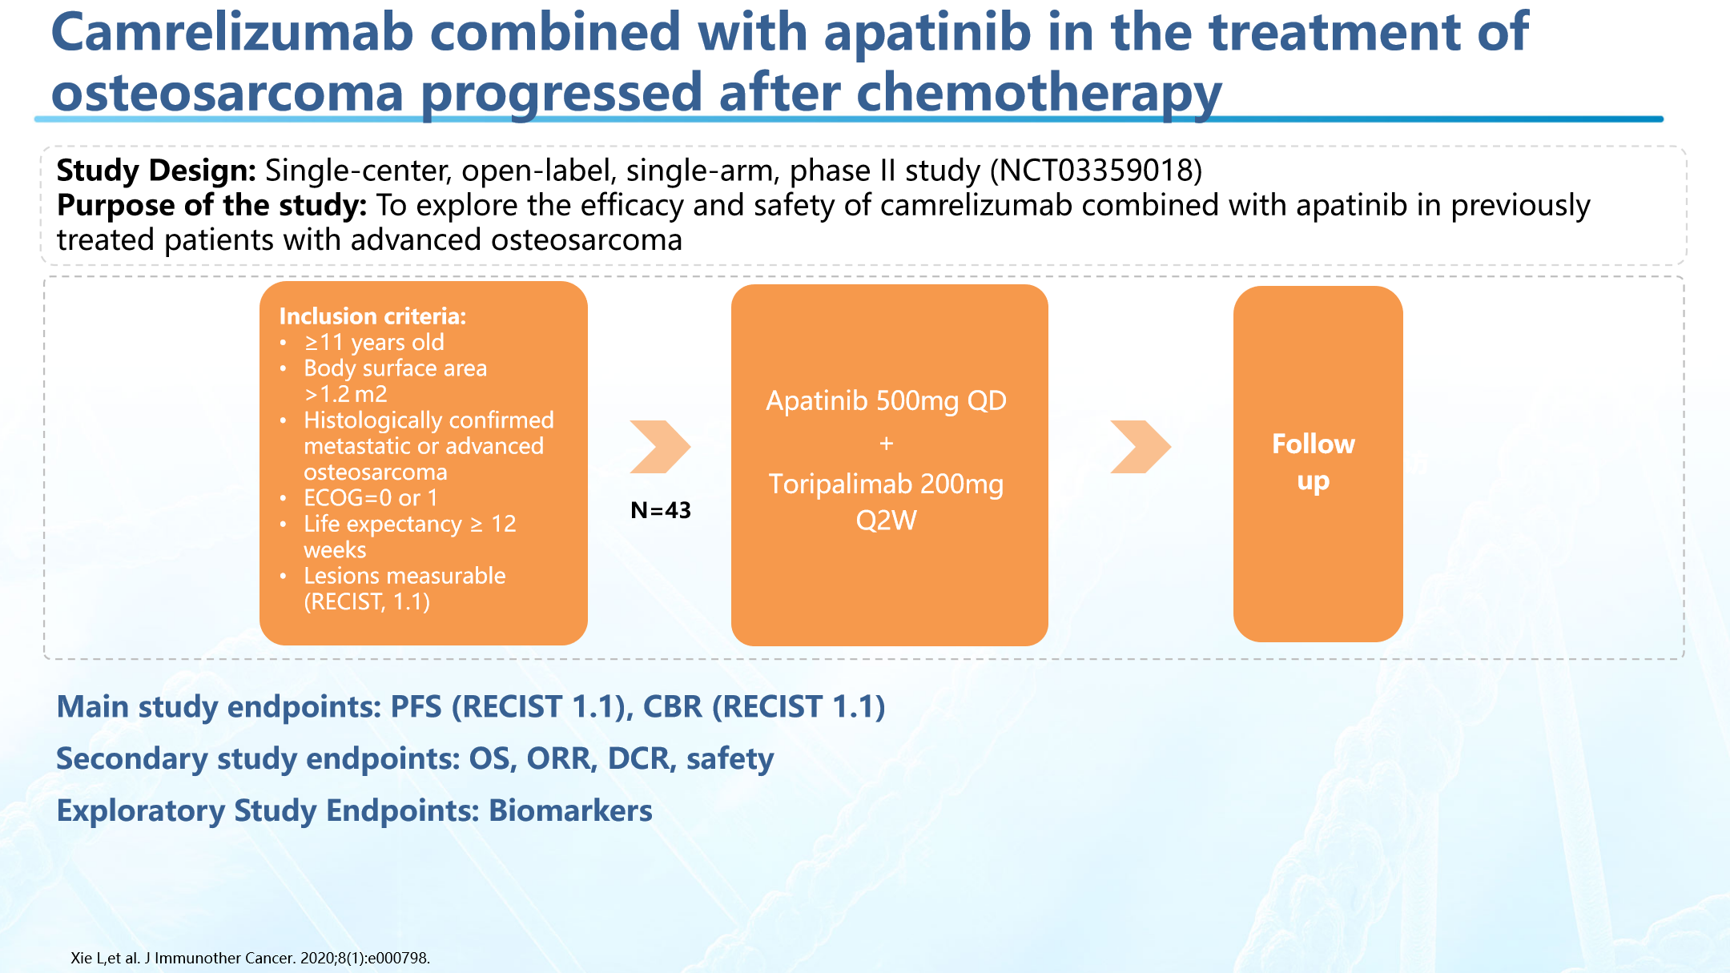
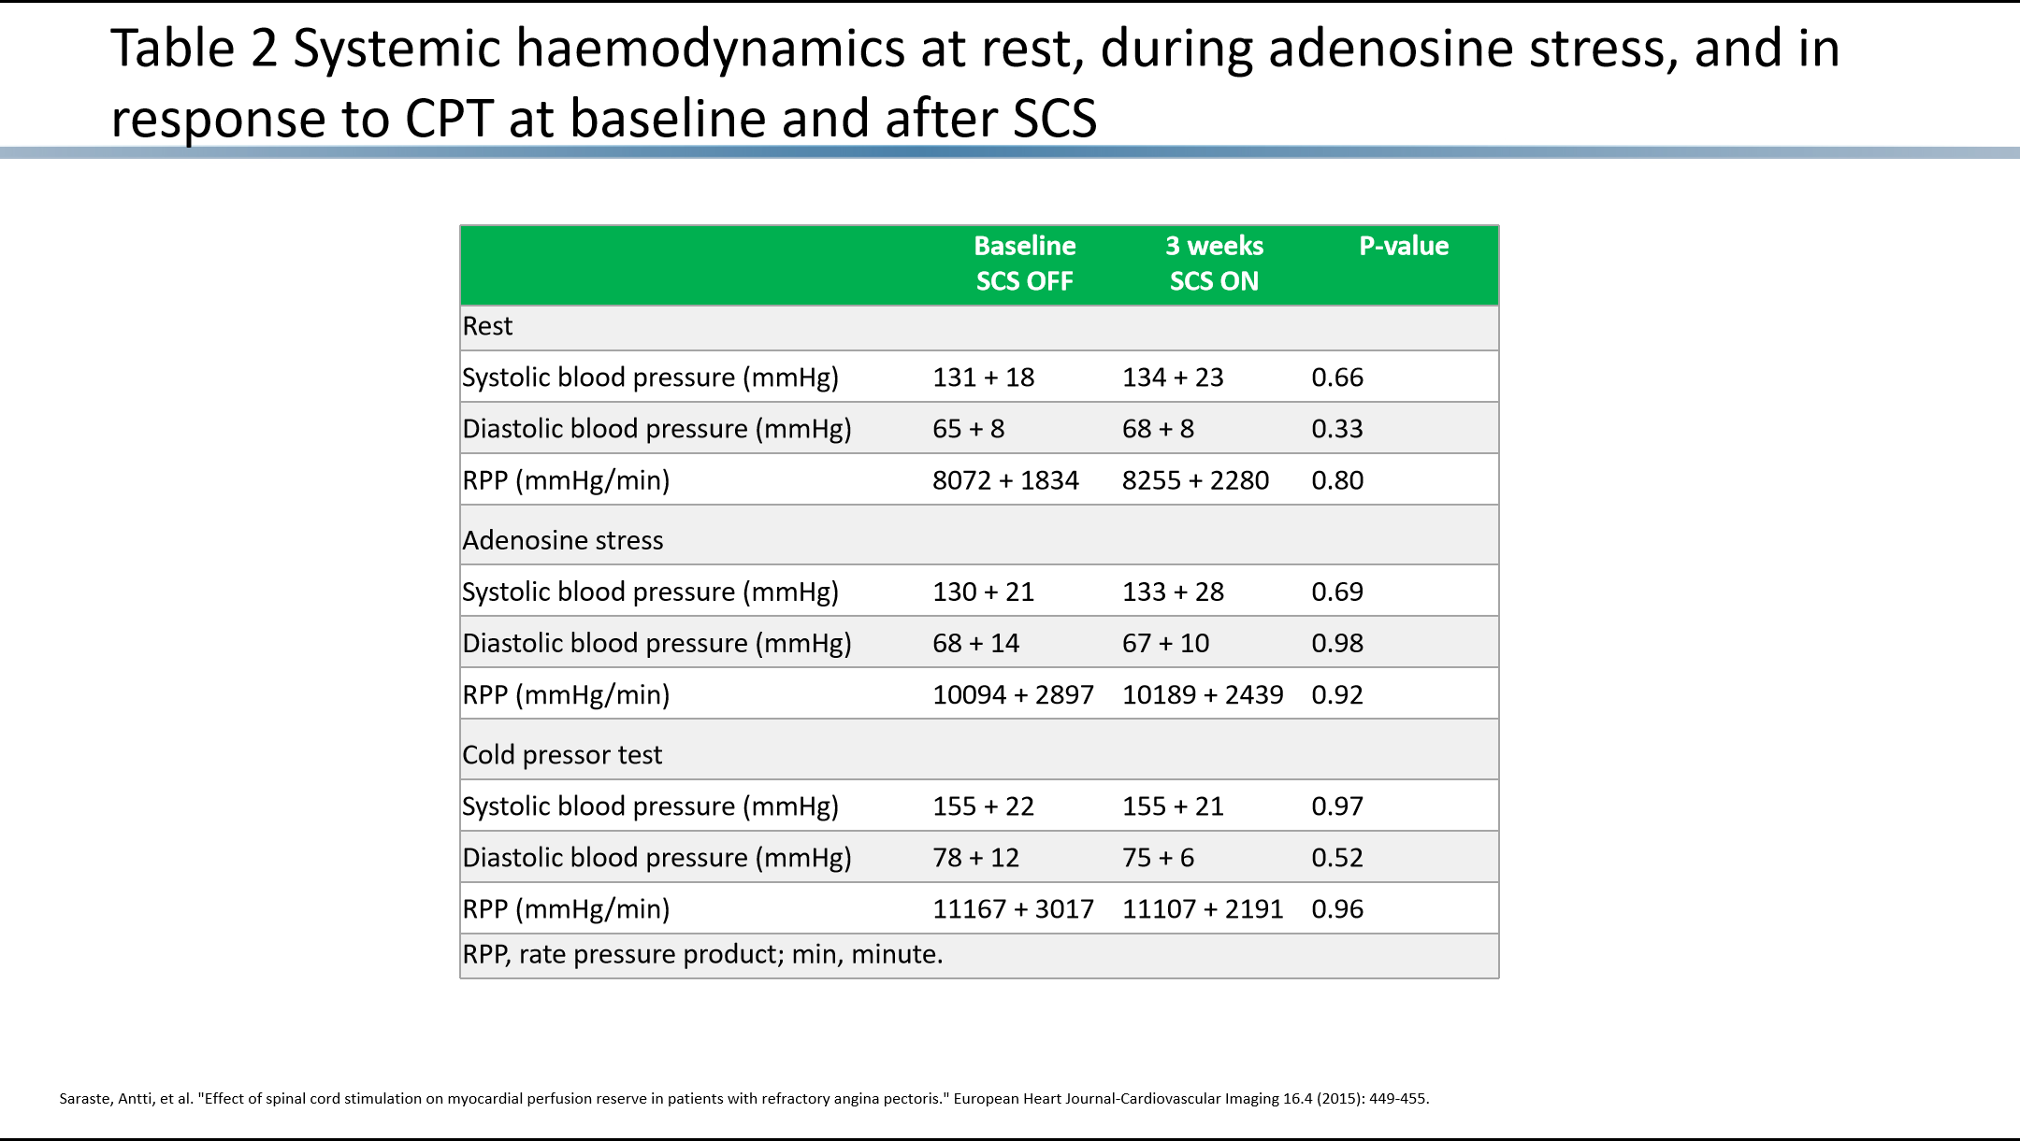
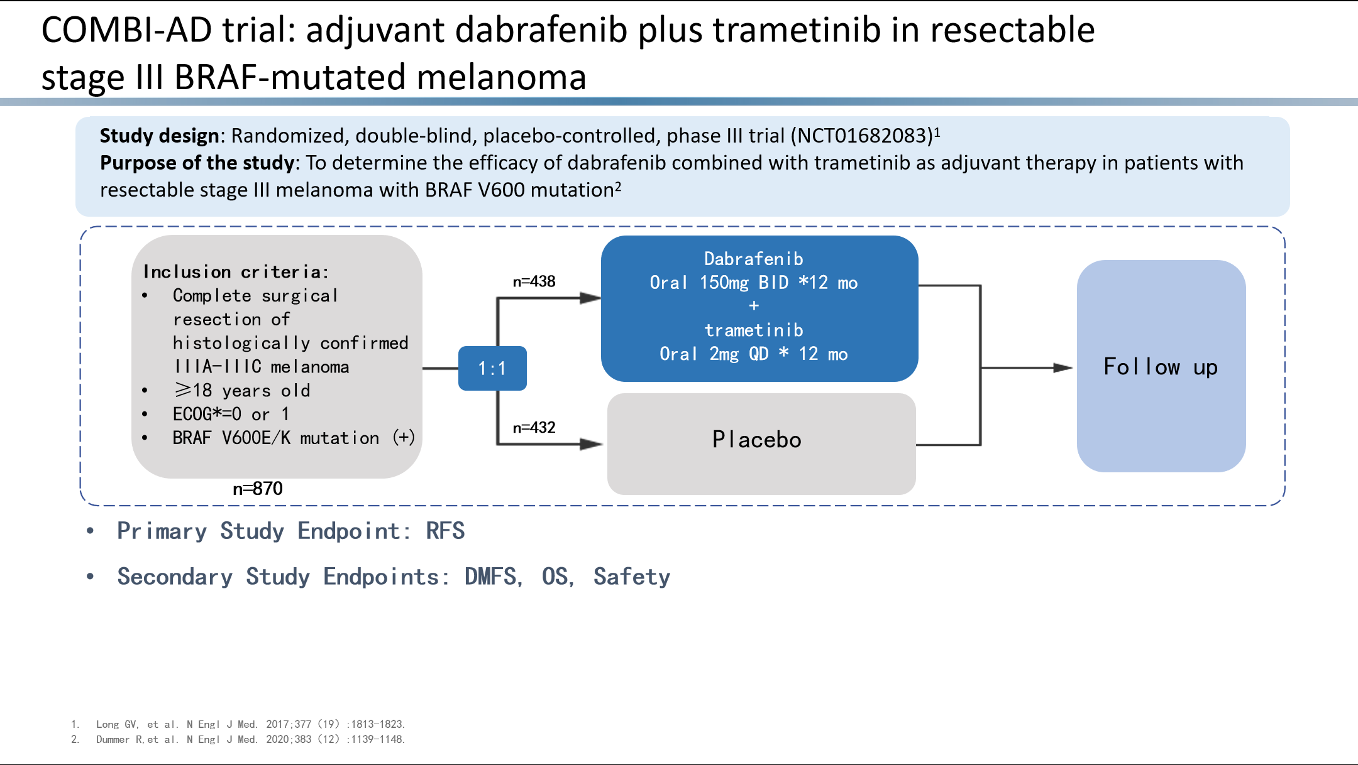
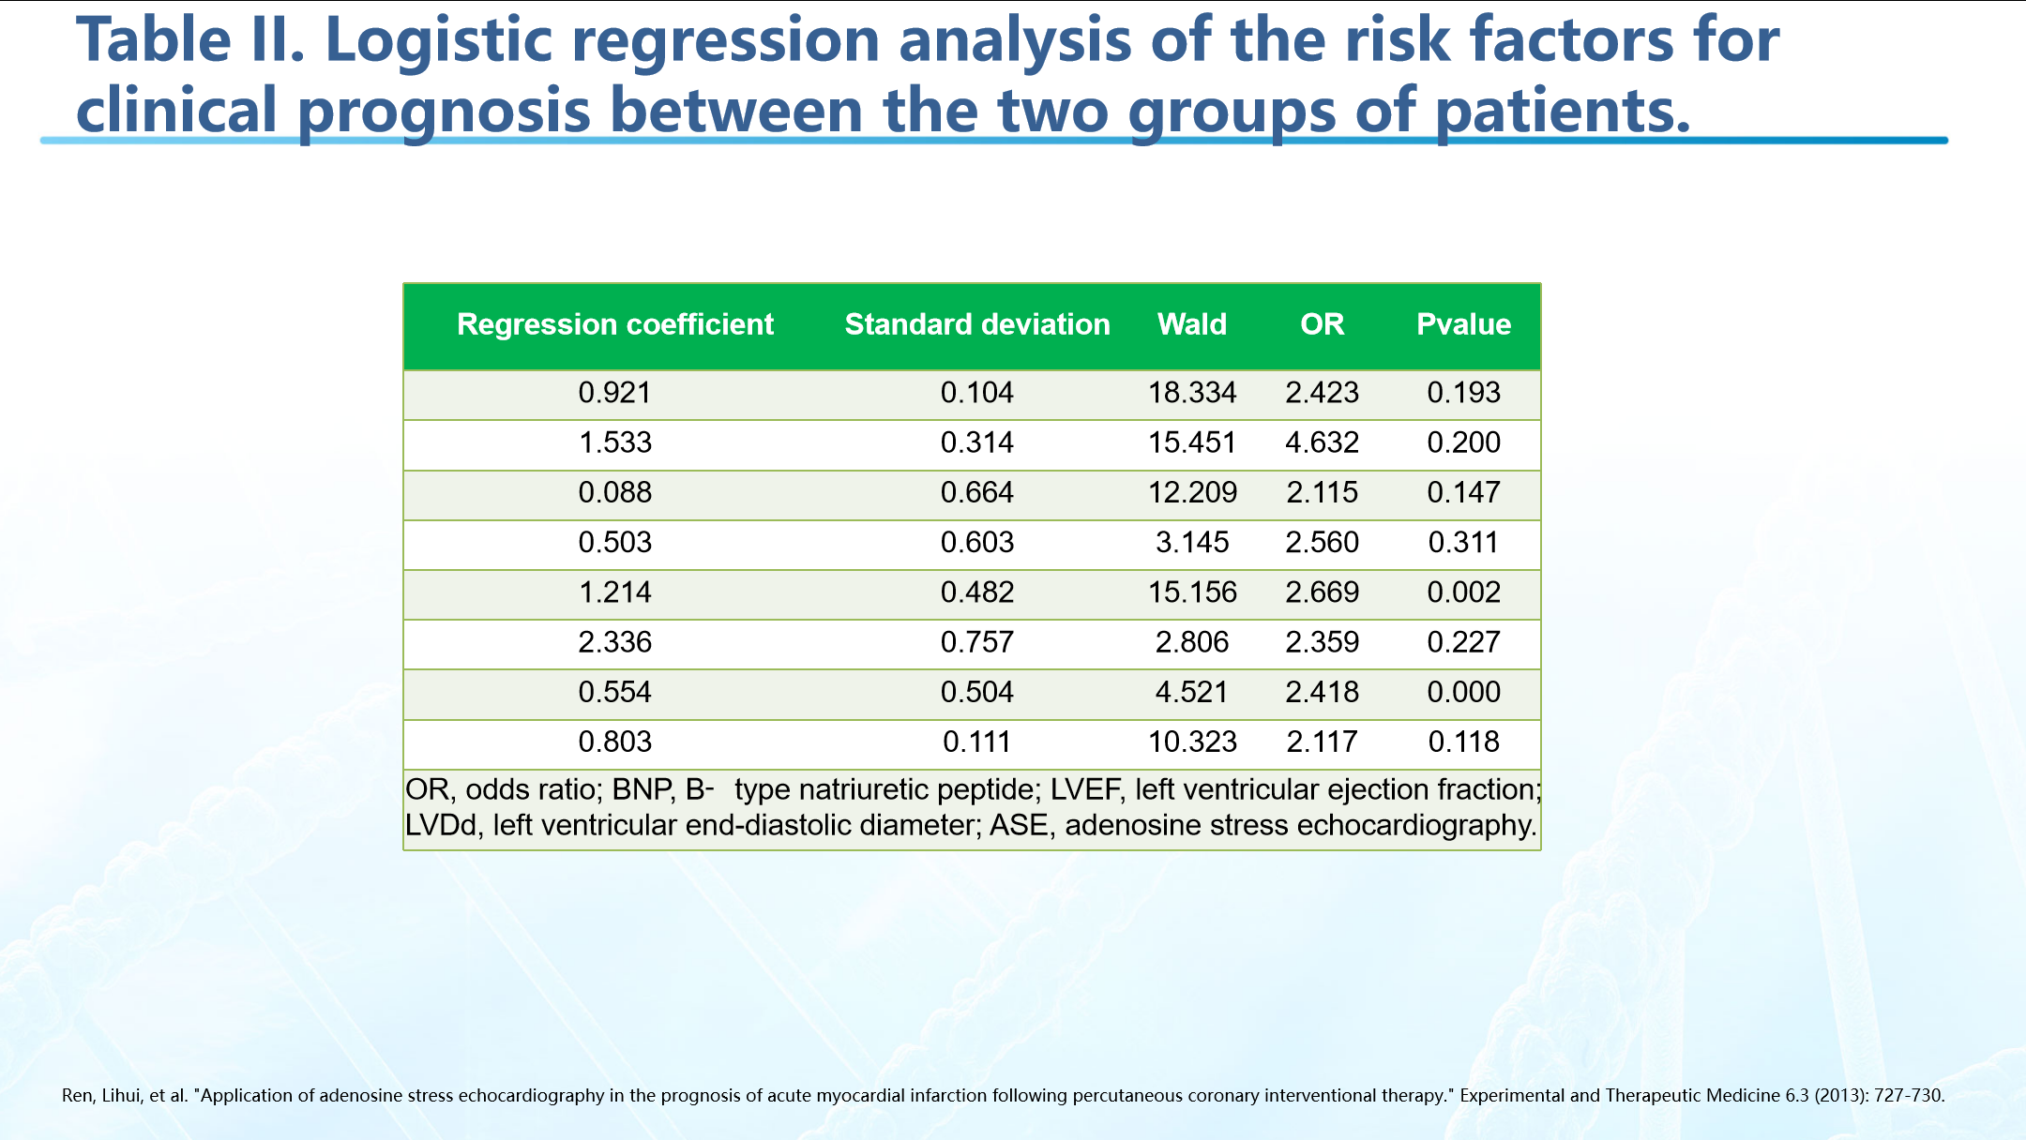

Home page Blog GitHub About us log in
logo
sing up
BAIX accelerates bioinformatics, medical research
Make medical research more accurate, efficient and easy
Jion us
Registration process
首页 Blog GitHub About us Log in
Part 1
Register
Part 2
Review
Part 3
Use
BAIX accelerates bioinformatics,
medical research
Make medical research more accurate, efficient and easy
After reviewing the email,
Activate function
Using BAIX,
Accelerate scientific research
Fill in keywords
02
审核
Data Sources
~1400 W
Knowledge graph
More than 14 million SCI medical documents
knowledge map graph structure storage,
Automatic labeling
~100 W
12 PB
Program
Genetic Drug Data
BAIX
BX-Medical SaaS Platform
KEGG database
Drugbank
Case presentation
PPT generation
Table recognition
Home page Blog GitHub About us 合作伙伴
Contact us
Shanghai Junshi Biomedical Technology Co., Ltd.
Hangzhou Zhongmei Huadong Pharmaceutical Co., Ltd.
Jiangsu Hengrui Pharmaceutical Co., Ltd.
Innovent Biopharmaceutical (Suzhou) Co., Ltd.
Shanghai Fosun Pharmaceutical (Group) Co., Ltd.
Qilu Pharmaceutical Co., Ltd.
BeiGene Cornerstone Pharmaceuticals
Bio-Thera Bio-Pharmaceutical Co., Ltd.
Chia Tai Tianqing Pharmaceutical Group Co., Ltd.
Zhongshan Akeso Biopharmaceutical Co., Ltd.
Beijing Tiantan Biological Products Co., Ltd.
Copyright 版权所有 © 白星花AI实验室 京ICP备2021038475号

Slide 3


Home page Blog GitHub About us log in
logo
sing up
About BAIX
BAIX focuses on the AI analysis SaaS platform of clinical data, real world and medical science and technology literature, and we are committed to breaking the island of medical data.
Through advanced AI innovation technologies such as machine learning, deep learning, and multimodal knowledge graphs, it can be effectively combined with medical clinical data, imaging data, real-world big data, and literature knowledge graphs to provide deeper, more comprehensive, and more accurate information for medical science and technology work. AI analysis helps pharmaceutical companies, doctors, and researchers conduct research on basic medicine and drug mechanisms. The existing analysis results have helped clients successfully publish nearly a hundred high-scoring SCl articles.
Contact us
No. 36, Haidian West Street, Beijing, China
19768 E 47th Dr, Denver, CO, US
bd@aibaixh.com
首页 Blog GitHub About us contact us

