Slide 1

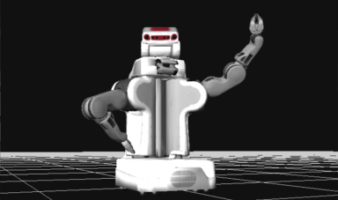
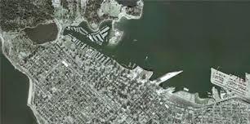
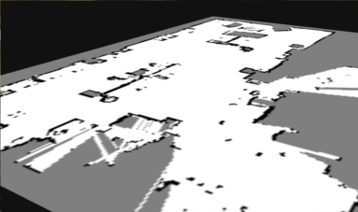
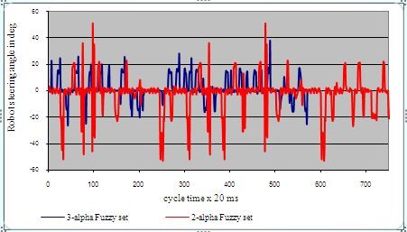
ROSDASH
Web-based Visual-programming-based Configurable Dashboard Platform for ROS
Notes:
Links:
http://laughingsquid.com/robot-power-poster-by-josh-ellingson/
http://robotwebtools.org/demos.html
http://www.sfu.ca/fs/Campus-Facility-Profiles/Campus-Maps.html
http://www.intechopen.com/books/evolutionary-computation/mobile-robot-navigation-using-alpha-level-fuzzy-logic-system-experimental-investigations

Slide 2
Why ROSDASH?
Love robots, but have problems visualizing the data behind them?
Use ROS, but tired of solving installation dependencies?
Need dashboards specific for your research?

Slide 3
Merits of ROSDASH
Web-based: Just open browser and work!
Visual programming: Drag and drop!
ROS: Support topic, service, and parameter!
Configurable: Change parameters and refresh the page!
Platform: Log in and create your own dashboard!
Extensible: Write your js code and link to it!

Slide 4
How to Run?
Roscore (talk to robots)
Rosbridge (ROS => websocket)
Roslibjs (websocket => js)
ROSDASH (specify IP of rosbridge)
Communication with robots works even off-line

Slide 5
How to Edit?
3 pages for each dashboard
Panel: Run widgets with ROS
Editor: Edit widgets
Diagram: Edit diagram representing connection between widgets and ROS topics

Slide 6
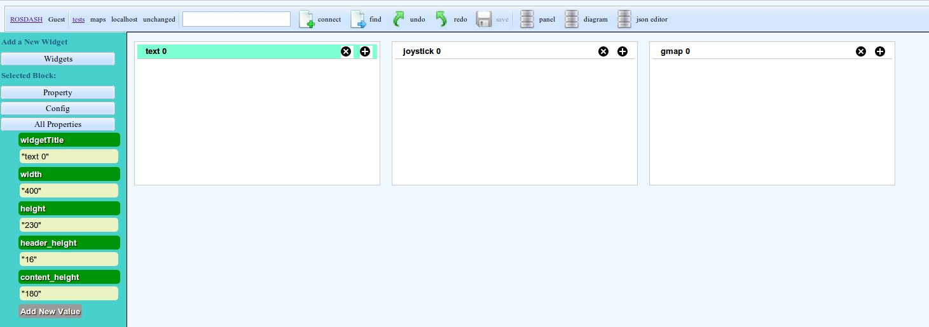
Editor
Add, move, or remove widgets
Change size of widgets

Slide 7
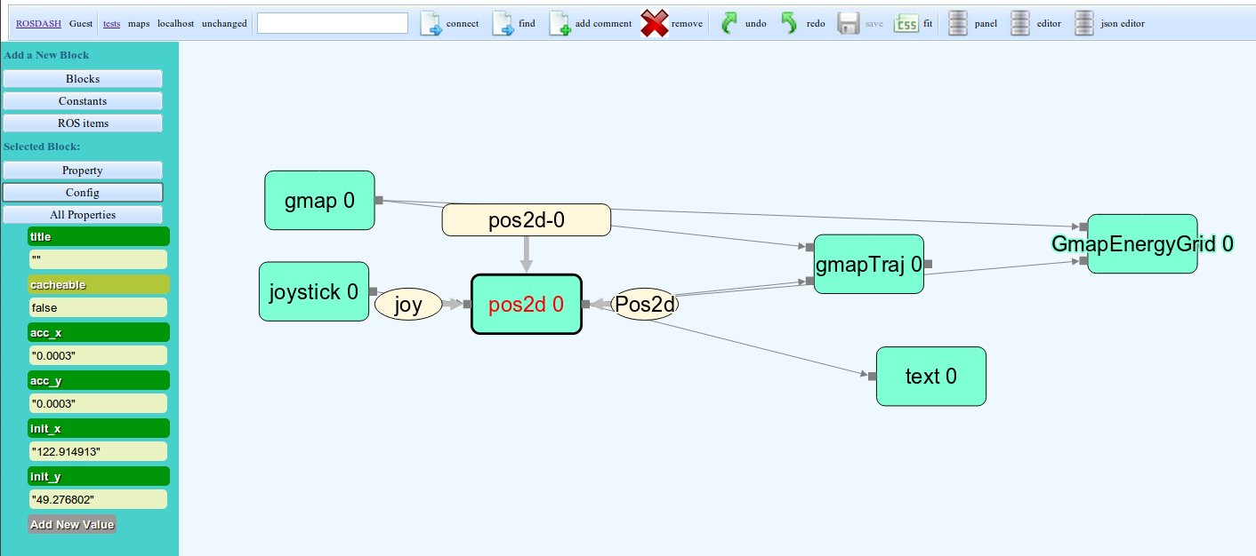
Diagram
Flow network representing connection
Add, move, or remove blocks
Change config of blocks

Slide 8
Dashboard
Parse flow network
All running widgets are independent
Event emitter

Slide 9
User-defined Widgets
Json, js, css files
Anywhere (local, internet, github)
Include json file path in your config file

Slide 10
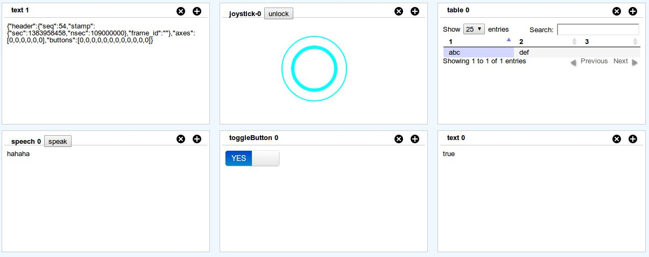
A List of Widgets (1)
Input: button, joystick
Output: textbox, speech, table

Slide 11
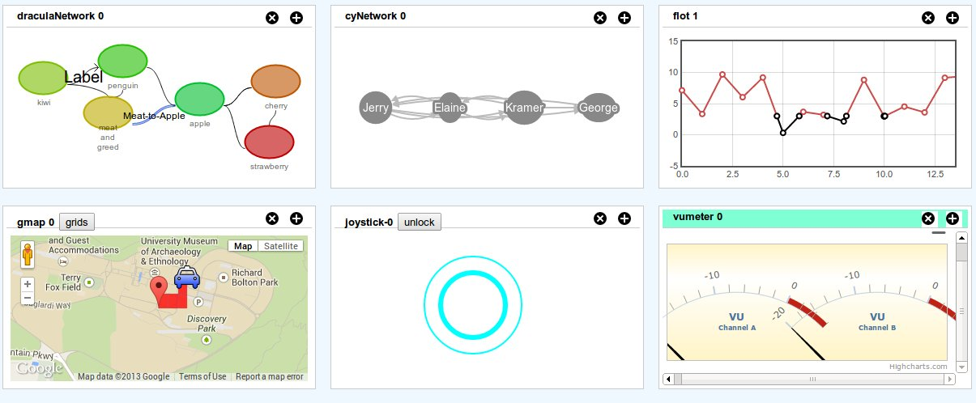
A List of Widgets (2)
Research: vu meter, network graph, Google maps, plot

Slide 12
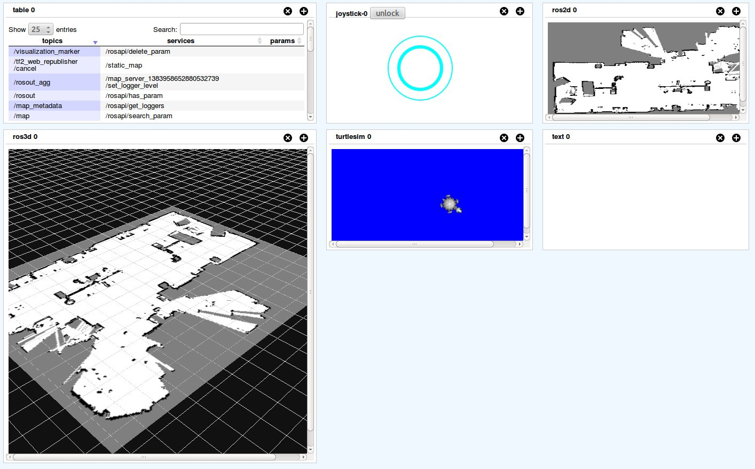
A List of Widgets (3)
ROS: 2D model, 3D model, mjpeg, turtlesim

Slide 13
A List of Widgets (4)
Others: database, camera video, login with OpenID, json editor

Slide 14
Future Work
Rosdash.com
What is needed in our lab?
What is needed in others' labs?
Website security
Discussion in NCFRN?

Slide 15
Steps to Create a Dashboard
Login with email account;
Go to your personal page;
Add a new page;
Open diagram page;
Pick some blocks to add;
Add some ROS topics from ROS item list, and connect them with widget blocks;
Open editor page;
Change the position of each widgets;
Run roscore and rosbridge;
Open panel page, and connect with rosbridge;
Run robots and see

Slide 16
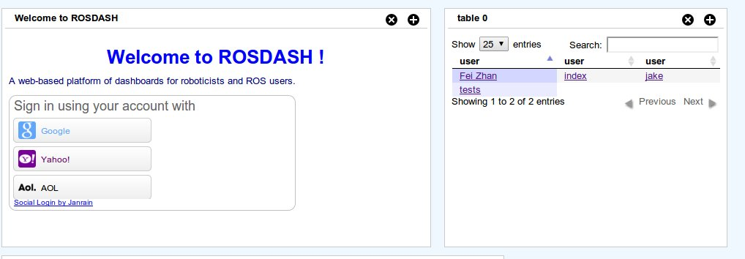
Steps to Create a Dashboard (1)
1. Login with email account;

Slide 17
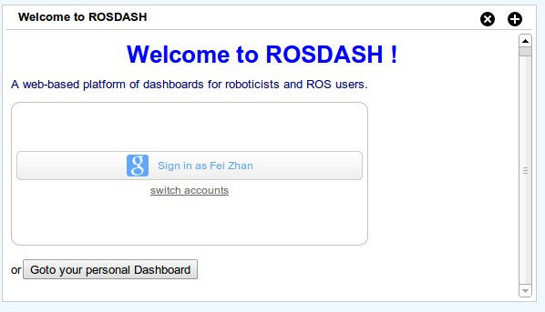
Steps to Create a Dashboard (2)
2. Go to your personal page;

Slide 18
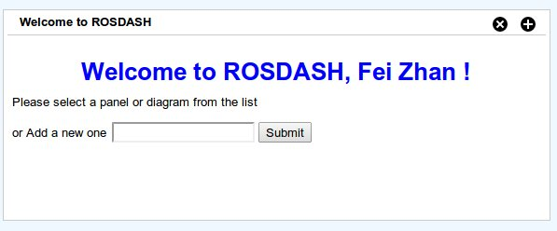
Steps to Create a Dashboard (3)
3. Add a new page;

Slide 19

Steps to Create a Dashboard (4)
4. Open diagram page;

Slide 20
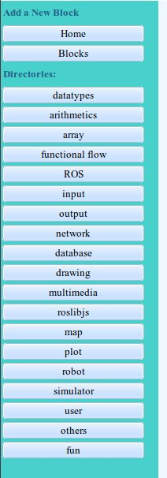
Steps to Create a Dashboard (5)
5. Pick some blocks to add;

Slide 21
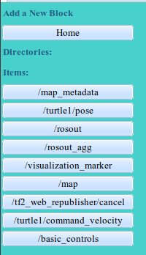
Steps to Create a Dashboard (6)
6. Add some ROS topics from ROS item list, and connect them with widget blocks;

Slide 22
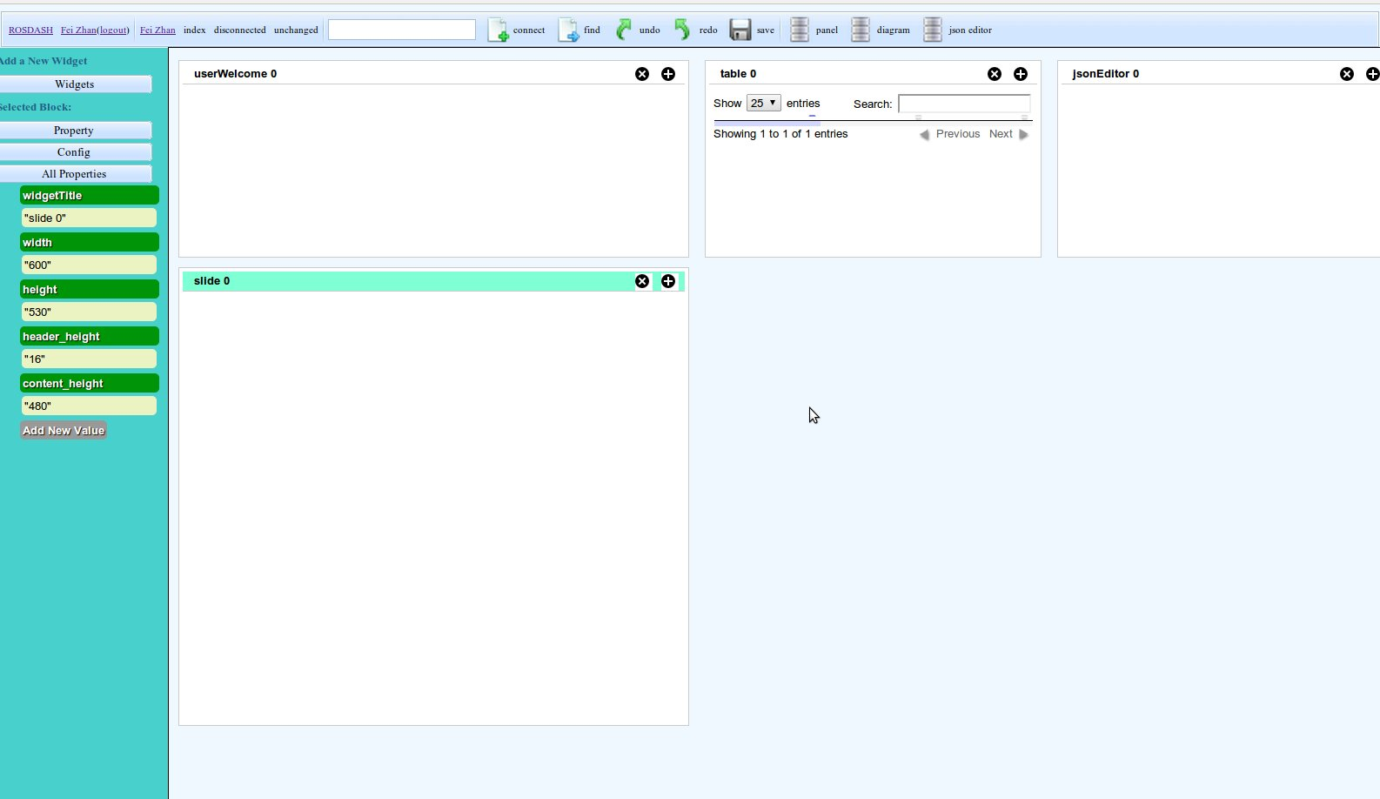
Steps to Create a Dashboard (8)
8. Change the position of each widgets in the editor page;

Slide 23
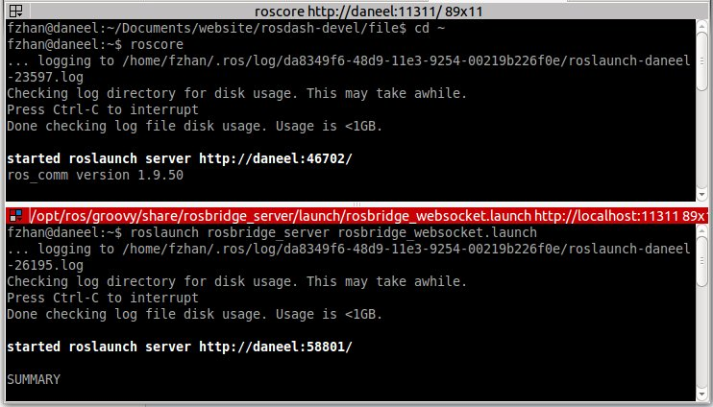
Steps to Create a Dashboard (9)
9. Run roscore and rosbridge;

Slide 24
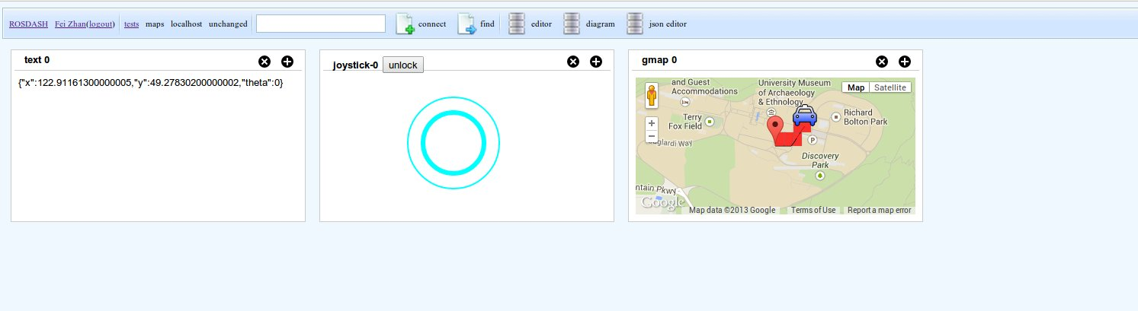
Steps to Create a Dashboard (10)
10. Open panel page, and connect with rosbridge;
11. Run robots and see

