Slide 1
Featureless Corridor: 2D vs 3D LiDAR

Slide 2
2D vs 3D LiDAR in a Featureless Corridor
w/ 2D LiDAR
How to apply
Map-based localization. Align scans to a 2D occupancy/contour map with ICP or NDT. Seed with wheel odom.
SLAM when no map. 2D scan matching + loop closure to cap drift. Keep grid small; reject outliers.
Examples
SICK NAV3xx on AGV/AMR. Uses natural contour localization [1].
Hokuyo UST-10LX on many AMRs.
Challenges
Geometric degeneracy. Long plain walls ⇒ ambiguous matches ⇒ drift. Mitigate with loop closure and IMU/odom fusion [2].
Dynamic scenes. People/carts hurt scan matching. Use dynamic masking or tracking [3].

Slide 3
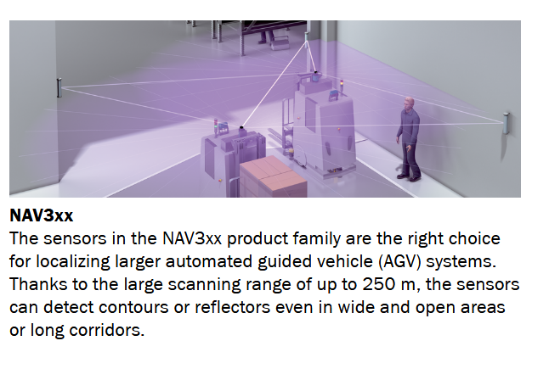
2D vs 3D LiDAR in a Featureless Corridor
w/ 2D LiDAR
How to apply
Map-based localization. Align scans to a 2D occupancy/contour map with ICP or NDT. Seed with wheel odom.
SLAM when no map. 2D scan matching + loop closure to cap drift. Keep grid small; reject outliers.
Examples
SICK NAV3xx on AGV/AMR. Uses natural contour localization [1].
Hokuyo UST-10LX on many AMRs.
Challenges
Geometric degeneracy. Long plain walls ⇒ ambiguous matches ⇒ drift. Mitigate with loop closure and IMU/odom fusion [2].
Dynamic scenes. People/carts hurt scan matching. Use dynamic masking or tracking [3].
https://www.sick.com/media/familyoverview/6/16/916/familyOverview_NAV3xx_g91916_en.pdf

Slide 4
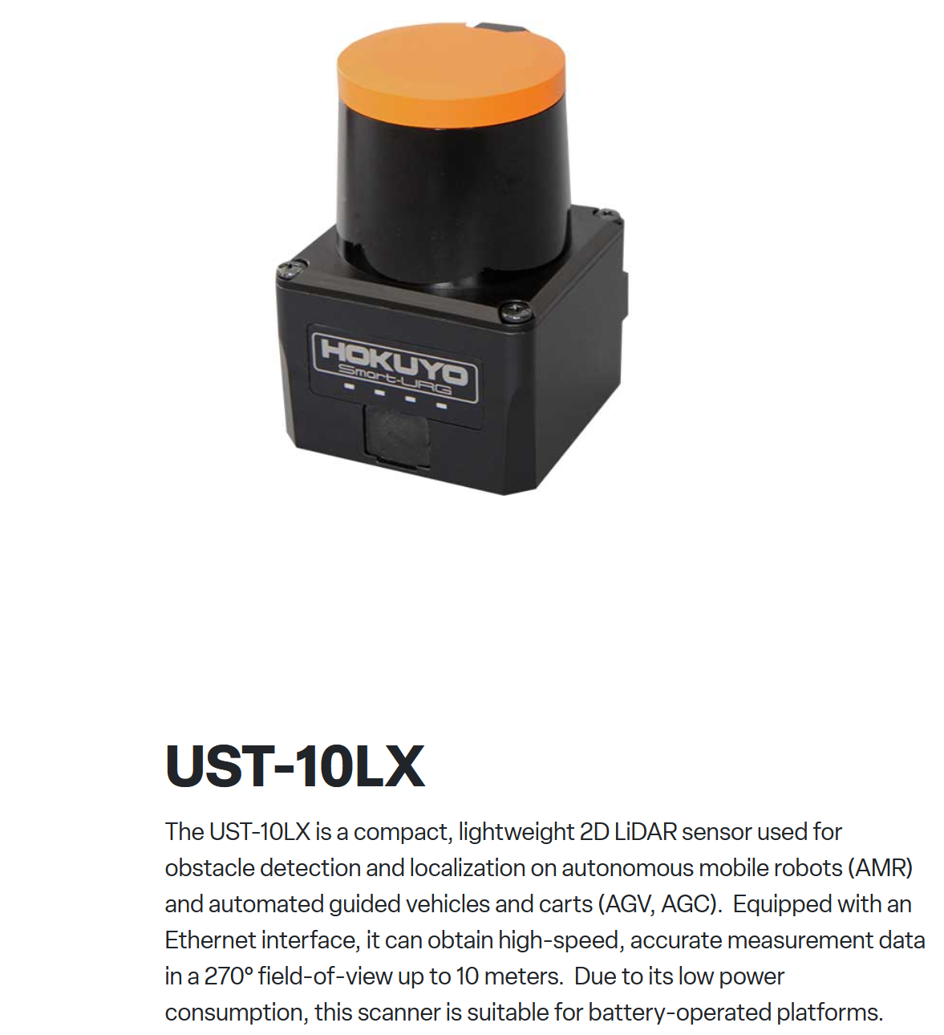
2D vs 3D LiDAR in a Featureless Corridor
w/ 2D LiDAR
How to apply
Map-based localization. Align scans to a 2D occupancy/contour map with ICP or NDT. Seed with wheel odom.
SLAM when no map. 2D scan matching + loop closure to cap drift. Keep grid small; reject outliers.
Examples
SICK NAV3xx on AGV/AMR. Uses natural contour localization [1].
Hokuyo UST-10LX on many AMRs.
Challenges
Geometric degeneracy. Long plain walls ⇒ ambiguous matches ⇒ drift. Mitigate with loop closure and IMU/odom fusion [2].
Dynamic scenes. People/carts hurt scan matching. Use dynamic masking or tracking [3].
https://www.hokuyo-usa.com/products/lidar-obstacle-detection/ust-10lx

Slide 5
2D vs 3D LiDAR in a Featureless Corridor
w/ 3D LiDAR
How to apply
Run 3D LiDAR SLAM with IMU fusion (LOAM/FAST-LIO-style).
Add loop closure for stability.
Examples
Balyo robotic forklifts use Ouster 3D digital LiDAR [3].
Challenges
Geometric degeneracy in long, planar corridors ⇒ drift. [4], [5].
Motion distortion & time sync. [4].
Perceptual aliasing for loop closure. [4].
Registration robustness under planar walls. [5], [6].
Higher compute and cost than 2D.

Slide 6
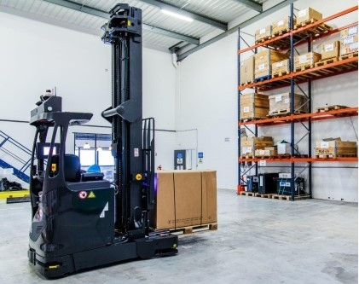
2D vs 3D LiDAR in a Featureless Corridor
w/ 3D LiDAR
How to apply
Run 3D LiDAR SLAM with IMU fusion (LOAM/FAST-LIO-style).
Add loop closure for stability.
Examples
Balyo robotic forklifts use Ouster 3D digital LiDAR [3].
Challenges
Geometric degeneracy in long, planar corridors ⇒ drift. [4], [5].
Motion distortion & time sync. [4].
Perceptual aliasing for loop closure. [4].
Registration robustness under planar walls. [5], [6].
Higher compute and cost than 2D.
https://www.businesswire.com/news/home/20210517005834/en/Balyo-Selects-Ousters-Digital-Lidar-for-Its-Robotic-Forklifts

Slide 7
2D vs 3D LiDAR in a Featureless Corridor
w/ 2D LiDAR
How to apply
Map-based localization. Align scans to a 2D occupancy/contour map with ICP or NDT. Seed with wheel odom.
SLAM when no map. 2D scan matching + loop closure to cap drift. Keep grid small; reject outliers.
Examples
SICK NAV3xx on AGV/AMR. Uses natural contour localization [1].
Hokuyo UST-10LX on many AMRs.
Challenges
Geometric degeneracy. Long plain walls ⇒ ambiguous matches ⇒ drift. Mitigate with loop closure and IMU/odom fusion [2].
Dynamic scenes. People/carts hurt scan matching. Use dynamic masking or tracking [3].
w/ 3D LiDAR
How to apply
Run 3D LiDAR SLAM with IMU fusion (LOAM/FAST-LIO-style).
Add loop closure for stability.
Examples
Balyo robotic forklifts use Ouster 3D digital LiDAR [3].
Challenges
Geometric degeneracy in long, planar corridors ⇒ drift. [4], [5].
Motion distortion & time sync (all sensor timestamps of LiDAR and IMU). [4].
Perceptual aliasing for loop closure. [4].
Registration robustness under planar walls. [5], [6].
Higher compute and cost than 2D.

Slide 8
Reference
[1] NAV3xx: High performance 2D LiDAR sensor for navigation of AGVs/AMRs (product family overview). SICK AG, 2025. Available: https://www.sick.com/media/familyoverview/6/16/916/familyOverview_NAV3xx_g91916_en.pdf
[2] H. Ye, G. Chen, W. Chen, L. He, Y. Guan, and H. Zhang, “Mapping while following: 2D LiDAR SLAM in indoor dynamic environments with a person tracker,” in IEEE int. Conf. On robotics and biomimetics (ROBIO), 2021, pp. 826–832. doi: 10.1109/ROBIO54168.2021.9739394.
[3] “Balyo selects ouster’s digital lidar for its robotic forklifts.” Business Wire / Ouster, Inc. Press release, May 17, 2021. Available: https://www.businesswire.com/news/home/20210517005834/en/Balyo-Selects-Ousters-Digital-Lidar-for-Its-Robotic-Forklifts
[4] K. Ebadi, L. Bernreiter, H. Biggie, et al., “Present and future of SLAM in extreme environments: The DARPA SubT challenge,” IEEE Transactions on Robotics, vol. 40, pp. 936–959, 2024, doi: 10.1109/TRO.2023.3323938.
[5] Z. Chen et al., “RELEAD: Resilient localization with enhanced LiDAR odometry in adverse environments,” arXiv preprint, 2024, doi: 10.48550/arXiv.2402.18934.
[6] D. Lee, H. Lim, and S. Han, “GenZ-ICP: Generalizable and degeneracy-robust LiDAR odometry using an adaptive weighting,” arXiv preprint, 2024, Available: https://arxiv.org/abs/2411.06766

