Slide 1
Core Concepts
Christopher Parnin

Slide 2
Today: My voice is mostly gone
You Will Lend Me Your Voice
Students will be called to help explain slides.

Slide 3
Software Process Models
What is a process model?
What are some examples?
What are some activities performed as part of a software process?

Slide 4
Process Model Activities
Software project management
Formal technical reviews
Software quality assurance
Software configuration management
Document preparation and production
Reusability management
Measurement
Risk management

Slide 5
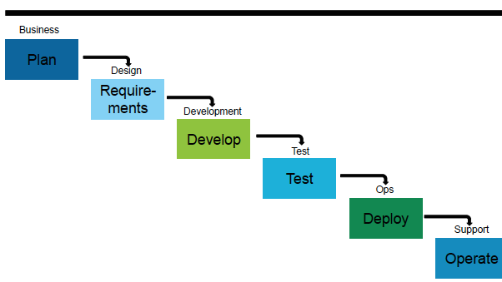
Waterfall model
Problems?
Benefits?
Still in use?

Slide 6
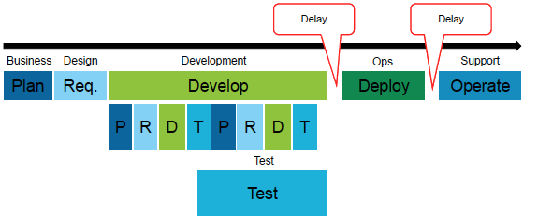
Agile Processes
Problems?
Benefits?
Where not in use?
Iteration: Plan, Requirements, Development, Testing.

Slide 7
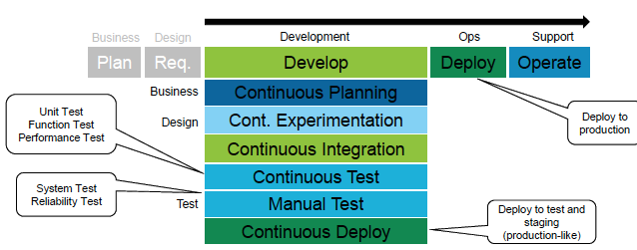
Continuous * (Perpetual Development)
We’ll circle back to this….

Slide 8
Maintenance
“the modification of software products after delivery to correct faults, to improve performance or other attributes, or to adapt the product to a changed environment.”

Slide 9
Some software never dies:
COBOL
70% of mission-critical applications are written in COBOL
200 billion lines of COBOL in use today
15% of all new app functionality is written in COBOL
5 billion new lines of COBOL are created each year
http://www.eweek.com/c/a/Enterprise-Applications/20-Things-You-Might-Not-Know-About-COBOL-As-the-Language-Turns-50-103943/

Slide 10
Types of maintenance
Perfective maintenance
involves improving functionality of software in response to a user’s defined changes
Corrective maintenance
this process involves the correction of errors that have been identified within the software
Adaptive maintenance
this process involves the alteration of the software which is due to changes within the software environment
Preventative maintenance
this involves updating the software in order to improve upon its future maintainability without changing its current functionality

Slide 11
Exercise
Give be an example of each on the last slide
Perfective maintenance
involves improving functionality of software in response to a user’s defined changes
Corrective maintenance
this process involves the correction of errors that have been identified within the software
Adaptive maintenance
this process involves the alteration of the software which is due to changes within the software environment
Preventative maintenance
this involves updating the software in order to improve upon its future maintainability without changing its current functionality

Slide 12
Can we do maintenance sooner?
If we deliver software earlier and often, how does change our software process?
What is difference between delivered software (on-site) vs service based?

Slide 13
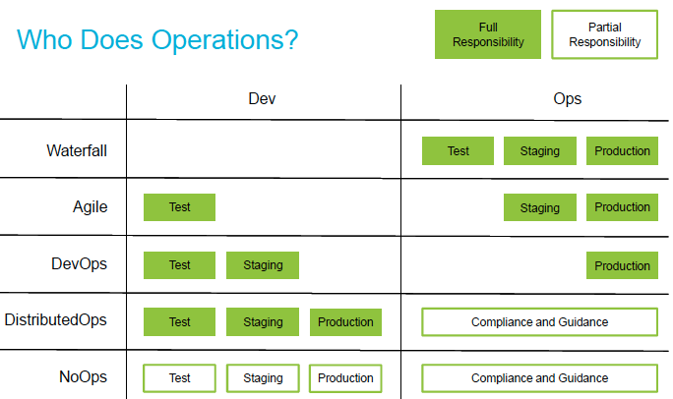
Operations Responsibility

Slide 14
Nightly Build
Build code and run smoke test (Microsoft 1995)
Benefits
It minimizes integration risk.
It reduces the risk of low quality
It supports easier defect diagnosis
It improves morale

Slide 15
Continuous Integration
A practice where developers automatically build, test, and analyze a software change in response to every software change committed to the source repository.

Slide 16
Continuous Delivery
A practice that ensures that a software change can be delivered and ready for use by a customer by testing in production-like environments.

Slide 17
Continuous Deployment
A practice where incremental software changes are automatically tested, vetted, and deployed to production environments.

Slide 18
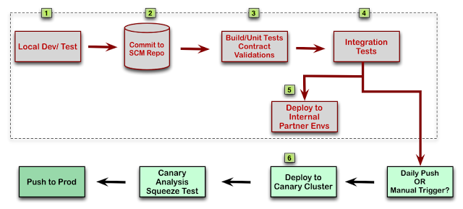
Example Deployment Pipeline

Slide 19
Skills
http://pcottle.github.io/learnGitBranching/

