Slide 1
Deep Learning

Slide 2
Outline
Introduction
Training
Classification
Code!
Autoencoders
Code!

Slide 3
Introduction
What is deep learning?
At its most basic level, we are learning functions that (1) take numbers as input and (2) output other numbers
These functions are called “neural networks”
Why?
Very loosely inspired by the interconnected neurons in our brain
Don’t be confused by the name: the analogy to brains is unimportant and irrelevant to modern deep learning
We will also call these “networks”, “models”, “mappers”, and “functions” interchangeably
They’re all referring to the same thing
Notes:
introduce nn as not skynet / HAL but are actually super simple (toddler)

Slide 4
Introduction
Deep Learning: what most people imagine
https://interestingengineering.com/new-artificial-intelligence-sees-like-a-human-bringing-us-closer-to-skynet

Slide 5
Introduction
Deep Learning: reality
https://www.pinterest.com/pin/767723067701062391/

Slide 6
Introduction
(OK, maybe:)
Deep Learning: reality
https://www.pinterest.com/pin/767723067701062391/

Slide 7
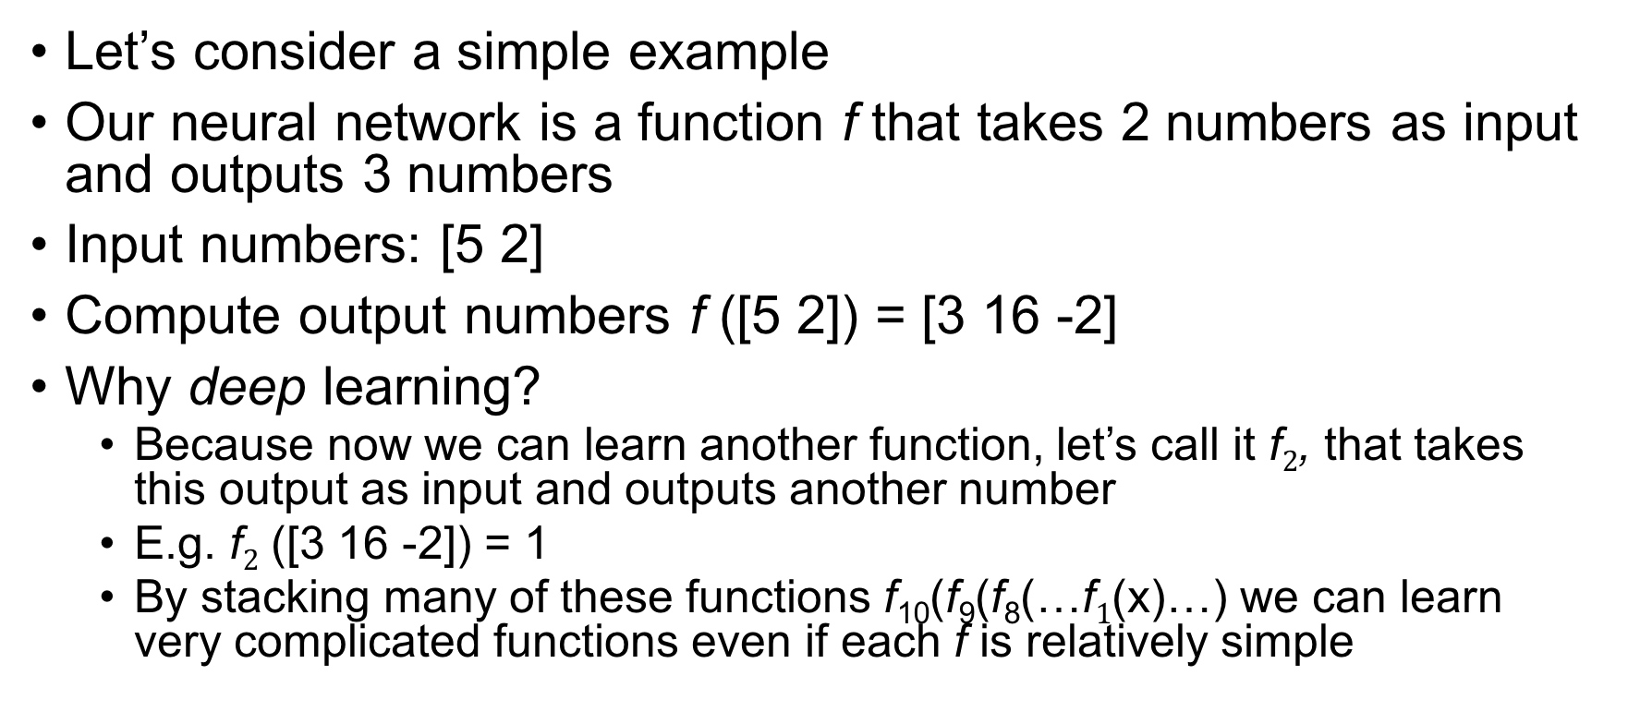
Introduction
Let’s consider a simple example
Our neural network is a function f that takes 2 numbers as input and outputs 3 numbers
Input numbers: [5 2]
Compute output numbers f ([5 2]) = [3 16 -2]
Why deep learning?
Because now we can learn another function, let’s call it f$2$, that takes this output as input and outputs another number
E.g. f$2$ ([3 16 -2]) = 1
By stacking many of these functions f₁₀(f₉(f₈(…f$1$(x)…) we can learn very complicated functions even if each f is relatively simple
Notes:
font overlap
neural networks learn a function, based on desired output
previous methods we restrict the types of functions severely

Slide 8
Introduction
Neural networks take a very simple building block
Lots of these building blocks make up the function f
This simple building block is called a perceptron
Let’s do a quick conceptual example first
We’ll use a perceptron to make a decision with given information

Slide 9
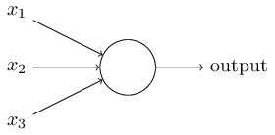
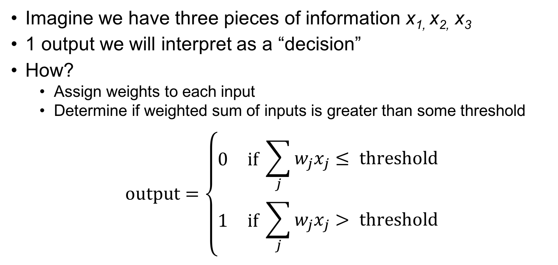
Introduction
Imagine we have three pieces of information x_{1,} x_{2,} x₃
1 output we will interpret as a “decision”
How?
Assign weights to each input
Determine if weighted sum of inputs is greater than some threshold
$$\text{output}=\left\{\begin{aligned}\begin{matrix}0 & \text{if} \end{matrix}\sum_{j}{w_{j}x_{j}}≤ \text{threshold} \\ \begin{matrix}1 & \text{if} \end{matrix}\sum_{j}{w_{j}x_{j}> \text{threshold}}\end{aligned}\right.$$
Nielsen, 2015

Slide 10
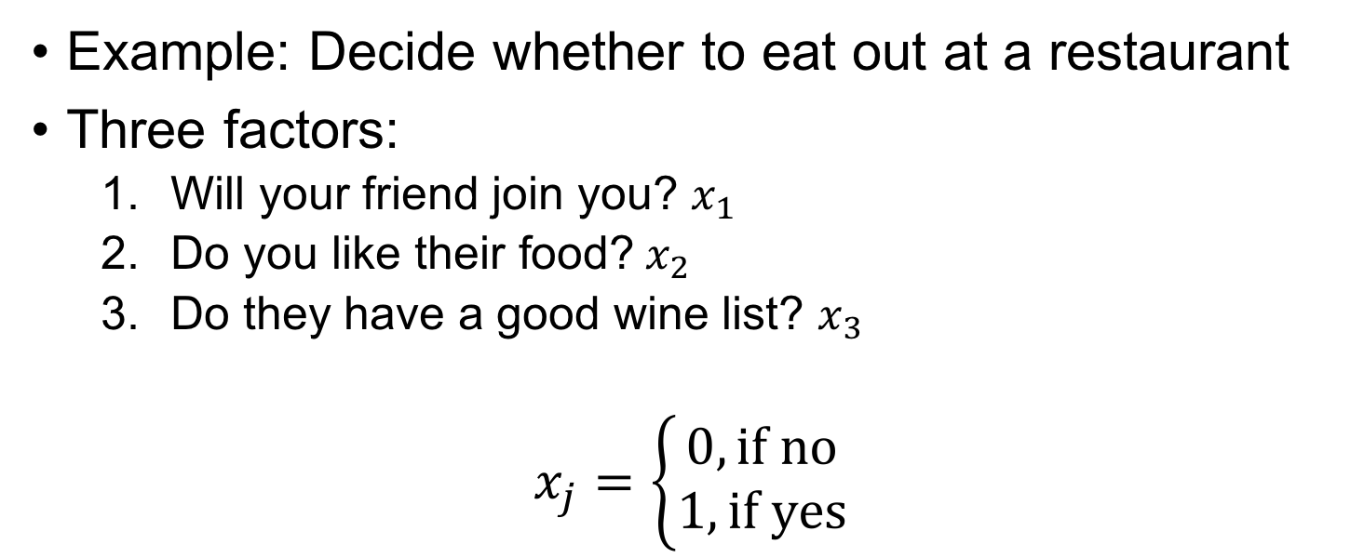
Introduction
Example: Decide whether to eat out at a restaurant
Three factors:
Will your friend join you? $x_{1}$
$\text{Do} \text{you} \text{like} \text{their} \text{food}\text{?} x_{2}$
Do they have a good wine list? $x_{3}$
$$x_{j}=\left\{\begin{aligned}0, \text{if} \text{no} \\ 1, \text{if} \text{yes}\end{aligned}\right.$$
Nielsen, 2015

Slide 11
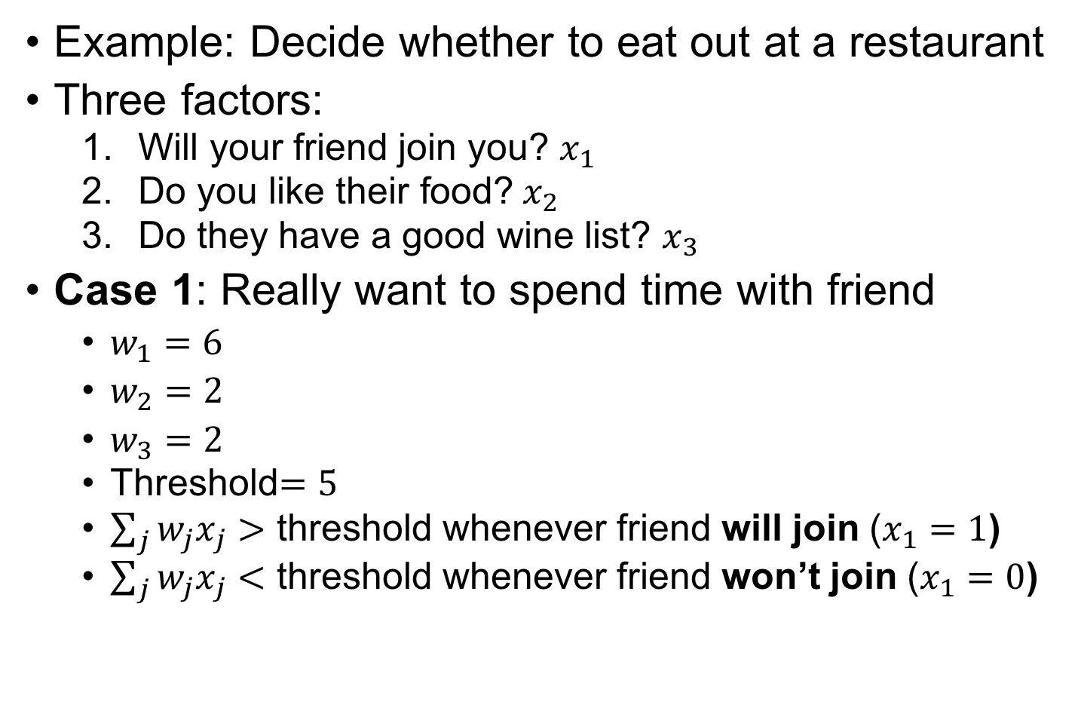
Introduction
Example: Decide whether to eat out at a restaurant
Three factors:
Will your friend join you? $x_{1}$
$\text{Do} \text{you} \text{like} \text{their} \text{food}\text{?} x_{2}$
Do they have a good wine list? $x_{3}$
Case 1: Really want to spend time with friend
$w_{1}=6$
$w_{2}=2$
$w_{3}=2$
Threshold$=5$
$\sum_{j}{w_{j}x_{j}}>$ threshold whenever friend will join ($x_{1}=1$)
$\sum_{j}{w_{j}x_{j}}<$ threshold whenever friend won’t join ($x_{1}=0$)

Slide 12
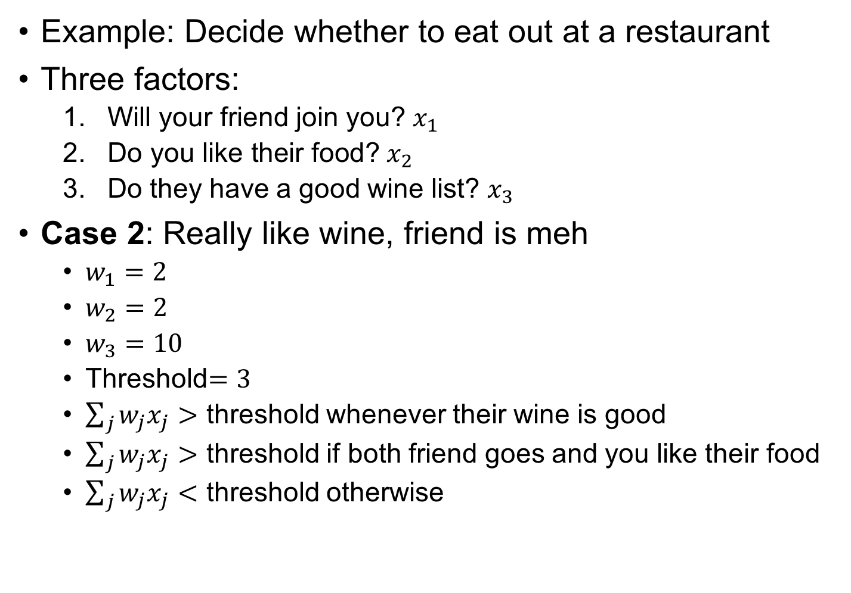
Introduction
Example: Decide whether to eat out at a restaurant
Three factors:
Will your friend join you? $x_{1}$
$\text{Do} \text{you} \text{like} \text{their} \text{food}\text{?} x_{2}$
Do they have a good wine list? $x_{3}$
Case 2: Really like wine, friend is meh
$w_{1}=2$
$w_{2}=2$
$w_{3}=10$
Threshold$=3$
$\sum_{j}{w_{j}x_{j}}>$ threshold whenever their wine is good
$\sum_{j}{w_{j}x_{j}}>$ threshold if both friend goes and you like their food
$\sum_{j}{w_{j}x_{j}}<$ threshold otherwise

Slide 13
Introduction
That example took binary inputs and resulted in a binary output
We can extend to
Continuous input & output
A network of many of these building blocks
Let’s look at a standard architecture diagram

Slide 14
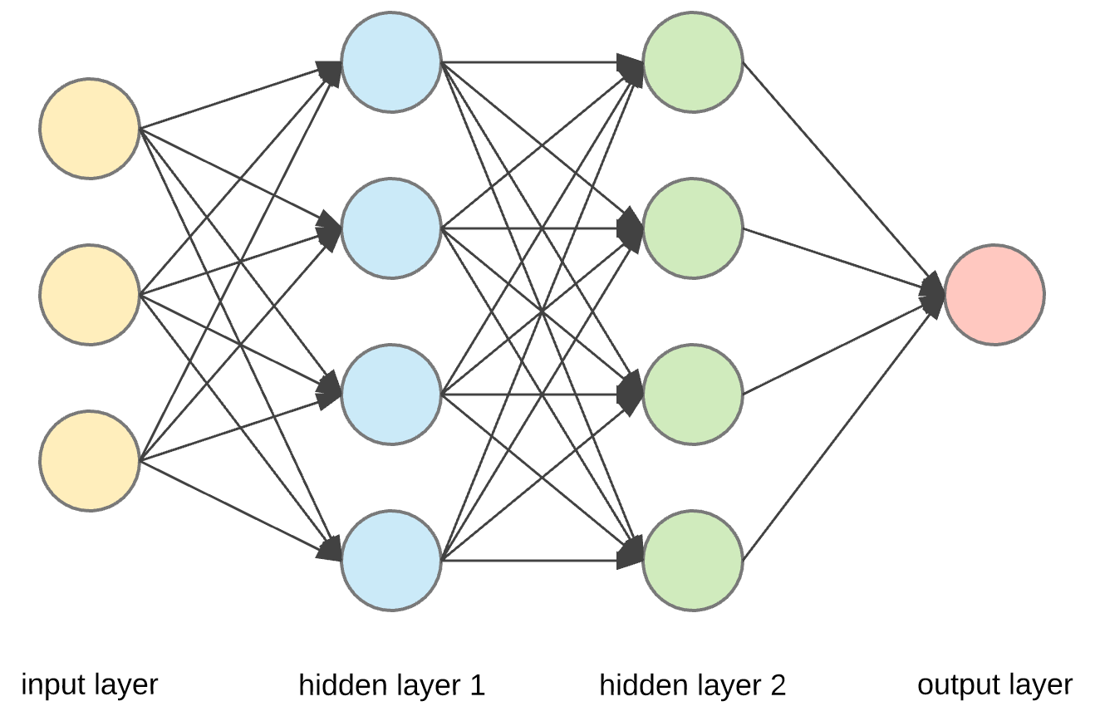
Introduction
Each node represents a number
Yellow nodes are input numbers: just plug them in
Could be genes, for example
The rest of the nodes are slightly more complicated, let’s take one as an example
Gene 1
Gene 2
Gene 3
https://towardsdatascience.com/applied-deep-learning-part-1-artificial-neural-networks-d7834f67a4f6

Slide 15
Introduction
Let’s add some notation
y = x₁*w₁ + x₂*w₂ + x₃*w₃
Multiplying/adding are simple linear operations
Composing a lot of them still is still only linear
We need some nonlinearity in there somewhere
Choose a nonlinear “activation” function
y = sigmoid(x₁*w₁ + x₂*w₂ + x₃*w₃)
We’ll talk more about activations shortly
y
w₁
x₁
w₂
x₂
w₃
x₃
https://towardsdatascience.com/applied-deep-learning-part-1-artificial-neural-networks-d7834f67a4f6

Slide 16
Introduction
Can repeat for all of the other nodes in the layer
Then use these as input for the next layer, and repeat
https://towardsdatascience.com/applied-deep-learning-part-1-artificial-neural-networks-d7834f67a4f6

Slide 17
Introduction
Each neuron is doing a numerical calculation, that is all
One way to think about it, though, is that each blue neuron learns “a feature” of the data
A trait, a concept, a property…
Each green neuron then learns “a feature of the features”
Gets more abstract as you get even deeper
https://towardsdatascience.com/applied-deep-learning-part-1-artificial-neural-networks-d7834f67a4f6

Slide 18
Introduction
Most importantly, we don’t need to tell it what these neurons should learn
We will give it a task, and grade its ability to that task
Then, it can use its neurons in whatever way it sees fit to accomplish that task
https://towardsdatascience.com/applied-deep-learning-part-1-artificial-neural-networks-d7834f67a4f6

Slide 19
Introduction
?
For most of our purposes, we can imagine this as a box that takes numbers as input and spits out other numbers
https://towardsdatascience.com/applied-deep-learning-part-1-artificial-neural-networks-d7834f67a4f6

Slide 20
Introduction
?
That doesn’t mean we won’t experiment with different things inside the box
We will toggle various choices inside that box
But we will evaluate the options based on their output
https://towardsdatascience.com/applied-deep-learning-part-1-artificial-neural-networks-d7834f67a4f6

Slide 21
Introduction
?
For example, let’s use this strategy to talk about activation functions
Why do we use non-linear activations instead of linear activations?
https://towardsdatascience.com/applied-deep-learning-part-1-artificial-neural-networks-d7834f67a4f6

Slide 22
Introduction
?
To test:
Take a simple data set
Train the network with linear activations, look at its output
Train the network with nonlinear activations, look at its output
Infer the effect of the internal architecture choice solely by its effect on the output
https://towardsdatascience.com/applied-deep-learning-part-1-artificial-neural-networks-d7834f67a4f6

Slide 23
Introduction
To test:
Take a simple data set
Train the network with linear activations, look at its output
Train the network with nonlinear activations, look at its output
Infer the effect of the internal architecture choice solely by its effect on the output

Slide 24
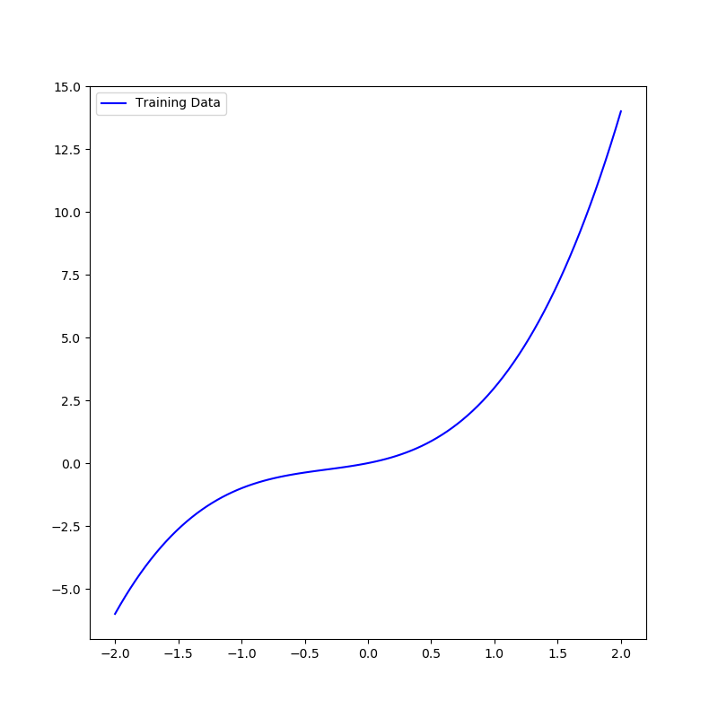
Introduction
To test:
Take a simple data set
Train the network with linear activations, look at its output
Train the network with nonlinear activations, look at its output
Infer the effect of the internal architecture choice solely by its effect on the output

Slide 25
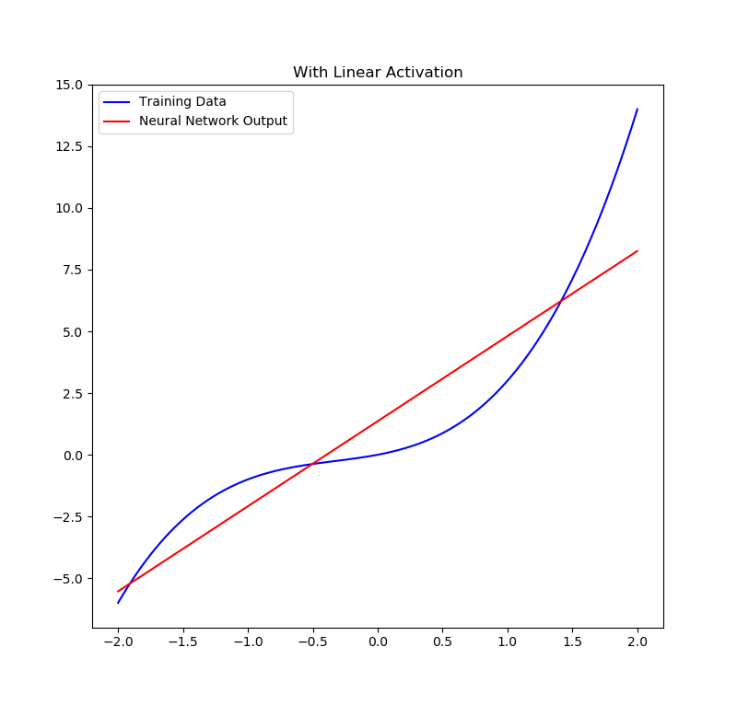
Introduction
To test:
Take a simple data set
Train the network with linear activations, look at its output
Train the network with nonlinear activations, look at its output
Infer the effect of the internal architecture choice solely by its effect on the output

Slide 26
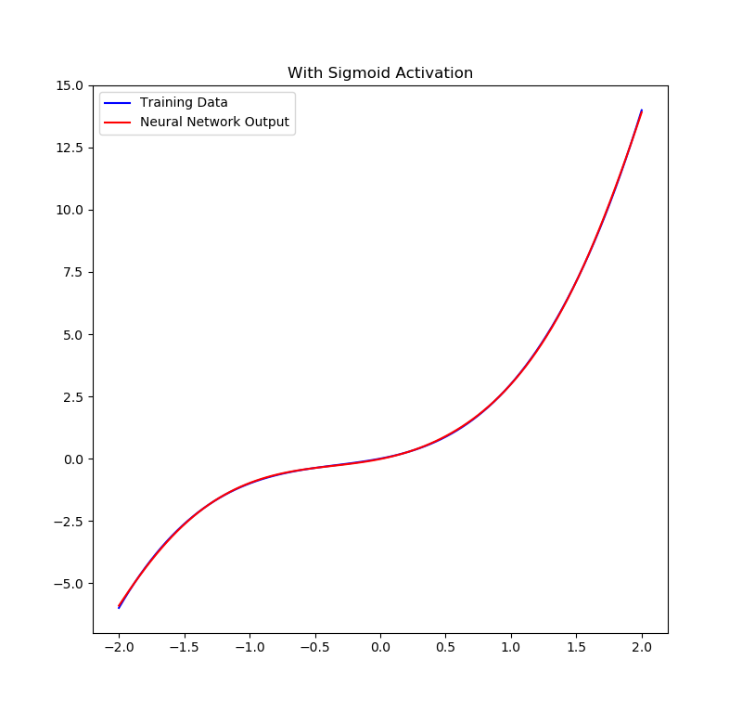
Introduction
To test:
Take a simple data set
Train the network with linear activations, look at its output
Train the network with nonlinear activations, look at its output
Infer the effect of the internal architecture choice solely by its effect on the output

Slide 27
Introduction
To test:
Take a simple data set
Train the network with linear activations, look at its output
Train the network with nonlinear activations, look at its output
Infer the effect of the internal architecture choice solely by its effect on the output
Internal nonlinearities make it able to output nonlinearities!

Slide 28
Training
As we’ve seen, these networks have parameters (also called weights) that multiply some input to give some output
When we first start a model, these parameters are given random initial values
Thus at first, the model doesn’t output anything meaningful
We want our model to learn something, so how do we do that?

Slide 29
Training
The fundamental resource of deep learning is data
Training a neural network involves two things:
Having data as input to the network
Being able to state mathematically what you want the network to output
Neural network
Data
Initial Output (garbage)
Desired Output
Compare
Gradient Descent

Slide 30
Training
Let’s take an example: taking single-cell RNAseq measurements as input and trying to classify each cell based on its cell type
What is our input data?
A matrix with rows of cells with columns of scRNAseq measurements
What is our desired output?
A cell type label

Slide 31
Training
Let’s take an example: taking single-cell RNAseq measurements as input and trying to classify each cell based on its cell type
Classification is a standard deep learning task
Takes points as input and tries to match them with some labels
E.g. given images as input, identify what is in the image
E.g. given a credit card transaction, predict whether it is fraudulent
Here our input is cells and our output will be a cell type label
Classification requires training data where we have example points along with their known cell type
What could an architecture for a classifier network look like?

Slide 32
Training
Cell Type 1
Imagine our input is a cell with measurements on 20000 genes and there are 5 possible cell types we are trying to identify
We will feed the network a point in 20000 dimensions
How will we know how to interpret its output?
We’ll give it an output slot that corresponds to each cell type label
Classifier
Gene1
Cell Type 2
…
Cell Type 3
Cell Type 4
Gene20000
Cell Type 5
Input
Output

Slide 33
Training
.1
At the very beginning, we will initialize the weights in our network with random values
Then, we take our first training point and pass it through the network
There will be output values, but they’ll be meaningless because the network hasn’t learned anything yet
Classifier
105
.2
…
.4
.1
84
.2
Input
Output

Slide 34
Training
Compare
.1
0
Now we need to compare the network’s output to the known label for this first cell
We’ll represent it as a “one-hot” vector
We need a way to score how well the network did
For classification, we use the cross-entropy loss
Classifier
105
.2
1
…
.4
0
.1
0
84
.2
0
Input
Output
Known label

Slide 35
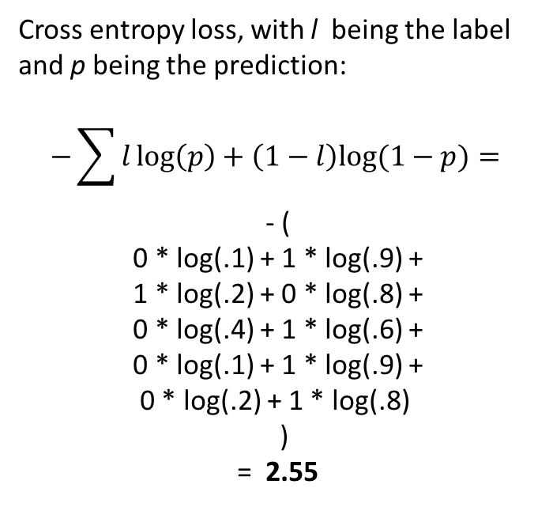
Training
Compare
.1
0
Classifier
Cross entropy loss, with l being the label
and p being the prediction:
$$−\sum{l\log\left(p\right)+\left(1−l\right)log⁡(1−p)}=$$
- (
0 * log(.1) + 1 * log(.9) +
1 * log(.2) + 0 * log(.8) +
0 * log(.4) + 1 * log(.6) +
0 * log(.1) + 1 * log(.9) +
0 * log(.2) + 1 * log(.8)
)
= 2.55
105
.2
1
…
.4
0
.1
0
84
.2
0
Input
Output
Known label

Slide 36
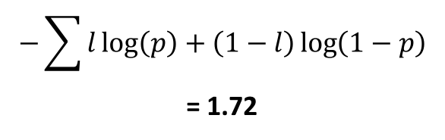
Training
Compare
.05
0
Classifier
Now we change the network weights to improve this score slightly
We can calculate how to do this by looking at the gradients (derivatives) of the weights with respect to the score
Afterwards, the output will be closer to the true value
And the score will be lower:
105
.4
1
…
.35
0
.05
0
84
$$−\sum{l\log\left(p\right)+\left(1−l\right)\log\left(1−p\right)}$$
= 1.72
.15
0
Input
Output
Known label

Slide 37
Training
This process is known as gradient descent
In practice, we don’t have to compute this one point at a time
We can do many at once (called a minibatch), for example maybe 100 at a time
It is easier to learn “rules for classifying different points” when the network can look at more than one point at a time
Training consists of taking many of these individual steps of gradient descent
Ideally, we repeat this process for as long as the score keeps improving
Once performing gradient descent no longer improves the score, we stop training because we’ve “reached convergence”

Slide 38
Training
The last point to consider: validation
We are giving the network cells and their known labels, and it is learning to match them
Ultimately, it is not useful if all the network can do is memorize what we tell it
What we really want is for it to be able to classify future cells of unknown cell type
So the question is, can the rules it has learned to classify cells into different cell types generalize beyond the ones it has already seen?

Slide 39
Training
To measure this, we hold out some of the cells with known labels from the training data
We call this the validation data
After training our network, we can ask it to predict the cell types of these cells (which it has never seen before) and grade its accuracy
While training data accuracy measures the network’s ability to “memorize”, validation data accuracy measures the network’s ability to “predict”

Slide 40
Code!
Let’s dig into an example in Tensorflow and see how to classify some cells into their cell types!

Slide 41
Autoencoders
The classification networks we’ve seen thus far are great at learning functions that take in points and output labels
They learn themselves what kind of information is helpful for classifying a point, and ignore information that is unhelpful
Imagine a realistic situation, though:
Run an expensive experiment to gather data
Receive data in the form of hundreds of files each with thousands of rows and columns
What do I do? What does my data say? Where do I even start?
Exploratory data analysis!

Slide 42
Autoencoders
To use classifiers, we need labeled data
What if we either (a) don’t know each point’s label or (b) have data that isn’t neatly categorizable into discrete labels?
Autoencoders are a general neural network framework that can be used to obtain a lower-dimensional representation of data
If we compress the data down to two dimensions, we can visualize it like we saw with PCA, for example, previously!
Autoencoders can be trained with unlabeled data

Slide 43
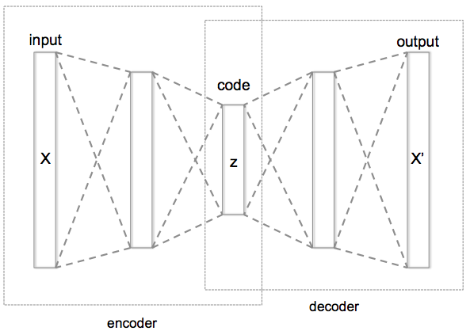
Autoencoders
Key idea for training is:
compress input into a code
recreate the original data from that code
[Hinton, Salakhutdinov, Science 2006]

Slide 44
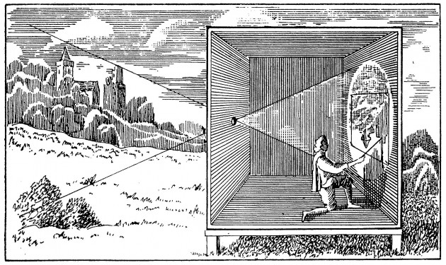
Input
Encoder
Hidden Representation
Decoder
Camera Obscura, the Renaissance autoencoder

Slide 45
Autoencoders
Can’t we cheat by just making the code equal to the original data?
Not very useful
Design the autoencoder so it can’t learn to copy the input perfectly
Restrict it to copy only approximately
Can prioritize certain aspects of the input
Examples
Restrict the size of the code (i.e. add a bottleneck)
Add regularization

Slide 46
Autoencoders
The output is a “denoised” version of the original data
Not every little detail can be memorized and returned
Imagine having to recount a discussion from last week
You may remember the ideas discussed, but likely would not be able to recall it verbatim
This is useful for downstsream applications for which your original data is too noisy
The code can be visualized and used as a dimensionality reduction method

Slide 47
Code!
Let’s go back to our example in Tensorflow and visualize our data with an autoencoder!

