Slide 1

Recap from Day 2
Notes:
TA introduction
Talk about not teaching code (not a programming workshop)

Slide 2
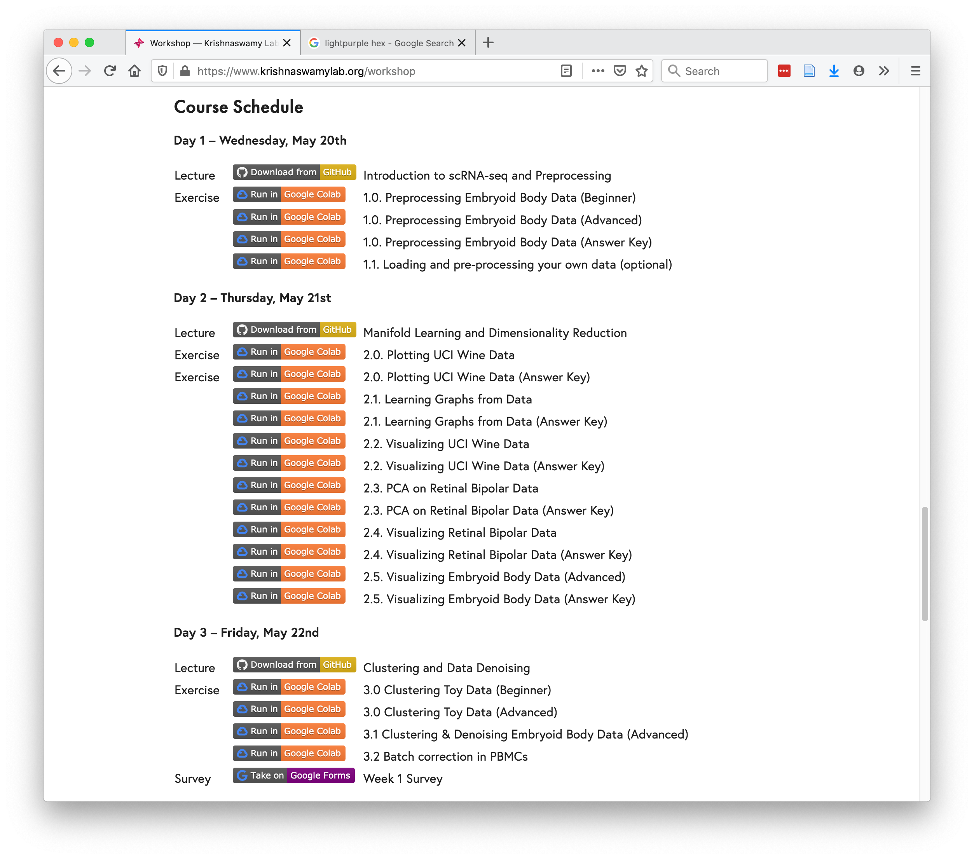
https://www.krishnaswamylab.org/workshop

Slide 3
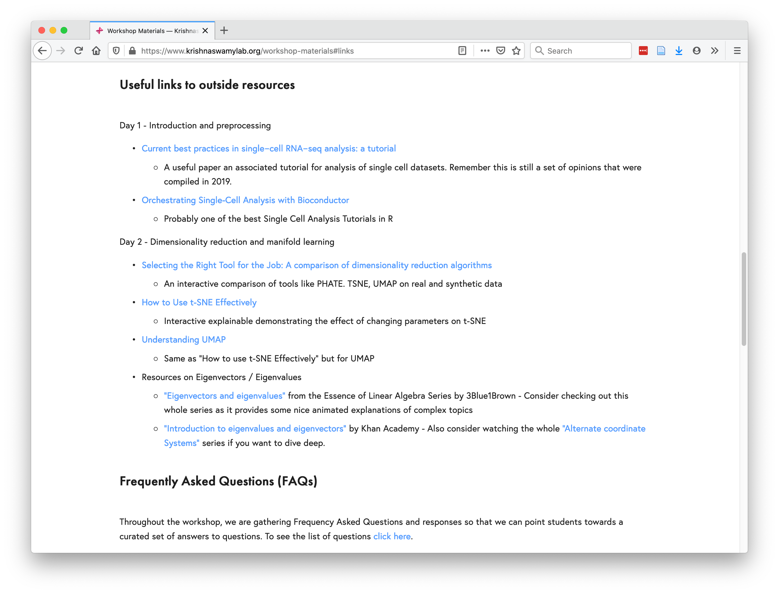
https://www.krishnaswamylab.org/workshop-materials#links

