Slide 1
Introduction to Docker

Slide 2
What is Docker?
A virtualization platform
A way to package an application, and all its dependencies, and share it with others
An isolated environment in which to install and try new software
Docker is a “container system for wrapping a piece of software in a complete file system with everything it needs to run”

Slide 3
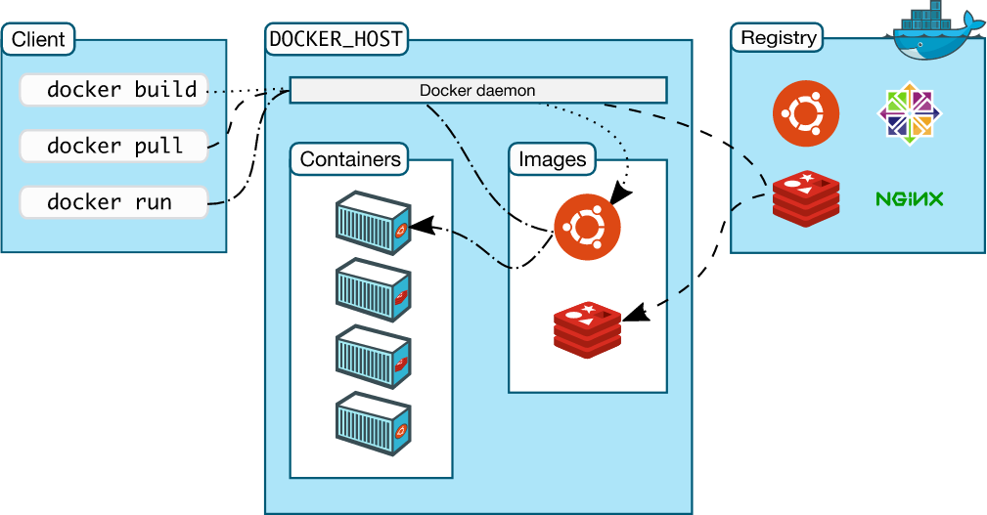
Docker Components

Slide 4
Docker Containers
WRITABLE CONTAINER
Add shiny server – image
WRITABLE CONTAINER
Add shiny – image
Add apache– image
Add R – image
Add emacs – image
Add development tools – image
Ubuntu – image
CentOS – image
KERNEL
Layered filesystem – sharing common files for efficient disk usage and image downloads
Images can be built using Dockerfile templates

Slide 5
Dockerfile
Shiny server
FROM centos:7
RUN yum groupinstall -y 'development tools'
RUN yum install -y wget
RUN rpm -Uvh https://dl.fedoraproject.org/pub/epel/epel-release-latest-7.noarch.rpm
RUN yum install -y R
RUN R -e "install.packages(c('shiny', 'rmarkdown'), repos='https://cran.rstudio.com')"
RUN R -e "install.packages('devtools', repos='http://mirrors.ebi.ac.uk/CRAN')"
RUN wget https://download3.rstudio.org/centos6.3/x86_64/shiny-server-1.5.0.730-rh6-x86_64.rpm
RUN yum install -y --nogpgcheck shiny-server-1.5.0.730-rh6-x86_64.rpm
EXPOSE 3838
COPY shiny-server.sh /usr/bin/shiny-server.sh
CMD ["/usr/bin/shiny-server.sh"]

Slide 6
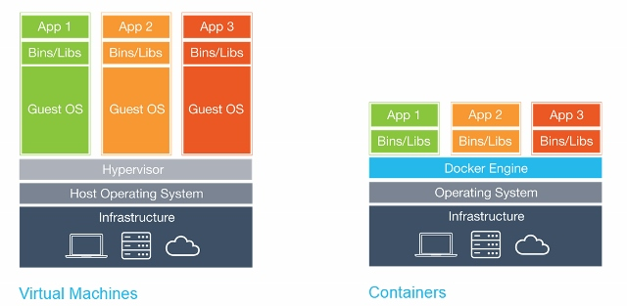
Docker vs Virtual Machines
Virtual Machines
Docker Containers
e.g. VMware, VirtualBox
Each virtual machine includes the entire guest OS – tens of GBs, can take minutes to start up
Containers run as isolated processes on the host OS
Lightweight, start instantly, use less memory
Both offer resource isolation and allocation

Slide 7
How have we used Docker?
MutSigCV
Shiny applications
Proteomics TMT analysis
Caldas drug sensitivity portal
Sanger Cancer Genome Project analysis pipeline
Training
CRUK Summer School on cancer genome analysis

Slide 8
Limitations
Linux only containers although Microsoft getting in on the act with Windows Server 2016
Additional layer of complexity
Need to run as root or expose elevated privileges of docker daemon (running as root) to users in the docker group
Can’t run docker applications on the CRUK-CI clusters ☹

Slide 9
So how can Docker help me?
Trialling new software
Clean, unpolluted starting point
Isolated environment – won’t affect other applications
Superuser privileges and complete control over what you install
Bioinformatics developers increasingly using docker to package and distribute applications
Much simpler installation route
Deployment of an application during development
Share your environment with a colleague to run on their machine
Update a production system with minimum downtime

