Slide 1
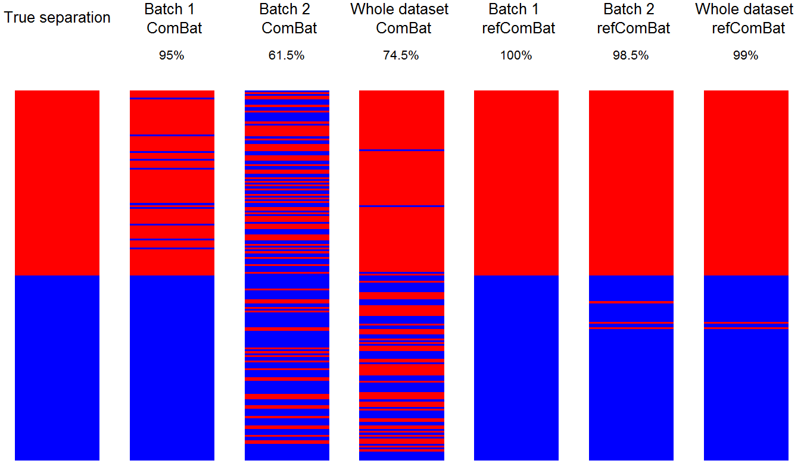
Data
Accuracy
Signature genes
Control genes

