Slide 1



T1dBladeSetupDlg.cpp
T1dImpeller.cpp
1
2
3
4

Slide 2
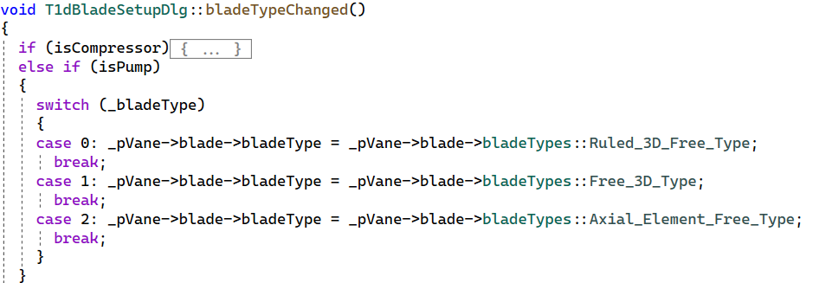
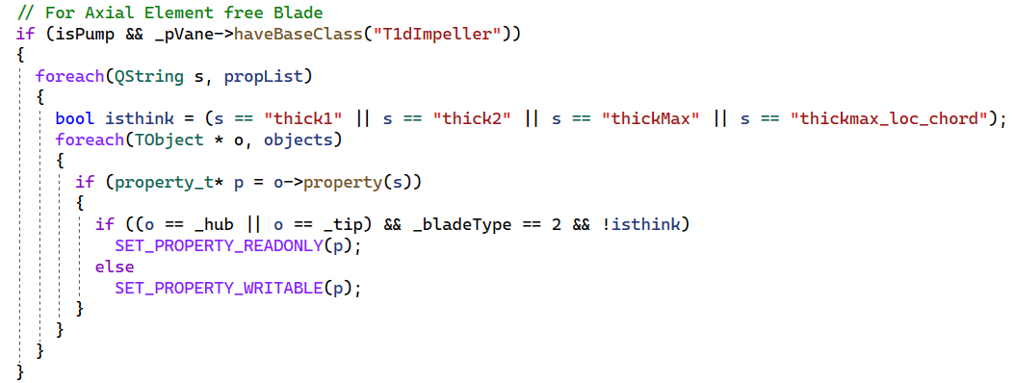

T1dBladeSetupDlg.cpp
T1dImpeller.cpp
5
6
7

Slide 3

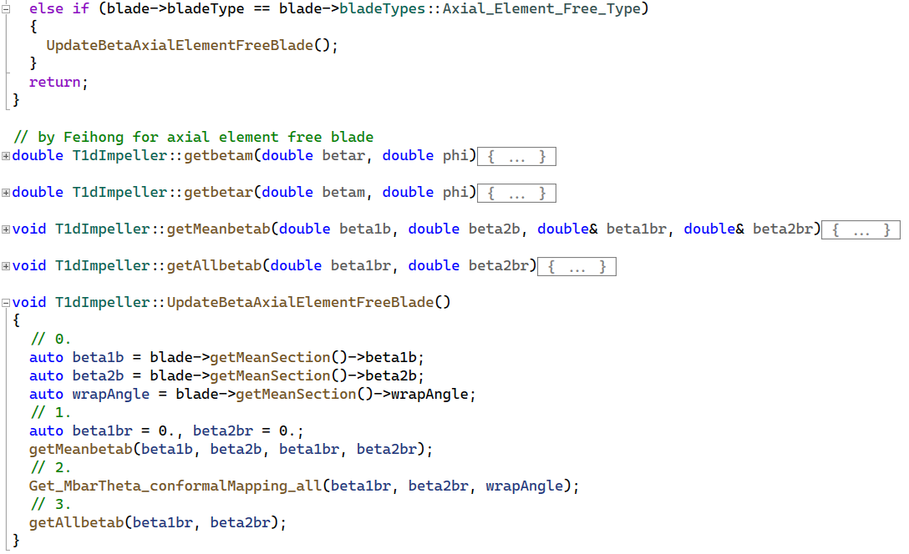
T1dImpeller.h
T1dImpeller.cpp

Slide 4
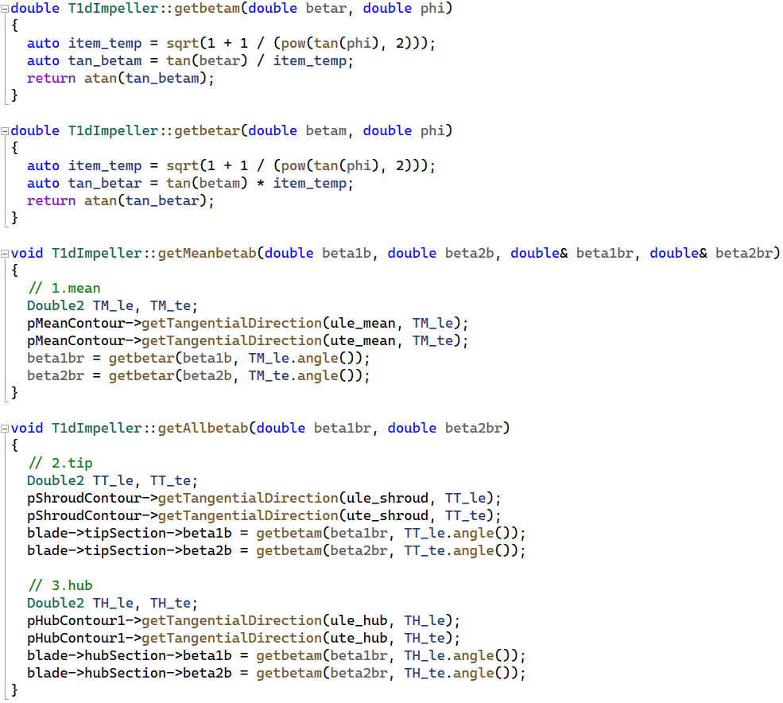
T1dImpeller.cpp

Slide 5
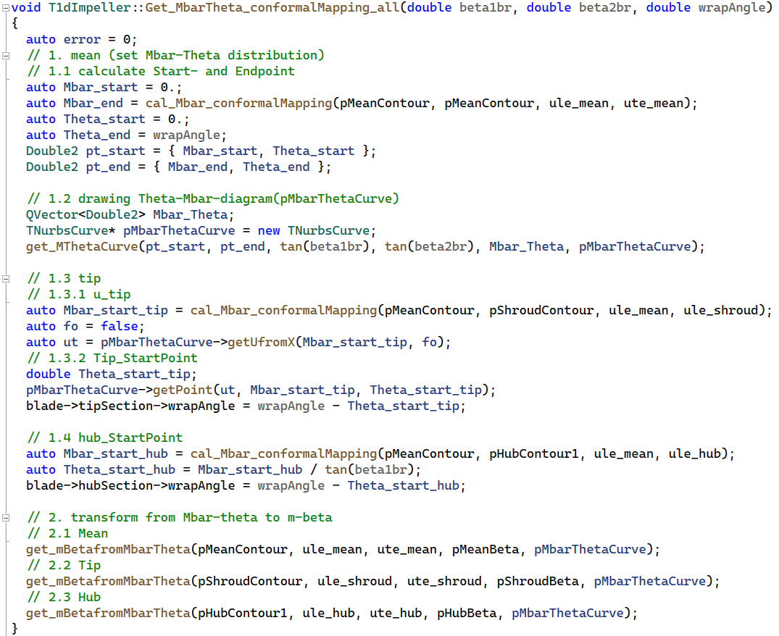
T1dImpeller.cpp

Slide 6
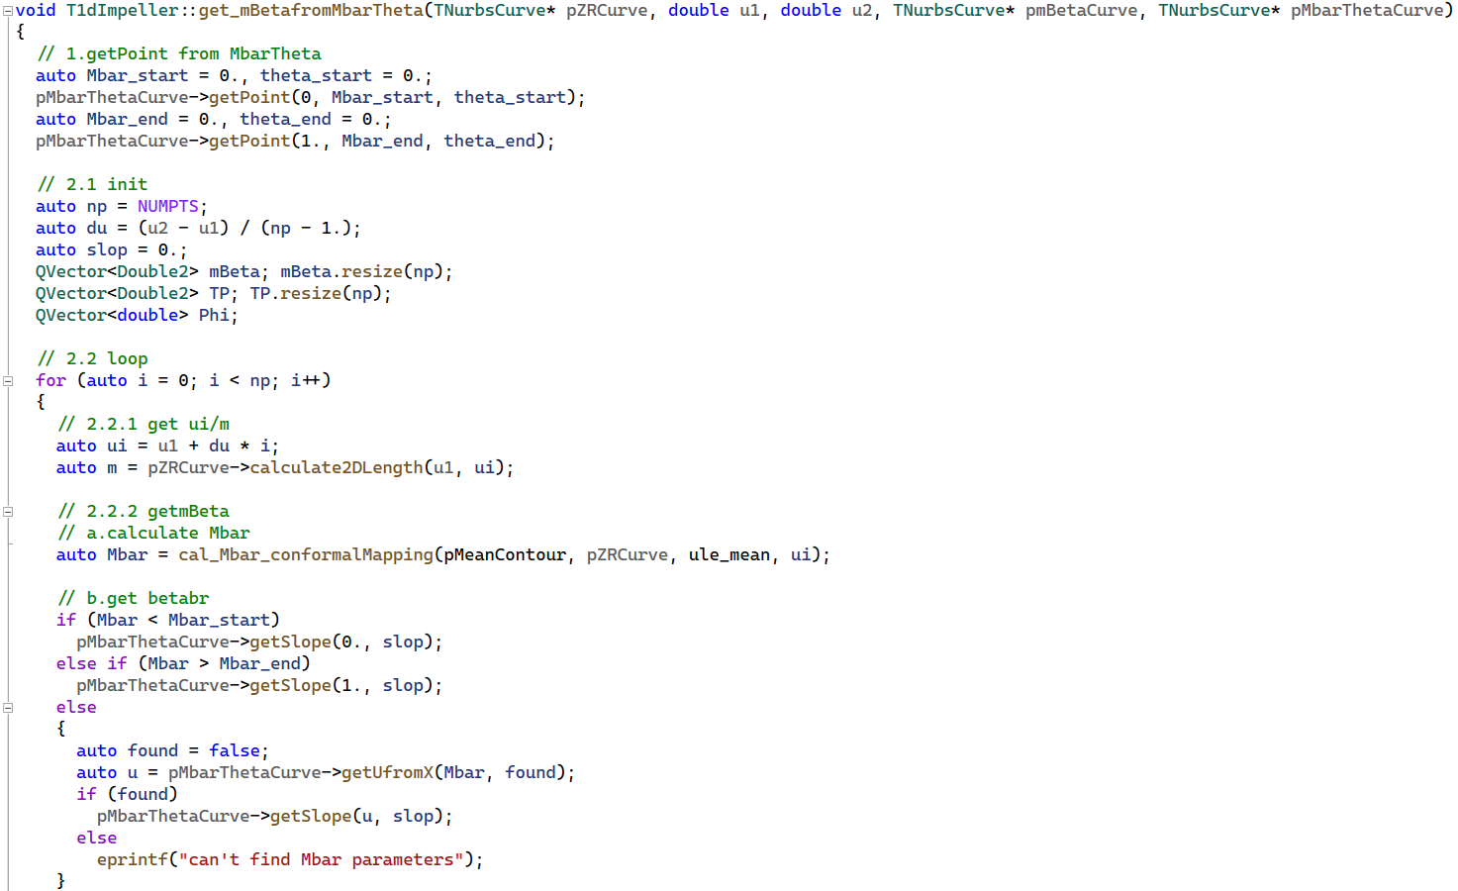

Slide 7
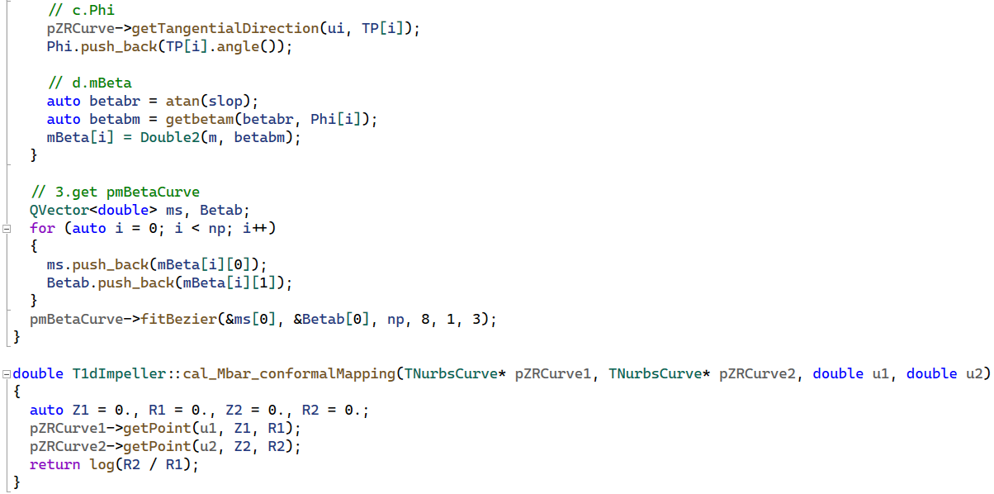
T1dImpeller.cpp

