Slide 1
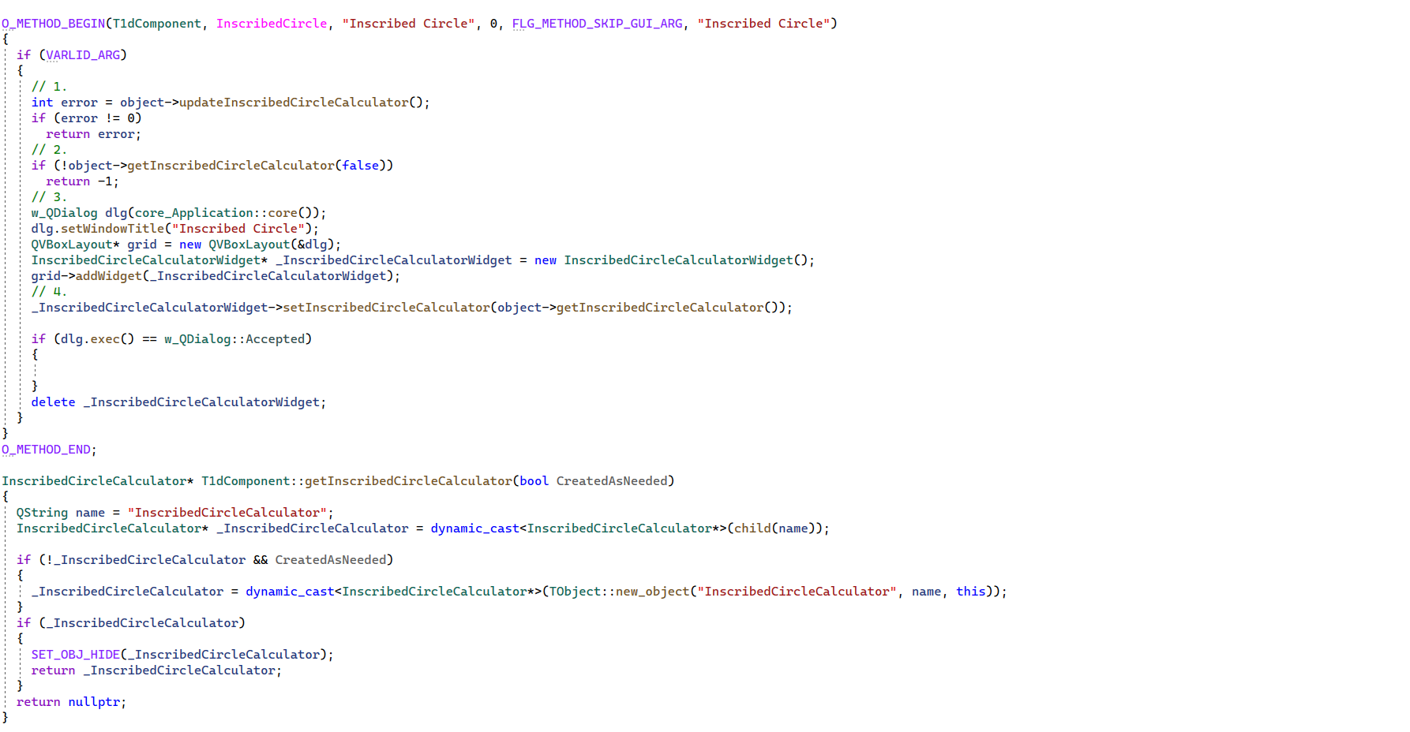
1dComponent.cpp
1.1
2.1
3.1

Slide 2
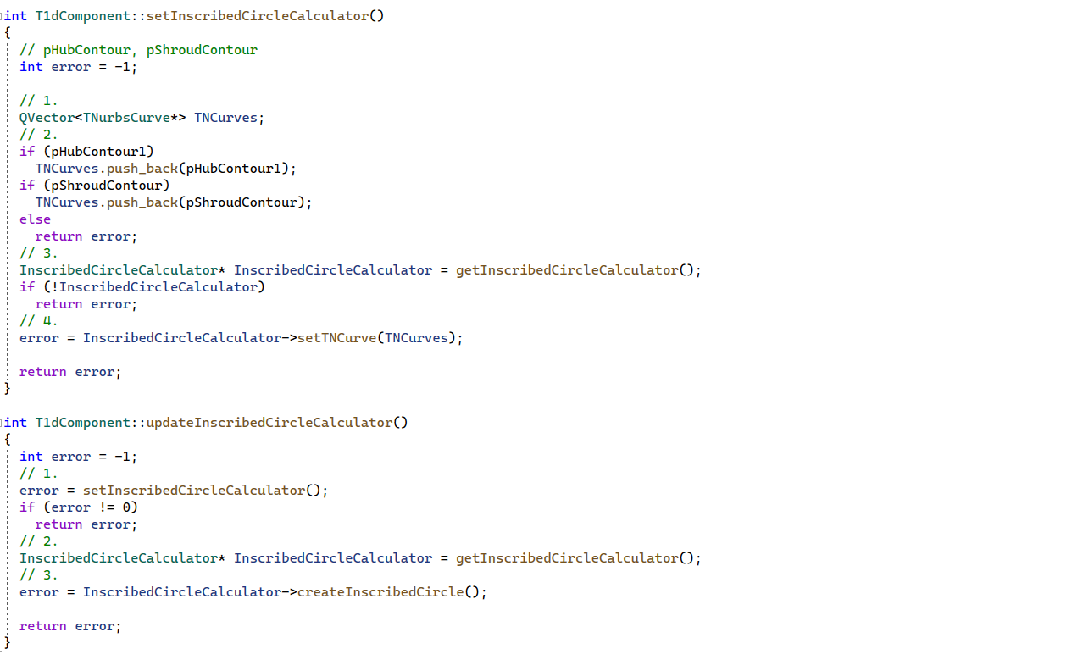
1dComponent.cpp
1.3
1.4
1.2

Slide 3
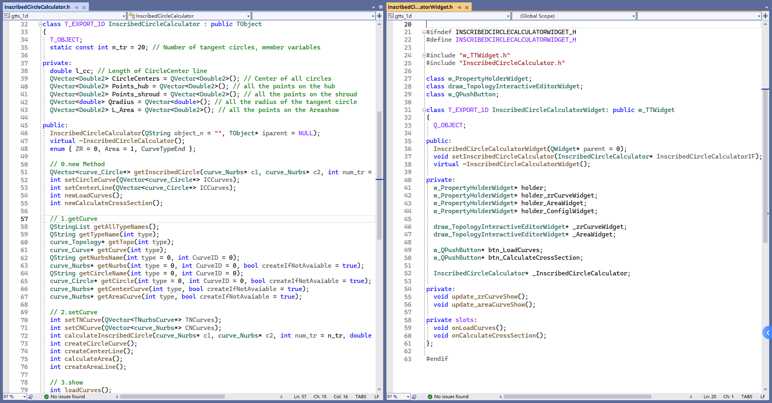
InscribedCircleCalculator.h /InscribedCircleCalculatorWidget.h

Slide 4
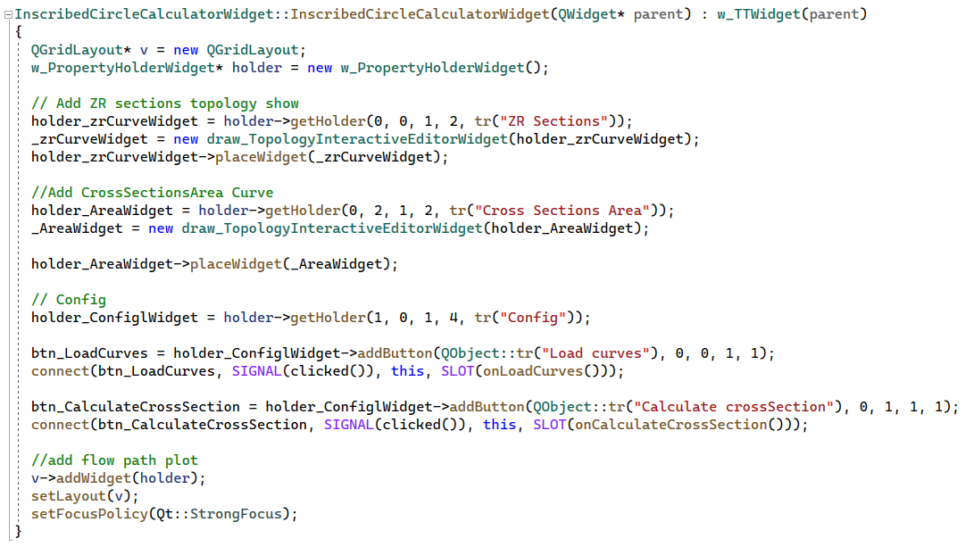
InscribedCircleCalculatorWidget.cpp
2.2
2.3

Slide 5
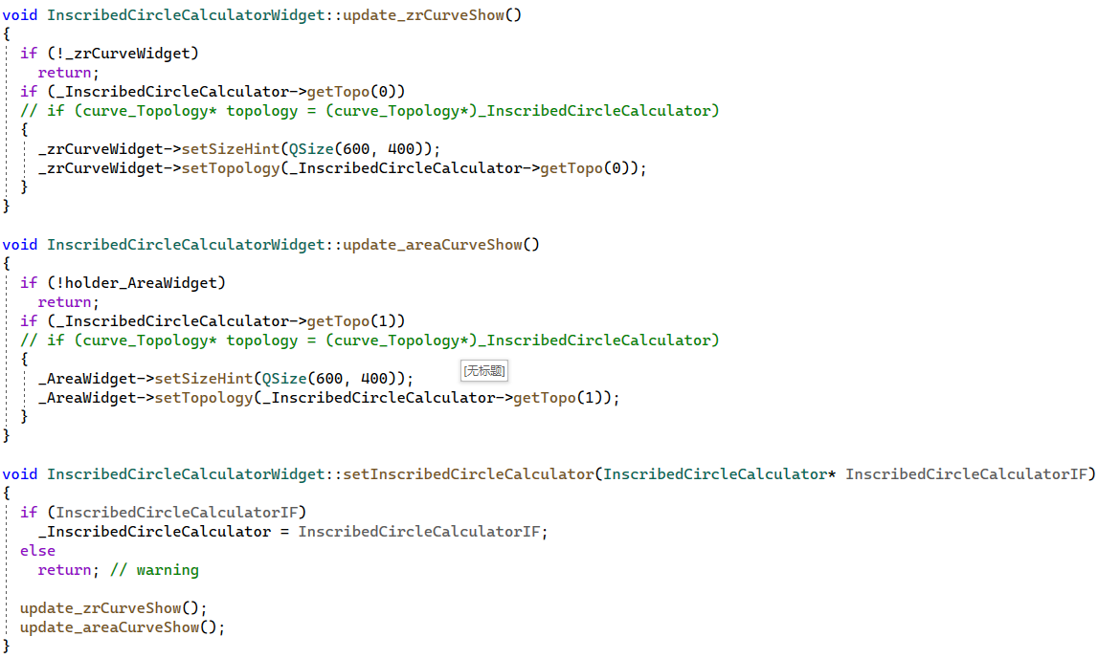
InscribedCircleCalculatorWidget.cpp
3.2

Slide 6
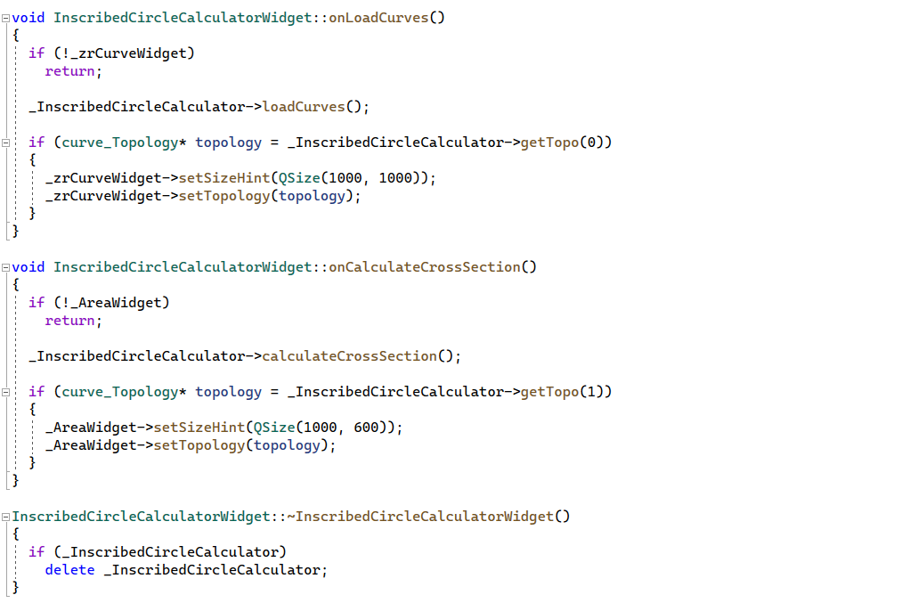
InscribedCircleCalculatorWidget.cpp
3.3
3.4

Slide 7
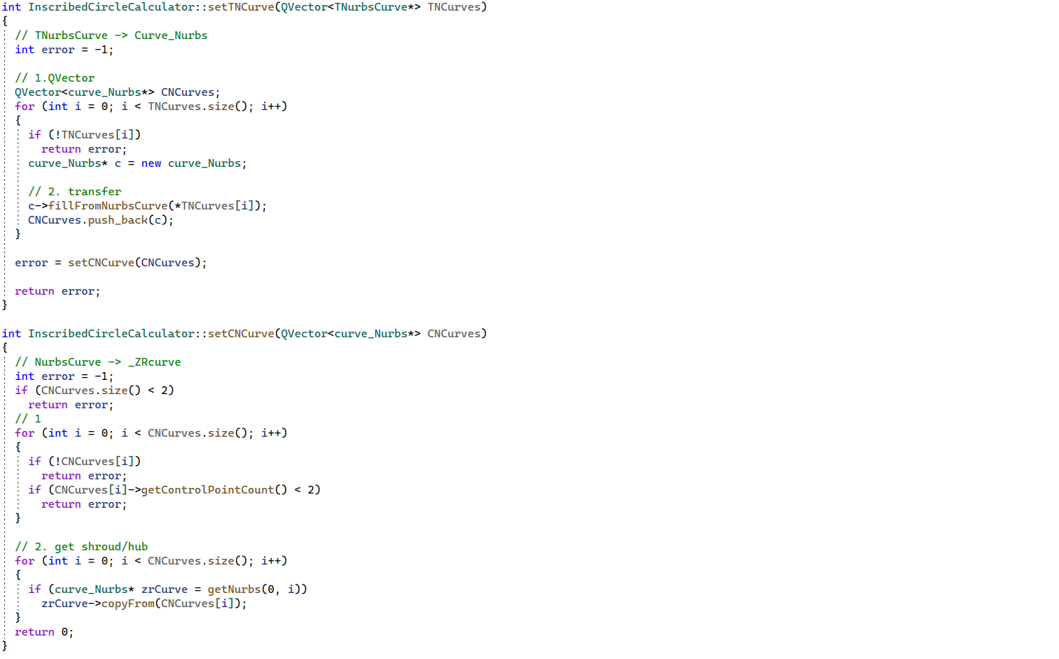
InscribedCircleCalculator.cpp
1.4.1
1.4.2
1.4.3
1.5
1.5.1

Slide 8
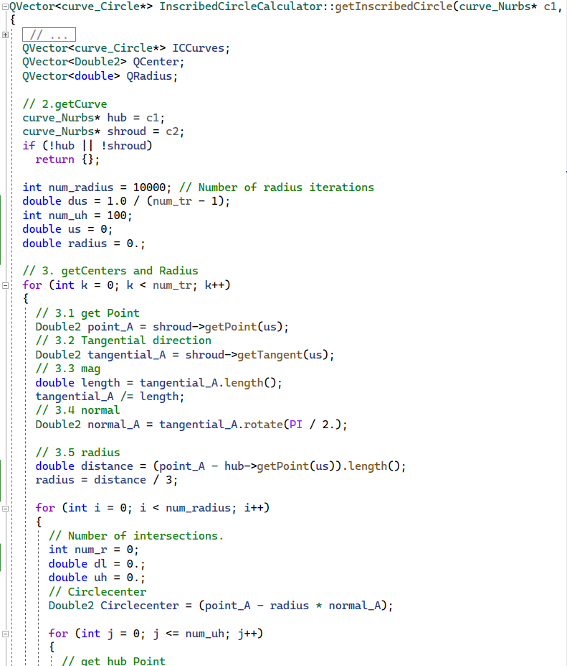
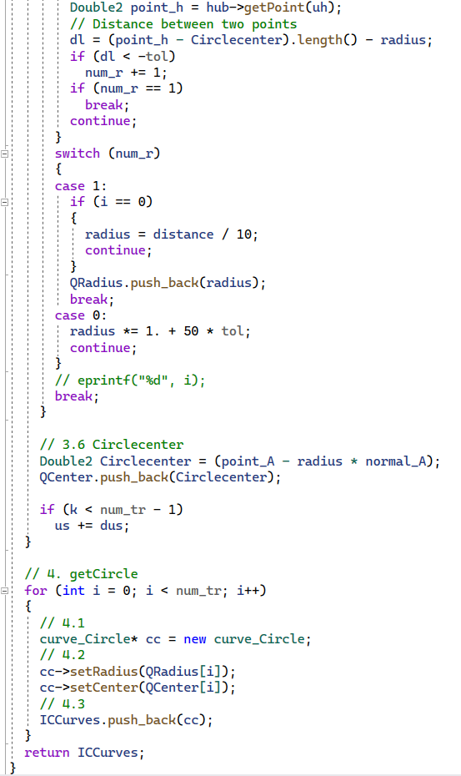
InscribedCircleCalculator.cpp
3.3.2.1
3.3.2.2
3.3.2.3
3.3.2.4

Slide 9
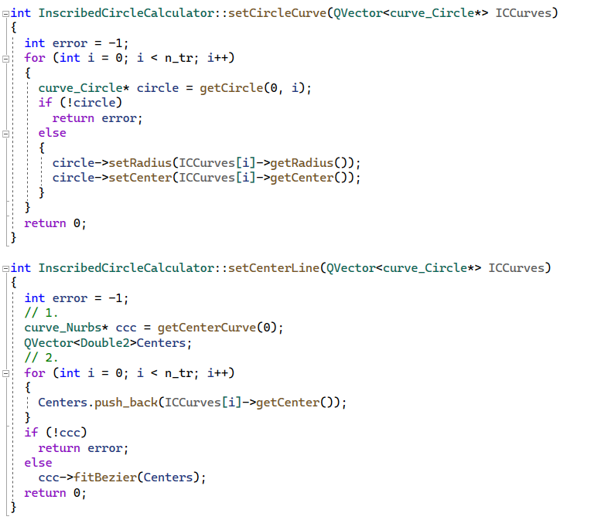
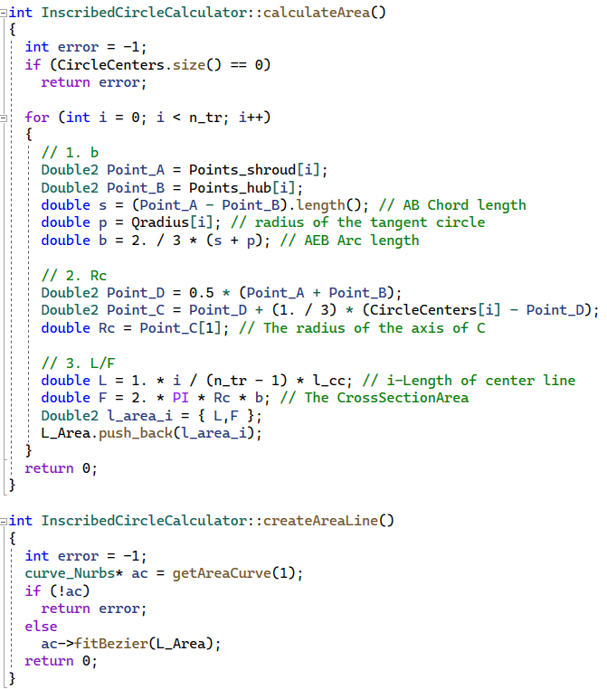
InscribedCircleCalculator.cpp
3.3.3.1
3.3.3.2
3.4.1.1
3.3.4.1
3.4.1.2
3.3.4.2
3.4.2.1
3.3.4.3
3.4.2.2

Slide 10
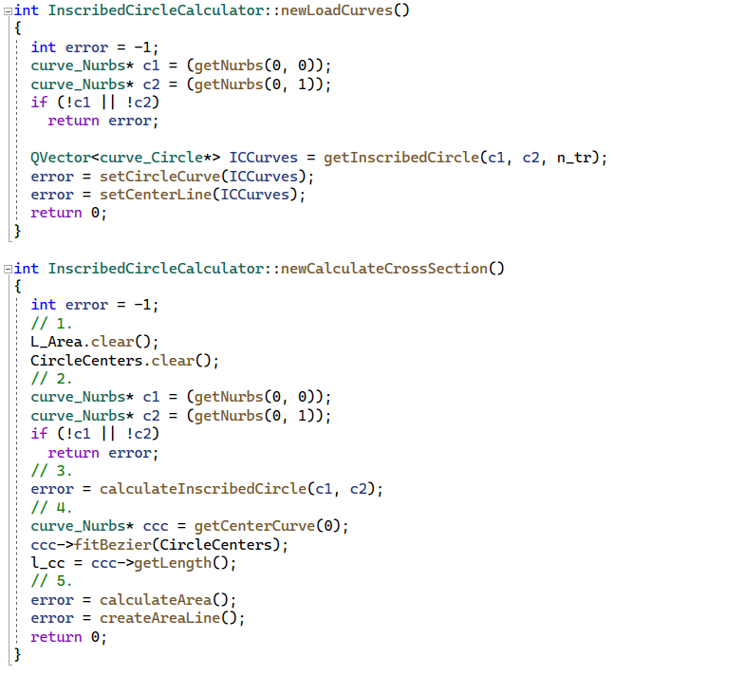
InscribedCircleCalculator.cpp
3.3.1
3.3.2
3.3.3
3.3.4
3.4.1
3.4.2

Slide 11
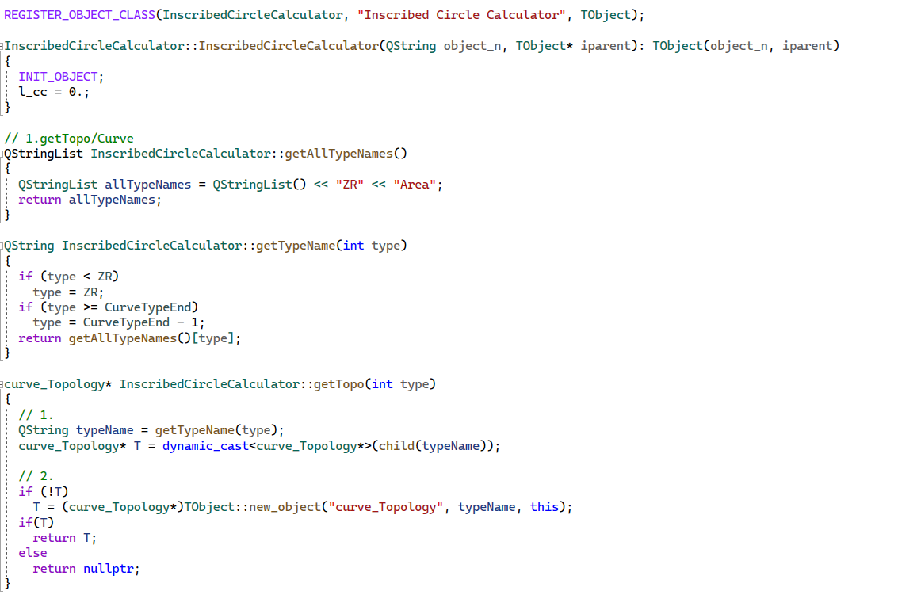
InscribedCircleCalculator.cpp

Slide 12
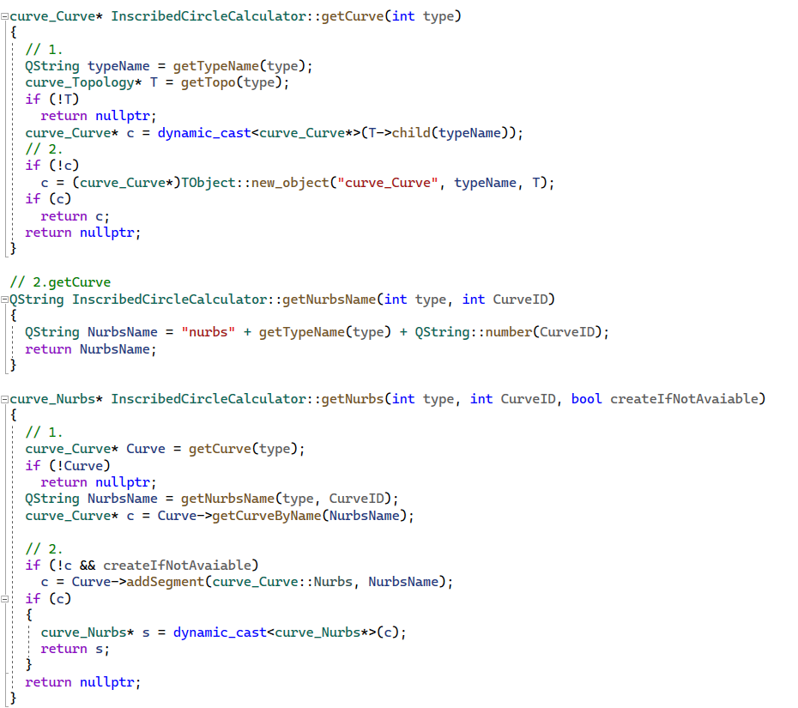
InscribedCircleCalculator.cpp

Slide 13
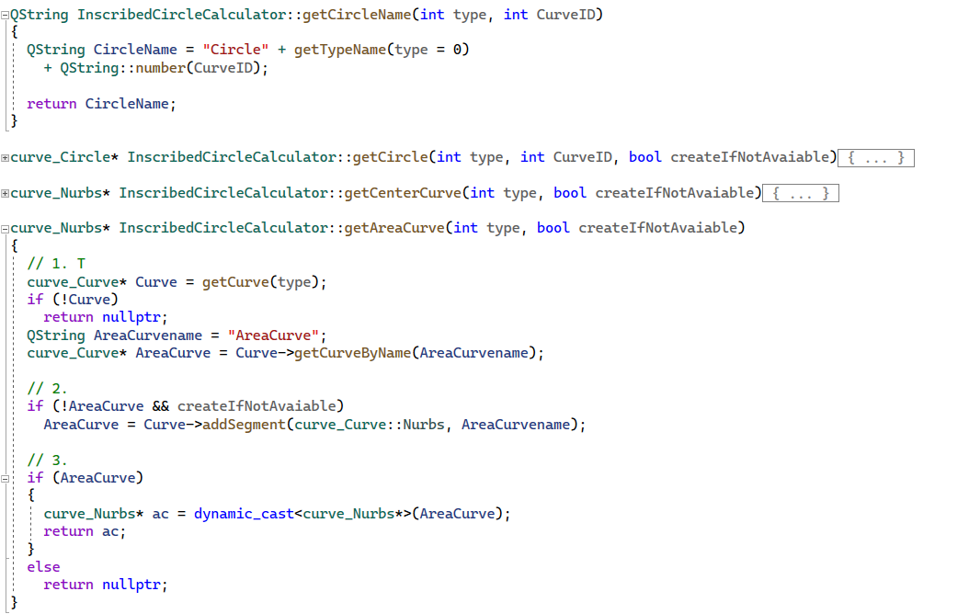
InscribedCircleCalculator.cpp

Slide 14
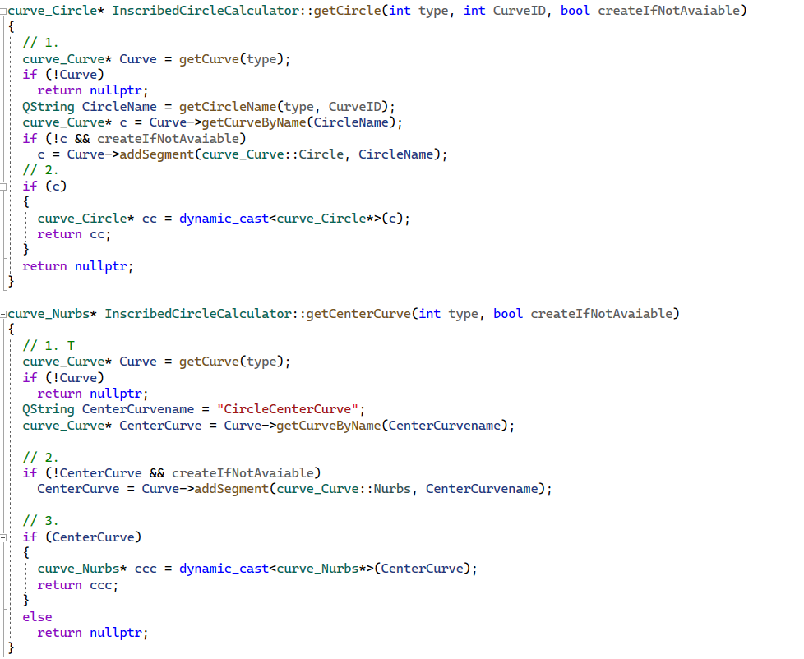
InscribedCircleCalculator.cpp

