Slide 1
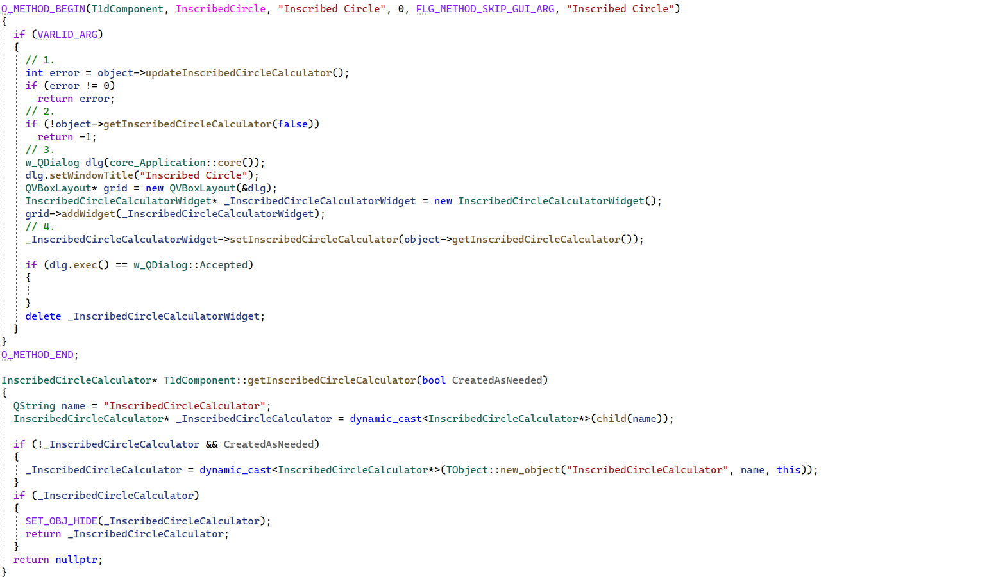
1dComponent.cpp

Slide 2
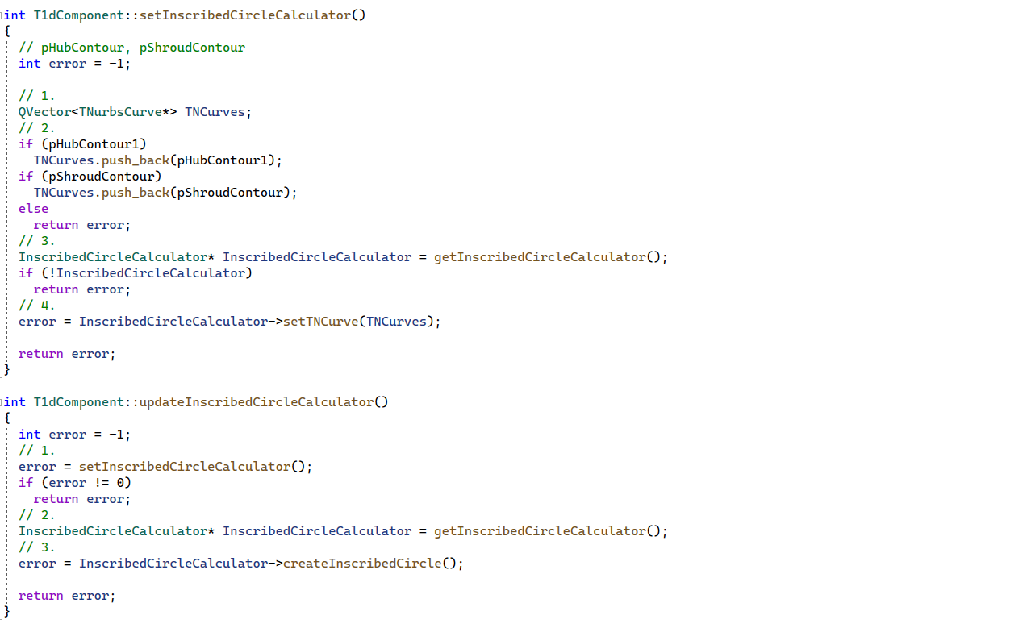
1dComponent.cpp

Slide 3
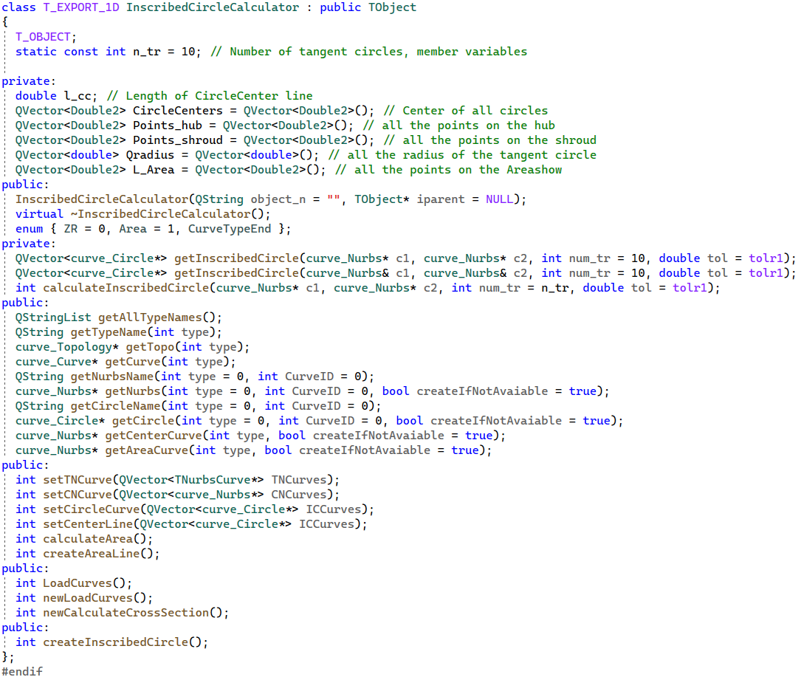
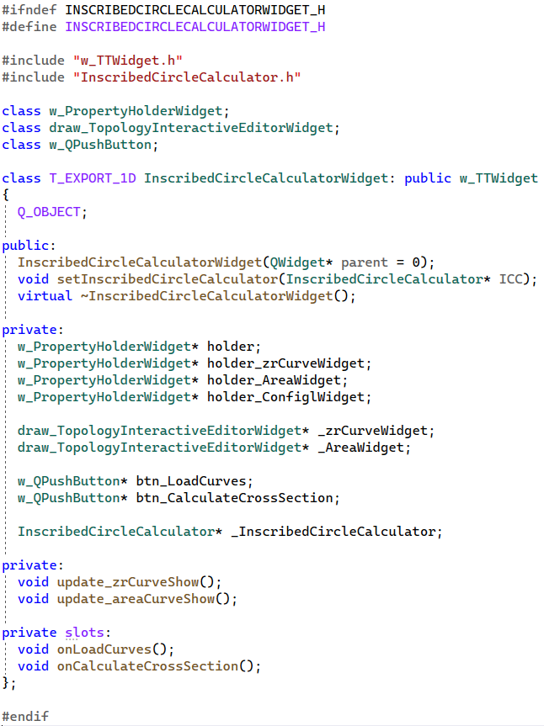
InscribedCircleCalculator.h /InscribedCircleCalculatorWidget.h

Slide 4
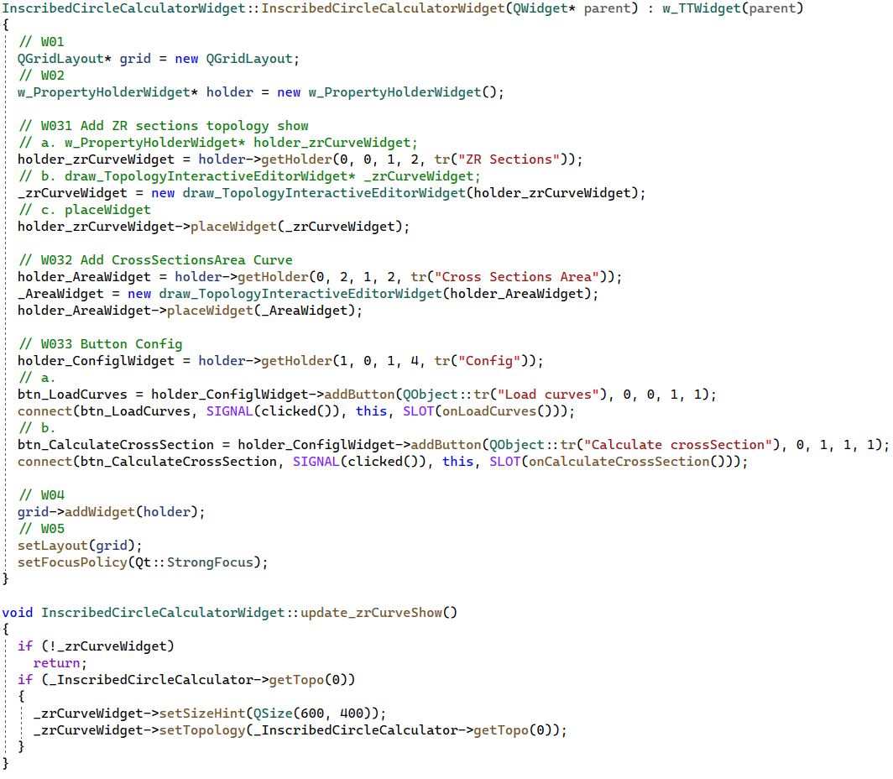
InscribedCircleCalculatorWidget.cpp

Slide 5
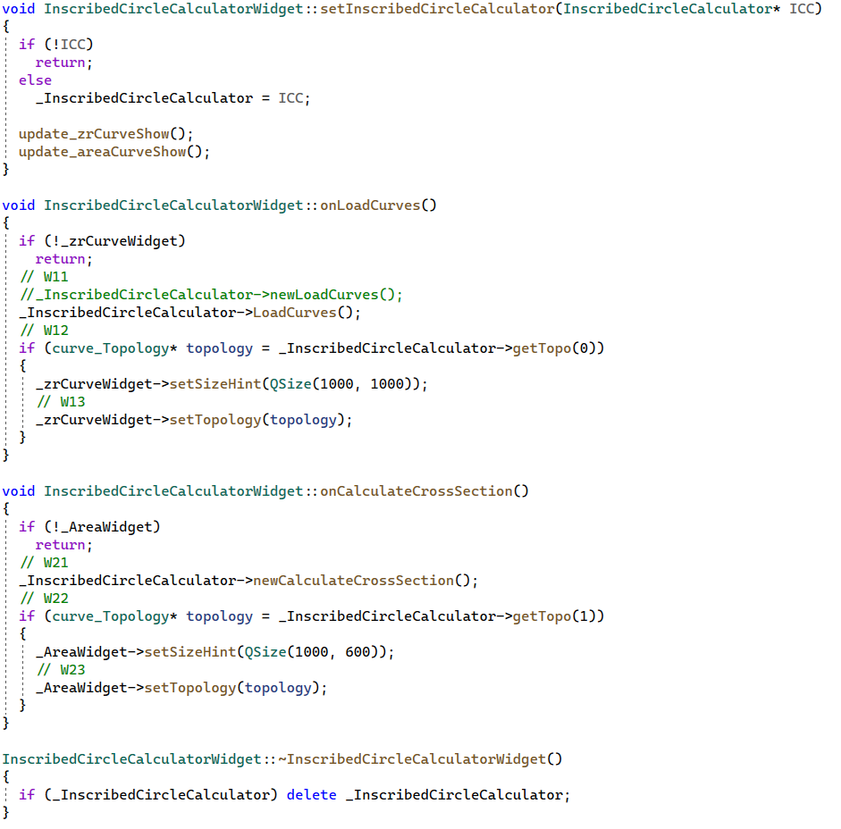
InscribedCircleCalculatorWidget.cpp

Slide 6
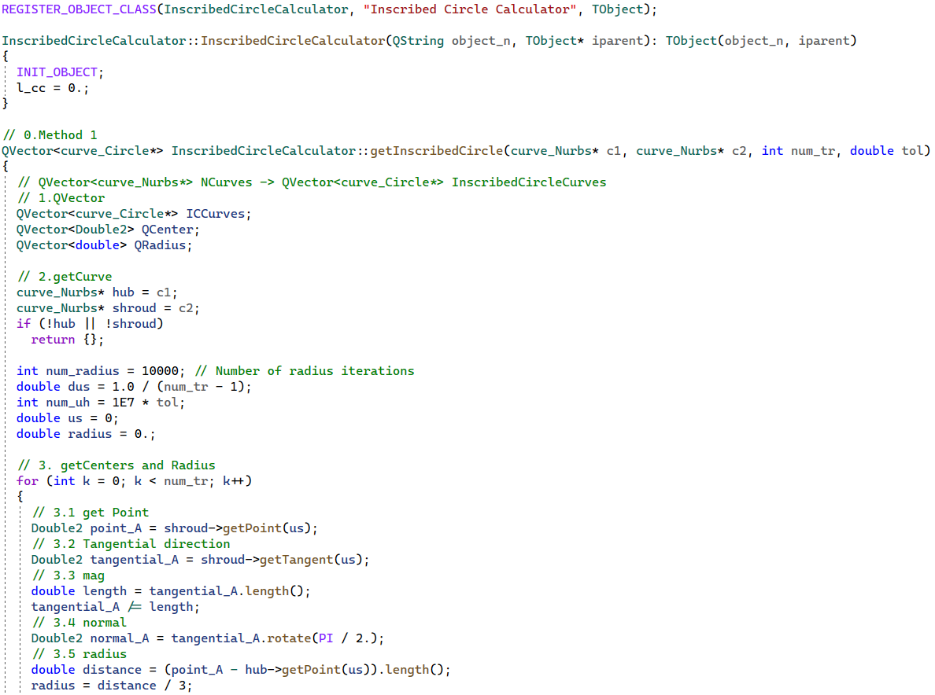
InscribedCircleCalculator.cpp

Slide 7
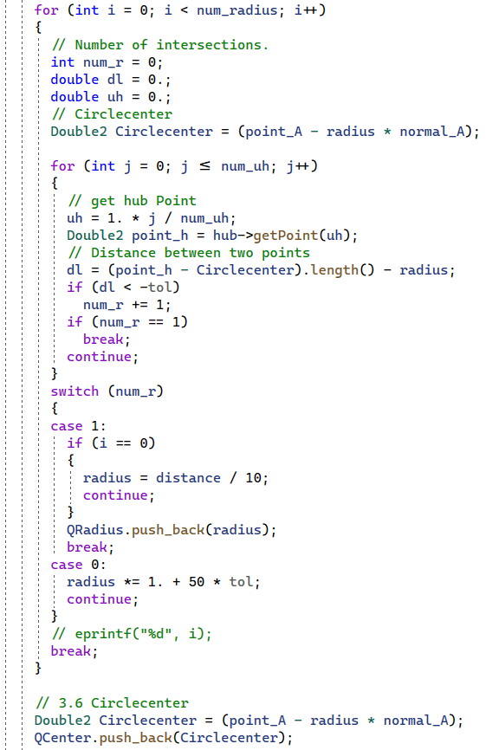
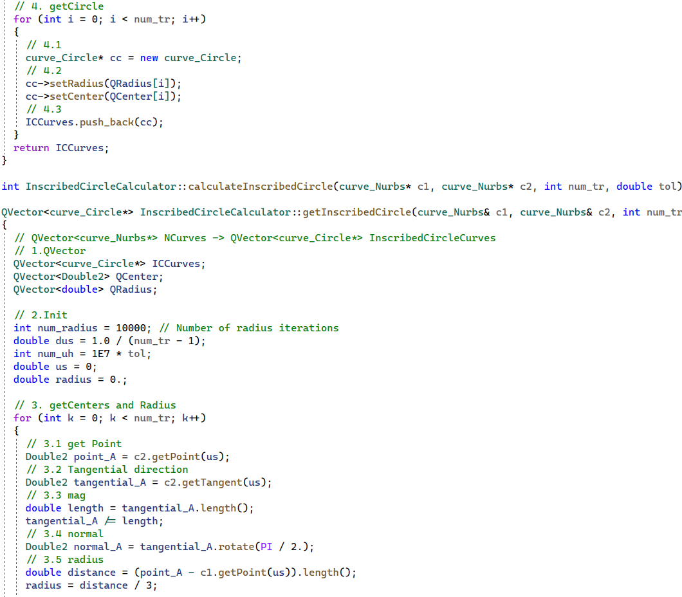
InscribedCircleCalculator.cpp

Slide 8
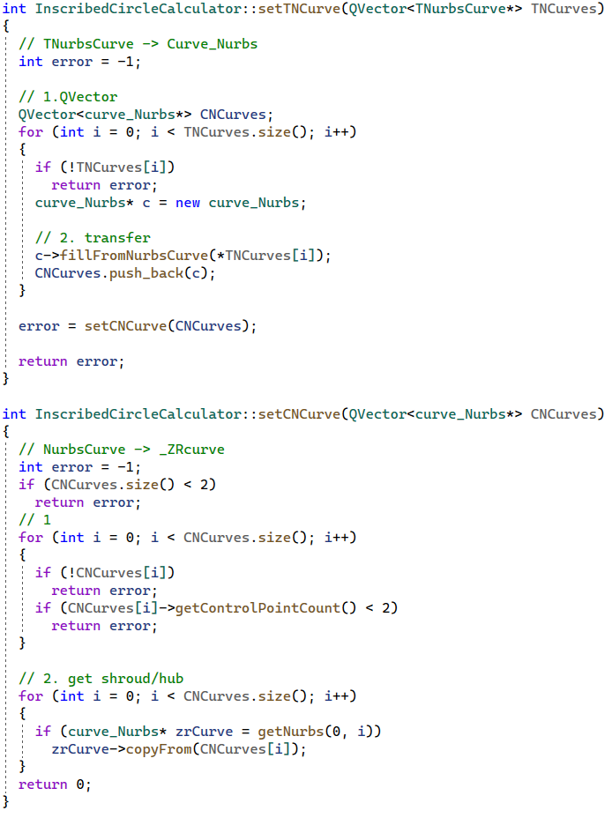
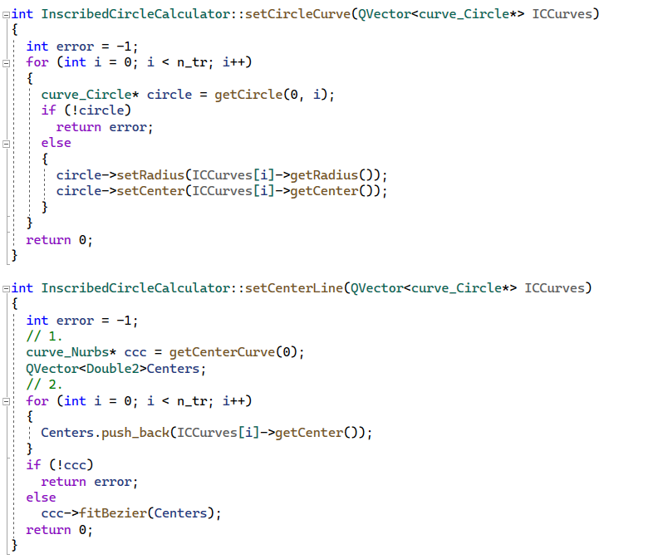
InscribedCircleCalculator.cpp

Slide 9
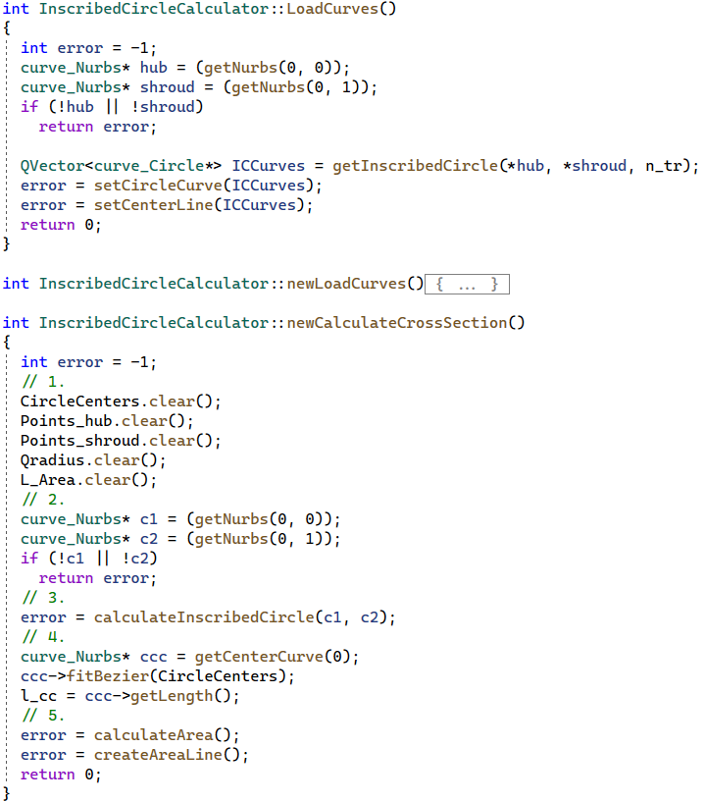
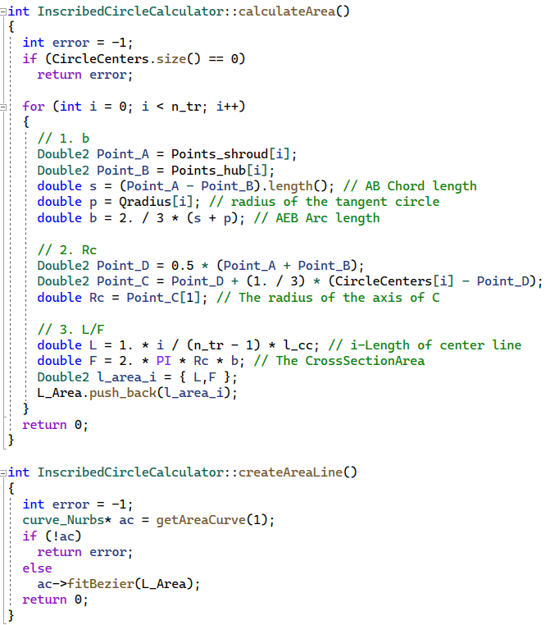
InscribedCircleCalculator.cpp

Slide 10
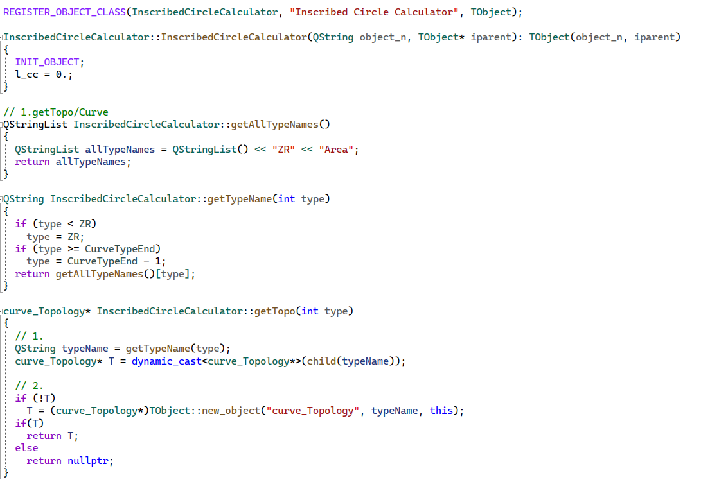
InscribedCircleCalculator.cpp

Slide 11
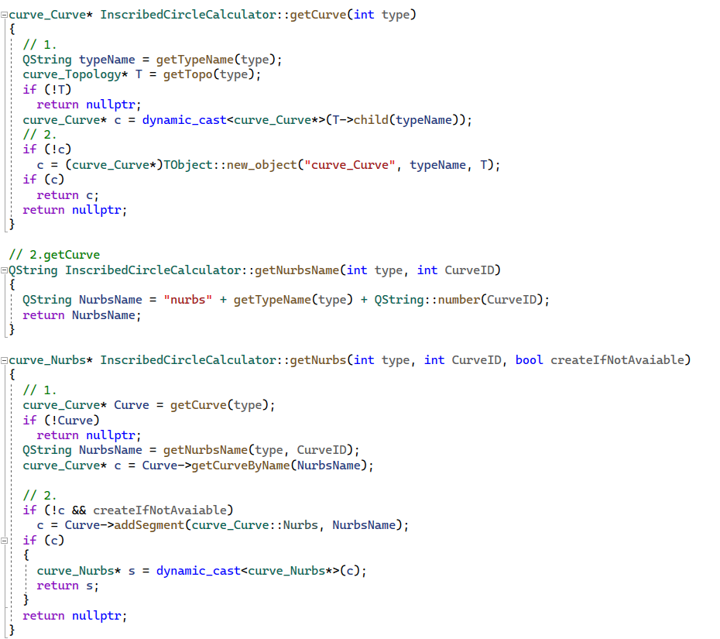
InscribedCircleCalculator.cpp

Slide 12
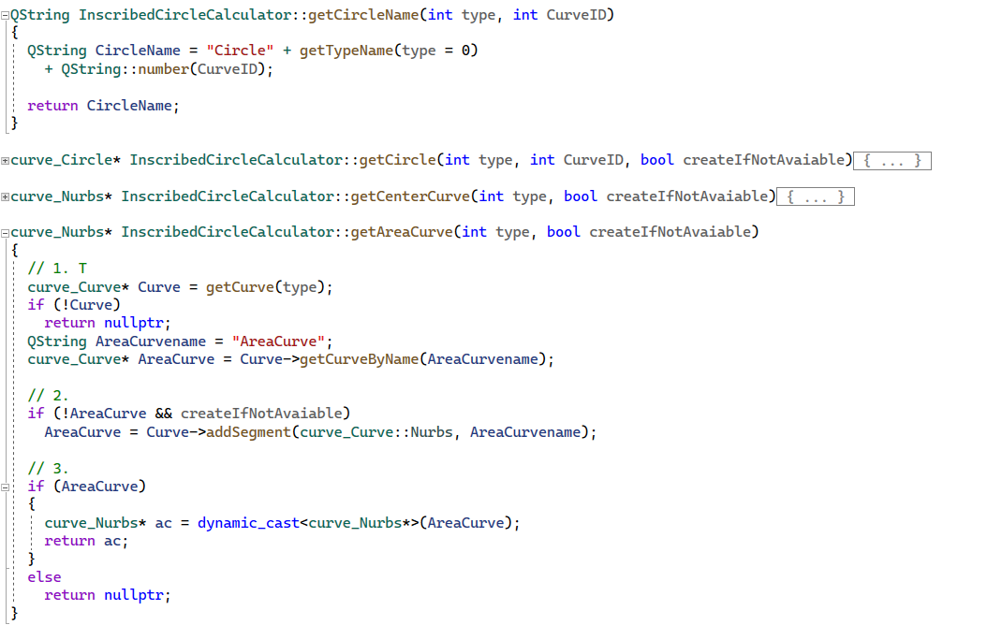
InscribedCircleCalculator.cpp

Slide 13
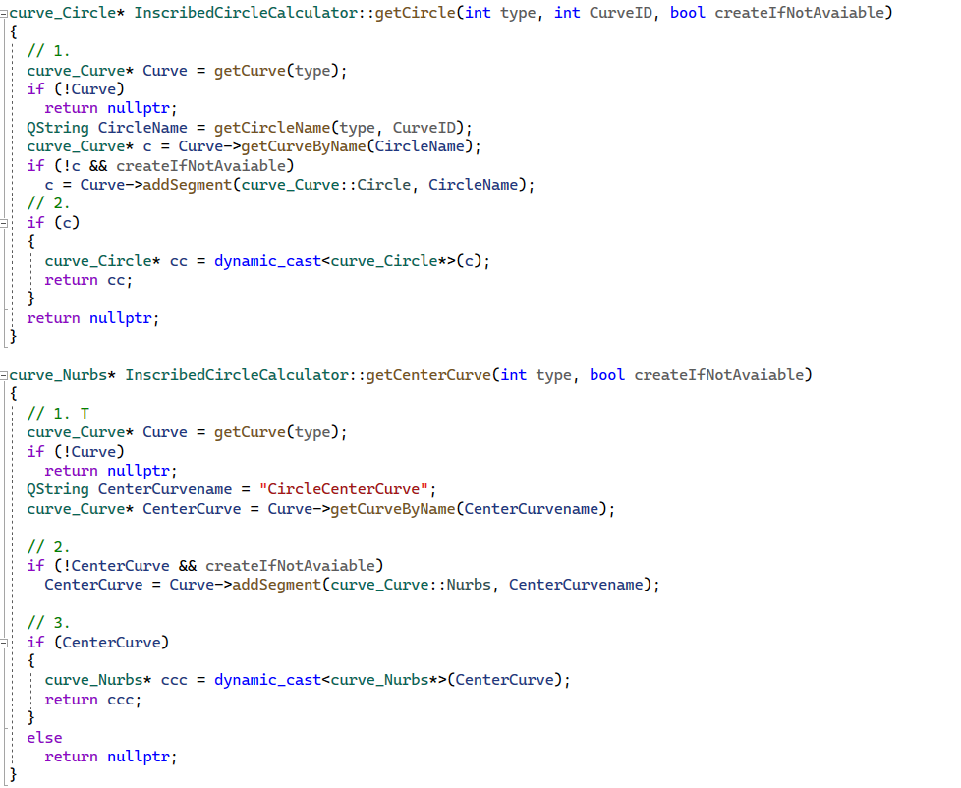
InscribedCircleCalculator.cpp

