Slide 1
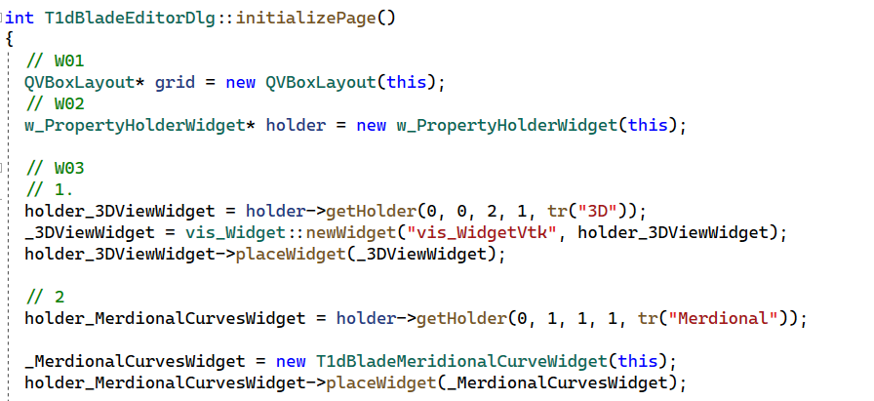

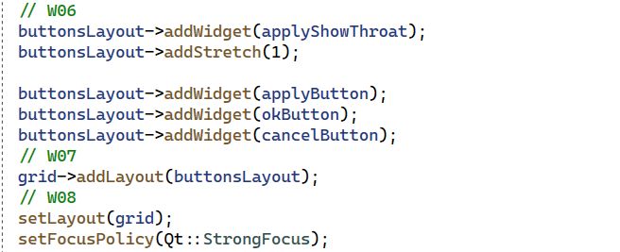

1dd_BladeEditor.cpp
1d_BladeEditor.cpp

Slide 2
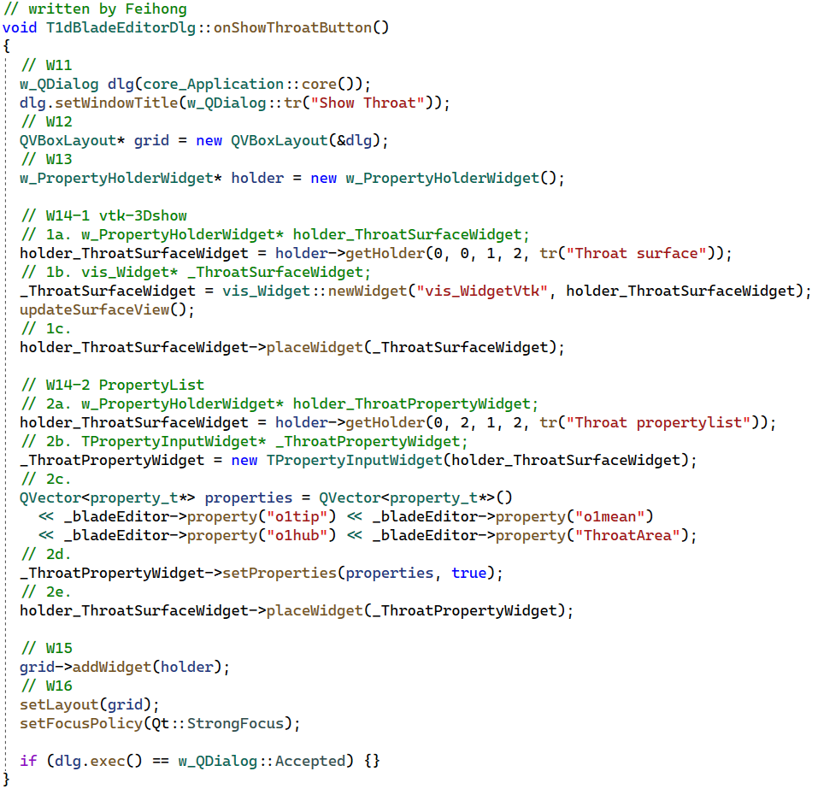
1dd_BladeEditor.cpp

Slide 3
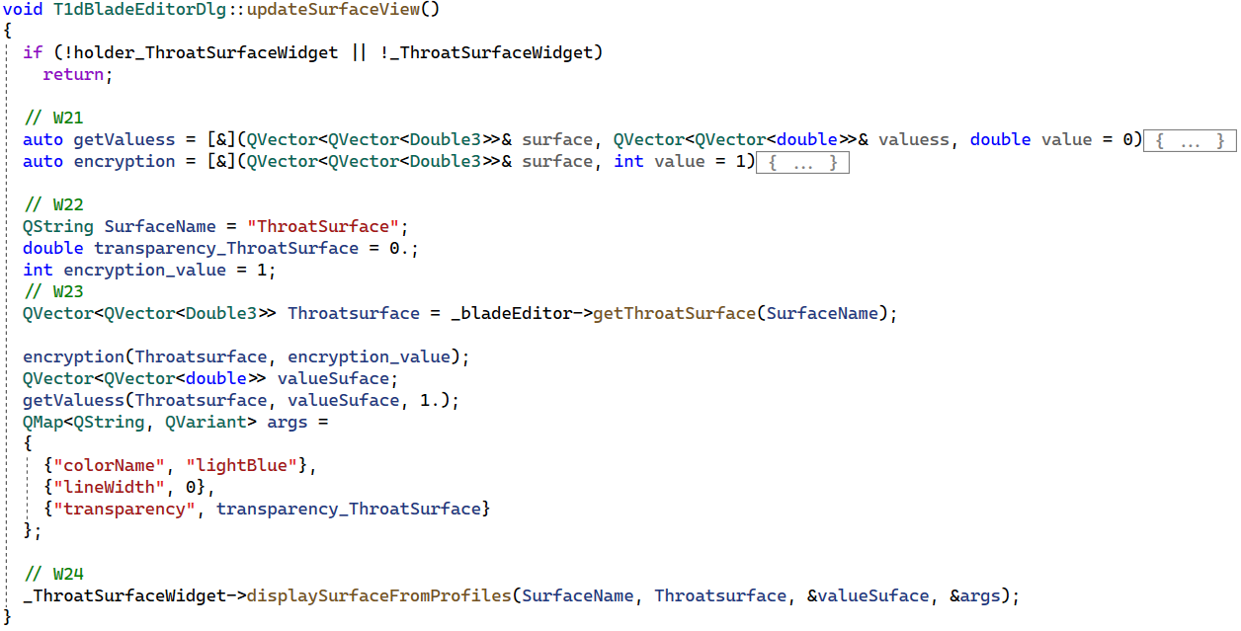
1dd_BladeEditor.cpp
1d_BladeEditor.cpp

Slide 4
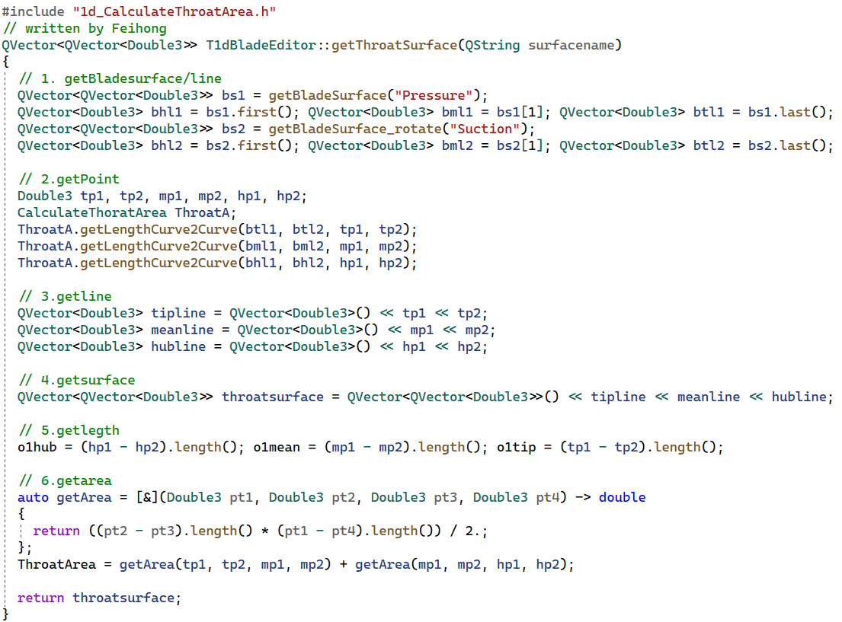
1d_BladeEditor.cpp

Slide 5
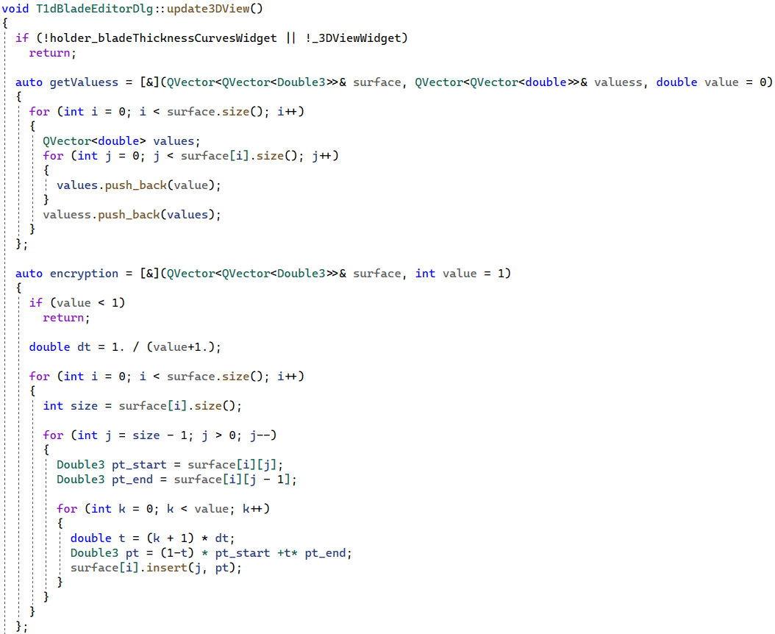
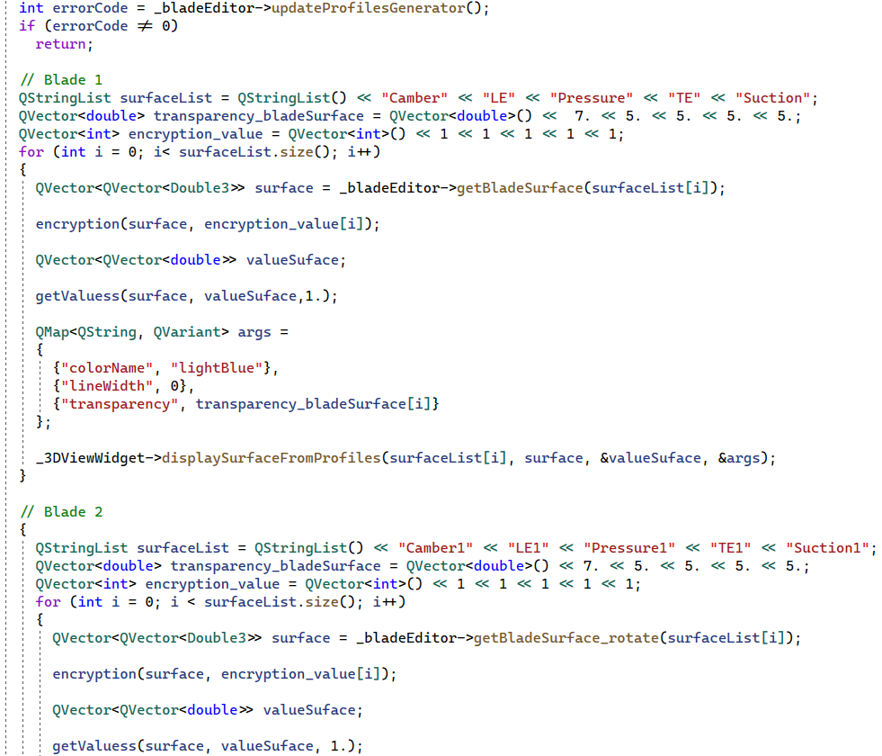
1dd_BladeEditor.cpp

Slide 6
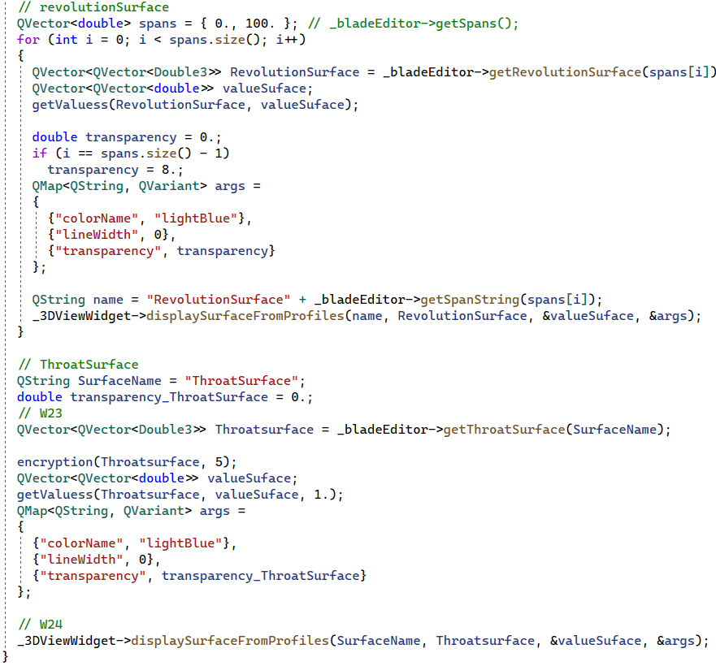
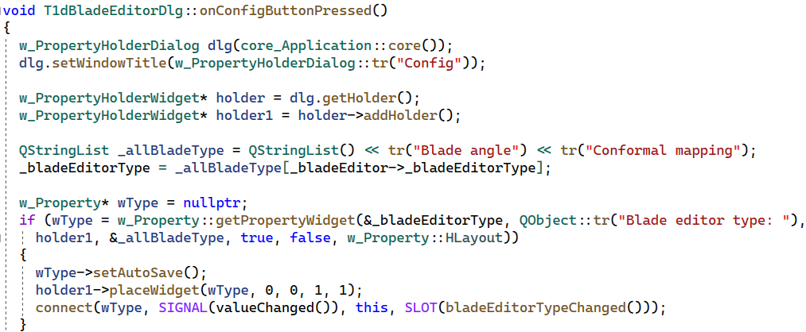
1dd_BladeEditor.cpp

