Slide 1
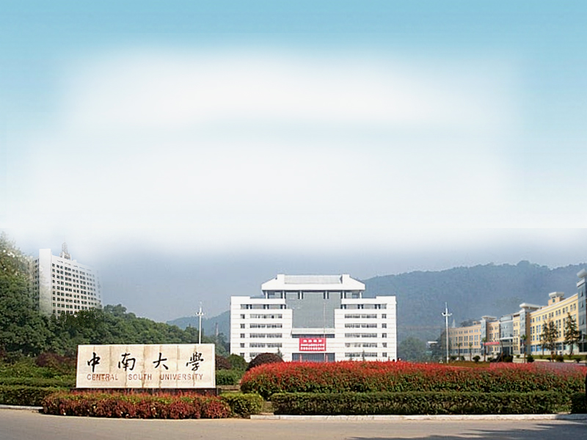
国家精品课程
Principles of Operating System
操作系统原理
胡志刚
中南大学软件学院
http://www.icourses.cn/mooc/

Slide 2
Textbook & References
Silberschatz．Operating System Concepts（V7）
北京：高等教育出版社, 2007,3
汤小丹．现代操作系统．
北京：电子工业出版社, 2009,9
胡志刚．计算机操作系统．
长沙：中南大学出版社,2005,8

Slide 3

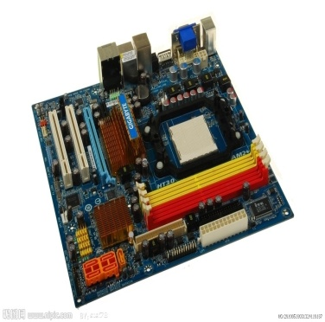
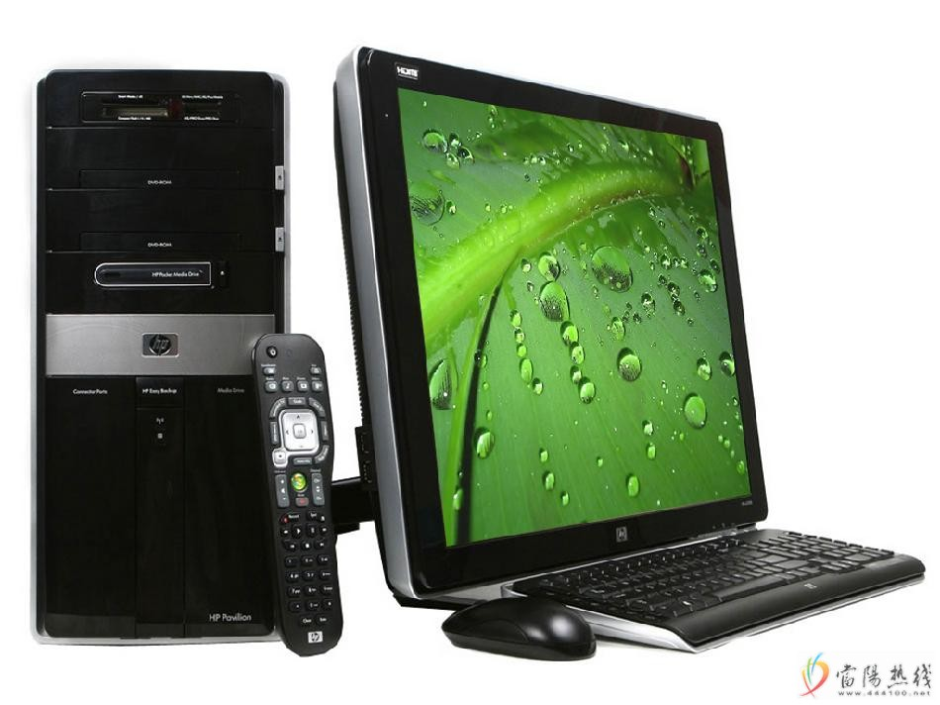
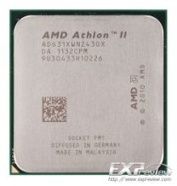
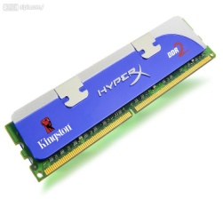
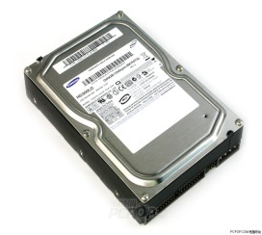
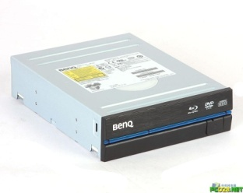

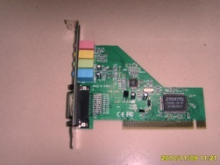
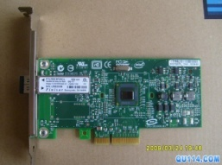
What is an Operating System
A manager: One program running at all times.
CPU/Memory/File/I/O Devices Management
Operating system goals
  convenient to use.
  Use the computer in an efficient manner.
Notes:
操作系统就是在用户和计算机硬件之间建立一个桥梁
实现目标位:执行用户进程，让计算机系统更容易的使用

Slide 4
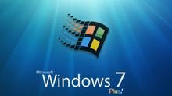


Types of Operating Systems
Real-time Operating System
Multi/Single-user Operating Systems
Multi/Single-tasking Operating Systems
Distributed Operating System
3 Years, 2000 Persons
25 functional Teams
Time-Sharing
Mobile
Operating System

Slide 5

4 Components of a Computer System

Slide 6

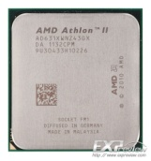

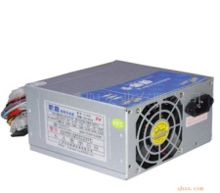





Computer VS Person
Operating System→?
Monitor Simple Batch Modern OS
40`s 50`s (DOS/Windows/Unix)

Slide 7
Why should study?
Help you understand important and hard OS concepts
The Concepts/Architectures/Algorithms are very traditional and classical

Slide 8
How to study?
Lectures do not cover everything
  Not all questions in homework or exams are from lectures
Students responsibility
  Attend lectures
  Read textbooks
  Homework, Experiments

Slide 9
Chapter 1: Introduction
Computer-System Organization
Operating-System Operations
Batched OS
Multiprogrammed OS
Time-sharing OS
Real-Time Systems

Slide 10

Computer System Organization
  One or more CPUs, device controllers connect through common bus providing access to shared memory
Notes:
系统组成包括外设，接口，以及CPU，主存等

Slide 11
Computer-System Operation
I/O devices and CPU execute concurrently
Each device controller is in charge of a particular device type
Each device controller has a local buffer
CPU moves data from/to main memory to/from local buffers
I/O is from the device to local buffer of controller
Device controller informs CPU that it has finished its operation by causing an interrupt
Notes:
中断向量
缓冲区间

Slide 12
Concepts of Interrupts
Current
Interrupt source
Interrupt
Interrupt system
Interrupt register
Break Point & Recovery Point
Interrupt service routine
Interrupt vector: contains the addresses of all the service routines
Interrupt service routine
BP
RP
PC
PSW
CSPS … TNZVC
PDP-11
Trap: A software-generated interrupt caused by an error or a user request

Slide 13
Common Functions of Interrupts
through the interrupt vector, transfers control to interrupt service routine
Save the address of the interrupted instruction
Incoming interrupts are disabled
Current
Interrupt service routine
BP
RP

Slide 14
Interrupt Handling
OS preserves the state of the CPU
Determines which type of interrupt has occurred:
  polling
  vectored interrupt system
Separate segments of code determine what action should be taken for each type of interrupt

Slide 15
I/O Structure
After I/O starts, control returns to program, two ways:
Synchronous: Only upon I/O completion
  Wait instruction idles the CPU
  Wait loop
Asynchronous: Without waiting for I/O completion
  System call
  Device-status table

Slide 16

Two I/O Methods
Synchronous
Asynchronous

Slide 17

Device-Status Table

Slide 18
Direct Memory Access Structure
Used for high-speed I/O devices able to transmit information at close to memory speeds
Device controller transfers blocks of data from buffer storage directly to main memory without CPU intervention
Only one interrupt is generated per block, rather than the one interrupt per byte

Slide 19
Mainframe Systems
Batch OS
Multiprogrammed OS
Time-sharing OS

Slide 20
Batch OS
Batching
  Programmers submitted jobs in a job control languages (shell…)
  Operators batched together jobs with similar needs and ran them as a group
Drawbacks
  Fast CPU and slow I/O devices
  Not interactive

Slide 21

Multiprogrammed OS
Multiprogrammed OS
  Keeping many jobs in memory
  Job scheduling for selecting a job to load into memory
  CPU scheduling for selecting which job to run
  Memory management
  Protection

Slide 22
State Switch of Job
Process Scheduling
Job Scheduling
CPU
Terminated
Submited
Reserved
P1
P2
P3
I/O
Running
Swap Area
Mediumterm Scheduling
Ready
Waiting

Slide 23
Simple/Multiprogrammed System
Job
Monitor
I/O
Job A
Job B
Scheduling
Type I/O
Disk I/O

Slide 24
Advantages of Multiprogrammed
(1) Improve CPU utilization
(2) Improve memory and I/O devices utilization
(3) Increase system throughput
Characteristics of Multiprogrammed System:
  Multiprogramming
  Unordered
  Scheduling

Slide 25
Time-sharing OS
Job1
User1
CPU
Job2
User2
Mem
Jobn
Usern
Memory sharing + time sharing → multiprogramming + interaction

Slide 26
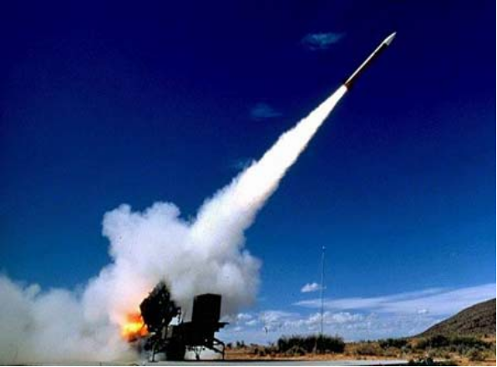
Real-Time Systems
Used in a dedicated application
  scientific experiments
  medical imaging systems
  industrial control systems
  some display systems
Well-defined fixed-time constraints
Real-Time systems may be either hard or soft real-time

Slide 27
Real-Time Systems
Hard real-time
  Secondary storage limited or absent
  Data stored in memory, or read-only memory (ROM)
Soft real-time
  Limited utility in industrial control of robotics
  Useful in multimedia, virtual reality,etc

Slide 28
Operating-System Operations
Dual-mode operation allows OS to protect itself and other system components
  User mode and kernel mode
  Mode bit provided by hardware
    to distinguish when system is running user code or kernel code
    Some instructions designated as privileged
    System call changes mode to kernel, return from call resets it to user

Slide 29

Transition from User to Kernel Mode

Slide 30
Storage Management——Caching
Performed at many levels in a computer (in hardware, operating system, software)
Information in use copied from slower to faster storage temporarily
Faster storage (cache) checked first to determine if information is there
  If it is, information used directly from the cache
  If not, data copied to cache and used there
Cache smaller than storage being cached
  Cache size and replacement policy

Slide 31

Performance of Various Levels of Storage
SRAM-http://baike.baidu.com/view/423438.htm
CMOS-http://baike.baidu.com/view/22318.htm

Slide 32

Migration of Integer A from Disk to Register
Multitasking environments must be careful to use most recent value
Multiprocessor environment must provide cache coherency in hardware

Slide 33
End of Chapter 1
Exercises
P36-P38
  1.10
  1.11
  1.13

