Slide 1
Chapter 4: Threads
Multithreading Models
Threading Issues
Windows XP Threads
Java Threads

Slide 2

Single and Multithreaded Processes

Slide 3
Benefits
Responsiveness
  Only part of the process will be blocked
Resource Sharing
  Memory & resources of the process
Economy
  Allocating memory & resources for a process is costly
Utilization of MP Architectures
  Multiple thread can run on multiple processors, increases concurrency

Slide 4
User Threads & Kernel Threads
Thread management done by user-level threads library
Three primary thread libraries:
  POSIX Pthreads
  Win32 threads
  Java threads
Supported by the Kernel
Examples
  Windows XP/2000
  Solaris
  Linux
  Tru64 UNIX
  Mac OS X

Slide 5
Multithreading Models
Many-to-One
One-to-One
Many-to-Many

Slide 6

Many-to-One
Many user-level threads mapped to single kernel thread
  Thread management is done by the thread library in user mode, it is efficient.
  If a thread makes a blocking system call, the entire process will block.
  Multiple threads are unable to run in parallel on MPs.
Examples:
  Solaris Green Threads

Slide 7

One-to-One
Each user-level thread maps to kernel thread
  Provides more concurrency
  Multiple threads run in parallel on MPs
  Drawback
    Creating a user thread requires creating a corresponding kernel thread
    burdens the performance
Examples:Windows NT/XP/2000,Linux,Solaris 9

Slide 8

Many-to-Many Model
Allows many user threads to be mapped to many kernel threads
Allows the OS to create sufficient kernel threads
  Specific to a particular application
  Specific to a particular machine
Create as many as necessary threads
Run parallel on MPs
When a thread is blocking, another can be scheduled

Slide 9
Windows XP Threads
Implements the one-to-one mapping
Each thread contains
  A thread id
  Register set
  Separate user and kernel stacks
  Private data storage area
The register set, stacks, and private storage area are known as the context of the threads
The primary data structures of a thread include:
  ETHREAD (executive thread block)
  KTHREAD (kernel thread block)
  TEB (thread environment block)

Slide 10
Java Threads
Fundamental model of program execution
Managed by the JVM, provided with API
Java threads may be created by:
  Extending Thread class
  Implementing the Runnable interface
Creating a Thread object doesn’t create the new thread, rather, it is start() method:
  Allocates memory & initializes a new thread in the JVM
  Calls run() method to make it eligible to be run by JVM

Slide 11
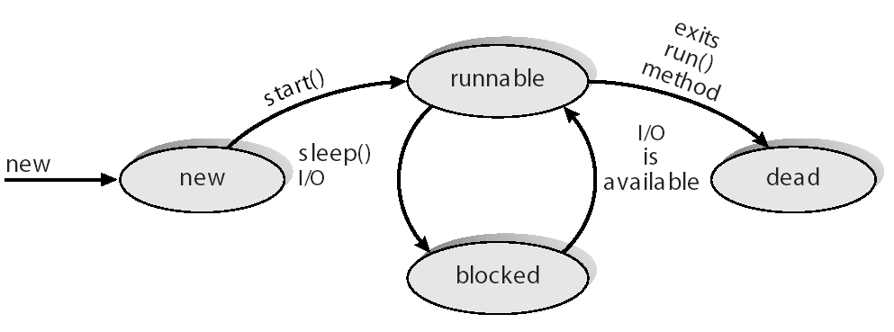
Java Thread States

Slide 12
Exercises
P146-P149
  4.2
  4.3
  4.4
Project3:Matrix Multiplication
  End of Chapter 4

