Slide 1
Chapter 6:
Process Synchronization
The Critical-Section Problem
Synchronization Hardware
Semaphores
Classic Problems of Synchronization
Monitors

Slide 2
Background
Concurrent access to shared data => inconsistency
Maintaining data consistency => orderly execution of cooperating processes
solution to the consumer-producer problem:
  integer count = number of full buffers
  Initially, count is set to 0
  incremented by the producer
  decremented by the consumer

Slide 3
Producer
while (true) {
/*produce an item and put in nextProduced*/
while (count == BUFFER_SIZE)
; // do nothing
buffer [in] = nextProduced;
in = (in + 1) % BUFFER_SIZE;
count++;
}

Slide 4
Consumer
while (true) {
while (count == 0) ; // do nothing
nextConsumed = buffer[out];
out = (out + 1) % BUFFER_SIZE;
count--;
/* consume the item */
}

Slide 5
Solution to Critical-Section Problem
Entry section
Critical section
Exit section
Remainder section

Slide 6
Solution to Critical-Section Problem
3 requirements to the CS problem:
Mutual Exclusion
Progress
Bounded Waiting

Slide 7
Peterson’s Solution
2 process solution
Assume LOAD & STORE instructions are atomic
The 2 processes share 2 variables:
  int turn;
  Boolean flag[2];
The variable turn indicates whose turn it is to enter the critical section.
The flag array is used to indicate if a process is ready to enter the critical section
flag[i] = true implies that process P_{i} is ready

Slide 8
Algorithm for Process P_{i}
while (true) {
flag[i] = TRUE;
turn = j;
while ( flag[j] && turn == j);
CRITICAL SECTION
flag[i] = FALSE;
REMAINDER SECTION
}

Slide 9
Synchronization Hardware
Many systems provide hardware support for critical section code
Uniprocessors – disable interrupts
  Currently running code would execute without preemption
  Inefficient on multiprocessor systems
Modern machines provide hardware instructions
  Test and Set
  Swap

Slide 10
TestAndSet Instruction
Definition:
boolean TestAndSet (boolean *target)
{
boolean rv = *target;
*target = TRUE;
return rv:
}

Slide 11
Solution using TestAndSet
Shared boolean variable lock, initialized to false
Solution:
while (true) {
while ( TestAndSet (&lock ))
; /* do nothing
// critical section
lock = FALSE;
// remainder section
}

Slide 12
Semaphore
Less complicated
Do not require busy waiting
Semaphore S – integer variable
Two standard operations modify S
  wait()
  signal()
  Originally called:
  P() from the Dutch proberen, “to test”
  V() from the Dutch verhogen, “to increment”

Slide 13
Semaphore (cont.)
Can only be accessed via two operations
  wait (S) {
  while S <= 0
  ; // no-op
  S--;
  }
  signal (S) {
  S++;
  }

Slide 14
Semaphore as
General Synchronization Tool
Counting semaphore
  integer value
Binary semaphore
  integer value range only between 0 and 1
  can be simpler to implement
  Also known as mutex locks

Slide 15
Semaphore as
General Synchronization Tool
Provides mutual exclusion
  Semaphore S; // initialized to 1
  wait (S);
  Critical Section
  signal (S);

Slide 16
Semaphore Implementation with no Busy waiting
Each semaphore is associated with an waiting queue
Each entry in a waiting queue has two data items:
  value
  pointer to next record in the list
Two operations:
  block – place the process invoking the operation on the appropriate waiting queue
  wakeup – remove one of processes in the waiting queue and place it in the ready queue

Slide 17
Semaphore Implementation with no Busy waiting (Cont.)
Definition of semaphore:
typedef struct{
int value;
struct process *list;
} semaphore;
Implementation of wait:
wait (semaphore *S){
S->value--;
if (S->value < 0) {
add this process to S->list
block();
}
}

Slide 18
Semaphore Implementation with no Busy waiting (Cont.)
Implementation of signal:
Signal (semaphore *S){
S->value++;
if (S->value <= 0) {
remove a process P from S->list
wakeup(P);
}
}
May have negative semaphore values

Slide 19
Deadlock and Starvation
Deadlock
Let S and Q be two semaphores initialized to 1
P₀ P₁
wait (S); wait (Q);
wait (Q); wait (S);
... …
signal (S); signal (Q);
signal (Q); signal (S);
Starvation

Slide 20
Classic Problems of Synchronization
Bounded-Buffer Problem
Readers and Writers Problem
Dining-Philosophers Problem

Slide 21
Bounded-Buffer Problem
N buffers, each can hold one item
Semaphore mutex initialized to the value 1
Semaphore full initialized to the value 0
Semaphore empty initialized to the value N

Slide 22
Bounded Buffer Problem (Cont.)
The structure of the producer process
while (true) {
// produce an item
wait (empty);
wait (mutex);
// add the item to the buffer
signal (mutex);
signal (full);
}

Slide 23
Bounded Buffer Problem (Cont.)
The structure of the consumer process
while (true) {
wait (full);
wait (mutex);
// remove an item from buffer
signal (mutex);
signal (empty);
// consume the removed item
}

Slide 24
Readers-Writers Problem
A data set is shared among a number of processes
  Readers – only read the data set
  Writers – can both read and write
  Allow multiple readers to read at the same time
  Only 1 writer can access the data simultaneously

Slide 25
Readers-Writers Problem
Problems
  1st readers-writers problem
    No reader kept waiting unless a writer has already obtained permission to use the shared object
    i.e., No reader should wait for other readers to finish simply because a writer is waiting
  2nd readers-writers problem
    Once a writer is ready, that writer performs its write as soon as possible
    i.e. If a writer is waiting, no new readers may start

Slide 26
Readers-Writers Problem
Starvation
  1st case, writers may starve
  2nd case, readers may starve
Solution to starvation
Shared Data
  Data set
  Semaphore mutex =1, ensure readcount is updated
  Semaphore wrt = 1
  Integer readcount initialized to 0

Slide 27
Readers-Writers Problem (Cont.)
Reader process
while (true) {
wait (mutex) ;
readcount ++ ;
if (readcount==1) wait (wrt) ;
signal (mutex)
// reading is performed
wait (mutex) ;
readcount - - ;
if (readcount==0) signal (wrt) ;
signal (mutex) ;
}
Writer process
while (true) {
wait (wrt) ;
//writing
signal (wrt) ;
}

Slide 28
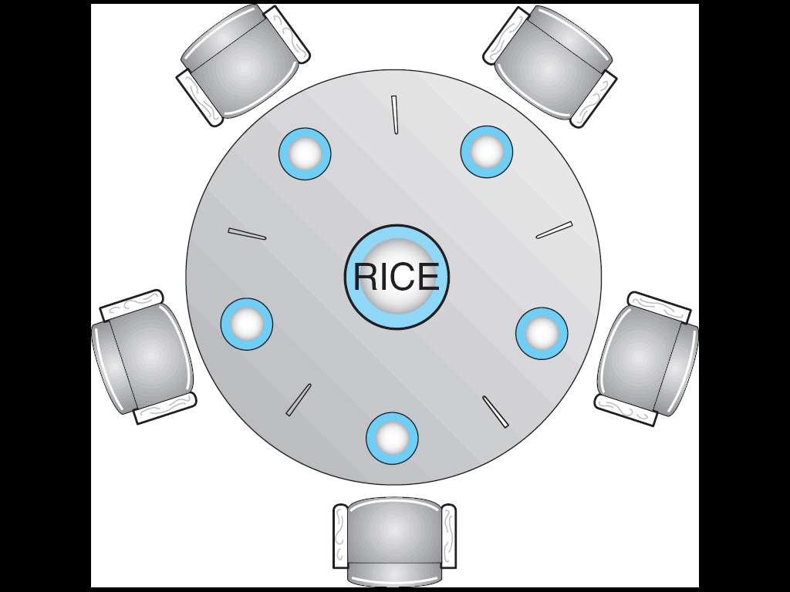
Dining-Philosophers Problem

Slide 29
Dining-Philosophers Problem
5 philosophers spend their lives thinking & eating
Shared data
  Bowl of rice (data set)
  Semaphore chopstick [5] initialized to 1
When a philosopher gets hungry, she tries to pick up 2 chopsticks
She may pick up only 1 chopsticks at a time
She can’t pick up a chopstick in the hand of a neighbor
When grabbed 2 chopsticks can she eat
After eating, she puts down chopsticks & thinking

Slide 30
Dining-Philosophers Problem (Cont.)
The structure of Philosopher i:
    While (true) {
    wait ( chopstick[i] );
    wait ( chopStick[ (i + 1) % 5] );
    // eat
    signal ( chopstick[i] );
    signal (chopstick[ (i + 1) % 5] );
    // think
    }

Slide 31
Dining-Philosophers Problem (Cont.)
Deadlock
Deadlock prevention:
  Allow at most 4 philosophers sitting at the table
  Allow a philosopher to pick up her chopsticks only if both chopsticks are available
  Asymmetric solution
    Odd philosopher picks up first her left chopsticks and then her right chopsticks
    Even philosopher picks up first her right chopsticks and then her left chopsticks
Guard against starvation

Slide 32
Monitors
A high-level abstraction for process synchronization
Only one active process within the monitor at a time
    monitor monitor-name
    {
    // shared variable declarations
    procedure P1 (…) { …. }
    …
    procedure Pn (…) {……}
    Initialization code ( ….) { … }
    …
    }
    }

Slide 33

Monitor with Condition Variables

Slide 34
Exercises
  6.1
  6.3
  6.9
Project4:Producer-Consumer Problem
  End of Chapter 6

