Slide 1
Chapter 8: Memory Management
Swapping
Contiguous Memory Allocation
Paging
Structure of the Page Table
Segmentation

Slide 2
Background
Main memory and registers are only storage CPU can access directly
Register (one CPU clock)
Main memory (several CPU clocks)
Cache (between main memory and CPU registers)
Protection of memory required to ensure correct operation (How?)

Slide 3
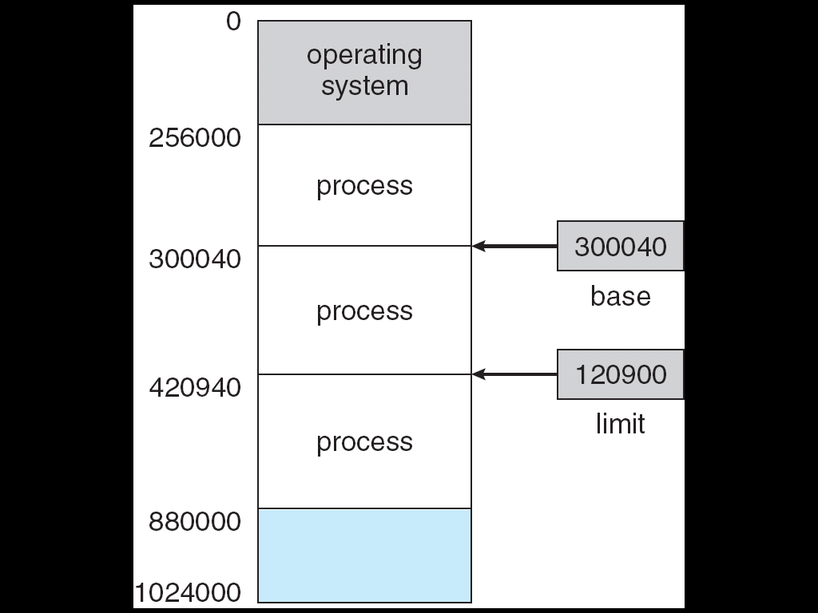
Base and Limit Registers
A pair of base and limit registers define the logical address space

Slide 4
Binding of Instructions and Data to Memory
Address binding (instructions and data):
  symbolic addresses to relocatable addresses
  Relocatable addresses to absolute addresses
  Compile time
    absolute code
  Load time
    relocatable code
  Execution time
    If a process can be moved, delayed until run time
    need hardware support for address maps (e.g., base and limit registers)

Slide 5

Multistep Processing of a User Program
.c
.obj
.exe
Windows 作为DLL实现文件:
ActiveX 控件 (.ocx) 文件；
控制面板 (.cpl) 文件
设备驱动程序 (.drv) 文件
…
.h / .dll
Loadlibrary
GetProcAddress

Slide 6
Logical vs. Physical Address Space
Logical address (virtual address)
  generated by the CPU
Physical address
  address seen by the memory unit
Logical and physical addresses are the same
  compile-time address-binding scheme
  load-time address-binding scheme
Logical and physical addresses differ
  execution-time address-binding scheme

Slide 7
Memory-Management Unit (MMU)
Hardware device that maps virtual to physical address
Relocation register (base register) is added to every address generated by a user process at the time it is sent to memory
The user program deals with logical addresses; it never sees the real physical addresses

Slide 8

Dynamic relocation using a relocation register

Slide 9
Dynamic Loading
Routine is not loaded until it is called
Better memory-space utilization
Useful when large amounts of code are needed to handle infrequently occurring cases
When a routine calls another
  checks if that routine has been loaded
  If not, the relocatable linking loader is called
Implemented through program design
No special support from the operating system is required

Slide 10
Dynamic Linking
Linking postponed until execution time vs. Static Linking
useful for system libraries, saving disk & memory
  E.g. language subroutine libraries
Stub - included in the image for library reference
  Small piece of code
    To locate the memory-resident library routine
    To load the library if it is not in the memory
  Stub replaced with the address of the routine

Slide 11

Contiguous Allocation
Main memory usually divided into two partitions:
  Resident operating system (usually low memory with interrupt vector)
  User processes (usually high memory)
Relocation registers used to protect memory access
  MMU maps logical address dynamically

Slide 12
Contiguous Allocation (Cont.)
Multiple-partition allocation
  Divide memory into n partitions
  Hole – available memory block
  Allocate memory from a hole large enough to accommodate the new arrival process from input queue
  Information maintained by OS
  a) allocated partitions b) free partitions (hole)
OS
OS
OS
OS
process 5
process 5
process 5
process 5
process 9
process 9
process 8
process 10
process 2
process 2
process 2
process 2

Slide 13
Dynamic Storage-Allocation Problem
How to satisfy a request of size n from a list of free holes
First-fit: Allocate the first hole that is big enough
Best-fit: Allocate the smallest hole that is big enough; must search entire list
  Produces the smallest leftover hole
Worst-fit: Allocate the largest hole
  Produces the largest leftover hole
First-fit and best-fit better than worst-fit in terms of speed and storage utilization

Slide 14
For JOB A, 18K; Allocation Comparing
0
0
0
OS
OS
OS
20K
20K
20K
30K
30K
30K
100K
100K
100K
IN USE
IN USE
IN USE
20K
20K
20K
IN USE
IN USE
IN USE
160K
160K
160K
5K
5K
5K
IN USE
IN USE
IN USE
210K
210K
210K
46K
46K
46K
256KB-1
256KB-1
256KB-1
（a）FIRST FIT
（b）BEST FIT
（c）WORST FIT

Slide 15
Fragmentation
External Fragmentation
  There is enough total memory space to satisfy a request, but the available spaces are not contiguous
  50% rule – for N allocated blocks, another 0.5N fragmented
Internal Fragmentation
  Overhead to keep track of little holes may be larger than the hole itself
  Break the physical memory into fixed-sized to blocks & allocate memory in units of block size

Slide 16
Fragmentation
Reduce external fragmentation by compaction
  Shuffle memory contents to place all free memory together in one large block
    Compaction is possible only if relocation is dynamic, and is done at execution time
    Move processes to an end
  Noncontiguous memory allocation
    Paging & segmentation

Slide 17
Paging
Logical address space can be noncontiguous
Frame - fixed-sized physical memory block
  size is power of 2, from 512 to 16M bytes, defined by hardware.
Page -logical memory block, same size with frame
Backing store is divided into the same size blocks
Keep track of all free frames
A page table to translate logical to physical addresses
Internal fragmentation

Slide 18
Address Translation Scheme
Address generated by CPU is divided into:
  Page number (p) – an index into a page table which contains base address of each page
  Page offset (d) – combined with base address to define the physical address
  For given logical address space 2^{m} and page size 2^{n}
page number
page offset
p
d
m - n
n

Slide 19

Paging Hardware

Slide 20

Paging Example

Slide 21

Free Frames
Before allocation
After allocation

Slide 22
Implementation of Page Table
Page table is kept in main memory
Page-table base register (PTBR)
Page-table length register (PTLR)
Data/instruction access requires two memory accesses.
  One for the page table and one for the data/instruction.
Translation look-aside buffers (TLBs) or Associative memory
  Each entry in the TLB contains: A key and a value

Slide 23
Associative Memory
Associative memory – parallel search
Address translation (p, d)
  If p is in associative register, get frame # out
  Otherwise get frame # from page table in memory
Page #
Frame #

Slide 24

Paging Hardware With TLB

Slide 25
Effective Access Time
Associative Lookup = ε time unit
Assume memory cycle time is 1 microsecond
Hit ratio = α
  percentage of times that a page number is found in the associative registers
Effective Access Time (EAT)
EAT = (1 + ε) α + (2 + ε)(1 – α)
= 2 + ε – α

Slide 26
Memory Protection
Memory protection implemented by associating protection bit with each frame
  Provide protection
    read-only, read-write, or execute-only
Valid-invalid bit attached to each entry in the page table:
  “valid” - the associated page is in the process’ logical address space, and is thus a legal page
  “invalid” - the page is not in the process’ logical address space

Slide 27

Valid (v) or Invalid (i) Bit In A Page Table

Slide 28
Shared Pages
Shared code
  One copy of read-only (reentrant, pure) code shared among processes
    text editors, compilers, window systems
  Shared code must appear in same location in the logical address space of all processes
  Can never be changed during execution
Private code and data
  Each process keeps a separate copy of the code and data
  The pages for the private code and data can appear anywhere in the logical address space

Slide 29
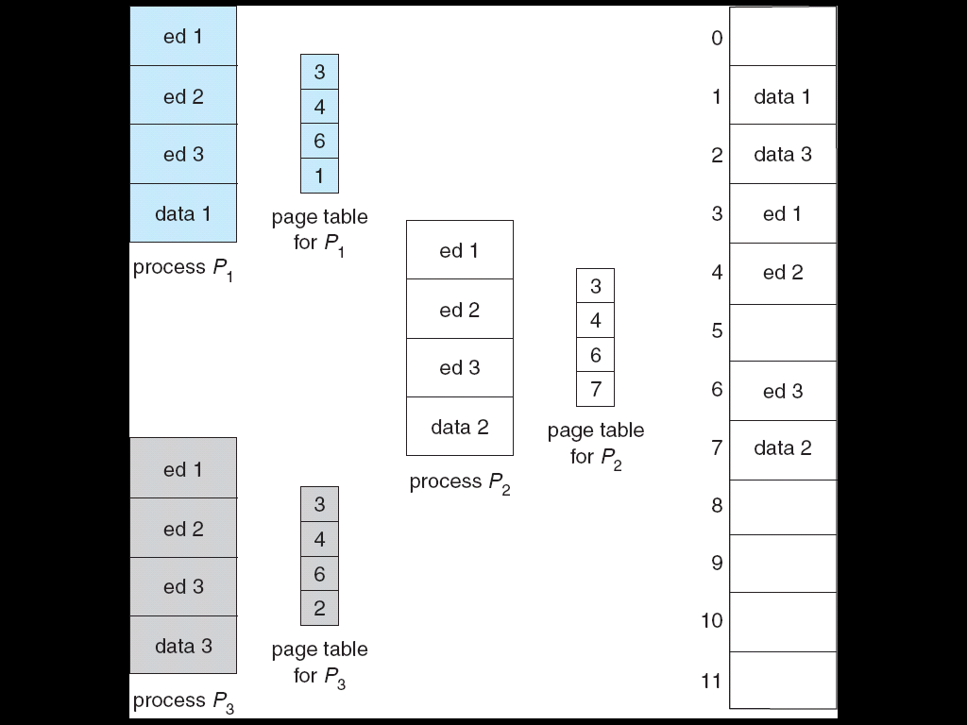
Shared Pages Example

Slide 30
Structure of the Page Table
Hierarchical Paging
Hashed Page Tables
Inverted Page Tables

Slide 31

Hierarchical Page Tables
Break up the logical address space into multiple page tables
A simple technique is a two-level page table

Slide 32
Two-Level Paging Example
A logical address (32-bit) is divided into:
  a page number consisting of 22 bits
  a page offset consisting of 10 bits (1K page size)
The page number is divided into:
  a 12-bit page number
  a 10-bit page offset
  where p₁ is an index into the outer page table, and p₂ is the displacement within the page of the outer page table
p₁
p₂
d
12
10
10
page number
page offset

Slide 33

Address-Translation Scheme

Slide 34


Three-level Paging Scheme

Slide 35
Hashed Page Tables
Common in address spaces > 32 bits
Hash table contains a linked list of element
Each element consists:
  The virtual page no.
  The value of the mapped page frame
  A pointer to the next element in the linked list
Algorithm:
  The virtual page no. is hashed into a page table
  Virtual page no. is compared in this chain searching for a match
  If a match is found, the corresponding physical frame is extracted

Slide 36

Hashed Page Table

Slide 37
Inverted Page Table
One entry for each real page of memory
  consists of the virtual address of the page stored in that real memory location
  with information about the process owns that page
Benefits:
  Decreases memory needed to store each page table
  Only one page table in the system
Drawbacks:
  Increases time needed to search the table when a page reference occurs
  Use hash table to limit the search to one — or at most a few — page-table entries

Slide 38

Inverted Page Table Architecture

Slide 39
Segmentation
MM scheme that supports user view of memory
A program is a collection of segments
A segment is a logical unit, with name & length such as:
main program,
procedure,
function,
method,
object,
local variables, global variables,
stack,
symbol table, arrays

Slide 40

User’s View of a Program

Slide 41
Logical View of Segmentation
1
1
4
2
3
4
2
3
user space
physical memory space

Slide 42
Segmentation Architecture
Logical address consists of a two tuple:
<segment-number, offset>,
Segment table – maps two-dimensional physical addresses; each entry has:
  Segment base – contains the starting physical address where the segments reside in memory
  Segment limit – specifies the length of the segment
Segment-table base register (STBR) points to the segment table’s location in memory
Segment-table length register (STLR) indicates number of segments used by a program;
segment number s is legal if s < STLR

Slide 43

Segmentation Hardware

Slide 44

Example of Segmentation
<2, 53>=4353
<3, 852>=4052
<0,1222>, trap to the OS

Slide 45
Segmentation Architecture (Cont.)
Protection
  With each entry in segment table associate:
    validation bit = 0 ⇒ illegal segment
    read/write/execute privileges
Protection bits associated with segments; code sharing occurs at segment level
Since segments vary in length, memory allocation is a dynamic storage-allocation problem
A segmentation example is shown in the following diagram

Slide 46
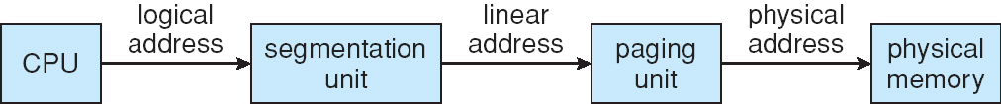
Example: The Intel Pentium
Supports segmentation & segmentation with paging
CPU generates logical address
  Given to segmentation unit
    Which produces linear addresses
  Linear address given to paging unit
    Which generates physical address in main memory
    Paging units form the equivalent of MMU

Slide 47
Intel Pentium Segmentation
Allows segments ≤ 4GB
16k segments/process
  8k private, kept in local descriptor table (LDT)
  8k shared, kept in the global descriptor table (GDT)
  Entry of LDT &GDT consists of 8-byte segment descriptor
    Segment Base
    Segment limit
Logical address is a pair (Selector, Offset)
16 bit selector:
Segment no. | GDT/LDT | protection
s | g | p
13 | 1 | 2

Slide 48

Intel Pentium Segmentation

Slide 49

Pentium paging
Page Size flag 0/1 decides a page of 4kb/4MB
4 4kb, 2-level scheme, 32 linear address:
  10 high-order bits reference an entry in the outermost page table
  10 innermost bits indexes inner page table
  12 low-order bits refer to the offset in the 4kb page
4 4MB, 22 low-order bits refer to the offset

Slide 50
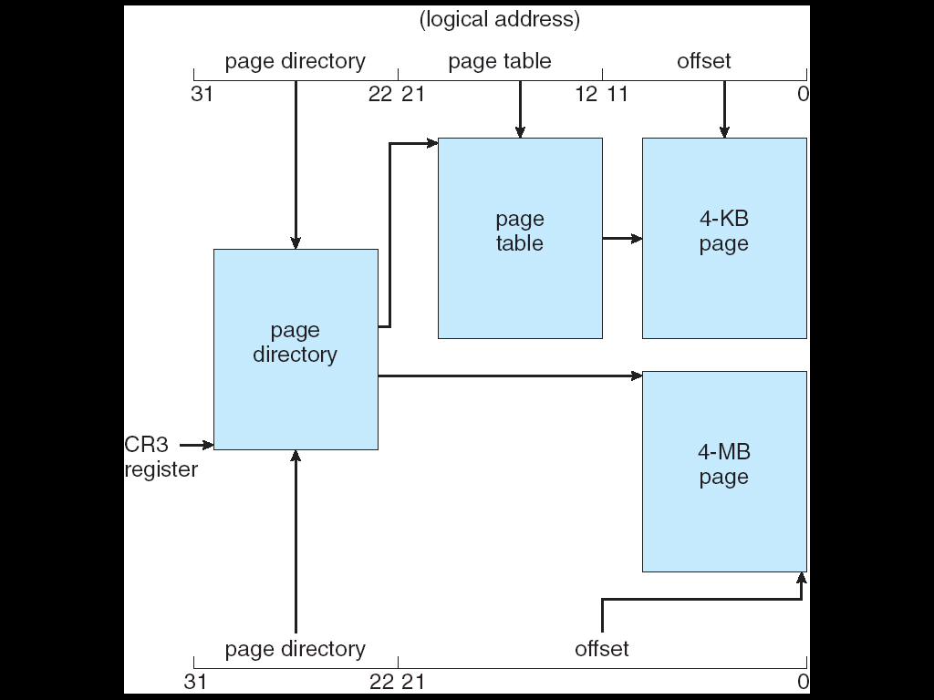
Pentium Paging Architecture

Slide 51
Exercises
  8.1
  8.9
  8.12
  End of Chapter 8

