Slide 1
Chapter 9: Virtual Memory
Demand Paging
Page Replacement
Allocation of Frames
Thrashing

Slide 2
Background
Virtual memory
  Separation of user logical memory from physical memory
  Only part of the program in memory
  Logical address space >= physical address space
In many cases, the entire program not needed:
  Error code
  Arrays, lists & tables allocated more than need
  Certain options & features of a program rarely used

Slide 3
Background
Benefits:
  Programs can be larger than physical memory
  Programmers needn’t care about memory limitations
  More programs could be run simultaneously
  Less I/O needed, each user program would run faster
  Easy to share files among several processes
  More efficient process creation
Drawbacks:

Slide 4
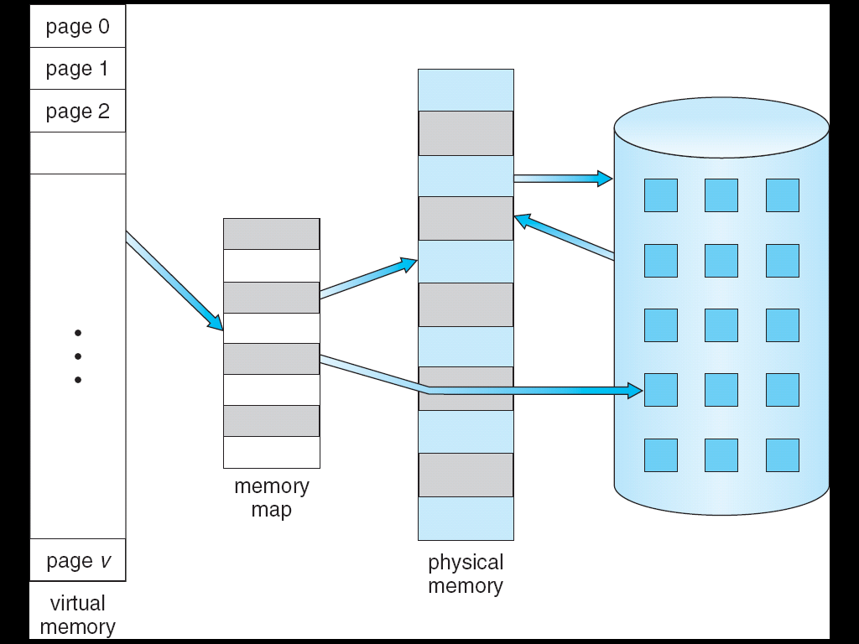
Virtual Memory That is Larger Than Physical Memory
⇒

Slide 5

Shared Library Using Virtual Memory
Library can be shared
Communication
Fork() system call

Slide 6
Demand Paging
Paging on demand
  Bring a page into memory only when it is needed
  Less I/O needed
  Less memory needed
  Faster response
  More users
Lazy swapper
  never swaps a page into memory unless page will be needed
  Swapper that deals with pages is a pager

Slide 7
Valid-Invalid Bit
A valid–invalid bit for each page table entry
  All are set to i initially
  v ⇒ in-memory & legal
  i ⇒ not-in-memory⇒ page fault when referenced
  invalid reference ⇒ abort
    not-in-memory ⇒ bring to memory
Frame #
valid-invalid bit
v
v
v
v
i
….
i
page table

Slide 8
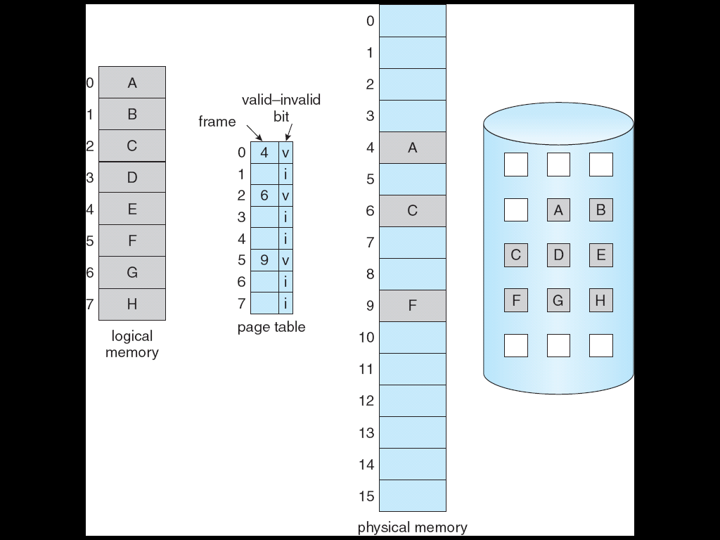
Page Table When Some Pages
Are Not in Main Memory

Slide 9
Page Fault
page fault
  First reference to a page will trap to operating system:
Invalid reference ⇒ abort
Valid but not in memory
  Find a free frame (from the free frame list)
  Swap page into frame
  Reset page tables
  Set validation bit = v
  Restart the instruction that caused the page fault

Slide 10

Steps in Handling a Page Fault

Slide 11
Page Fault (Cont.)
Restart instruction
  C=A+B
  1. fetch the instruction
  2. fetch A
  3. fetch B
  4. Add A and B
  5. Store the sum in C
  (C not in memory)
Problems can be ignored
  Repetition
  1 instruction cause N page faults

Slide 12
Performance of Demand Paging
Page Fault Rate 0 ≤ p ≤ 1.0
  if p = 0 no page faults
  if p = 1, every reference is a fault, Pure demand paging
Effective Access Time (EAT)
EAT = (1 – p) x memory access
+ p x page fault time (page fault overhead
+ swap page out (optional)
+ swap page in
+ restart overhead)

Slide 13
Demand Paging Example
Memory access time = 200 nanoseconds
Average page-fault service time = 8 milliseconds
EAT = (1 – p) x 200 + p (8 milliseconds)
= (1 – p x 200 + p x 8,000,000
= 200 + p x 7,999,800
If one access out of 1,000 causes a page fault, then
EAT = 8.2 microseconds.
This is a slowdown by a factor of 40!!

Slide 14
What happens if there is no free frame?
Page replacement
  find some page in memory, but not really in use, swap it out
  algorithm
  performance – an algorithm which will result in minimum number of page faults
Same page may be brought into memory several times

Slide 15
Page Replacement
Prevent over-allocation of memory
  Modify page-fault service routine to include page replacement
modify (dirty) bit
  reduce overhead of page transfers – only modified pages are written to disk
Separation between logical memory and physical memory
  large virtual memory can be provided on a smaller physical memory
Frame-allocation, page-replacement algorithms are needed to implement demand paging

Slide 16

Need For Page Replacement

Slide 17
Basic Page Replacement
Find the location of the desired page on disk
Find a free frame:
- If there is a free frame, use it
- If there is no free frame, use a page replacement algorithm to select a victim frame
Bring the desired page into the (newly) free frame; update the page and frame tables
Restart the process

Slide 18

Page Replacement

Slide 19
Page Replacement Algorithms
Criteria: lowest page-fault rate
Evaluate algorithm by
  running it on a particular string of memory references (reference string)
  computing the number of page faults on that string
In all our examples, the reference string is
1, 2, 3, 4, 1, 2, 5, 1, 2, 3, 4, 5

Slide 20

Graph of Page Faults
Versus The Number of Frames
Expected

Slide 21
First-In-First-Out (FIFO)
Reference string: 1, 2, 3, 4, 1, 2, 5, 1, 2, 3, 4, 5
3 frames (3 pages can be in memory at a time per process)
1
2
3
4
1
2
5
1
2
3
4
5
1
9 page faults
1
4
5
2
2
1
3
3
3
2
4

Slide 22
FIFO (cont.)
Reference string: 1, 2, 3, 4, 1, 2, 5, 1, 2, 3, 4, 5
4 frames
Belady’s Anomaly: more frames ⇒ more page faults
1
2
3
4
1
2
5
1
2
3
4
5
1
1
5
4
10 page faults
2
2
1
5
3
3
2
4
4
3

Slide 23

FIFO Illustrating Belady’s Anomaly

Slide 24
Optimal Algorithm
Replace page not be used for longest period of time
4 frames example
How do you know this?
Used for measuring how well your algorithm performs
1
2
3
4
1
2
5
1
2
3
4
5
1
4
6 page faults
2
3
4
5

Slide 25
Least Recently Used (LRU)
Reference string:
Counter implementation
  Every page entry has a counter; every time page is referenced through this entry, copy the clock into the counter
  When a page needs to be changed, look at the counters to determine which are to be changed
1
2
3
4
1
2
5
1
2
3
4
5
1
1
1
5
2
2
2
3
5
4
8 Page faults
4
3

Slide 26
LRU Algorithm (Cont.)
Stack implementation – keep a stack of page numbers in a doubly linked list:
  Page referenced:
    move it to the top
    requires 6 pointers to be changed at worst
    Each update is a little more expensive
    But no search for replacement

Slide 27

Use Of A Stack to Record
The Most Recent Page References

Slide 28
LRU Approximation Algorithms
Reference bit
  HW associate with each page a bit, initially = 0
  When page is referenced, bit is set to 1
  Replace the one which is 0 (if one exists)
    We do not know the order, however
Additional reference bit algorithm
  Record each entry of a page table entry with a 8-bit byte
  At an regular interval, a timer interrupt transfers the control to the OS
  The bits shift right, values:
    00000000
    11111111
    01100111
    11001000

Slide 29
LRU Approximation Algorithms
Second chance
  Need reference bit
  Clock replacement
  If page to be replaced (in clock order) has reference bit = 0, then replace
  If page to be replaced has reference bit = 1 then:
    set reference bit 0
    leave page in memory
    replace next page (in clock order), subject to same rules

Slide 30

Second-Chance (clock)
Page-Replacement Algorithm

Slide 31
Counting Algorithms
Keep a counter of the number of references that have been made to each page
LFU Algorithm
  replaces page with smallest count
  Problem: heavily used initially, then never used
    Shift the counts right by 1 bit to decay average usage count
MFU Algorithm
  the page with the smallest count was probably just brought in and has yet to be used

Slide 32
Allocation of Frames
Process needs minimum number of pages, cause
  Page number ↓ =>process execution ↓
  Enough to hold all pages an instruction references
    E.g. indirect addressing
E.g. IBM 370 – 6 pages to handle MVC instruction:
  instruction is 6 bytes, might straddle 2 pages
  2 pages to handle from
  2 pages to handle to
Two major allocation schemes
  fixed allocation
  priority allocation

Slide 33
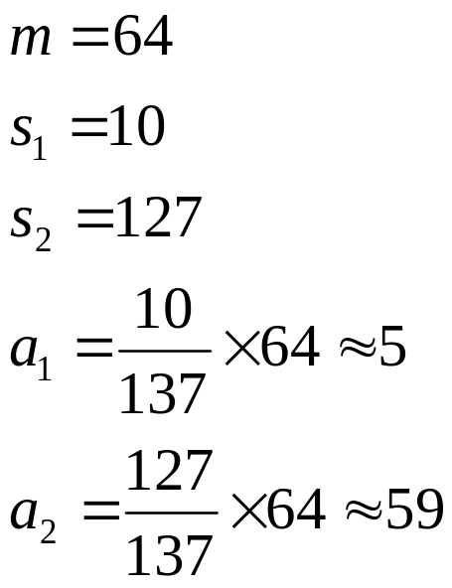

Fixed Allocation
Equal allocation – e.g., if there are 100 frames and 5 processes, give each process 20 frames.
Proportional allocation – Allocate according to the size of process

Slide 34
Priority Allocation
Use a proportional allocation scheme using priorities rather than size
If process P_{i} generates a page fault,
  select for replacement one of its frames
  Select for replacement a frame from a process with lower priority number

Slide 35
Global vs. Local Allocation
Global replacement
  process selects a replacement frame from the set of all frames
  one process can take a frame from another
  Prob.: process can’t control its page-fault rate
Local replacement
  each process selects from only its own set of allocated frames
  Prob.: less used pages of memory

Slide 36
Thrashing
If a process does not have “enough” pages=>
  the page-fault rate is very high
  low CPU utilization
  OS thinks that it needs to increase the degree of multiprogramming
  another process added to the system
Thrashing: a process is busy swapping pages in and out
  Spending more time in swapping than executing

Slide 37

Thrashing (Cont.)

Slide 38
Demand Paging and Thrashing
Why does demand paging work?
Locality model
  how many pages a process using
  Process migrates from one locality to another
  A program may have N localities, they may overlap
Why does thrashing occur?
  Σ size of locality > total memory size
  Active pages > frames allocated

Slide 39
Working-Set Model
Δ : working-set window
  a fixed number of page references
  e.g. : 10,000 instruction
WSS_{i} (working set size of P_{i}) =
total no. of pages referenced in the most recent Δ (varies in time)
  if Δ too small will not encompass entire locality
  if Δ too large will encompass several localities
  if Δ = ∞ ⇒ will encompass entire program

Slide 40

Working-set model
D = Σ WSS_{i} : total demand frames
m : total no. of available frames
if D > m ⇒ Thrashing
Policy: if D > m, then suspend one of the processes

Slide 41
Keeping Track of the Working Set
Approximate with fixed-interval timer + a reference bit
E.g.: Δ = 10,000
  Timer interrupts after every 5000 time units
  Keep in memory 2 bits for each page
  Whenever a timer interrupts copy and sets the values of all reference bits to 0
  If one of the bits in memory = 1 ⇒ page in working set
Why is this not completely accurate?
Improvement = 10 bits and interrupt every 1000 time units

Slide 42

Page-Fault Frequency Scheme
Establish “acceptable” page-fault rate
  If actual rate too low, process loses frame
  If actual rate too high, process gains frame

Slide 43
Exercises
  9.4
  9.5
  9.14
  End of Chapter 9

