Slide 1
Chapter 10-11:File-System
File Concept
Access Methods
Directory Structure
Protection
File-System Structure
Allocation Methods
Free-Space Management
Directory Implementation

Slide 2
File Structure
None - sequence of words,bytes
Simple record structure
  Lines
  Fixed length
  Variable length
Complex Structures
  Formatted document
  Relocatable load file
Who decides
  Operating system
  Program

Slide 3
File Attributes
Name – only information kept in human-readable form.
Type – needed for systems that support different types.
Location – pointer to file location on device.
Size – current file size.
Protection – controls who can do reading， writing， executing.
Time，date，and user identification
Information about files are kept in the directory structure， which is maintained on the disk.

Slide 4
File Operations
Create
Write
Read
Seek
Delete
Truncate
Open(F_{i}) – search the directory structure on disk for entry F_{i}， and move the content of entry to memory.
Close(F_{i}) – move the content of entry F_{i} in memory to directory structure on disk.

Slide 5
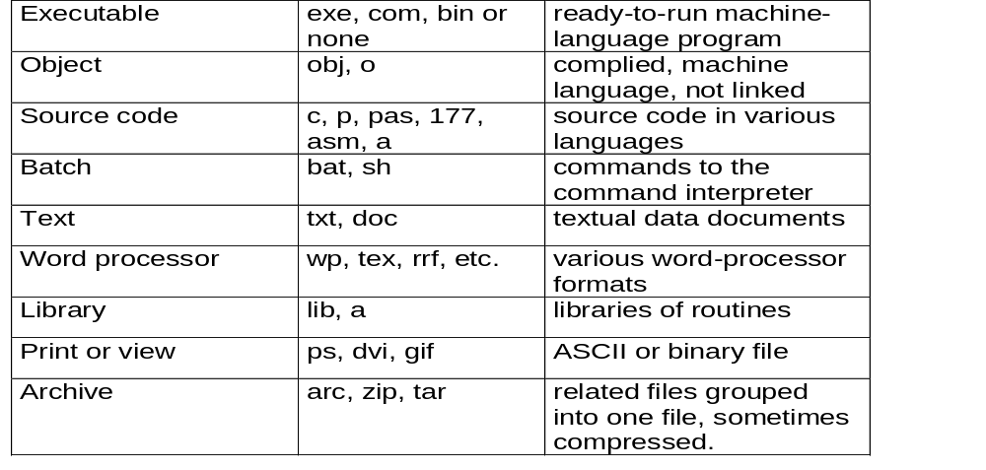
File Types – name,extension

Slide 6
Access Methods
Sequential Access
read next
write next
reset
Direct Access
read n
write n
position to n
read next
write next
rewrite n

Slide 7
Directory Structure
A collection of nodes containing information about all files.
Directory
Files
F 1
F 2
F 3
F 4
F n
● Both directory structure and files reside on disk.

Slide 8
Information in a Device Directory
Name
Type
Address
Current length
Maximum length
Date last accessed
Date last updated
Owner ID
Protection information

Slide 9
Operations Performed on Directory
Search for a file
Create a file
Delete a file
List a directory
Rename a file
Traverse the file system

Slide 10
Organize the Directory to Obtain
Efficiency – locating a file quickly.
Naming – convenient to users.
  Two users can have same name for different files.
  The same file can have several different names.
Grouping – logical grouping of files by properties

Slide 11

Single-Level Directory
A single directory for all users.
● Naming problem
● Grouping problem

Slide 12

Two-Level Directory
Separate directory for each user.
● Path name
● Can have the same file name for different user
● Efficient searching
● No grouping capability

Slide 13

Tree-Structured Directories

Slide 14
Tree-Structured Directories -2
Absolute or relative path name
Creating a new file is done in current directory.
Delete a file
rm <file-name>
Creating a new subdirectory is done in current directory.
  mkdir <dir-name>
Example： if in current directory /spell/mail
mkdir count
mail
prog
copy
prt
exp
count
Deleting “mail” ⇒ deleting the entire subtree rooted by “mail”.

Slide 15

Acyclic-Graph Directories
Have shared subdirectories and files.
Two different names （aliasing）
If dict deletes list ⇒ dangling pointer.

Slide 16

General Graph Directory

Slide 17
General Graph Directory -2
How do we guarantee no cycles?
  Allow only links to file not subdirectories.
  Every time a new link is added use a cycle detection algorithm to determine whether it is OK.

Slide 18
Protection
File owner should be able to control：
  what can be done
  by whom
Types of access
  Read
  Write
  Execute
  Append
  Delete
  List

Slide 19
Access Lists and Groups
Mode of access: read, write, execute
Three classes of users
RWX
a） owner access 7 ⇒1 1 1
b） groups access 6 ⇒1 1 0
c） public access 1 ⇒0 0 1
Ask manager to create a group （unique name）,and add some users to the group.
For a particular file （say game） or subdirectory, define an appropriate access.
owner
group
public
chmod
761
game

Slide 20
File-System Structure
File structure
  Logical storage unit
  Collection of related information
File system resides on secondary storage.
File system organized into layers.
File control block – storage structure consisting of information about a file.

Slide 21
File System Organization
Application programs
Logical file system
File organization module
I/O control
Devices

Slide 22
Contiguous Allocation
Each file occupies a set of contiguous blocks on the disk.
Simple – only starting location and length are required.
Random access.
Wasteful of space （dynamic storage-allocation problem）.
Files cannot grow.

Slide 23
Contiguous Allocation (Cont.)
e.g.：A contains 3 records，stroed in block: 6,7,8.
...
A
location
length
...
A
R0 R1 R2

Slide 24

Linked Allocation
Each file is a linked list of disk blocks： blocks may be scattered anywhere on the disk.
Allocate as needed, link together;
e.g., file starts at block 9

Slide 25
Linked Allocation
Simple – need only starting address
Free-space management system – no waste of space
No random access
Mapping

Slide 26

Indexed Allocation
Brings all pointers together into the index block.
Logical view.

Slide 27
Indexed Allocation
Need index table
Random access
Dynamic access without external fragmentation， but have overhead of index block.
Mapping from logical to physical in a file of maximum size of 256K words and block size of 512 words. We need only 1 block for index table.

Slide 28
Indexed Allocation – Mapping
Two-level index （maximum file size is 512³）
Q₁
LA / （512 x 512）
R₁
  Q₁ = displacement into outer-index
  R₁ is used as follows：
Q₂
R₁ / 512
R₂
  Q₂ = displacement into block of index table
  R₂ displacement into block of file：

Slide 29
Indexed Allocation– Mapping

outer-index
index table
File

Slide 30

Combined Scheme：
UNIX （4K bytes per block）

Slide 31
Free-Space Management
Bit vector（n blocks）
0
1
2
n-1
…
1 ⇒ block[i] free
0 ⇒ block[i] occupied
bit[i] =
■ Block number calculation
（number of bits per word）*（number of 0-value words） +offset of first 1 bit

Slide 32
Free-Space Management -2
Bit map requires extra space. Example
block size = 2¹² bytes
disk size = 2³⁰ bytes （1 gigabyte）
n = 2³⁰/2¹² = 2¹⁸ bits （or 32K bytes）
Easy to get contiguous files
Linked list （free list）
  Cannot get contiguous space easily
  No waste of space
Counting

Slide 33
Efficiency and Performance
Efficiency dependent on：
  disk allocation and directory algorithms
  types of data kept in file’s directory entry
Performance
  disk cache
  free-behind and read-ahead
  improve PC performance by dedicating section of memroy as virtual disk, or RAM disk.

Slide 34
Recovery
Consistency checker– compares data in directory structure with data blocks on disk, and tries to fix inconsistencies.
Use system programs to back up data from disk to another storage device （floppy disk, magnetic tape）.
Recover lost file or disk by restoring data from backup.

Slide 35
Exercises
  10.1
  10.5
  11.2
  11.4
  11.6
End of Chapter 10-11

