Slide 1
Chapter 12：Mass-Storage Systems
Disk Structure
Disk Attachment
Disk Scheduling
Disk Management
Swap-Space Management
RAID Structure

Slide 2
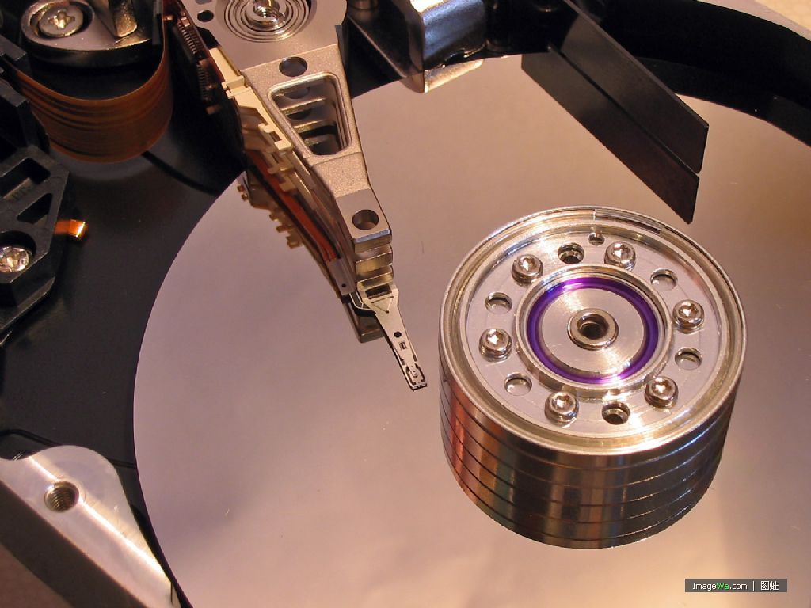

Slide 3
Overview of Mass Storage Structure
Magnetic disks
  Transfer rate
    data flow between drive and computer
  Positioning time (random-access time) :
    seek time - move disk arm to desired cylinder
    rotational latency - rotate desired sector under disk head
  Head crash
    disk head making contact with the disk surface

Slide 4
Interface | SATA 3Gb/s
Capacity (GB) | 320
Sector size (bytes) | 512
Recording zones | 24
Data heads (physical) | 4
Data disks | 2
Max. areal density (Gbits/sq. inch) | 252
Data buffer (MB) | 16
Rotational speed (RPM) | 7200
Latency average (ms) | 4.2
Media transfer rate (Mbits/sec, max) | 1136
Interface Transfer Rate (MB/sec, max) | 300
Seek time - Average (typical)ms (read) | 12
Seek Time - Track to track (typical) ms (read) | 1
Seek Time - Full stroke (typical) ms (read) | 20

Slide 5

Moving-head Disk Machanism

Slide 6
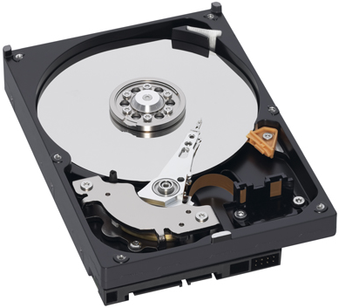

Slide 7
Disk Structure
Addressed as 1-dimensional arrays of logical blocks
  Used to be addressed: cylinder, tracks, sector
Logical block - smallest transfer unit
Logical blocks are mapped into disk sectors.
  Sector 0 is the 1st sector of the 1st track on the outermost cylinder

Slide 8
Disk Scheduling
Access time has two major components
  Seek time
  Rotational latency
Minimize seek time
Seek time ≈ seek distance
Disk bandwidth
  Total # of bytes transferred, divided by the total time

Slide 9
Disk Scheduling (Cont.)
Disk I/O system call request specifies:
  Input/output
  Disk address
  Memory address
  # of sectors
Several algorithms exist to schedule the servicing of disk I/O requests
A request queue (0-199) for blocks on cylinders:
98, 183, 37, 122, 14, 124, 65, 67
Head pointer 53

Slide 10

FCFS
Illustration shows total head movement of 640 cylinders.

Slide 11
(Shortest-seek-time-first)SSTF
Selects the request with the minimum seek time from the current head position.
A form of SJF scheduling:
  may cause starvation
Illustration shows total head movement of 236 cylinders

Slide 12

SSTF (Cont.)

Slide 13
SCAN
Algorithm:
  The disk arm starts at one end of the disk
  moves toward the other end
  servicing requests until it gets to the other end
  the head movement is reversed
Sometimes called the elevator algorithm.
Illustration shows total head movement of 208 cylinders.

Slide 14

SCAN (Cont.)

Slide 15
(Circular Scan) C-SCAN
Provides a more uniform wait time than SCAN
Algorithm:
  The head moves from one end to the other
  servicing requests as it goes
  When it reaches the other end, it immediately returns to the beginning of the disk
  Without servicing any requests on the return trip
Treats the cylinders as a circular list that wraps around from the last cylinder to the first one

Slide 16

C-SCAN (Cont.)

Slide 17
C-LOOK
Version of C-SCAN
Algorithm:
  Arm only goes as far as the last request in each direction
  reverses direction immediately
  without going all the way to the end of the disk

Slide 18

C-LOOK (Cont.)

Slide 19
Selecting a Disk-Scheduling Algorithm
SSTF is common and has a natural appeal
SCAN and C-SCAN perform better for a heavy load.
Performance depends on the pattern of requests.
Requests can be affected by the file-allocation method.
Either SSTF or LOOK is a reasonable choice for the default algorithm

Slide 20
Disk Management
Low-level / physical formatting – Dividing a disk into sectors that the disk controller can rd & wrt
Sector structure includes
  Header – contains sector #
  Data area
  Trailer – contains ECC
ECC (error-correcting code)
  When written, update
  When read, calculate & check

Slide 21
RAID Structure
Redundancy arrays of inexpensive disks
Redundancy arrays of independent disks
Provides reliability & performance via redundancy of multiple disk drives
RAID is arranged into 6 different levels

Slide 22
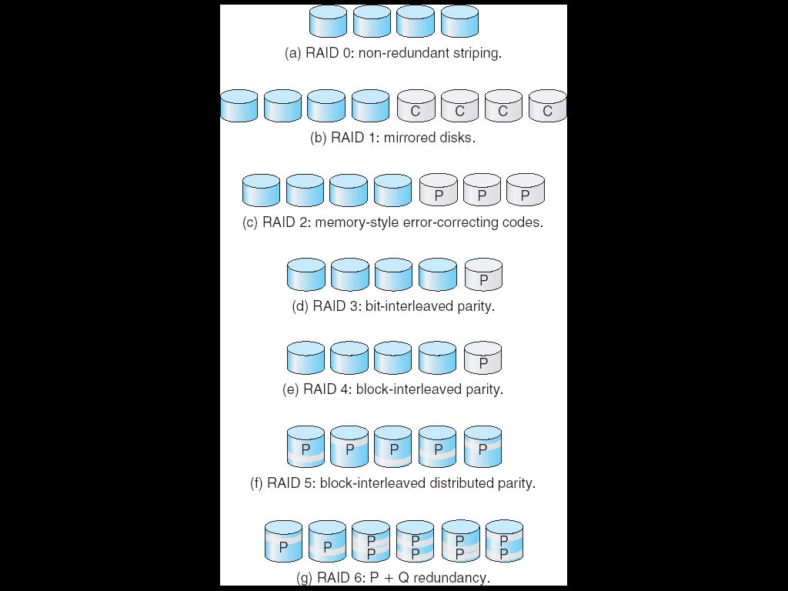
RAID Levels

Slide 23
RAID Levels

Slide 24
Exercises
  12.3
  12.14
  End of Chapter 12

